Slide 1
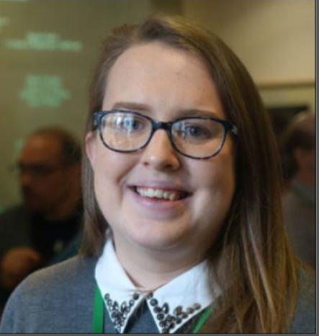
Creating and delivering accessible presentations with PowerPoint
Lizi Green
May 2023

Slide 2
Welcome
This session has captions and is recorded
Please use the chat window to ask questions
Slides, a transcript and recording will be made available via email in the coming days
You will be presented a feedback form upon leaving this training which includes the option to ask any follow up questions or suggest topics for future training

Slide 3


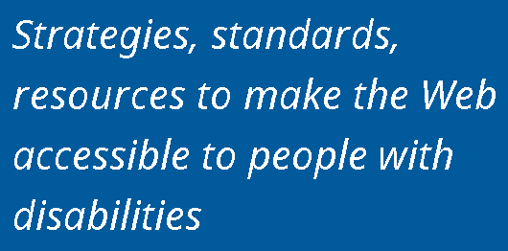

About AbilityNet

Slide 4
Agenda
Accessibility principles and standards
Setting up accessible PowerPoint templates
Creating accessible PowerPoint content
Checking PowerPoint for accessibility
Creating accessible PDFs from PowerPoint
Delivering inclusive presentations

Slide 5
Accessibility principles and standards

Slide 6
Accessibility principles: POUR
Perceivable: Content is presented in ways that can be perceived by all
Operable: Content must be operable by all
Understandable: Information and the operation of user interface must be understandable
Robust: Content is reliable and compatible with assistive technology and standards

Slide 7



International accessibility standards
Web Content Accessibility Guidelines (WCAG) 2.1 Level AA
ETSI EN 301 549
Aligned to WCAG 2.1 AA
Section 10 covers non-web documents
Note – not all WCAG requirements transfer to documents

Slide 8
Public Sector Bodies Accessibility Regulations
Covered:
PowerPoint slides published on a website or intranet
Webinars must meet captioning requirements (not necessary for live, but must be added within 14 days after the event if the presentation stays online) -https://www.jisc.ac.uk/guides/video-captioning-and-accessibility-regulations
Exempt:
PDFs or other documents published before 23 September 2018 (unless users need them to use a service)
Content on intranets or extranets published before 23 September 2019 (unless you make a major revision after that date)

Slide 9
Accessible PowerPoint templates

Slide 10
Poll 1
Do you have accessible PowerPoint templates available in your organisation?
Yes
No
Not sure

Slide 11
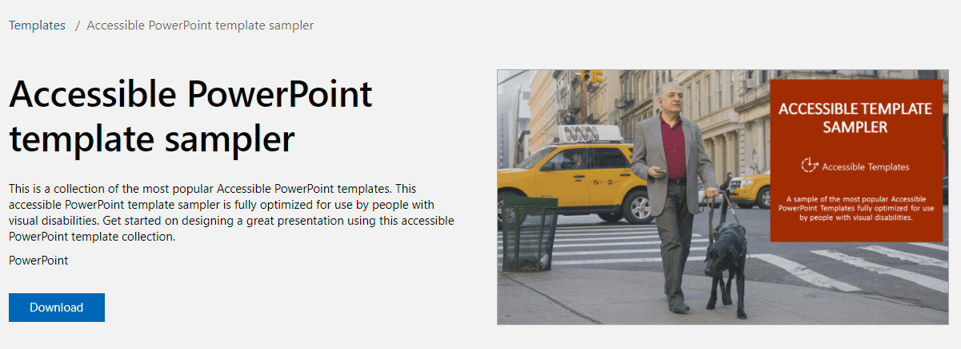
Accessible template examples
Search for accessible templates via File > New > Search for “accessible”
Accessible PowerPoint template sampler

Slide 12
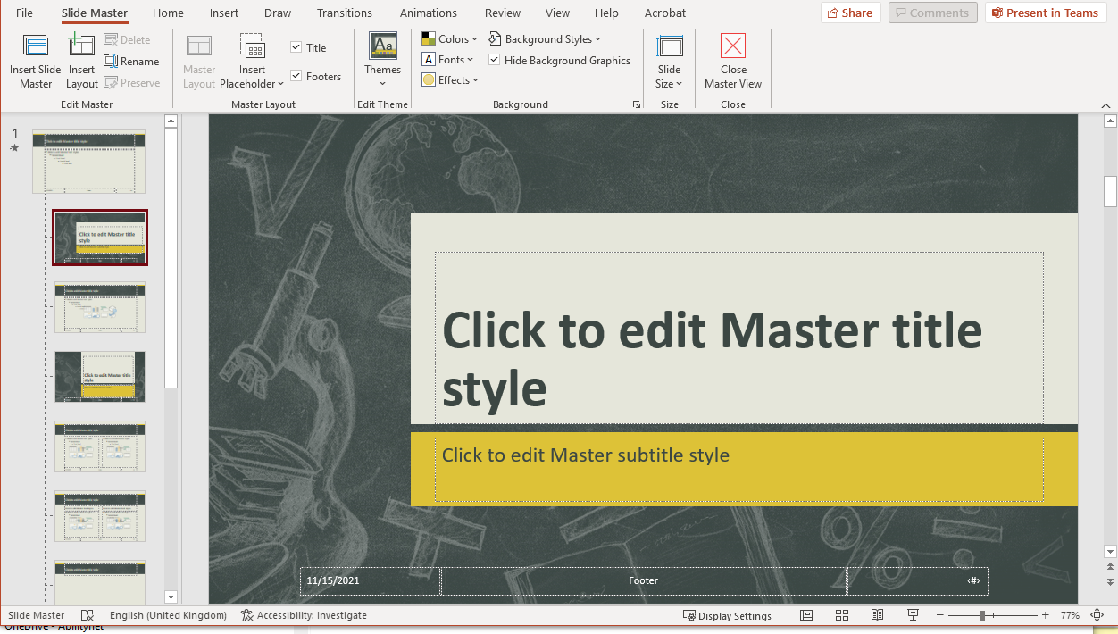
Accessible template requirements
Accessible templates need to provide
A title placeholder for every slide
Text defaults that use appropriate fonts, good sizing and colour contrast
Logical reading order for assistive technology

Slide 13
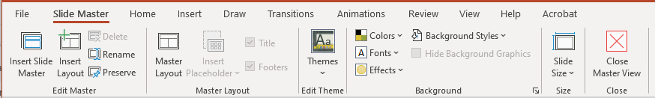
Slide Master view
Use View > Slide Master to see the Slide Master view
Ensure the title placeholder is present on each template

Slide 14
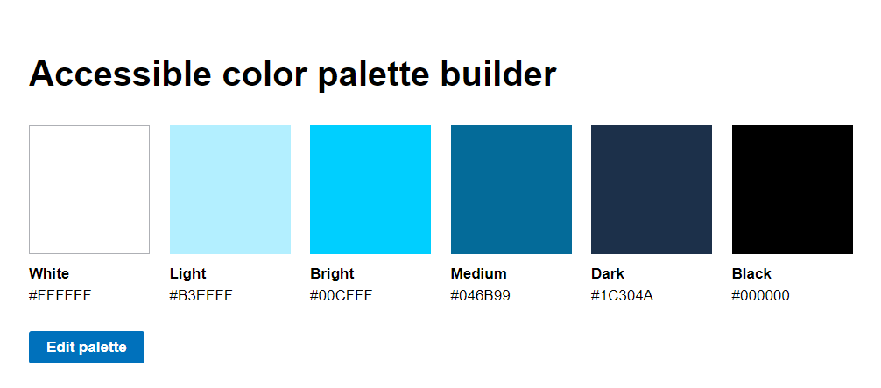
Fonts, size and text contrast
Use a sans serif font – e.g. Arial, Calibri, Tahoma
Use at least 18pt text
Avoid using all capital letters and excessive italics or underlines
Include at least a 4.5:1 contrast between text and background
Colour contrast tools
  TPGi Colour Contrast Analyser
  Colorsafe palette builder
  Accessible colour palette builder

Slide 15
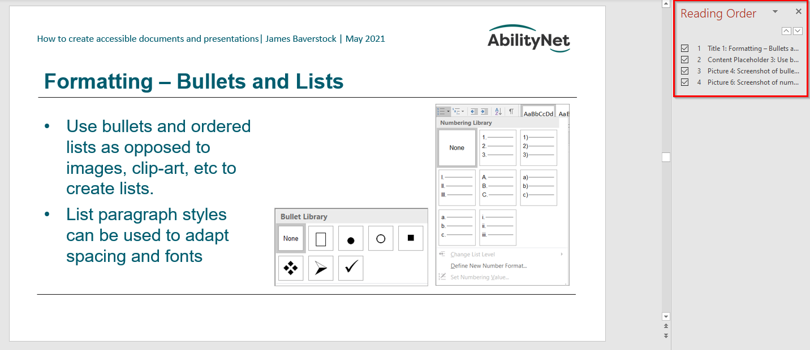
Reading order for assistive technology
In PowerPoint, check the reading order panel to ensure that content will be presented in the correct order for assistive technology users
Review > Check accessibility > Reading order pane

Slide 16

Any questions so far?
@Mark

Slide 17
Accessible PowerPoint content

Slide 18
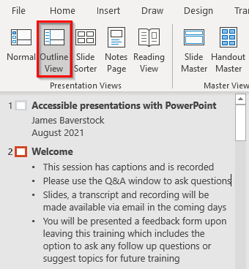
Slide titles
Give each slide a unique title
Use the Outline View to review your titles: View > Outline View
Add a title for a slide that doesn’t have one with Accessibility > Slide Title
A title can be make invisible (but available for assistive technology) via:
Home > Arrange > Selection Pane > Change Visibility

Slide 19
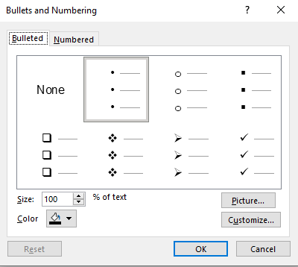
Bullets and lists
Use bullets and ordered lists as opposed to images, clip-art, etc to create lists
Use Outline View to review your lists

Slide 20
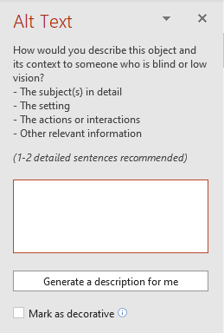
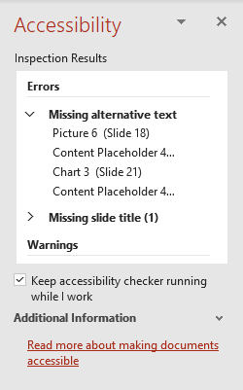
Adding ALT text to graphics in PowerPoint
From the images
Right click an image
Edit Alt Text
Type a description or mark as decorative
From accessibility checker
Select dropdown on graphic and choose appropriate option

Slide 21
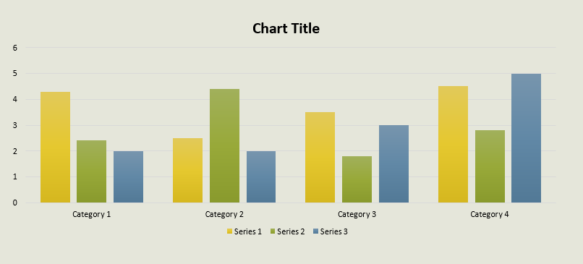
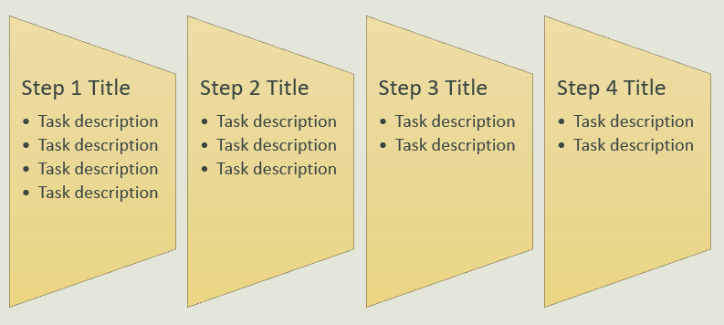
Charts and SmartArt
Insert alt text for the whole graphic via the Accessibility Checker
Provide extended description via speaker notes or slides at the end of the presentation for tabular data if necessary

Slide 22
SmartArt example
SmartArt accessibility
Insert text into alt text field via accessibility checker (and speaker notes)

Slide 23
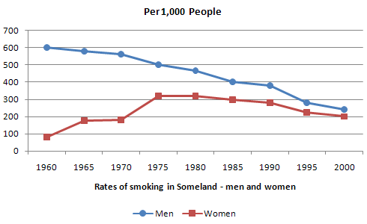
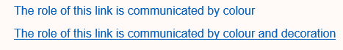
Use of colour
Ensure that colour is not the only way that information is communicated.
links should have some decoration (e.g. underlined) and charts shouldn’t rely on colour vision.
Remember text and graphics need good contrast

Slide 24
Colour contrast
We’ve mentioned colour contrast for text in templates, but also consider contrast for images of text if used
Non-text contrast – at least 3:1 contrast with adjacent colours for meaningful graphics such as elements in charts

Slide 25
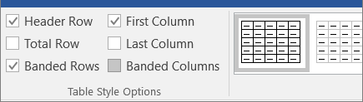
Tables
Use a simple table structure for data only
Use table headers:
  Table Design > Table Style Options
  Select Header Row and First Column (if row headers are in use)

Slide 26
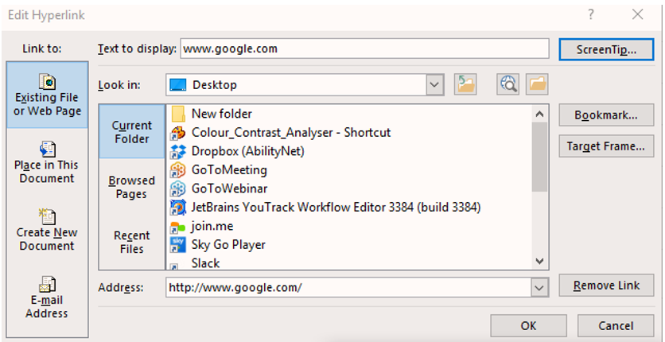
Links
Ensure that the purpose of links is obvious and self-evident from tabbing onto them.
Where possible, enter a meaningful name into the text to display field.

Slide 27
Embedded video
Add alt text so people using screen readers will know the video is present
Make sure any embedded or linked media is accessible with captions, transcripts or audio description as required
Include a transcript for embedded audio

Slide 28
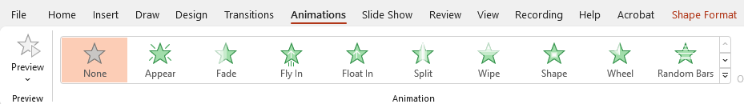
Animations
Avoid flashing and blinking content
Make sure any animations last no more than 5 seconds and consider if they are necessary
Some types of motion may make people with vestibular disorders unwell

Slide 29
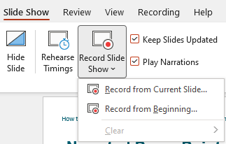
Narrated PowerPoint
Some users may benefit from having a recorded version of the presentation provided with the slide deck
PowerPoint has a Record Slide Show option which facilitates this
Allows you to record narration and to re-record just one slide if necessary

Slide 30
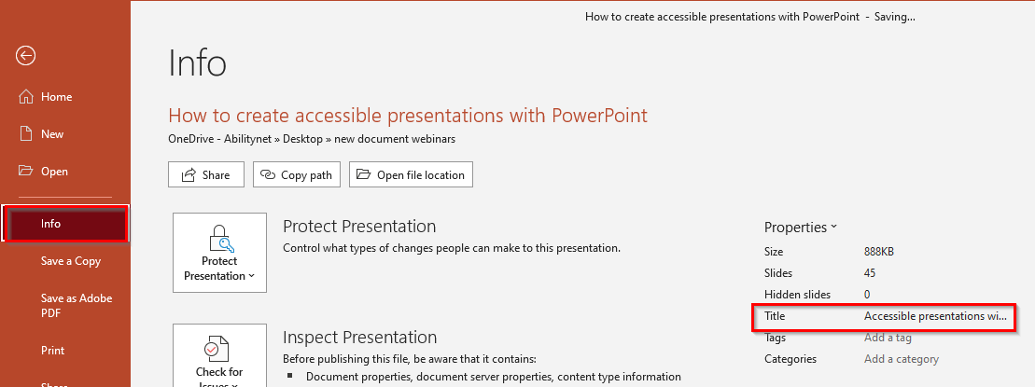
Setting metadata
Add a descriptive title for the presentation via File > Info > Properties: Title

Slide 31
Microsoft PowerPoint accessibility
Golden Rules:
use descriptive titles and lists to provide meaningful structure
ensure that non-text content (e.g. images) have alternative text
check your reading order makes sense
use colour and meaningful hyperlink text to ensure perceivability
Microsoft: Make your PowerPoint presentations accessible to people with disabilities

Slide 32
Any questions so far?
@Mark

Slide 33
Poll 2
Do you use the Microsoft Office Accessibility Checker on your own presentations?
Yes
No
Sometimes

Slide 34
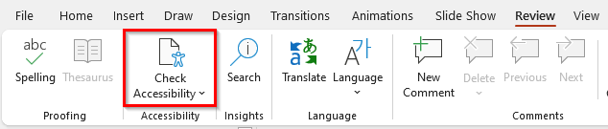
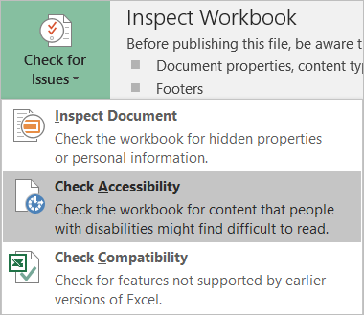
Microsoft Office Accessibility Checker
The Accessibility Checker finds accessibility issues, explains why you should fix these issues and how to fix them. Review > Check Accessibility.

Slide 35
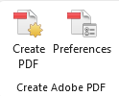
Converting PowerPoint to PDF
If you have Acrobat installed, use the PDF maker with the Acrobat tab in the ribbon > Create PDF. Show preferences > “Enable accessibility and Reflow” needs to be checked
Otherwise, use File > Save a Copy > PDF. Ensure Options > “Document structure tags for accessibility” is checked
Do not use File > Print to PDF – tags and other accessibility information will not be included in the PDF.

Slide 36
Delivering accessible presentations

Slide 37




Inclusive communication for presentations
Vision
Hearing and Communication
Mobility / Touch
Cognition and Learning

Slide 38
Inclusive communication: Vision
Consider colour contrast and font size when creating your slide deck and accessibility for screen reader users (e.g. alternate text and reading order)
Don’t assume participants can see your presentation. Cover the displayed text in what you say and describe any informative images you show onscreen (providing your own audio description)
For online presentations, announce questions before you answer them and read out poll questions and results

Slide 39
Poll 3
Have you ever used live captioners for presentations at your organisation?
Yes
No
Unsure

Slide 40

Inclusive communication: Hearing
For large in-person events, use a microphone and check the sound system
For online presentations, use a headset and check audio quality
If sharing your face via video:
  Try to set up your face well lit
  Keep background uncluttered & blur if possible
Provide captioning – ideally use a human captioner for large events or where you know you will have attendees who require captioning

Slide 41
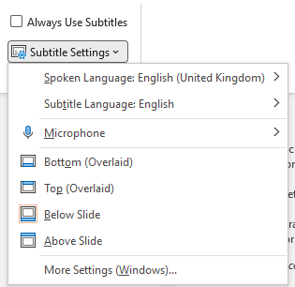
PowerPoint captions
To use PowerPoint’s built-in captions
Slide Show > Subtitle settings
Ensure language settings are correct

Slide 42

Inclusive communication: Mobility and touch
For in-person presentations, ensure the meeting location is accessible
For online presentations, use keyboard accessible conferencing platforms, like Zoom or Teams
Allow sufficient time for users to answer polls and ask questions in Q&A

Slide 43

Inclusive communication: Cognition & learning
Speak clearly and keep language simple
Manage cognitive load – avoid overloading slides with information
Pause between topics to give your audience time to process information
Avoid overdoing animation
Read out polls and questions & allow sufficient time for people to answer

Slide 44
Meeting etiquette
Ask your audience what they need in advance
Explain what accessibility features are available at the beginning of the webinar
Provide an accessible version of the slide deck to users

Slide 45


Online platform considerations
Zoom and Microsoft Teams are the conferencing systems that are widely regarded as the most accessible
If you are using a different service
  Do some research on how accessible it is
    Keyboard accessibility
    Accessibility for screen readers
    Captioning capability
  Ask some people with relevant disabilities what they think

Slide 46
Summary
Use accessible templates for your presentations – check the accessibility of any organisational templates
Create accessible slide content: content structure, reading order, use of colour, alternative text for images
Deliver inclusive presentations: tell your audience about available accessibility options, describe informative images, give people sufficient time to use online reply options

Slide 47
Resources
Microsoft: Make your PowerPoint presentations accessible to people with disabilities
Microsoft: Accessible PowerPoint template sampler
WEBAIM: PowerPoint accessibility
TPGi Colour Contrast Analyser
WAI: How to make your presentations accessible for all

Slide 48
Any questions so far?
@Mark

