Slide 1




CAN WE IMPROVE TRACTOR SAFETY?
PRELIMINARY RESULTS FROM A PILOT SAFETY TRAINING PROGRAMME
By Aswathi Surendran
University of Galway

Slide 2




PROJECT TEAM
Ms Aswathi Surendran
Dr Jenny McSharry
Dr Denis O’Hora
Dr John McNamara
Mr Francis Bligh MSc
Dr David Meredith
Dr Oonagh Meade

Slide 3




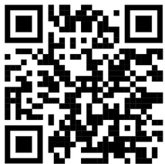

PROGRESSION
Who needs to do what, differently?
Which barriers and enablers need to be addressed – Farmers’ perspective
What are the potential behaviour change techniques and mode(s) of delivery - with stakeholders and experts
How can behaviour change be measured and understood?
Feasibility study
https://osf.io/ayxvs/

Slide 4

OBJECTIVES
01
Equip farmers with knowledge, skills, and resources to adopt preventive safety behaviours to address tractor-related blind spots at their farms and improve farm safety.
Trial registration: https://www.isrctn.com/ISRCTN22219089

Slide 5
01
Peer-2-Peer Demonstration
INTERVENTION
Facilitated discussion session
02
Safety training procedure agreement
03
04
Demonstration kit
Trial registration: https://www.isrctn.com/ISRCTN22219089

Slide 6
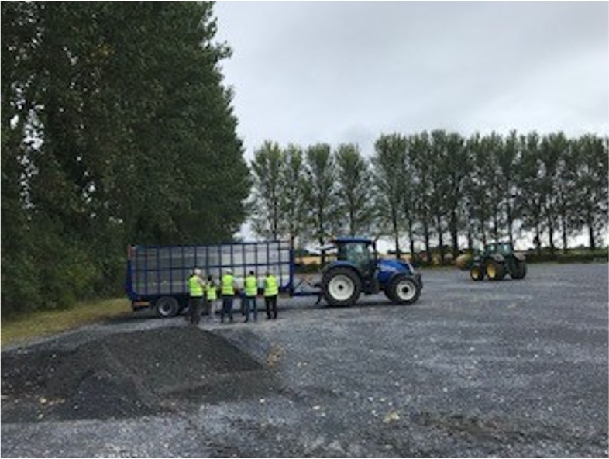

Peer-2-Peer Demonstration
1.1
Estimating the distance
I found the demonstration fantastic. And the distances is done out for you. You know you were able to read out the speed. You were able to stand at it. And it was surprising the distances as the speed went up on the tractor the distance it took to stop. And I’d say it surprised a lot of the rest of them as well.

Slide 7
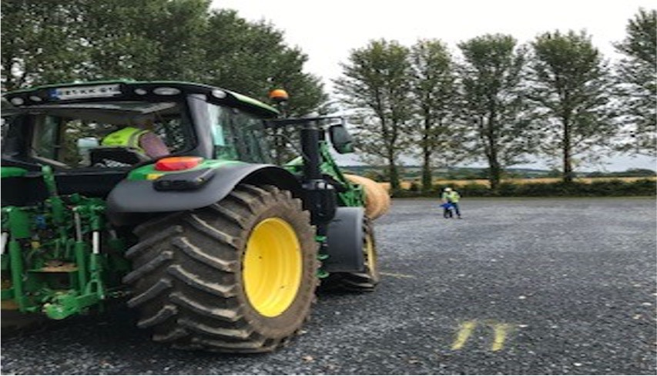
Peer-2-Peer Demonstration
Identify blind spots
1.2
And it showed a lot of the things that you know I’ll be honest I didn’t realise and I’m all my life driving tractors, that somebody can be standing so near to you and that they don’t have to be a child and there’s a blind spot. That’s what I found. You know so again I would go to say you know there’s a lot of common sense in this. And I think that’s where the advantage was for someone was that if the course was longer in a classroom some of the lads that we would be employing wouldn’t have been interested in doing it.

Slide 8
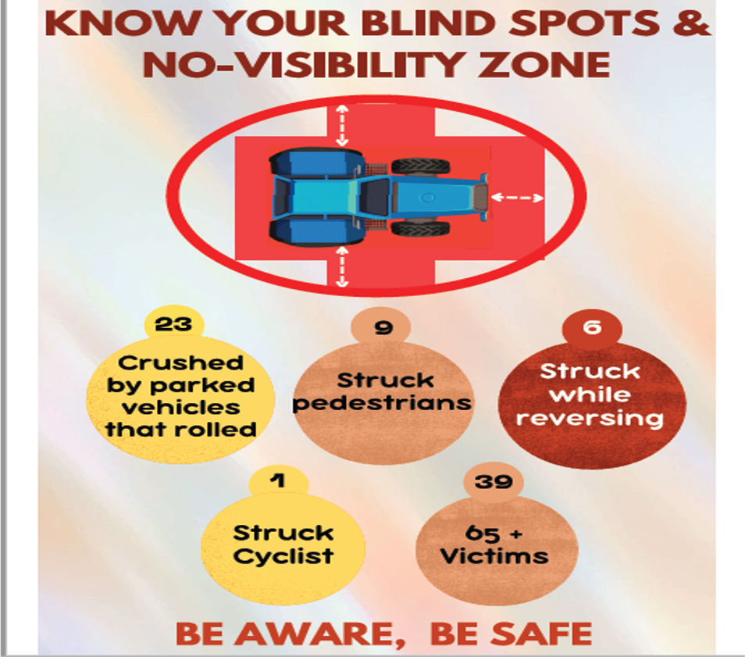
POSTER

Slide 9
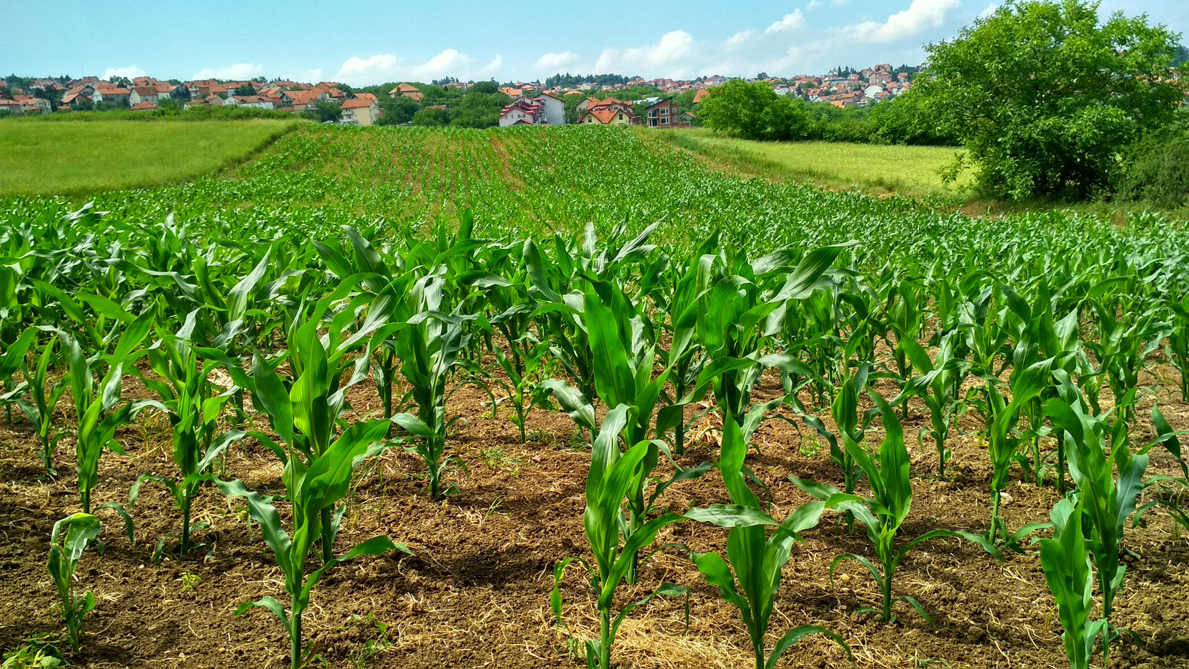
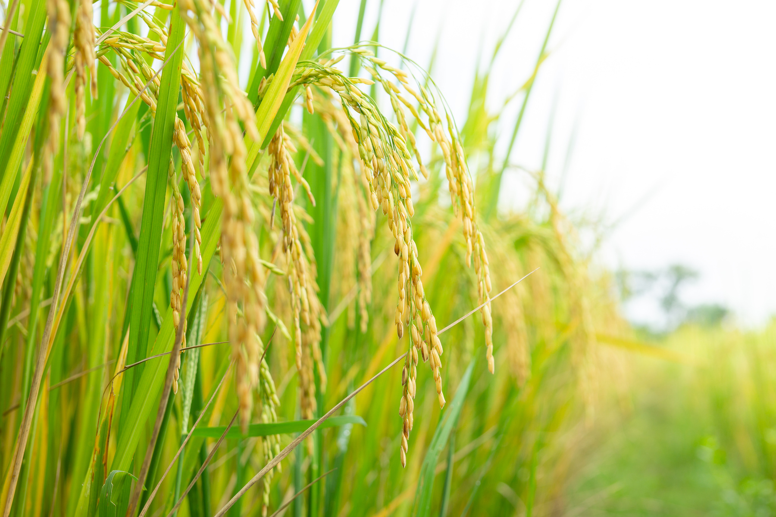
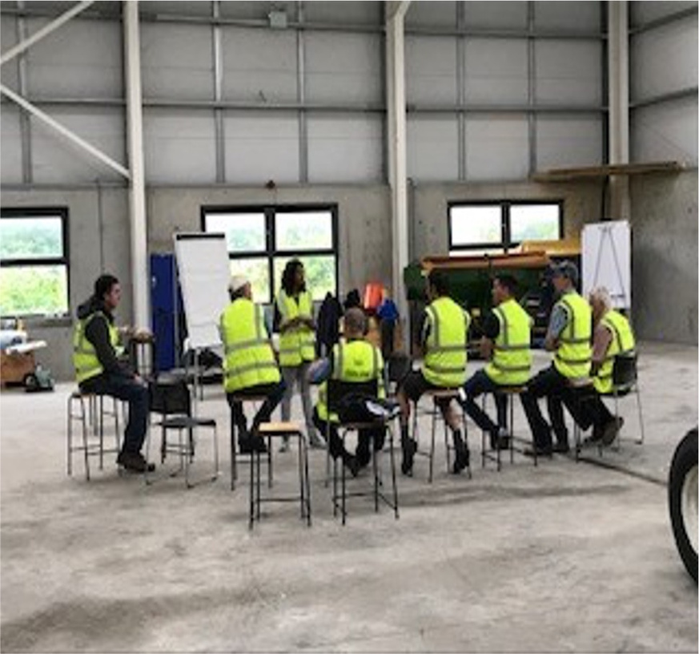
2.
List possible solutions to overcome the obstacles
Facilitated Discussion Session
1.
3.
List possible obstacles to achieving your safety goals
List possible strategies to perform the safety goals and address blind spots

Slide 10
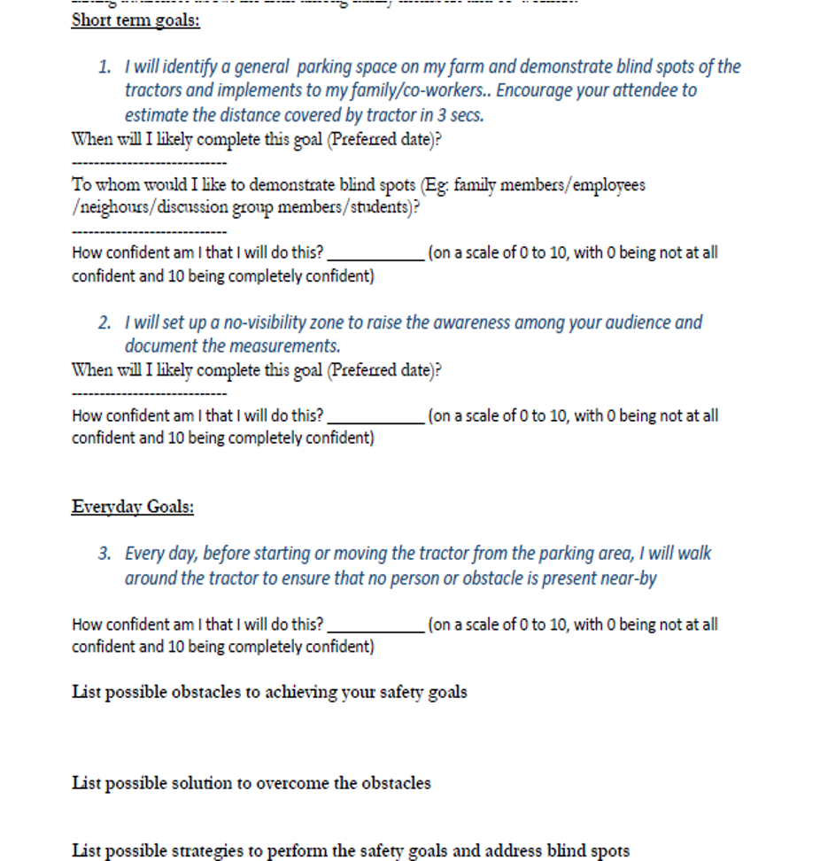
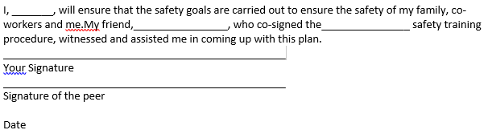
SAFETY TRAINING PROCEDURE AGREEMENT
Setting customized safety goals
Setting customized safety goals
01
01
02
Peer-to-peer agreement

Slide 11
And the first time I was called over you know and I was delighted. There is, there’s definitely learning from that. And then sure you have to hear the younger person’s point of view as well which is good. Yeah. Because there’s not a day you’ll go out but you’ll learn something new I think definitely anyway.
Well I always feel a discussion after a demonstration like that is very important. I thought it was a good healthy discussion. There was one or two suggestions went around. Yeah I always think a discussion is good after a demonstration and I thought that one was a good discussion we had as well.

Slide 12
SAFETY TRAINING PROCEDURE AGREEMENT
That gave us the kind of ownership and responsibility that we had to do the tasks. The next time I saw him, we could say to each other had we done it or not. It gave us the ownership of what we had to do. That was important.
It was good to make a plan I think. It makes it more real and it gives you kind of guidelines to follow. Whereas when you say you’re going doing something unless you put it down on paper sometimes it doesn’t actually happen.
Call your peers in 2 weeks time and I think there’d be no problem doing that after being there for a couple of hours because you know people were comfortable with each other.

Slide 13
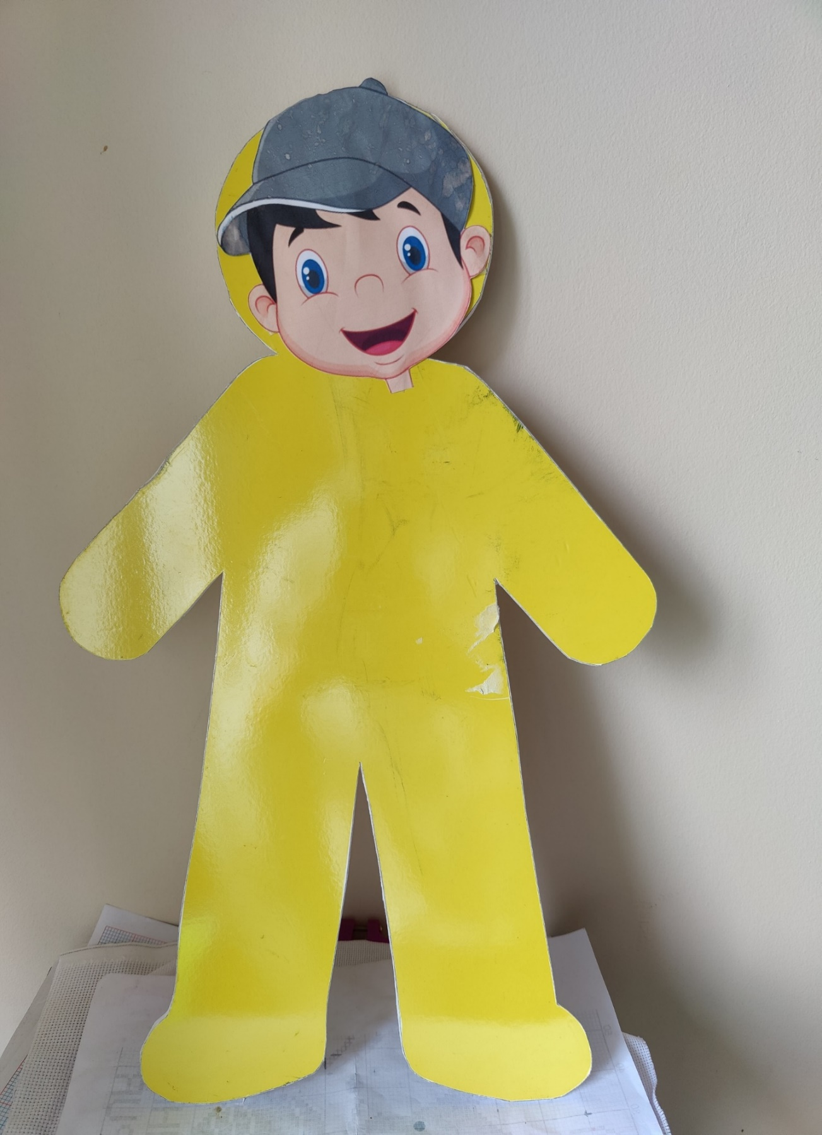
DEMONSTRATION KIT

Slide 14





EVALUATION
Exit Survey
SMS Survey
Personal interview

Slide 15
OUTCOME: FEASIBILITY
Is the structure of the programme realistic, clear and reasonable for the participants?
Can we recruit and retain the participants?

Slide 16
OUTCOME: FIDELITY
Could the intervention be delivered as per protocol?
Were participants capable to complete the tasks?
Did the participants enact the intervention successfully?

Slide 17
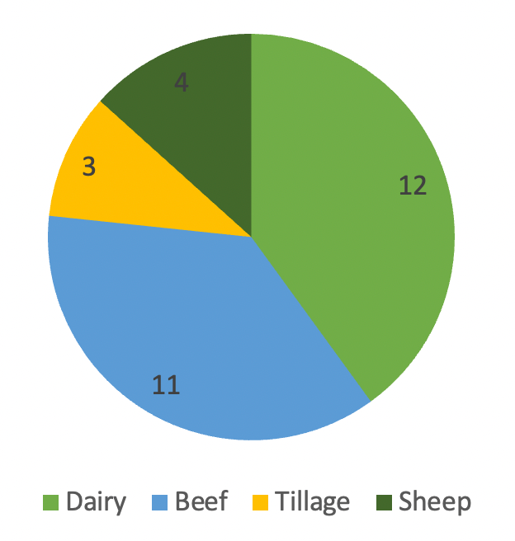
RESULTS: RECRUITMENT & RETENTION
Dairy | 12
Beef | 11
Tillage | 3
Sheep | 4

Slide 18
RESULTS: RECRUITMENT & RETENTION
Participant #
Diary
Beef
Tillage
Sheep
0
5
10
15

Slide 19

RESULTS: RECRUITMENT & RETENTION
Participant #
Diary
Recruitment
20
Attended
19
Beef
Completed safety goals
18
Tillage
Evaluation
17
Sheep
0
5
10
15

Slide 20
OUTCOME: ACCEPTABILITY
What was the participants feedback about the programme?
Was the programme easy to understand?
How did the participants feel about performing the tasks themselves?
What were the benefits the participants perceived?
To what extent did the participant feel that strategy was effective?

Slide 21
HOW DO YOU APPRECIATE VARIOUS ASPECTS OF THE PROGRAM?
Useful
Very Useful
Demonstration
Facilitated discussion
Safety training procedure
Poster
0
25
50
75
100

Slide 22



The program met my expectations regarding what I wanted to learn.
I think the day was well structured
I will apply what I learned today at home
Agree
Agree
Agree
Strongly Agree
Strongly Agree
Strongly Agree
0%
25%
50%
75%
0%
20%
40%
60%
0%
25%
50%
75%
100%
My son, he just helps out an odd time. And he’d be talking to a lot of people and I heard him explain it to a friend of his he was talking about it.
Agree
It did yeah. Oh God it did. Yeah. Yeah. yeah. You showing it kind of made it easier to explain and made it simpler so it did. Once we were shown what to do it makes it easier to show someone else.
Strongly Agree
0%
20%
40%
60%
80%
I will recommend this program to my friends

Slide 23

I OBTAINED A CLEARER UNDERSTANDING OF THE TOPICS DEMONSTRATED
Agree
Strongly agree
Demonstration of Blind spots
Setting up visibility zone
Checking the perimeter of the tractor
0
25
50
75
100
Father wasn’t aware that there was so many blind spots. Even in relation to the loader when I was out the front with the little Jimmy as we called him he found it interesting that there was some places where he thought he would have been able to see him he wasn’t. He said it was very good from that point of view that even going forward if he was standing out in front of me let’s say and we were attaching some implement to the loader that he’s more aware that he’d have to stand further out so I can actually see his hand signals when he’s guiding me compared to where he thought he should be.

Slide 24

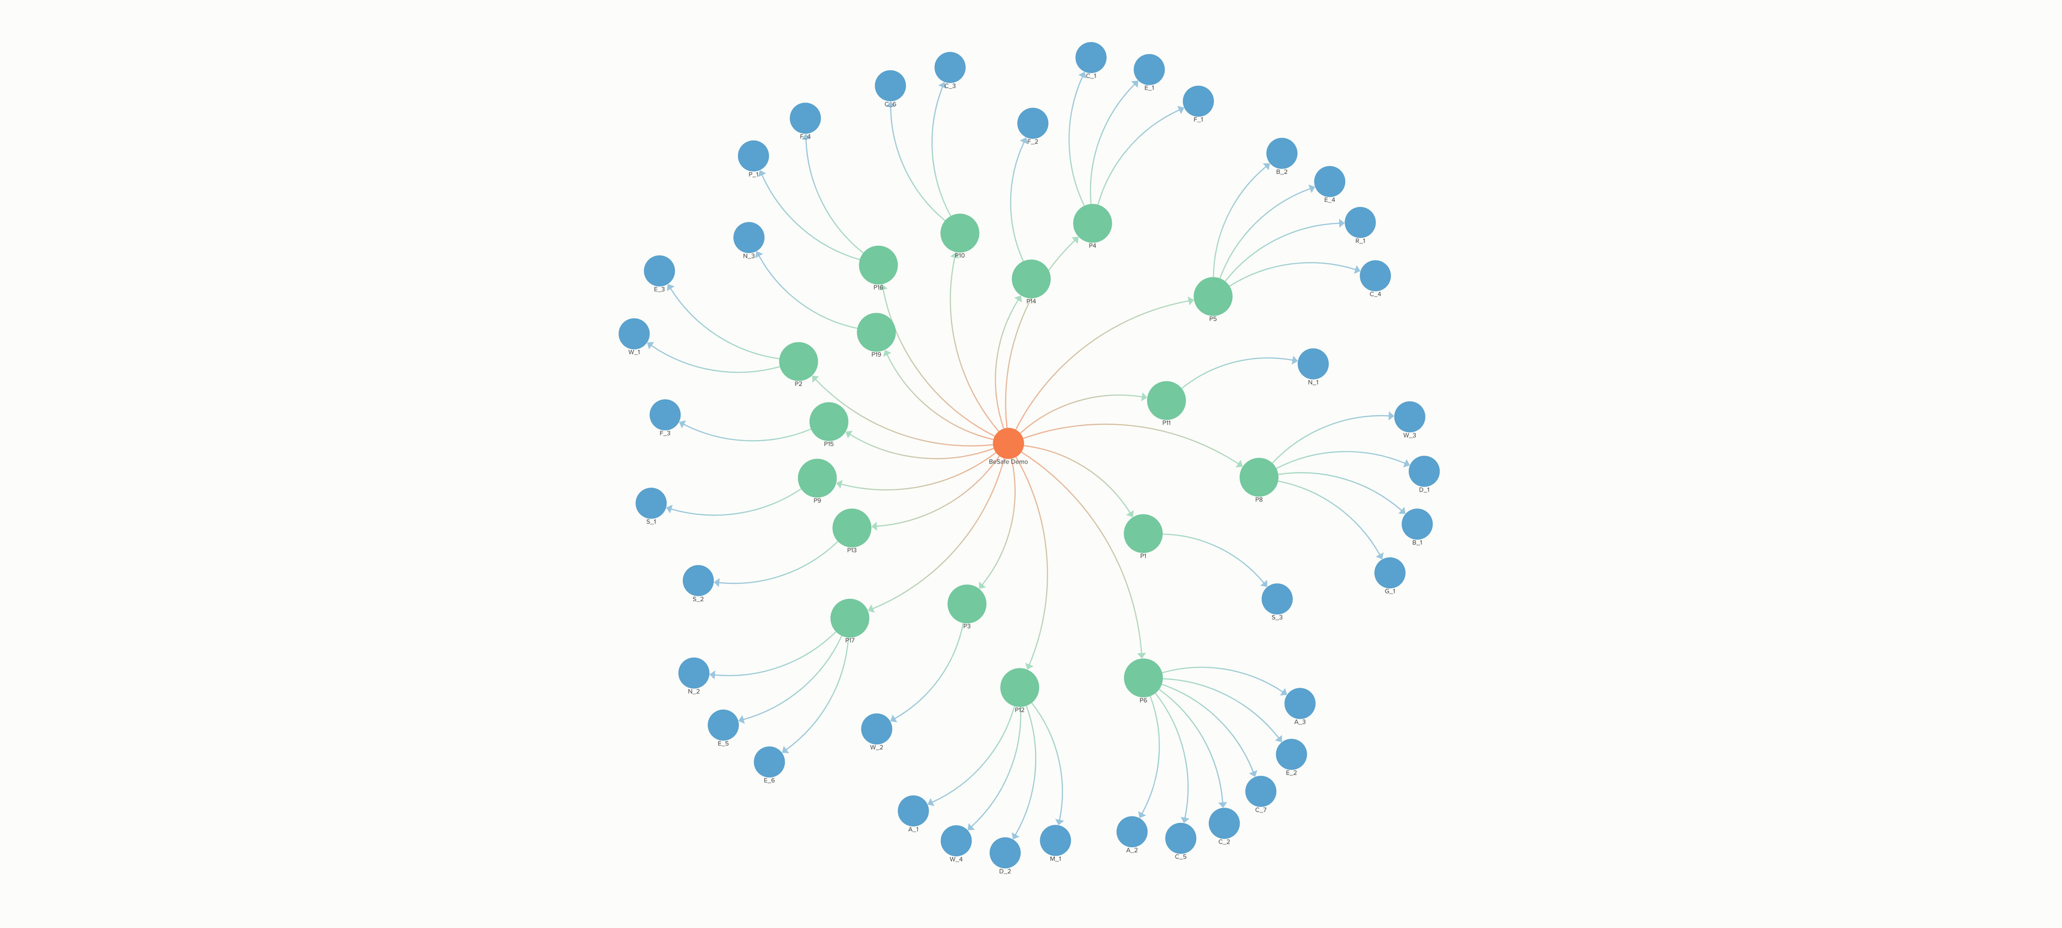
OUTREACH

Slide 25
Apprentices
Siblings
Children
Nephews
Neighbours
Parents
Wives
Employees
OUTREACH

Slide 26
OUTREACH: DEMONSTRATION KIT
that little yellow man....we put it on to a cone. And you could not believe. Now we advanced a little bit. We had a trailer on one of the tractors and I suppose we used it for our own example, when you drive into a yard and you want to back into the pit of silage what you’ve to look out for because there’s personnel around the place. So we got great use I have to say out of it.

Slide 27
OUTREACH: PRE-CHECK TREND
Never
If others are present
I’m actually going to print it (poster) off. I was going to make a little laminated thing to stick inside in the tractor just where you’ll see it when you hop in. Its on the list of things to do.
Occasionally
Regularly
Existing habit
0
2
4
6

Slide 28
ADDITIONAL CHANGES
Installation of reverse camera
Purchase of appropriate trailers
01
03
04
Tractor health check by experts
02
Setting up remainders

Slide 29
LONG TERM OUTOMES
Do you remember at the start of your demonstration you told us about how far the tractor would be at 5 miles an hour so I went through all that first you know just as an opener and then I went through the demonstration as you showed me. I wouldn’t be someone entirely comfortable with getting up in front of a crowd to teach. I was a little bit out of my comfort zone but I didn’t mind doing it and we all got something from it ourselves.
Transparent, replicable, repeatable behaviour change techniques
Train the trainer package & Demonstration toolkit
Potential integration with farm initiatives
Older farmer friendly safety programme
Intervention development methodology

Slide 30
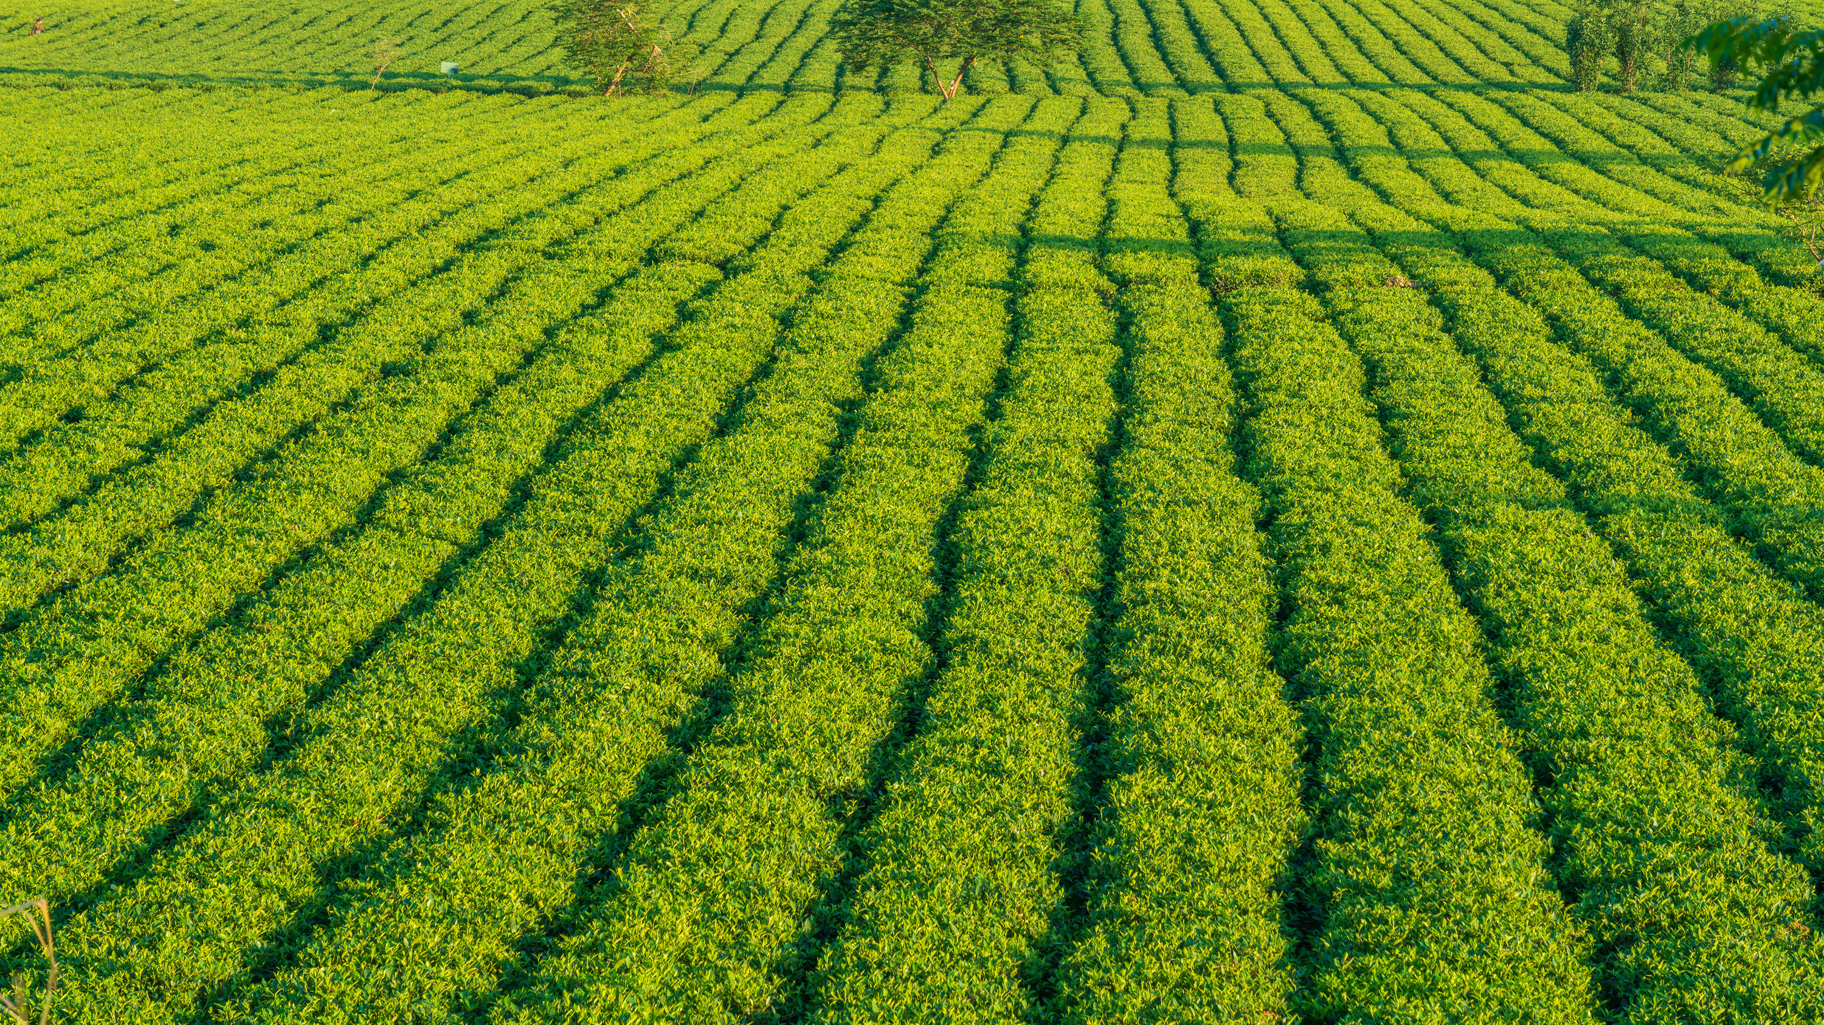


THANK YOU!
Aswathi Surendran
@AswathiS18

