Slide 1



Developing Behavioural Farm Safety Interventions for
Machinery-Related Risks informed by Farmers’ Experiences and International Best Evidence
Notes:
Thanks
Making a stand for farm safety
We want to help make farming safer for those who put food on our plates everyday
Farming is among the most dangerous occupations in the world and we all need to do our bit to make it safer

Slide 2
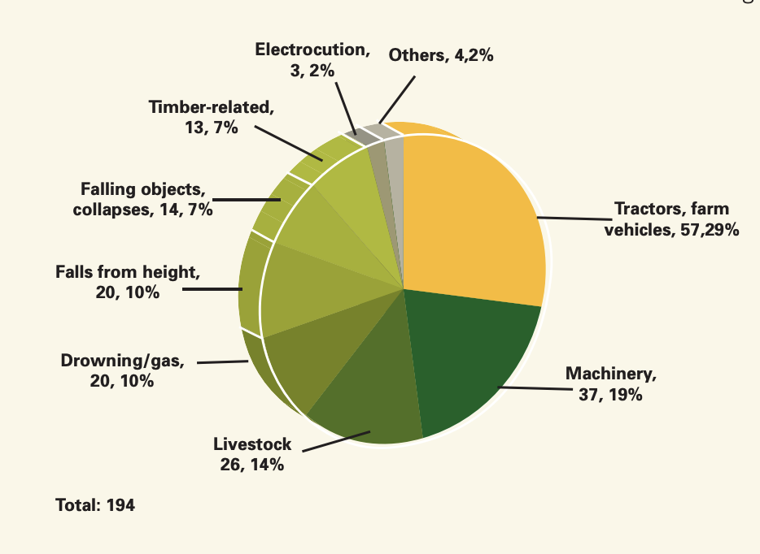
Machinery-related Fatalities
  HSA Farm Safety Action Plan (2016)
Notes:
The vast majority of these farm fatalities were potentially preventable (Health and Safety Authority, 2015).
In comparative European terms, Ireland has made considerable progress in terms of its farm safety record, currently ranking in the top 5 for lowest rates of farm fatalities (Health and Safety Authority, 2015).

Slide 3


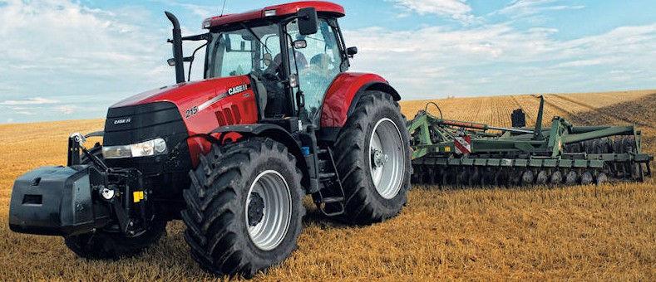

Project Outline
1. Systematic Review
3. Expert Group
2. Focus Groups
4. Pilot Interventions

Slide 4
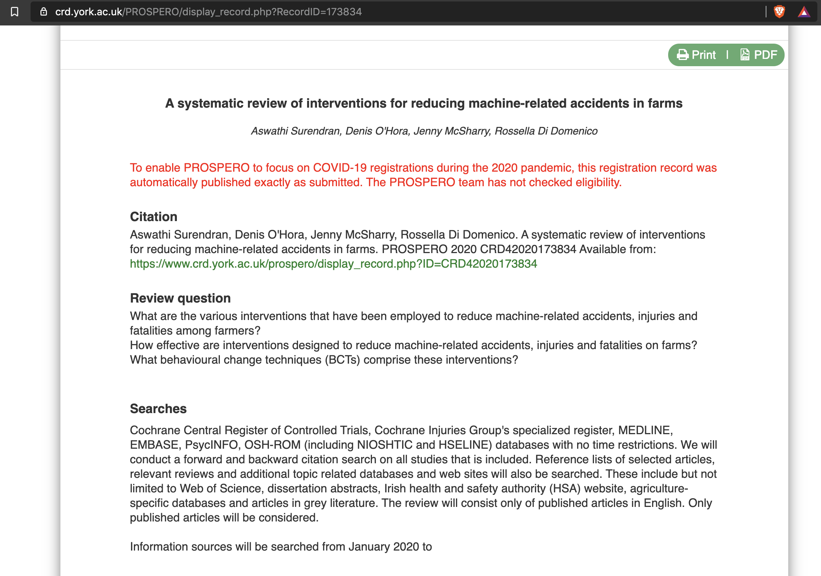
Systematic Review
Notes:
PROSPERO
International prospective register of systematic reviews
First step
Let the research community know what we are doing
Pre-register the questions of interest
Research Questions

Slide 5
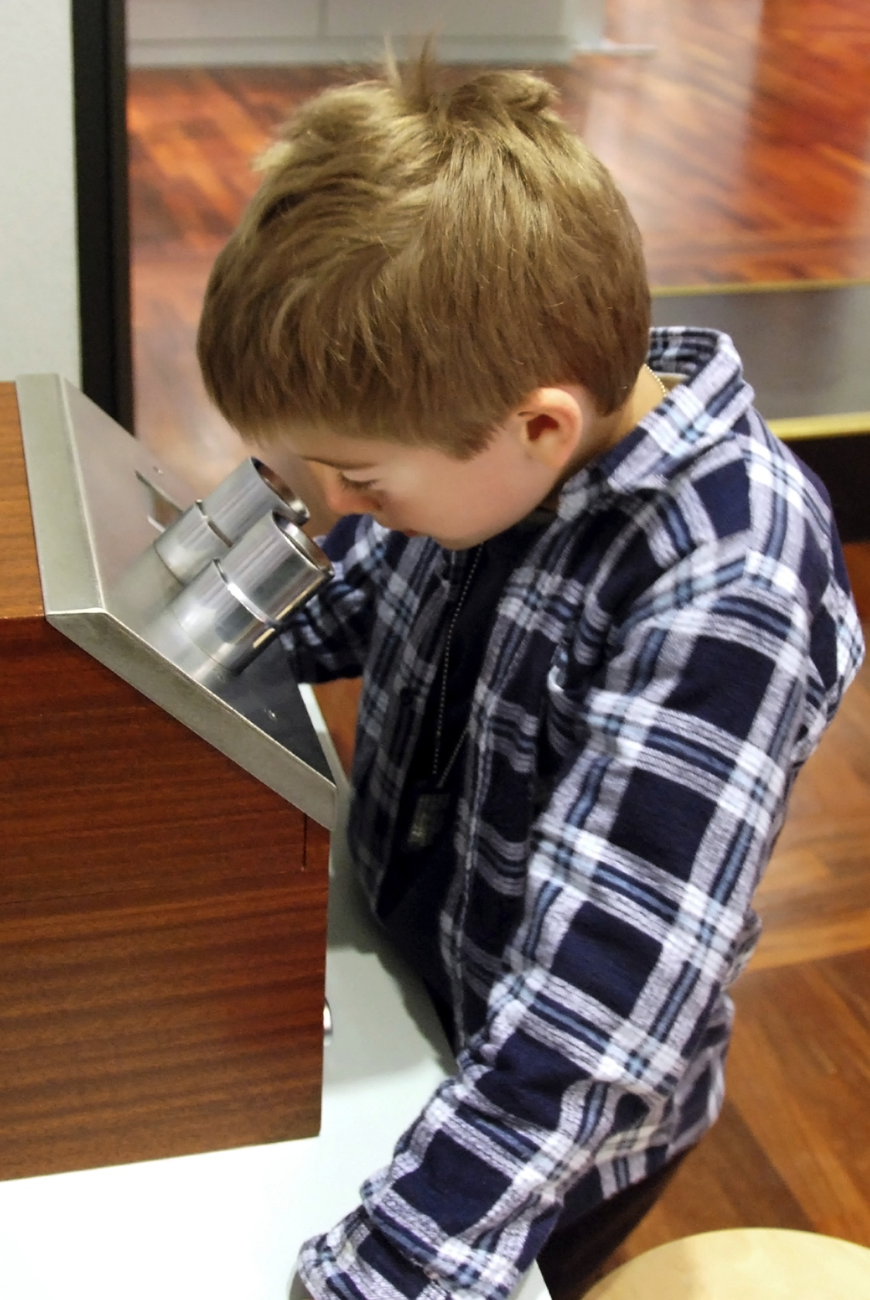
Systematic Review
Records identified through database search
(n=2592)
Records screened
(n=63)
Full-text articles assessed for eligibility
(n=42)
Studies included in the qualitative synthesis
(n=10)*
*Pubmed,Web of Science,PsychInfo,Scopus,Google scholar
Medline,Safetylit,OSH_ROM,HAS/TEAGASC Database,Agricola,Agris, Cochrane Central Register of Controlled Trials

Slide 6
Systematic Review
“Broad brush” approach
Little targeting of specific groups or hazards
Notes:
Demography – Majority for adults. Interventions designed for either Adult farmers or farm children.
Lack of statistically strong studies on effect
Lack of behvaioural based interventions
Most popular one is education or training based. Existing literatures hasn’t shown any significant benefit out of this
Hurdles: Practical limit on isolating the effects , spreading of information

Slide 7
Project Outline
1. Systematic Review
3. Expert Group
2. Focus Groups
4. Pilot Interventions

Slide 8
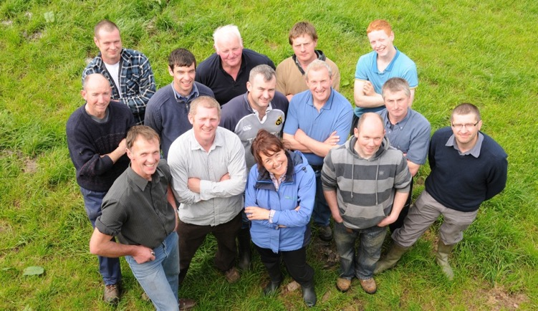

Complexity of Farm Safety
fit
WORKER
What we bring to work
well nourished
pre-existing conditions
hungry
tired
equipment
work design
well rested
distracted
WORKPLACE
Where work gets done
awareness
Incident
annoyed
weather
physical design
time pressure
default design
training
EMPLOYMENT
“Ways” of working
challenging environments
appreciated
Farmers’ perspectives help identify critical variables
Notes:
Mention All Ross talk this morning
Mention Lone Workers

Slide 9
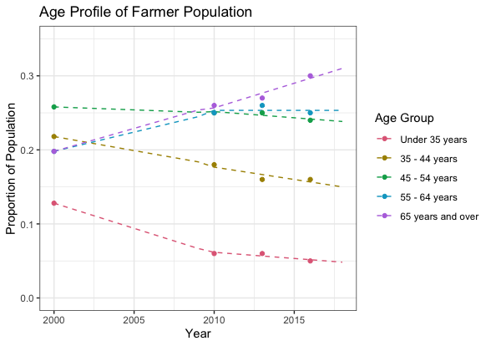
Older Farmers
Notes:
Somce the 60s evidence that Stress impacts on mental health
Stress limits the resources we can bring to bear on the problems we face everyday
Over time, leads to erosion of mental health, especially with dysfunctional coping
Agriculture has an ageing workforce with the average age of an Irish farmer now standing at fifty-seven and farmers are eight times more likely to be fatally injured in a farm accident than the general working population 5

Slide 10
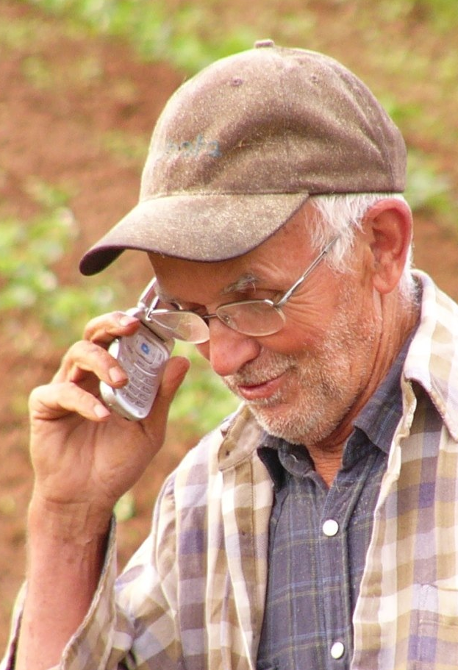
Ageing and Safety
Ageing workforce (mean = 57)
Effects of Ageing
  visual acuity, bone mass and density, physical flexibility and strength, cognitive flexibility, memory
Changes gradual, hard to notice
Long history of working in a young person’s way
Positives: Wisdom, experience, networks
Notes:
Agriculture has an ageing workforce with the average age of an Irish farmer now standing at fifty-seven and farmers are eight times more likely to be fatally injured in a farm accident than the general working population 5

Slide 11
Ageing and Policy
Very difficult to address age-related issues with policy
  Can’t make farmers younger!
  Can’t stop farmers farming
  Perceived discrimination
May be amenable to behavioural approaches
Potential for enhanced impact
  Older farmers set the norms for the farming family
  Set the norms for the broader community

Slide 12
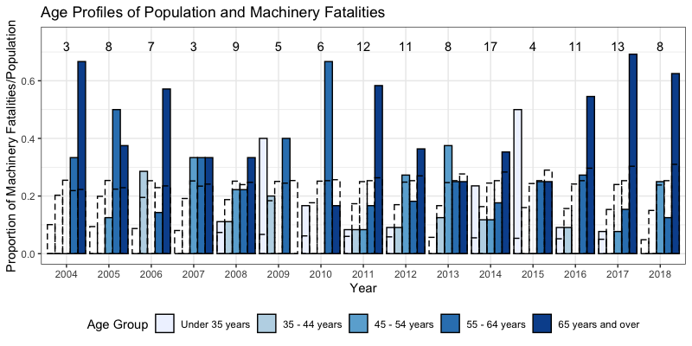
Reflection of Population?
Notes:
Somce the 60s evidence that Stress impacts on mental health
Stress limits the resources we can bring to bear on the problems we face everyday
Over time, leads to erosion of mental health, especially with dysfunctional coping

Slide 13
Project Outline
1st half of 2021
1. Systematic Review
3. Expert Group
2. Focus Groups
4. Pilot Interventions
2022-23

Slide 14
Expert Consensus
Prioritizing
Long term Impacts
Standardisation
Guidelines on implementation

Slide 15
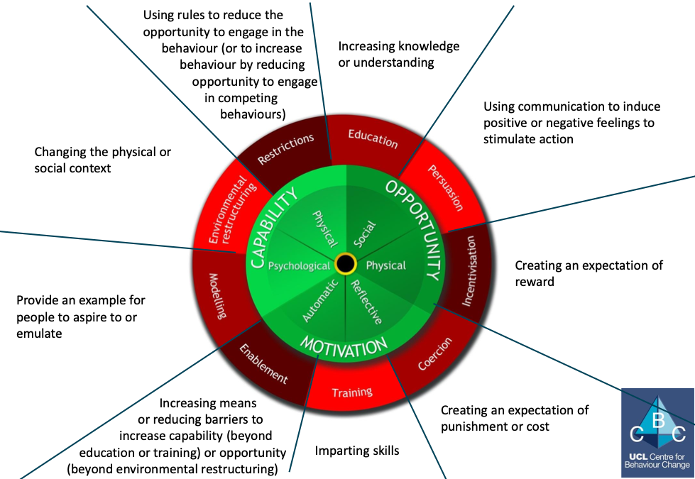
Intervention Development

Slide 16

Thank You

Slide 17
Questions

Slide 18
Total Worker Health™
WORKPLACE Protecting Worker Safety & Health | EMPLOYMENT Preserving Human Resources | WORKERS Promoting Worker Health & Well-Being
Control of Hazards & Exposures | New Employment Patterns | Optimal Well-Being
Prevention of Injuries, Illnesses & Fatalities | Health & Productivity | Workers with Higher Health Risks
Promoting Safe & Healthy Work | Healthcare & Benefits | Compensation & Disability
Risk Assessment & Control

Slide 19
Total Farmer Health
 | Self Employed | Lone Workers | Older workers
Social Support (Discussion groups) | Reduce burnout, depression Enhance resilience Financial and auditing support (stressor) Assess best practice Facilitate communication of best practice | Provide help when needed Connect lone workers | Take advantage of current support networks
Safety Best Practice | Reduce physical threats (workplace design) Reduce system threats | Design practices for lone workers | Design practices for older workers
Exercise and Diet | Enhance physical fitness Enhance decision making, cognition | Design exercise and diets for lone workers | Reduces age-related cognitive and physical decline

