Slide 1


Farmers’ Perspective on Farm Machine Accidents and Safety: An Investigation Using Focus Groups
Ms. Aswathi Surendran, Dr Jenny McSharry, Dr Denis O’Hora, (NUI Galway)
Dr David Meredith, Dr John McNamara (Teagasc).

Slide 2
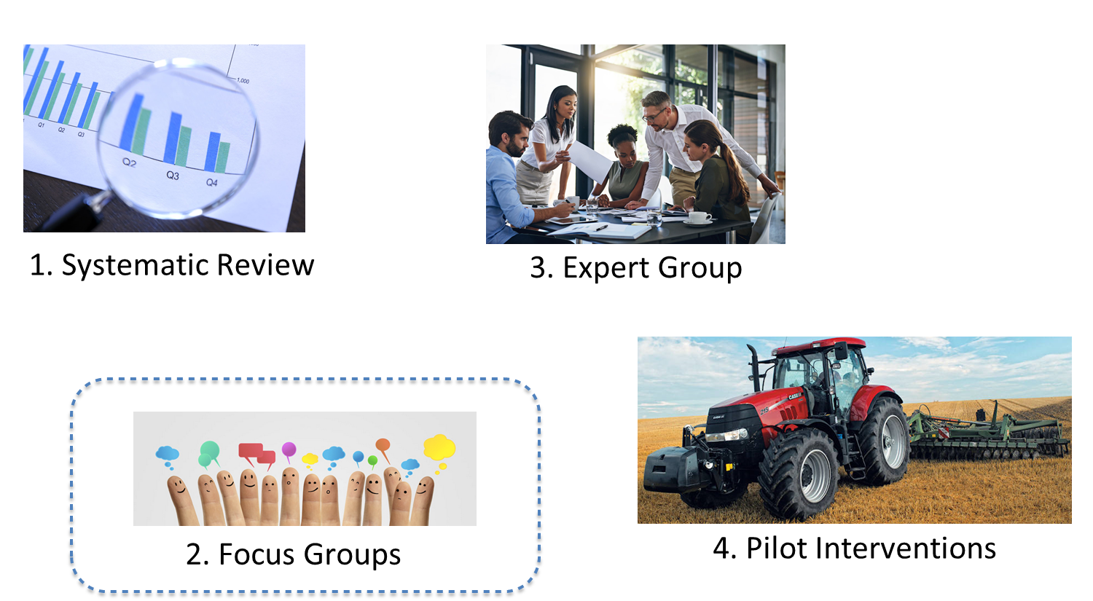
PROJECT OUTLINE

Slide 3


Farm Safety Review
Intervention to address machine safety
Attempts to address the concerns of senior farmers
Addressing the heterogeneous nature of the farm
Behavioural based interventions
Participation of stakeholders in the early
stages of intervention development
Details of the intervention modules/elements
What is missing in the existing interventions?
Systematic Review
Focus Groups

Slide 4
Participants
4 Focus Groups
19 Farmers (60+ age)
Tractor owners > 17 Participants
Quad Bike > 8 participants
5 participants were in at least 1 accident
18 Men & 1 Woman
Dropped out : 4
Farm Types* | #
Suckler | 8
Diary | 5
Sheep | 6
Tillage | 7
*Mixed farms | 5

Slide 5
A focus group during Covid-19
Mode of focus group
Technical difficulties
Scheduling conflicts & fatigue
Thematic saturation
Sense of anonymity
High engagement
Unexpected benefits
Notes:
Unexpected benefits : Providing advices and exchanging of ideas between farmers
Fatigue: Already existing discussion groups

Slide 6
Initial Findings: Emerging themes & COM-B model
COM-B | THEMES
 | Facilitators | Barriers
Physical capability
 |  | Lack of resources to meet the requirement(time, work force)
Psychological capability | Experience and Knowledge about the causes of accidents | Distractions due to stress
 | Modelling of safe behaviour to next generation
Physical opportunity |  | Lack of control over external factors like weather
 |  | Lack of automated monitoring systems
 |  | Lack of financial support
Social opportunity | Modelling of safe behaviour to next generation | Lack of social network and discussion groups for safety
 |  | Lack of regulations and guidelines undermining peer safety influence
Reflective motivation | Conscious change to old age friendly farming activities Modelling of safe behaviour to next generation | Lack of regulation and oversight
Automatic motivation |  | Failure to follow safety guidelines
Identifying facilitators and barriers
Dual nature of the components
Notes:
The same components act as a facilitator and as hurdles

Slide 7
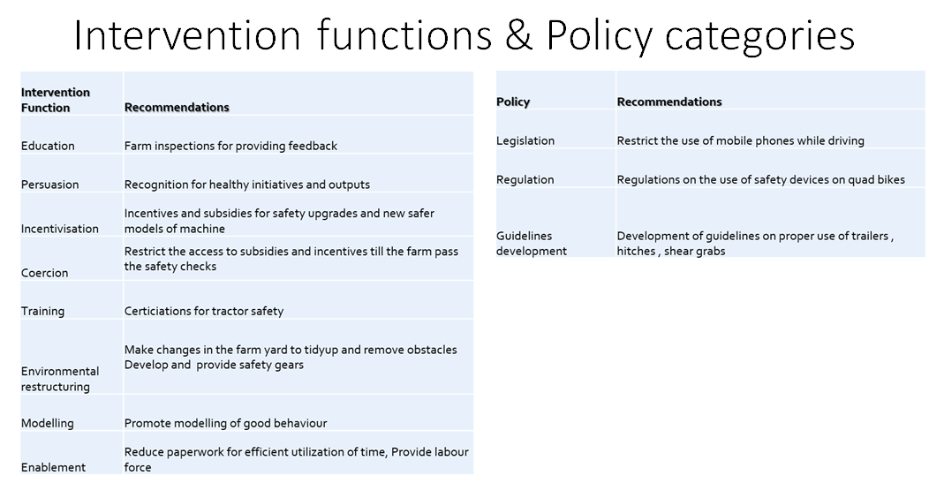
INTERVENTION FUNCTIONS & POLICY CATEGORIES

Slide 8
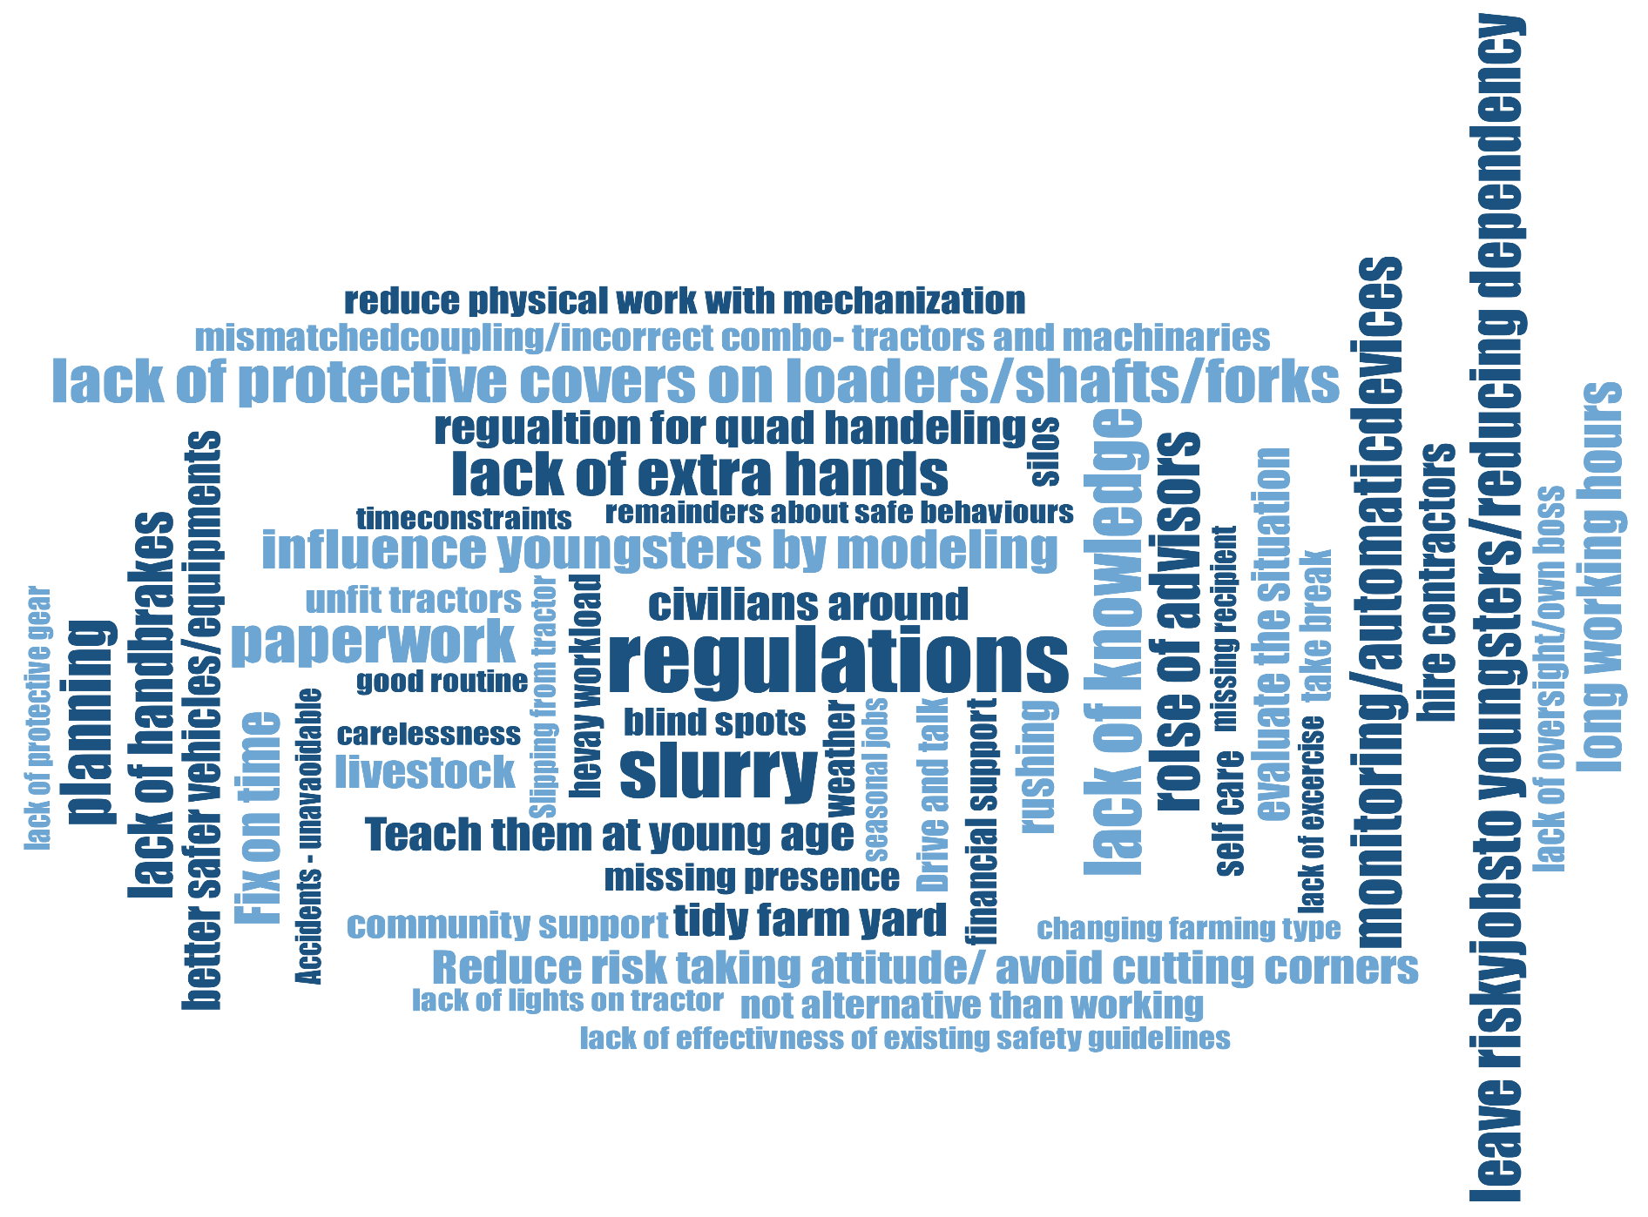

Slide 9

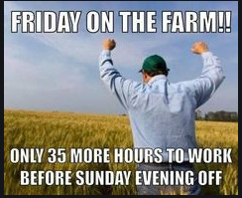
HIGHLIGHTS
“I know it’s an unpopular opinion but oversight is required”
Role of advisors
Missing inheritance
Mismatched combo
Modelling safety behaviours
Cascading effects
Non-machine concerns: Slurry, Silos & Livestock
Notes:
Regulations – positive attitude : I know it’s unpopular opinion but oversight is required. Make compulsory. Nothing else get to the farmers. I'm no better than the rest of them. (FFG2, Pos. 337)
Role of advisors
Missing inheritance
Mismatched combo
Modelling safety behaviours

Slide 10
THANK YOU!

Slide 11
POINTS
Current stage
Why this focus group- Findings from SR
FFG Demography, geography
Paperwork
Inter link between
Conducting FFG during covid : steps
Engagement of participants
Impact of covid on FFG
Drop out rate and causes
BCw initial findings
Suggested intervention fns
Unofficial findings from social media- undercover researcher
So what next?

