Slide 1
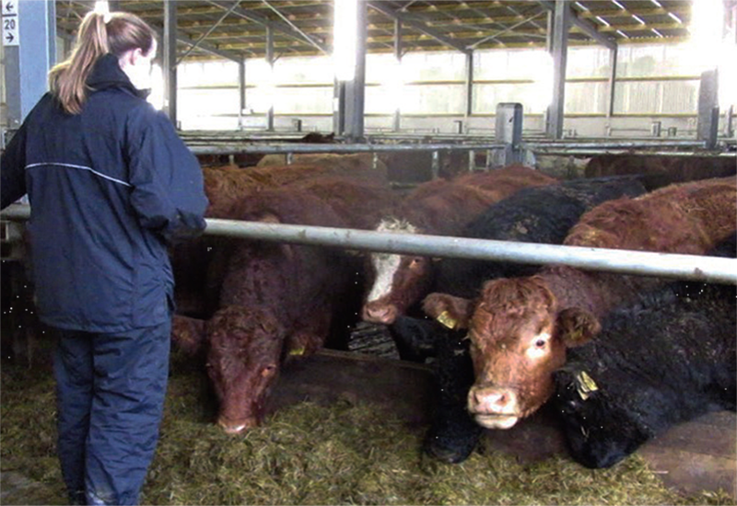
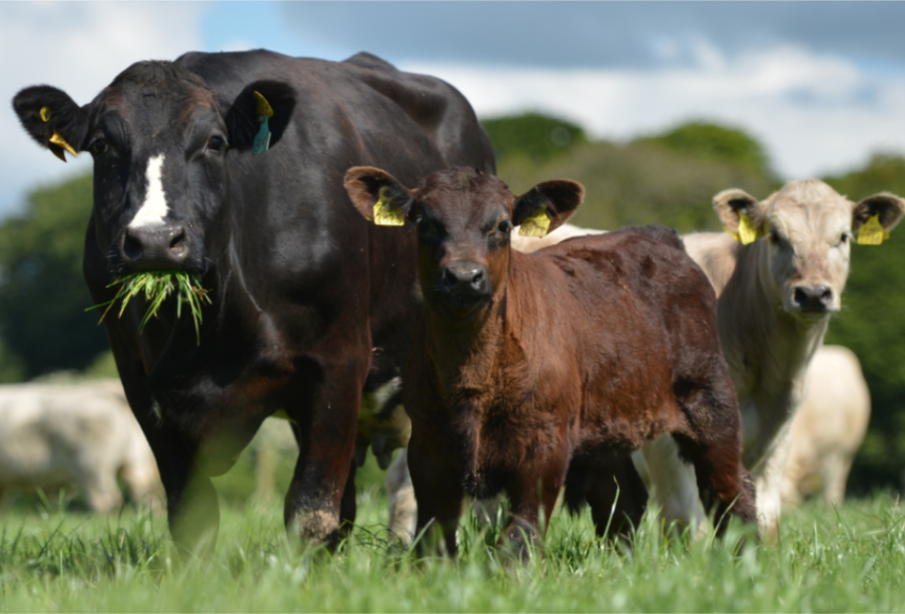




Farm safety attitudes and behaviours of livestock Farmers in Ireland
27th April 2021
Ms Niamh Woods, Dr Mohammad Mohammadrezaei (Teagasc),
Dr Mark McGee (Teagasc), Dr Marijke Beltman (UCD),
Mr Francis Bligh, Dr John McNamara, Dr David Meredith and
Dr Bernie Earley (Teagasc).

Slide 2
Objectives
To describe the factors that contribute to farmers' adoption of recommended farm safety management strategies
To develop safer work systems on farms for livestock handling and management of facilities
To promote the adoption of safer systems for handling livestock on farms

Slide 3
Farmer survey
April → July 2019
21 counties
34 group meetings
    32 “Beef” Knowledge Transfer discussion meetings (n = 350)
    2 education groups
    (n = 37)
387 respondents
Data collection & analysis
    Hard copy → database
Demographic questions
Farm size
Livestock handling
Facilities on farms
Attitude & behaviour towards safety
Accidents & ‘near misses’

Slide 4
Respondent age

Slide 5
Respondents by County

Slide 6
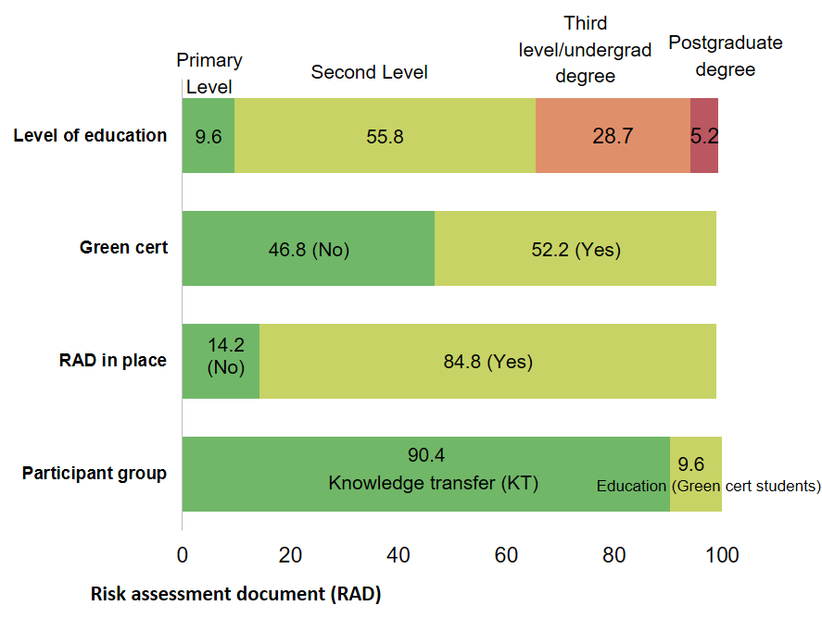
Results: Demographics
Risk Assessment document (RAD)
Percentage

Slide 7
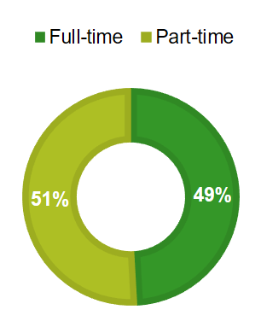
Results: Demographics
On-farm hours worked
(Mean = 42 h, SD = 21.45)
Off-farm hours worked
(Mean = 37 h, SD = 13.62)
Enterprise | Percentage of Farmers
Suckler bred | 84.8
Dairy bred | 4.1
Combination of both | 9.6

Slide 8
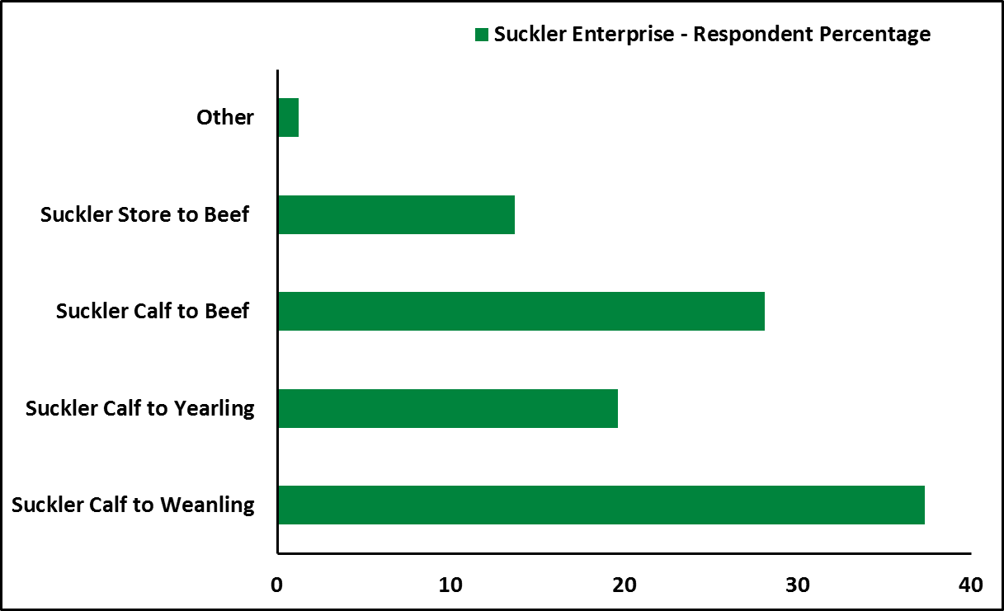
Enterprise – Suckler Bred
84.8% of farmers operated ‘suckler bred’ beef systems

Slide 9
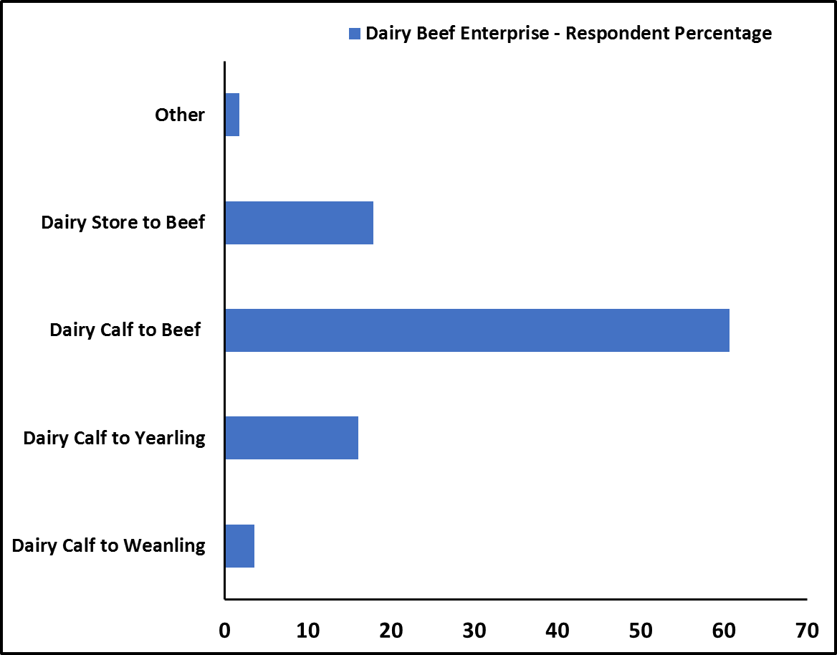
Enterprise – Dairy Bred
4.1% operated ‘dairy bred’ beef systems
Notes:
As a result of the different measurements scales used to assess farmers’ safety behaviours (mostly by way of ‘Likert’ scales), a standardisation technique was used to compare behavioural and psychosocial factors.
The responses received were changed to ordinal scales, ranging from 0 to 100. Following this, the ‘mean imputation’ (MI) technique was used to treat outliers and missing values.
To combine individual behavioural measures, and prevent probable multicollinearity between factors, explanatory factor analysis (EFA) was used to identify appropriate combinations of variables, i.e. the factors suitable for integration into single constructs measuring, for example, behaviour. By applying principal component analysis (PCA) two components were identified (components with variance extraction of 60% and above). For example, four questions regarding the use of a vehicle when herding animals and two questions regarding the display of signage at field entrances (with animals present) were expressed as two separate constructs as the ‘factor loading’ for these questions was greater than 0.5, confirming strong inter-correlation. Spearman's correlation coefficient, signified by r_{sp}, was used to measures the strength and direction of association between two ranked variables.

Slide 10
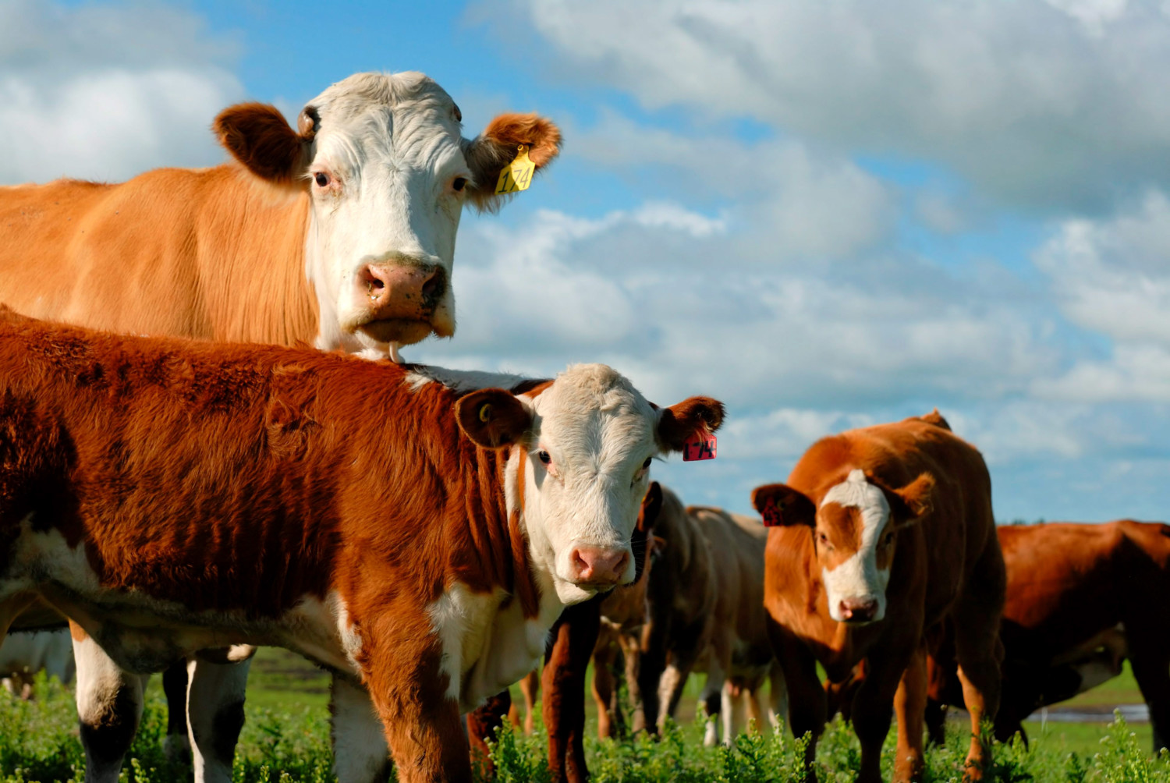
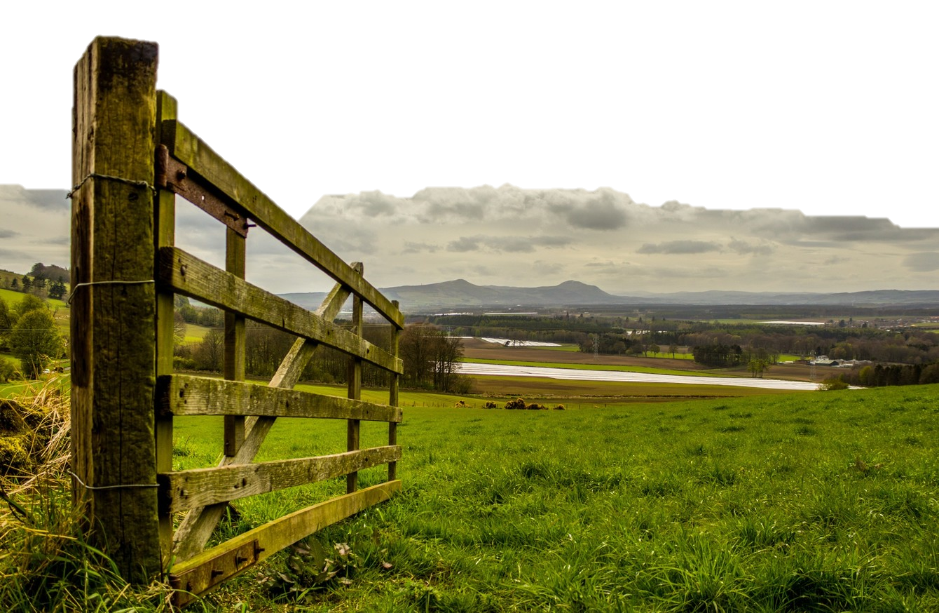
Results: Demographics
Herd size, Dairy bred cattle
(Mean = 13, SD = 46.45)
Herd size, Suckler bred cattle
(Mean = 113, SD = 139.33)
Herd size, Total
(Mean = 120, SD = 172.59)
Farm size (ha) Owned
(Mean = 40.4, SD = 28.65)
Farm size (ha) Rented
(Mean = 9.6, SD = 18.08)
Farm size (ha) Total
(Mean = 49.8, SD = 33.67)

Slide 11
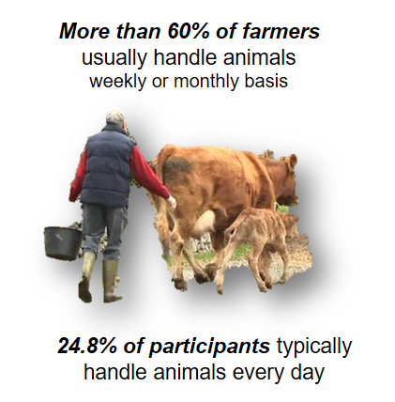
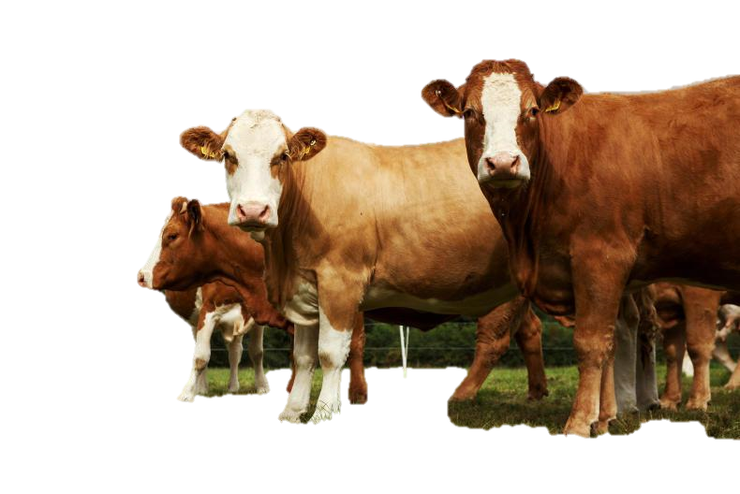
Results: Demographics
Usually handle animals on a weekly or a monthly basis
82.2% of farmers had no experience of an animal-related accident over past five years
63.3% of farmers reported having no ‘near miss’
66.7% agreed that if H & S training was mandatory prior to receiving a “basic payment scheme” (BPS) payment, it would be a positive change
Notes:
Basic Payment Scheme’ (BPS) (operated by the Department of Agriculture, Food and the Marine (DAFM)), the majority (40.3%) received ‘€10,000- €20,000’, followed by 28.7% of farmers receiving ‘€20,000- €50,000’.

Slide 12
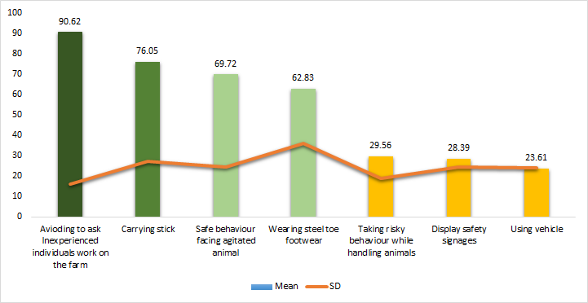


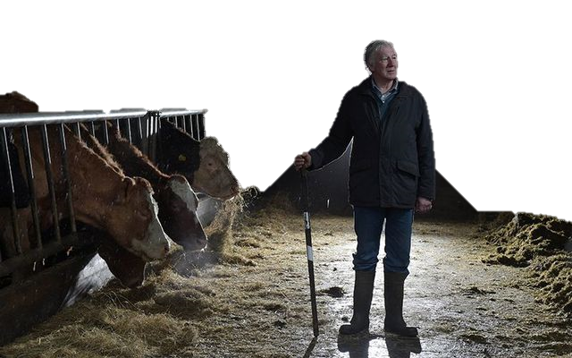
Results: Behaviours
Would not ask inexperienced persons to work on the farm
(reverse scale)
Average of score ranging from 0 to 100

Slide 13
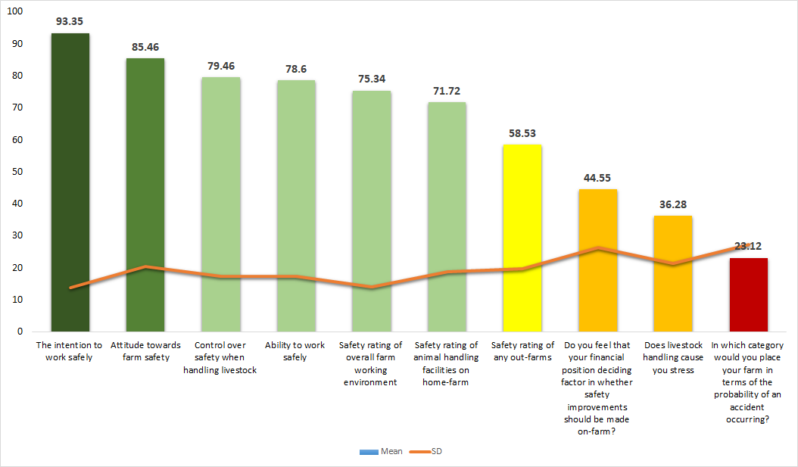
Results: Cognitive factors
Financial position
matters
Optimistic perception
Different views
Average of score ranging from 0 to 100
RS RS RS
(Reverse scale)

Slide 14
Conclusions
The overall intentions of farmers to work safely rated very highly
Farmers’ attitudes towards the importance of farm safety were generally very positive
Farmers believe they have adequate ability to work in a safe manner
Farmers believe that they have control over their safety when working with animals on farm
Farmers rarely foresee the probability of accidents occurring, however they reported different views

Slide 15
Acknowledgements
BeSafe DAFM Research Stimulus Fund (17/S/269 – RMIS 0434RE)
Participating Farmers and Students
Teagasc Advisors
Administration staff at Teagasc, Grange

Slide 16
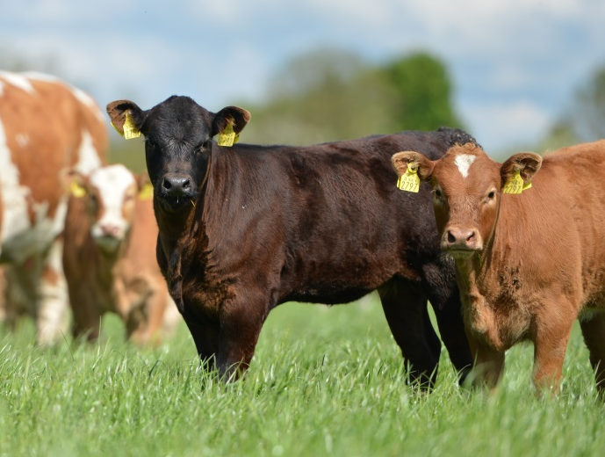
Thank you for your attention

Slide 18
Intention to work safely | 93.35 (SD = 13.78)
Attitude towards farm safety | 85.46 (SD = 20.56)
Ability to work safely | 78.60 (SD = 17.35)
Control over safety when handling livestock | 79.46 (SD = 17.53)
Safety rating of animal handling facilities on home-farm | 71.72 (SD = 18.85)
Safety rating of overall farm working environment | 75.34 (SD = 14.23)
Safety rating of any out-farms | 58.53 (SD = 19.73)
In questions where scales were reversed, the following standard means were calculated-
Do you feel that your financial position is a deciding factor in whether safety improvements should be made on-farm? | 44.55 (SD = 26.32)
Does livestock handling cause you stress | 36.28 (SD = 21.43)
In which category would you place your farm in terms of the probability of an accident occurring? | 23.12 (SD = 27.38)

