Slide 1




BeSafe
Behaviours for Safer Farming
This research is funded by the Department of Agriculture, Food and the Marine through the RSF. Grant No: 17S269

Slide 2


Where does this work fit into ‘Teagasc Together’?
To support improvements in farmers’ living standards and wellbeing.
Safety
BeSAFE
Thematic Area
Projects
SafeDairy
Teagasc Strategic Goal 1
Health
Farmers Have Hearts – CHP
Wellbeing
On Feirm Ground
Farmer Isolation
Measuring Farmer Quality of Life
Recent and Ongoing Teagasc Health, Safety and Wellbeing Research

Slide 3
BeSafe Project
Task No. | Task | Responsibility
Task No. 2 | Risk perceptions and behavioural intention for health and safety among farmers | Teagasc (DM, MM). Ongoing
Task No. 3 | Risk perceptions and behavioural intention for health and safety among agriculture students in the development of professional knowledge | Teagasc (DM, MM), UCD (JK, SF). Ongoing
Task No. 4 | Comparative assessment of knowledge transfer (farm extension services) and regulatory systems governing OHS practices among selected European Countries | Teagasc (JMcN). Complete
Task No. 5 | Quantifying the exposure to risk: an evaluation of the relationship between time spent working and farm injuries and fatalities | Teagasc (DM, MM). Ongoing
Task No. 6 | Learning from the DAFM Knowledge Transfer OHS initiative: An assessment of facilitator’s and farmer’s experiences | Teagasc (DM, JMcN and MM). Ongoing
Task No. 7 | Identification and Analysis of Behavioural Machinery-related Farm Safety Interventions | NUI Galway (DO’H, JMcS, and AS), Teagasc (DM, JMcN). Ongoing
Task No. 8 | Adoption of safer work systems for handling livestock and managing facilities on farms, and effecting change in farmer behaviour | Teagasc (BE, DM, MM), UCD (MB, NB and NW). Ongoing
Task No. 9 | Participatory co-design of interventions to enhance farm safety | Teagasc (AMW, MB, DM). Ongoing
Task No. 10 | Dissemination | All

Slide 4
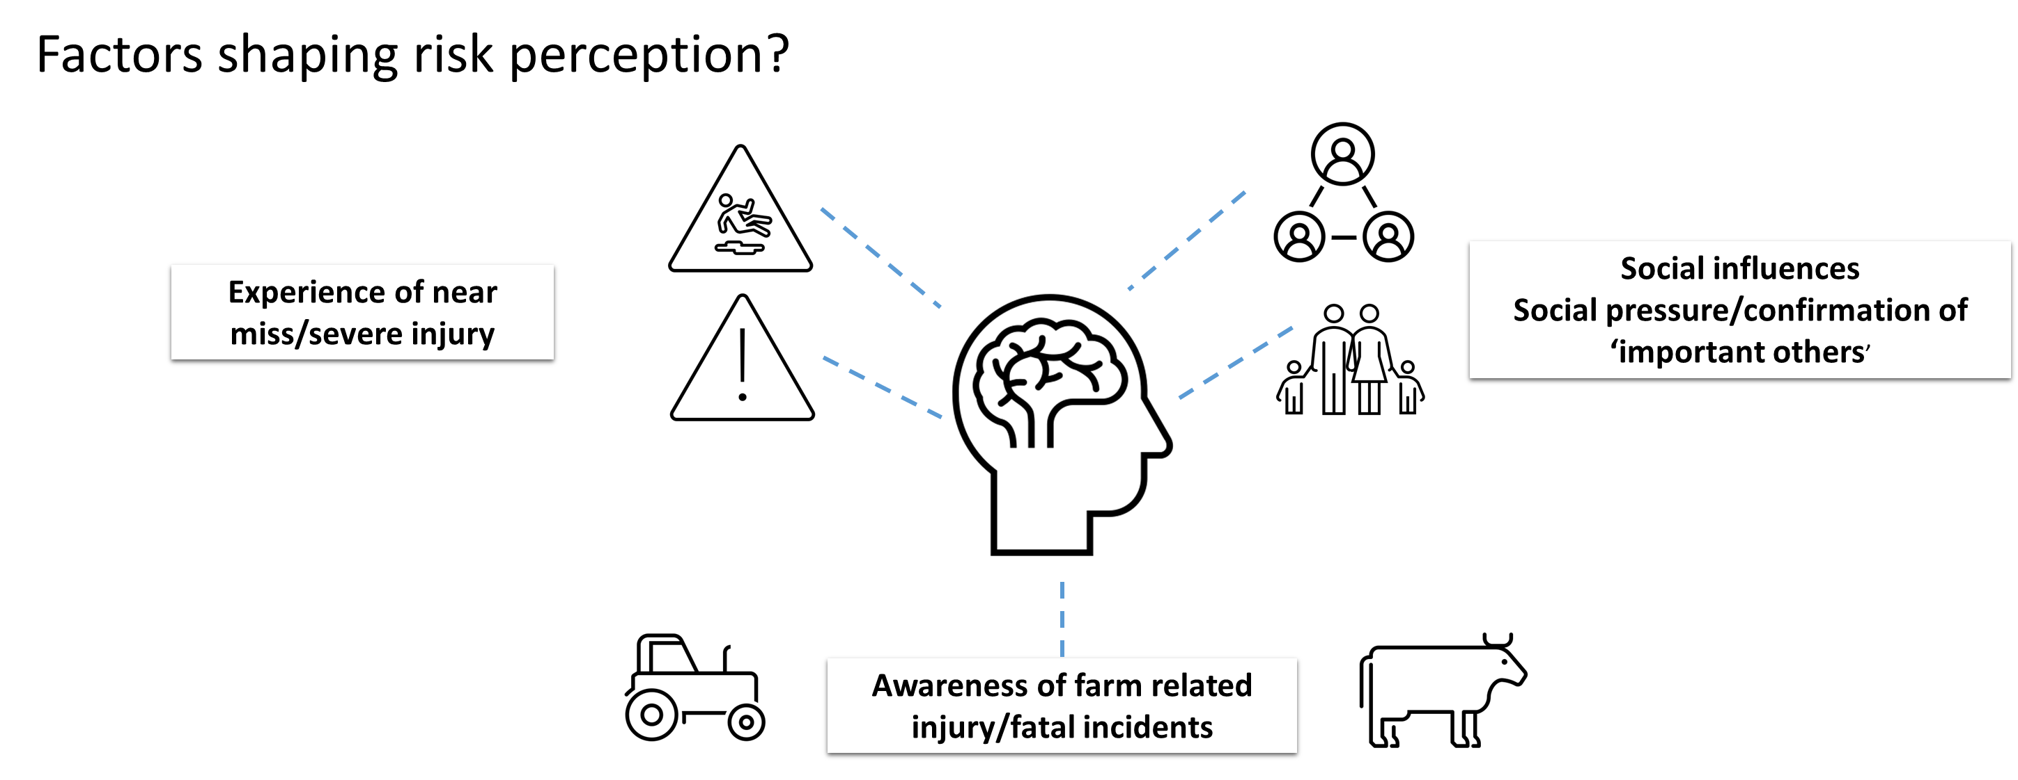
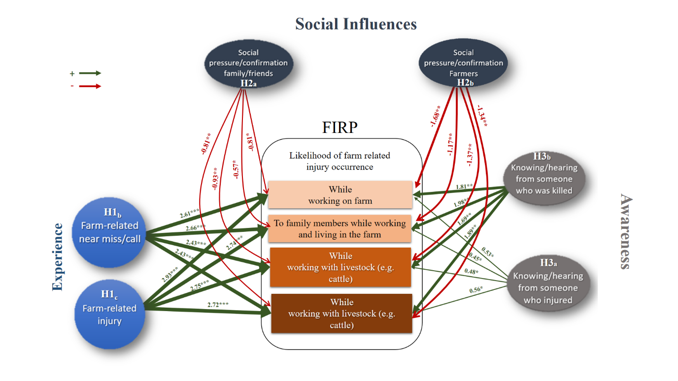
Do social influences, awareness, or experience influence farm safety risk perception?
No significant association between ‘farming experience’ and students’ level of risk perception.
Family and friends negatively influence risk perception.
Having a near miss / close call increases risk perception.
Awareness of fatal and non-fatal incidents positively, and significantly, impacts risk perception.

Slide 5
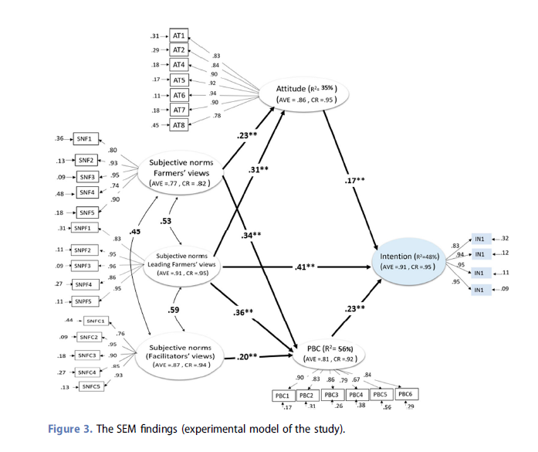
Why would advisors be reluctant to discuss safety?
FHS is not a key issue
  Not an organisational priority
  Not the clients’ priority
The lack of social support from conventional farmers
The lack of social support from leading farmers
Discussing FHS is challenging
  FHS is not in their ‘comfort zone’
  Reluctant to raise the issue
The lack of social support from their colleagues (I.e. other job demands and priorities)

Slide 6
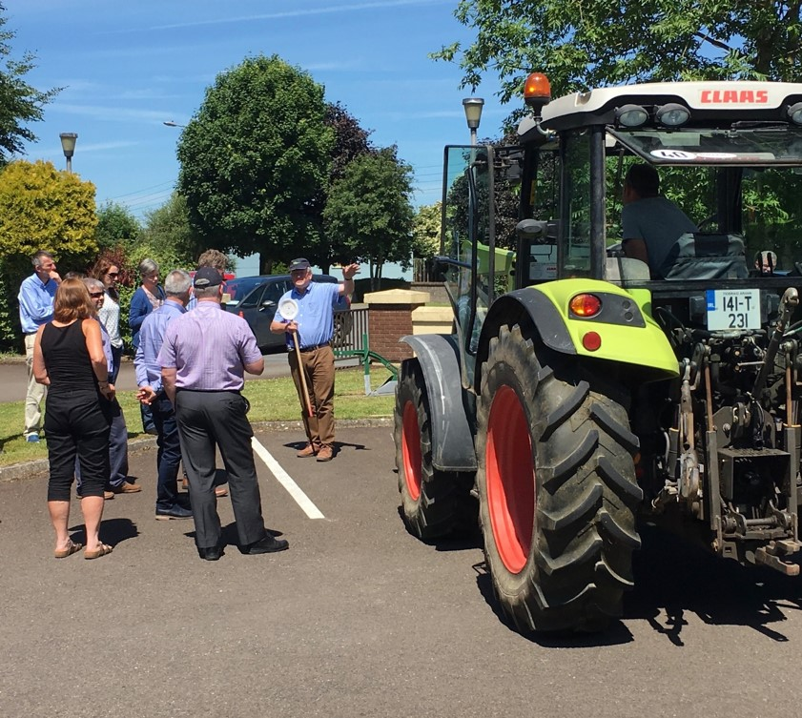
Pulling it all together
Results from surveys of farmers, advisors and students all highlight the critical role that farmers play in shaping the extent to which people are willing to engage with farm safety.
Key stakeholders are looking to each other to lead on the farm safety issue.
We need to develop ways that bring together and maximises the influence of these stakeholders on farm safety cultures in Ireland.
  Farmers have to be at the centre of this.

Slide 7
BeSafe: Next Steps
Raise awareness and keep doing so
Developing, piloting and testing communication, engagement and education and training resources
  Engage farmers in the process (co-design)
  Normalise the safety conversation –
    What can be learnt about the issue
    Could it happen on my farm
    What steps could I/we take to reduce the risk
Tractor/Machinery Safety
Livestock Safety / Animal Handling
Develop tools to support farmers and advisors engage in farm safety topics
Continue work with student population (including vets who are a positive social influence).
BeSafe International Conference (August 2023).

