Slide 1

BeSAFE: Behaviours for Safer Farming
David Meredith, Teagasc
January 31st 2020

Slide 2
Farm Fatalities (Number)

Slide 3
Demographic Profile of Farm Fatalities

Slide 4
Age and Causes of Fatalities

Slide 5



Current Programme
Encourage diversification of the rural economy and enhance the quality of life in rural areas
Farmer Safety and Health
BeSAFE
Communities of Safe Farm Practice
Thematic Area
Current Projects
Farmers Have Hearts
Farmer wellbeing
Teagasc Strategic Goal 3
BeSAFE: Behaviours for Safer Farming
Co-ordinator/Project Leader, 4 year RSF project, 1 Post Doc, 2 WFs
Aim: develop a comprehensive understanding of the factors that influence farmer safety and to exploit this understanding to effect positive lasting change.
Provides an integrative structure for all research in this area

Slide 6
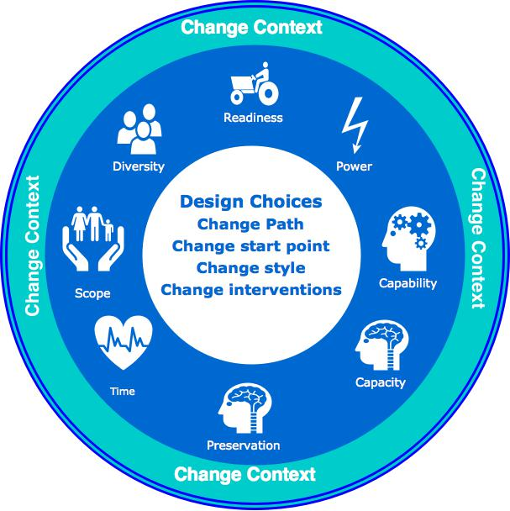
BeSAFE
Identify knowledge, attitudes, behaviours and priorities among farmers and trainee farmers regarding safety and risk management
Evaluate the effect of personal, household, social and professional networks on safety and risk management behaviours of farmers and trainee farmers
Apply statistical analysis to assign farmers and trainee farmers to groups based on their ‘behaviour type’ with respect of safety and risk management in general and animal and machinery risks in particular
Update analysis of farm accident and fatality trends in Ireland
Evaluate the governance and support systems targeting farm safety internationally through behaviour change initiatives

Slide 7
BeSAFE
Assess outcomes to the 2016 – 2019 Knowledge Transfer Programme health and safety initiative on discussion group facilitators and participants
Design and implement pilot interventions targeting improvements in risk perception concerning animal and machinery related safety
Develop safer work systems on farms for livestock handling and management of facilities
Engage with the EU COST network ‘Safety Culture and Risk Management in Agriculture’
Disseminate results to policy and research stakeholders and the agricultural community, and, inform policy and regulatory initiatives in the area of farm safety.

