Slide 1

How to create accessible documents with Word and PDF
Katey Hügi
May 2023

Slide 2
Welcome
This session has captions and is recorded
Please use the Q&A to ask questions and chat for general correspondance
Slides, a recording, and a transcript will be made available via email in the coming days
I welcome any feedback, follow-up questions, or suggested topics for future training

Slide 3


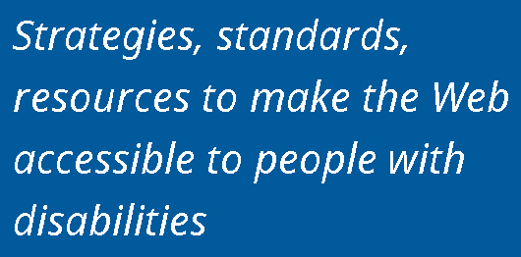

About AbilityNet

Slide 4
Agenda
Applying accessibility principles to documents
Creating accessible templates in Word
Creating accessible content with Word
PDF accessibility
Accessible forms options

Slide 5
Example documents
Inaccessible Word document
More accessible Word document
PDF version

Slide 6
Poll 1
How much experience do you have with document accessibility?
None or little experience
Moderately experienced
Very experienced

Slide 7
Applying accessibility principles to documents

Slide 8
Accessibility principles: POUR
Perceivable: Content is presented in ways that can be perceived by all
Operable: User interface components and navigation must be operable
Understandable: Information and the operation of user interface must be understandable
Robust: Content is reliable and compatible with assistive technology and standards

Slide 9
Remember, some documents:
Convey information visually – so they need to be perceivable if accessed through assistive technology
Are interactive – so they need to be operable
Request user inputs – so they need to minimise user errors
Will have different levels of support for assistive technology
Choosing the correct document format will influence the effort involved to make it accessible

Slide 10



International accessibility standards
Web Content Accessibility Guidelines (WCAG) 2.1 Level AA
ETSI EN 301 549
Aligned to WCAG 2.1 AA
Section 10 covers non-web documents
Note – not all WCAG requirements transfer to documents

Slide 11
Characteristics of accessible documents
Searchable text
Navigational aids (bookmarks, headings, table of contents)
Metadata e.g. title and document language
Programmatic document structure e.g. tags
Logical reading order
Interactive form fields that can be tabbed to with keyboard
Alternative text for non-text elements
Appropriately formatted tables

Slide 12
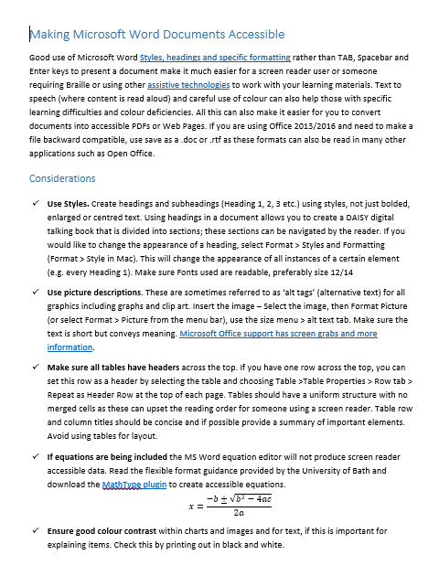
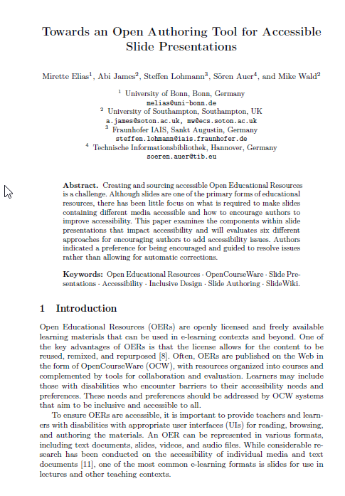
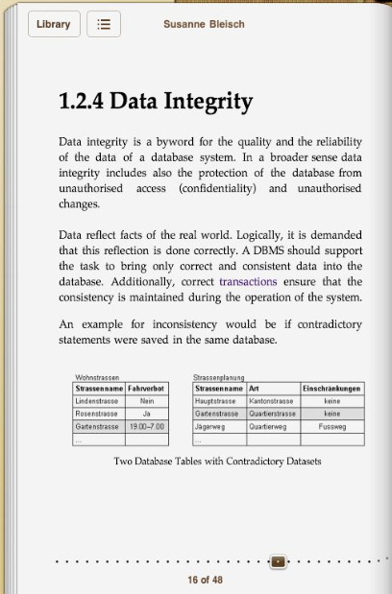
What types of document format are available?
Office & editable formats
PDF - print focused formats
ePub & HTML based formats

Slide 13
Accessibility pros and cons for document formats
Format | Pros | Cons
Word Office format - *docx | Easiest to make accessible Compatible with wide range of assistive tech & devices Can be personalised by the user | Interactive features & complex tables are not accessible Accessibility compromised by security settings
PDF | All users get the same view & difficult to edit Interactive activities & complex tables can be made accessible | Creating / fixing accessible PDFs requires specialist skills and tools Cannot be personalised by the user
HTML based format e.g. web page, ePub | All users get the same view but can be personalised. Compatible with wide range of assistive tech & devices Interactive activities & complex tables can be made accessible | Accessibility may need specialist skills or tools that are not accessible out of the box. No default viewer at the moment for ePub

Slide 14
Poll 2
What document formats does your organisation post online or share?
Editable documents (e.g. Word)
Presentations (e.g. PowerPoint)
Spreadsheets (e.g. Excel)
Locked documents (e.g. PDFs)
Other – please state in chat pane

Slide 15
Questions?

Slide 16
Creating accessible templates to avoid potential issues

Slide 17
Word template: Styles and structure
Set up styles for:
  Headings 1 – 6: use outline level to set heading level
  Normal text: think about paragraph and line spacing, font style and colour
  Bulleted and numbered lists: ensure there are styles for common types of text

Slide 18
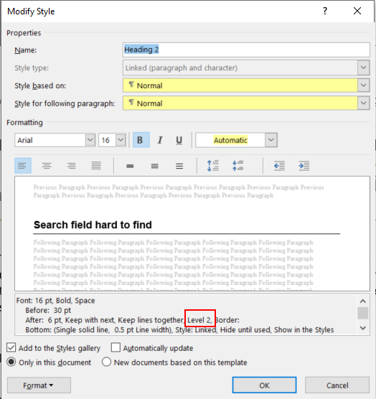
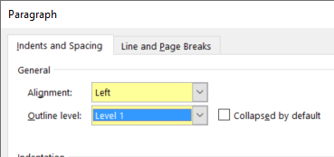
Example: Setting heading level in Word
On the Home tab, in the Styles group, select a heading style, for example, Heading 1 or Heading 2.
Do not use headings only for styling.

Slide 19
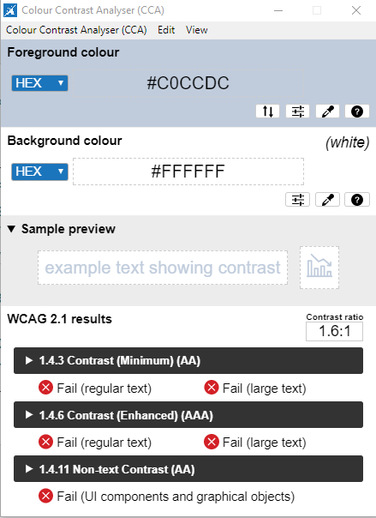
Font size, style and colour
Text size of 12 point or higher will benefit most users, but Word documents allow easy text-resizing
Avoid overly-decorative fonts and continuous capitalisation as they can be difficult to read
Provide at least a 4.5:1 colour contrast between text and background (3:1 for large text) – TPGi colour contrast analyser

Slide 20
Decorative content
Headers and footers
  Use built in tools to add headers, page numbers etc. so they are ignored by assistive technology
Background images
  Ensure background graphics are marked as decorative

Slide 21
Accessible template requirements
Style and structure
Accessible text defaults
Logical reading order
Sufficient colour contrast
Decorative content is marked as such

Slide 22
Questions?

Slide 23
Adding content to documents

Slide 24
Poll 3
Does your organisation check accessibility when documents are created?
Yes
No
Sometimes
Don’t know
We have a policy but it’s not policed

Slide 25
Types of content we need to make accessible
Text
Images
Tables
Links
Lists and headings
Form fields
Media
Charts

Slide 26
What do we mean by accessible text?
It is not an image.
You can select and copy it.
When you select all text / convert to a text document, it has the correct reading order.

Slide 27
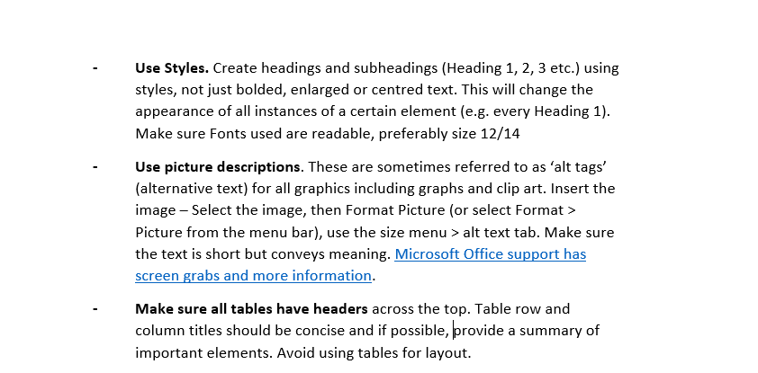
Example: What can we do wrong with lists?

Slide 28
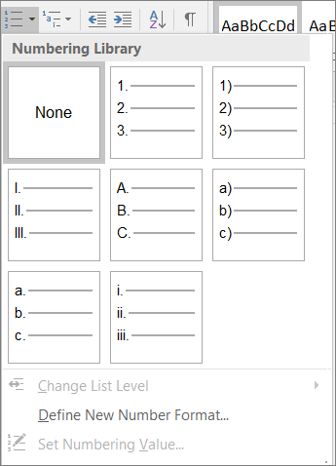
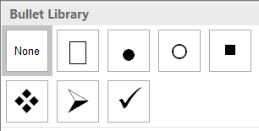
Formatting – Bullets and lists
Use bullets and ordered lists as opposed to images, clip-art, etc to create lists.
List paragraph styles can be used to adapt spacing and fonts

Slide 29
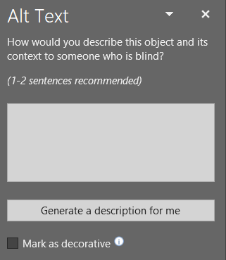
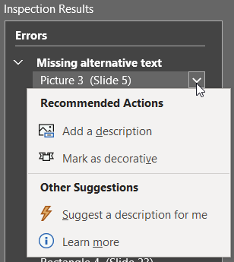
Adding ALT text to graphics in Word
From the images
Right click an image
Edit Alt Text
Type a description or mark as decorative
From accessibility checker
Select dropdown on graphic and choose appropriate option

Slide 30

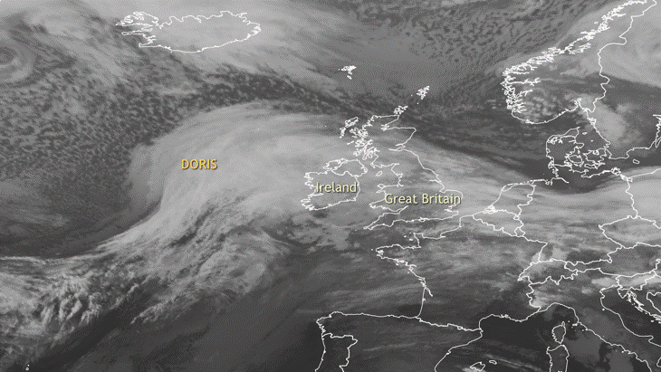
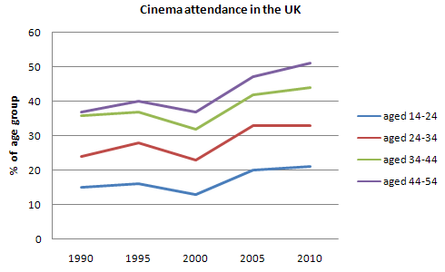
Example: Images and alternative descriptions
A
C
An empty beach
B
Colour line graph for cinema attendance in UK between 1990 and 2010 by age group.
Animation of satellite images of storm Doris crossing UK and Ireland.

Slide 31
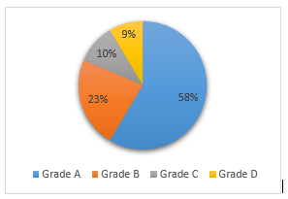
Charts and SmartArt
For charts and SmartArt, alt text can be added for the entire image
Save imported charts as images and add alt text before conversion to PDF
Provide longer descriptions if necessary for complex charts and diagrams

Slide 32
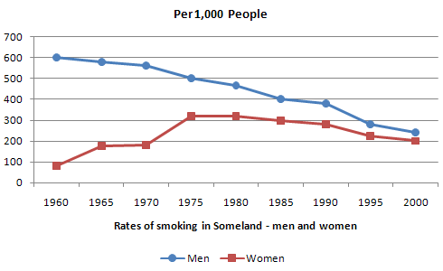
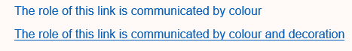
Use of colour
Ensure that colour is not the only way that information is communicated.
links should have some decoration (e.g. underlined) and charts shouldn’t rely on colour vision.

Slide 33
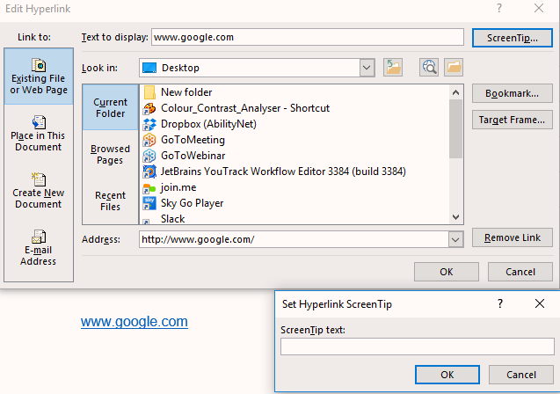
Links
Ensure that the purpose of links is obvious and self-evident from tabbing onto them.
Where possible, enter a meaningful name into the text to display field.
Use the screentip pop-up to provide a tooltip for users.

Slide 34
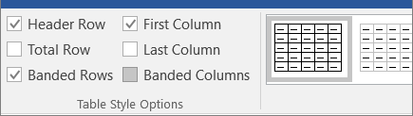
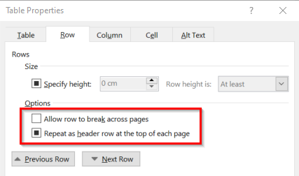
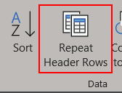
Formatting – Tables
Use table headers:
Table Design > Table Style Options
Select Header Row and First Column (if first column is acting as a header)
In Word Select Table properties: “Repeat as header row at the top of each page”
Deselect “Allow row to break across pages”
Do not use tables for formatting!

Slide 35
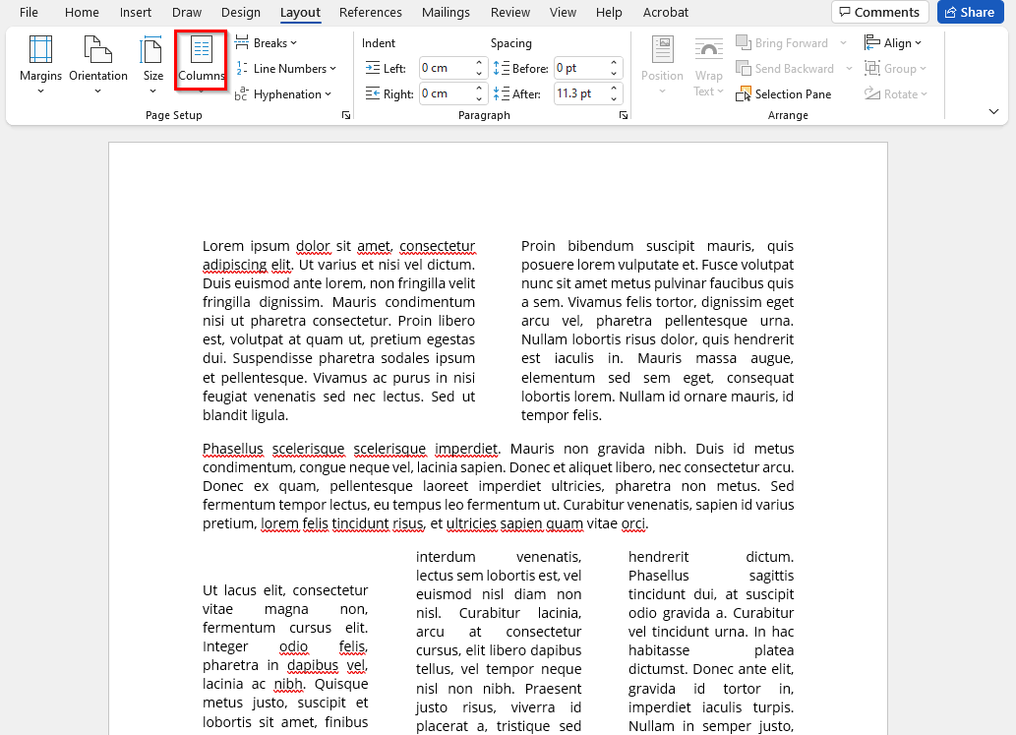
Formatting - Columns
Use columns rather than just using SPACE or TAB to align text
Laying out text using the built-in column functionality is an accessible layout method and the correct column reading order will be inherited by tagged PDFs created from the Word document

Slide 36
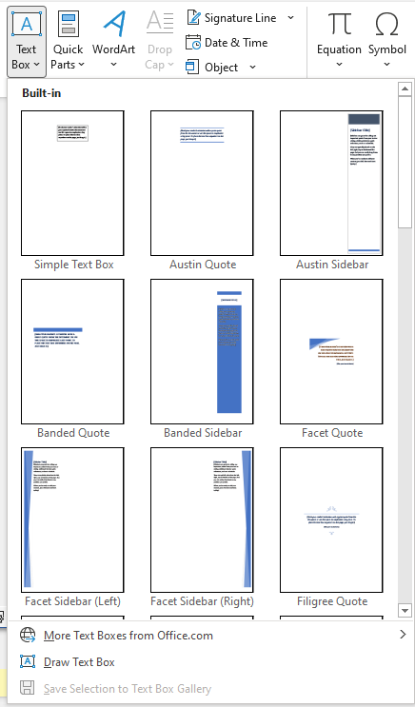
Formatting - Text boxes
Avoid adding text boxes via the inbuilt Word functionality – these are not easily accessible to screen reader users and are not placed in the correct reading order for assistive technology
Instead create text boxes by adding a border and positioned text to paragraphs

Slide 37
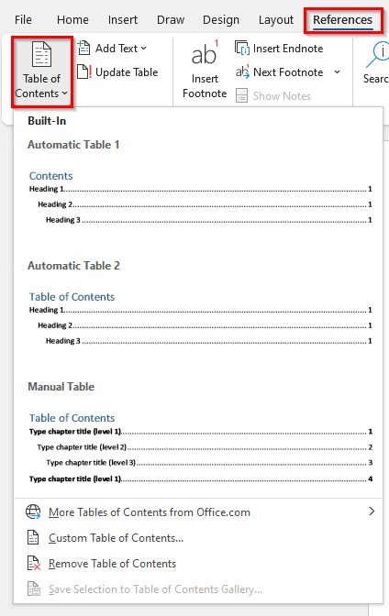
Table of contents
A table of contents can be added for longer documents via References >Table of Contents using the heading structure you have defined
Including a table of contents helps users to navigate themselves with an outline of the content

Slide 38
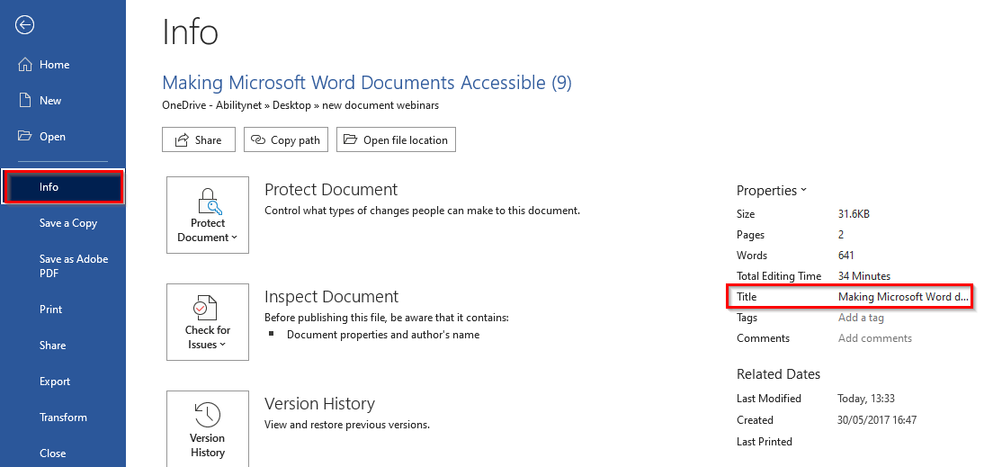
File name and title
Provide a descriptive file name for your file.
Providing a descriptive title will ensure this is inherited by a PDF created from your Word file

Slide 39
Microsoft Word accessibility
Golden Rules:
use the formatting tools to provide meaningful structure with built-in headings and styles
ensure that meaningful non-text content (e.g. images) has alternative text
use colour and meaningful hyperlink text to ensure perceivability
Microsoft: Make your Word documents accessible

Slide 40
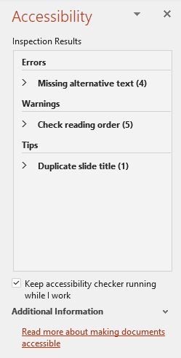
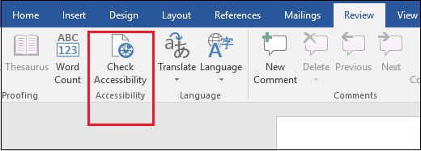
Microsoft Office Accessibility Checker
The Accessibility Checker finds accessibility issues, explains why you should fix these issues and how to fix them: Review > Check Accessibility
Google docs – see Grackle suite

Slide 41
Questions?

Slide 42

Optional break

Slide 43
PDF Accessibility

Slide 44
PDF accessibility – why is this so challenging?
Why are PDFs so challenging to make accessible?

Slide 45

The challenge of making PDFs accessible
Often scanned documents
Require additional accessibility tags to add structure
Don’t have great usability on mobile
Often heavily designed and complex layouts
Some types of content (such as mathematical and scientific notation) have limited accessibly support
Additional software and skills required to make PDFs accessible

Slide 46
Additional requirements for accessible PDFs
Text is not an image
Permissions are set correctly
File has appropriate metadata e.g. title and language
Content is tagged
  Applies alternative text, semantics and reading order

Slide 47
PDF accessibility checkers
Adobe Acrobat Pro – check and fix
PAC 2021 – checker, freeware for Windows
CommonLook PDF Validator (require Acrobat Standard or Pro)
PAVE – online tools, some fixing possible
Manual checks will still be required

Slide 48
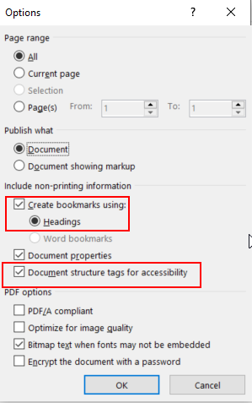
Exporting Word to accessible PDF
Add Title and other metadata
Convert embedded Office objects to images and add alt text
Select the following options in Save As > PDF > Options:
  Create bookmarks using headings
  Document structure tags for accessibility

Slide 49
Lightweight PDF check
Run the PDF file through a checker. Look for:
  Image only file – this will need OCRing
  No tags – this will need lots of remediation if complex structure
  Permissions affecting accessibility
Tab through the file to check if links and fields are interactive
Use View > Zoom > Reflow and Save > Other > Text (accessibility) and check
  Check for reflow issues and reading order issues

Slide 50
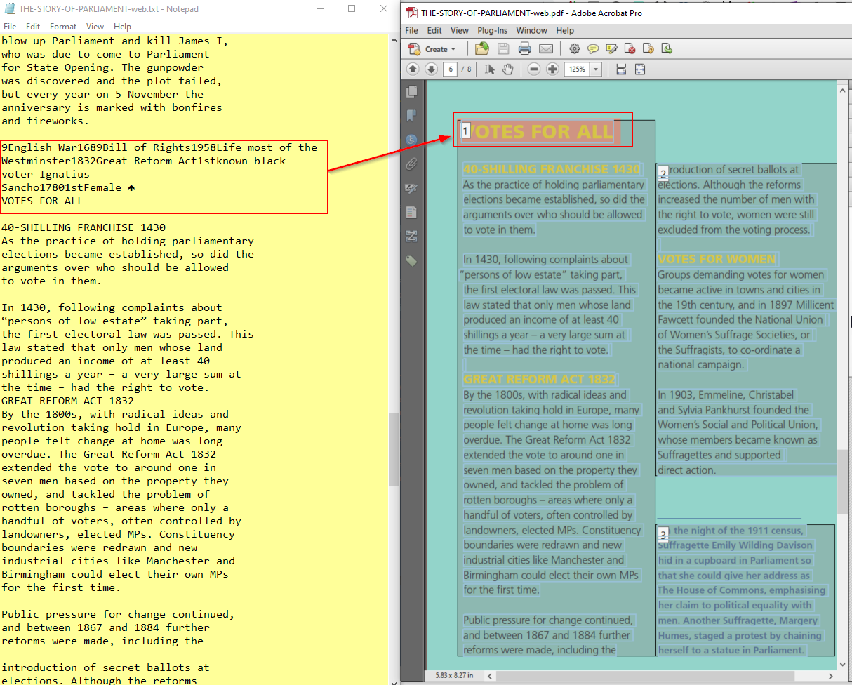
Reading order issues in PDF
Any content that is not laid out linearly could be read in the wrong order.
Without tags, content likely to read in the order it was added to files and text will be concatenated where there were line breaks.

Slide 51
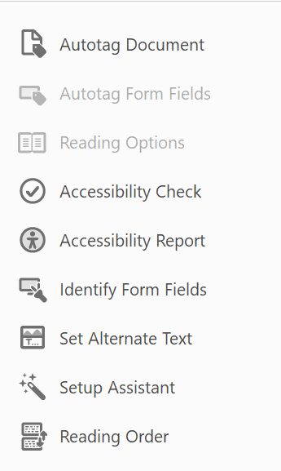
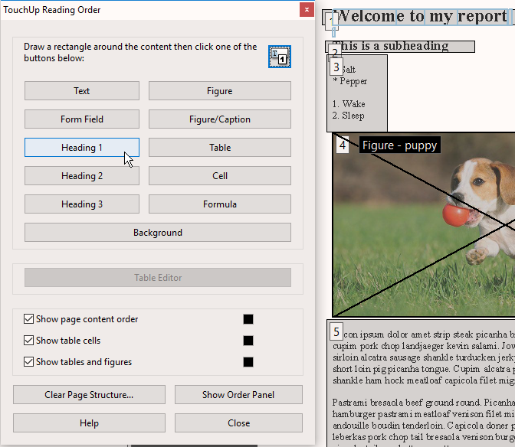
Using Acrobat Pro to check & fix issues
Run Full Check and view report
Fix metadata and permissions issues
Add tags or correct tagging where necessary

Slide 52
Accessible Forms

Slide 53
Accessible Forms – Word vs PDF
Word Forms
More accessible if plain text e.g. leave empty space to fill out the form.
Built-in form controls have limited accessibility
Protecting content so only form fields can be edited makes the file inaccessible
PDF forms
Can be made accessible if form fields are tagged along with the rest of the file
Complex forms will be costly to make accessible
Many users will struggle to complete the form digitally

Slide 54
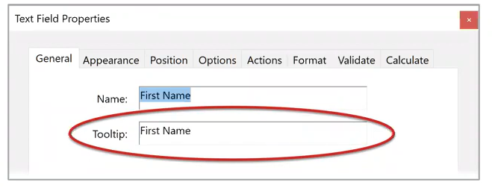
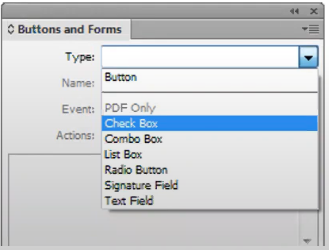
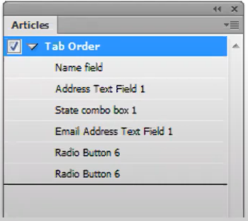
Accessible PDF forms requirements
In Adobe Acrobat every field needs to
be added, given a tooltip & tagged
Tab order must also be checked
Forms can also be created
in Adobe InDesign

Slide 55
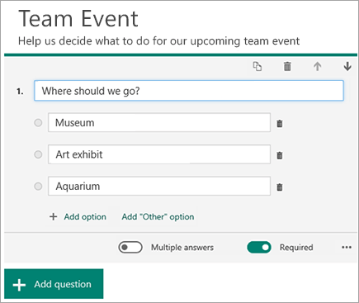
Easy accessible online form solutions
Microsoft Forms
Google Forms
Online survey tools e.g. Survey Monkey
Remember data protection

Slide 56
Summary
Accessibility requirements apply to all digital documents
Always consider if information needs to be in another format, or could be presented as HTML.
Accessibility is best implemented at the source when creating PDF documents and a good initial publication process is essential
Ensure you have a clear accessibility documents policy, good templates and procedures for checking content.

Slide 57
Questions?

Slide 58
Resources
Microsoft: Create accessible Office documents
Adobe: PDF accessibility overview
Daisy Consortium: WordToEPUB - Conversion tool for ePUB from Word
Web Accessibility Initiative: alt decision tree
Benetech: Poet alternative text training tool
WebAIM: Accessibility techniques for older versions of Word

Slide 59
Thank you
Katey Hügi
May 2023

