Slide 1
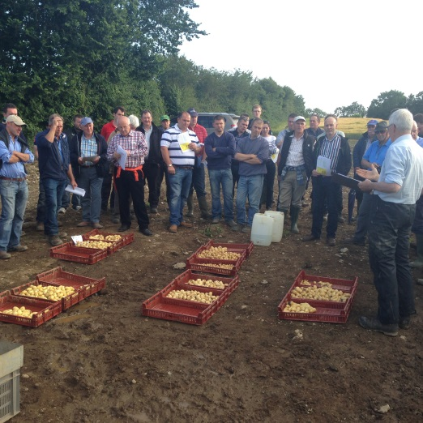
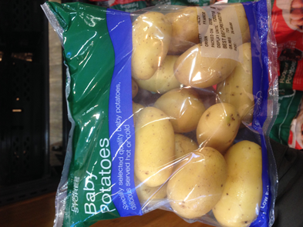



Salad Potato Project
Michael Hennessy
Head of Crops and Energy Knowledge Transfer, Teagasc

Slide 2
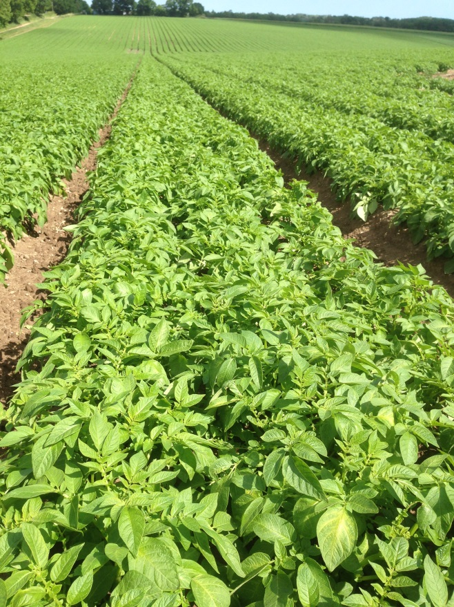
Introduction
Background
Objectives of the program
Highlights
Results
Future

Slide 3
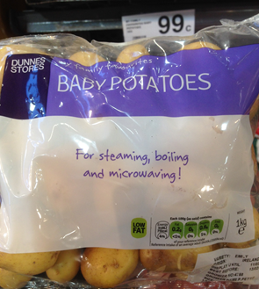
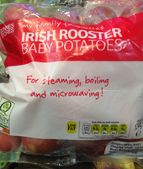
Background
Main crop profitability and market access
  Drop in consumption
  Increase consumption in other potato categories
  Diversification necessary
Diversification options
  Utilise machinery and infrastructure
  Seed, processing, chipping opportunities
    Salad Potato?

Slide 4
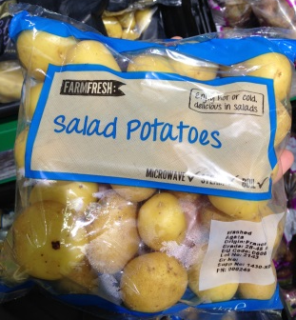
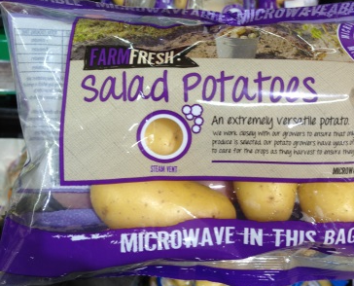
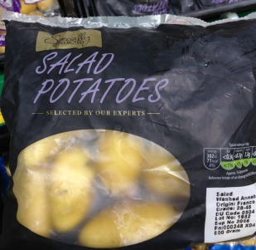
Industry Statistics
Salad Potato market
  Multiple trade 20,000t (6-7% of the Ware Market)
    Plus restaurant & catering trade
Imports make up the balance
Opportunities for Irish produce
Estimated Irish Production
(IFA figures) | 2013 | 2014 | 2015
Area (hectares) |  | 130 | 148
Irish Production (t) | 3070 | 3200 | 3650

Slide 5

Salad Potato Working Group
Working group set up to investigate Salad Potato potential
  IFA, Bord Bia & Teagasc
Key objectives
  Grow the market for indigenously salad potatoes
  Increase the tonnage grown in Ireland
  Increase the number of growers
  Improve growers knowledge
  Leave a legacy of information

Slide 6
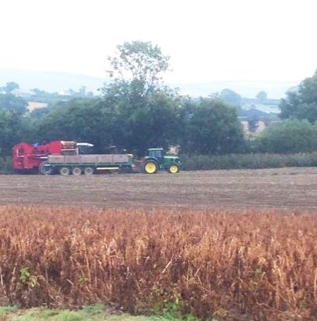
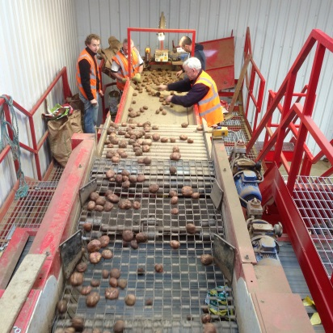
How Salad Potatoes can fit?
Alternative to ware
  Target different market segment
  Higher value market
Agronomic considerations
  Sown later
  Harvested earlier
  Use same equipment (with adjustment)
  But
  Higher risk (alternative markets)
  Equipment costs
  Irrigation a necessity

Slide 7
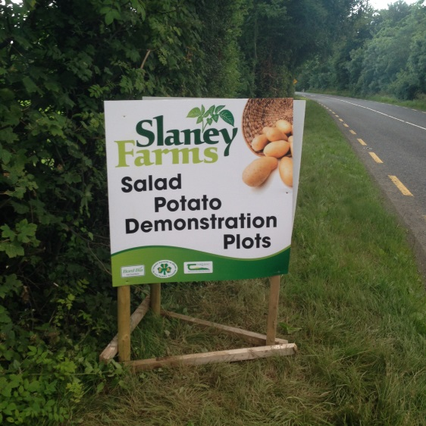
Program 2015
Key meetings for information dissemination
  April, May, July and September
  Establish information gaps
  Target existing growers to help production base
  More widely inform potato growers of salad potatoes
Demonstration farm
  John Stafford, Wexford (Slaney Farms)
External collaboration
  Dr. Stuart Wale, SRUC, Scotland
    Potato researcher/consultant

Slide 8
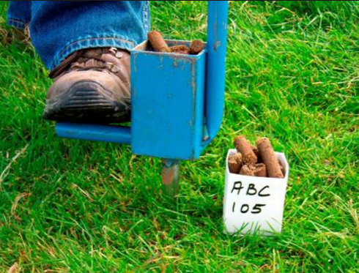
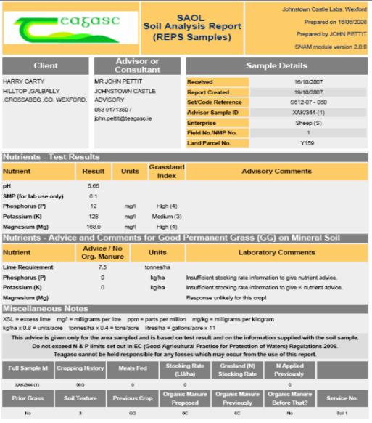
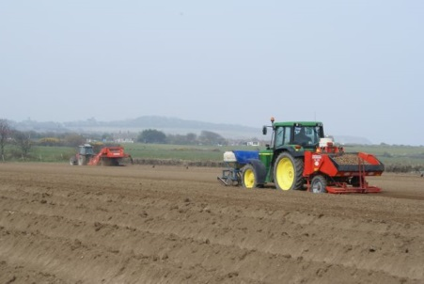
Program 2015
Meeting 1 (Planning for the season , April 2015)
Key outcomes
  Market Specifications (size 25-45 or 47)
    Skin finish critical, Variety & Yield
    Rejection - no market- no sale
  Agronomic issues
    Soils, machinery, irrigation, PCN, Black dot
  Important of soils & fertility
    Free draining, long rotation, free from disease, irrigation
    Phosphorus & tuber set
  High stem numbers (high tuber counts)
    Seeding rate critical role

Slide 9
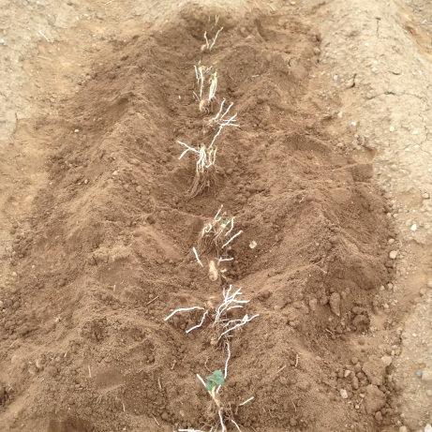
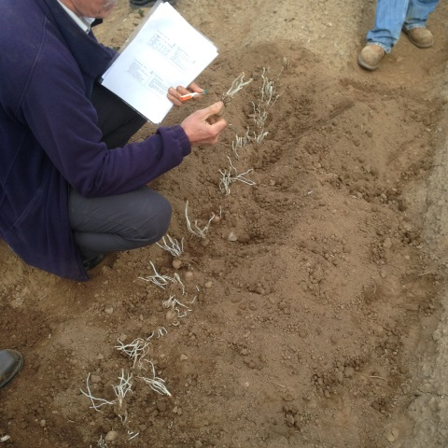
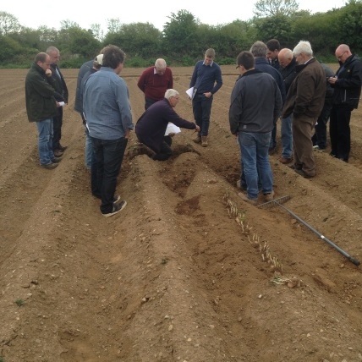
Program 2015
Meeting 2 (Field visit – assessing planting and planning irrigation)
Field Demonstration (Maris Peer, Charlotte, Jester, Jazzy, Imagine)
Key outcomes
  Seeding rate and placement
    Split grading
    Differential in spacing from intended of 17-54%
  Stem numbers and association with tuber numbers
  Phosphate help to drive tuber numbers
  Irrigation and its interaction with skin finish (common scab)

Slide 10
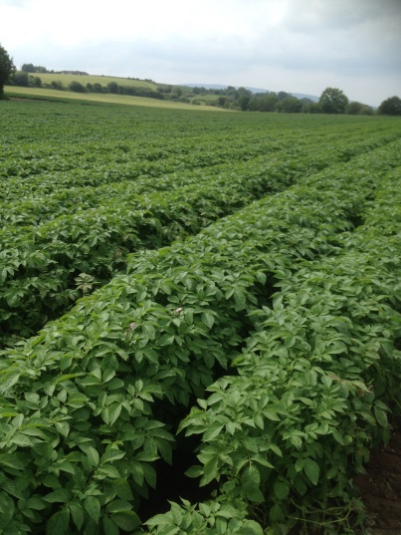
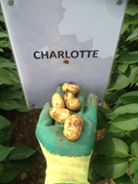
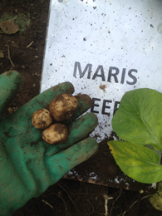
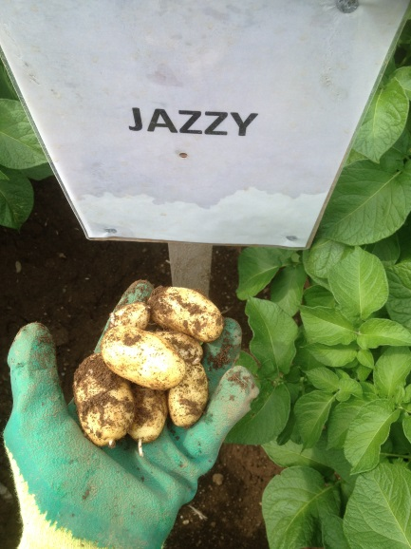
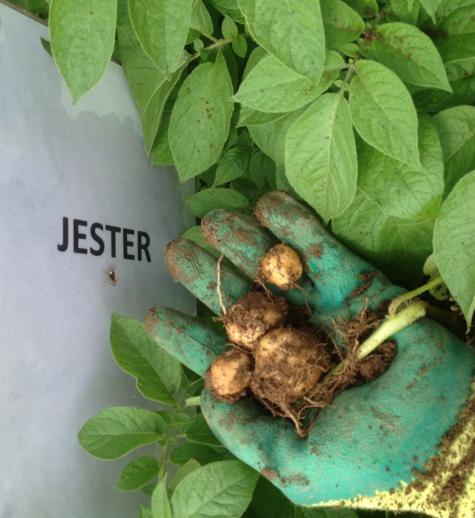
Program 2015
Meeting 3 (Field visit prior to burn off, July)
Key outcomes
  Test digs critical to assess size
  Emerged May 25-30th – burn off July 20-25th
    Burn off 7-8 weeks after emergence
  Large differences in variety tuber size/distribution
  )

Slide 11
Test dig results (Demonstration only)

Slide 12
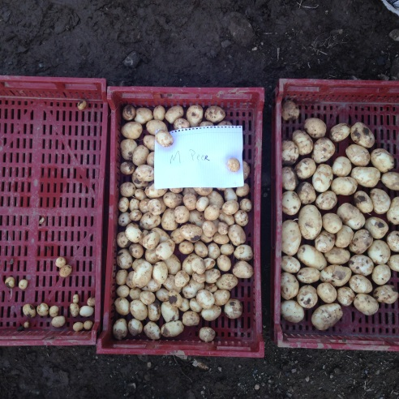
Program 2015
Meeting 4 (Salad Potato Storage)
Key outcome
  Maris Peer
    Good numbers & skin, yields a bit low
  Jazzy
    Excellent yield, skin a bit dull, early sale
  Charlotte
    Good quality (but skin) with reasonable yield
  Jester
    Huge numbers, quite a bit under spec, good skin
    Jelly end rot (early sale)
  Imagine
    Good yield and skin, divided opinion as to market
Notes:
Harvest critical – too dry waited for rain and harvested straight afterwards - could get it wrong!!
All had DM 17-18%
Jazzy low DM did not register but cooked similar to others
Jester seed issue

Slide 13
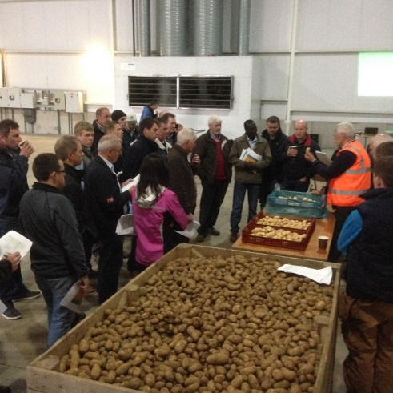
Program 2015
Meeting 4 (Salad Potato Storage)
Key outcome
  Long term storage of salads potatoes is possible
    Increased level of detail needed
      Preserve Skin finish and moisture
        Drying and ventilation
        Storage temperatures
  Higher profitability
    Yes but …
      High yields and price needed
      Increased risks

Slide 14
Profitability
Main Crop versus Salad Production (Demonstration Plots)
Cost | Main Crop* €/ha | Salad (demo) €/ha
Seed | 1250 | 2565
Fertilisers | 600 | 529
Other Variable inputs | 770 | 680
Machinery | 2360 | 1786
Misc. Costs | 135 | 130
Irrigation |  | 500
Total Costs | 5115 | 6190
* Teagasc Costs and Returns 2015
Notes:
Main crop = Gross margin /ha = €72
Rental (350/ac)= €21
Storage

Slide 15
Profitability
Main Crop versus Salad Production (Demonstration Plots)
Cost | Main Crop | Salad
Total Costs (€/ha) | 5115 | 6190
Price €/t | 200 | 350
Yield t/ha | 40 | 30
Gross Margin €/ha | 2885 | 4310
Low Yield t/ha |  | 25
Gross Margin €/ha |  | 2560
Low Yield t/ha & low price (€250/t) |  | 25
Gross Margin €/ha |  | 60
Notes:
Main crop = Gross margin /ha = €72
Rental (350/ac)= €21
Storage

Slide 16
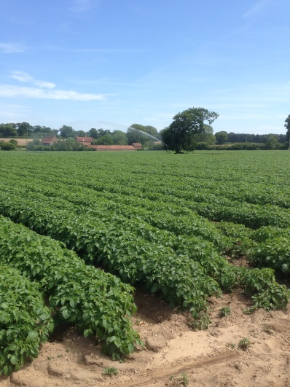

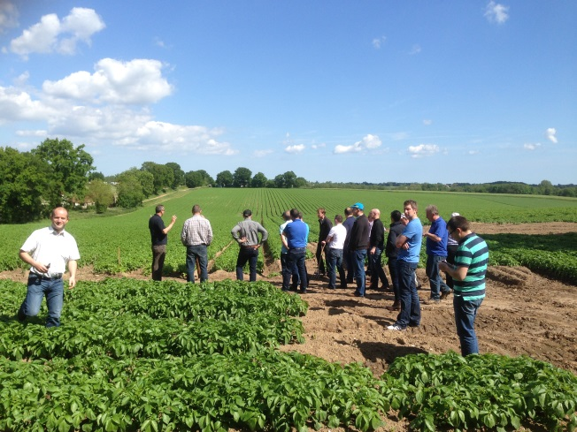
Lessons from UK salad growers
Multiples want variety exclusivity
Growing to a contract price
Specialist salad growers
  Quad planting increase yields
    15% compared to single row
Tight financial margins

Slide 17
Salad Potato initiative 2016
Program description
  Slaney Produce (John Stafford) host farmer
    Test plots on 3 farms
    Demo plots in Oak Park
  key meetings
    Linkage with SRUC
    Site selection
    Planting
    Storage key factors
All potato growers welcome to meetings

Slide 18
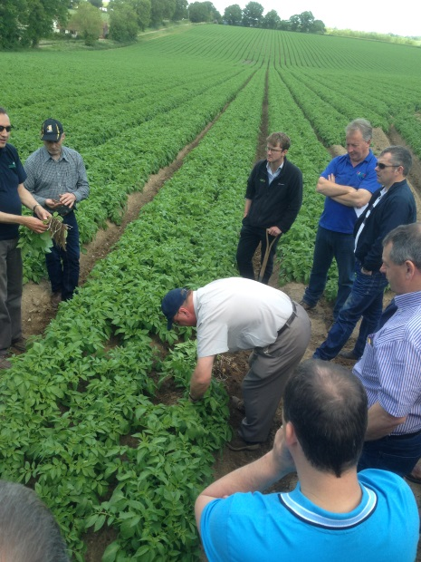
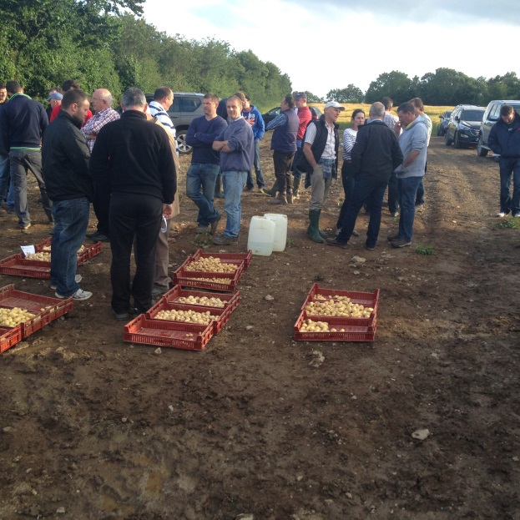
Thanks for your attention
Questions?

