Slide 1
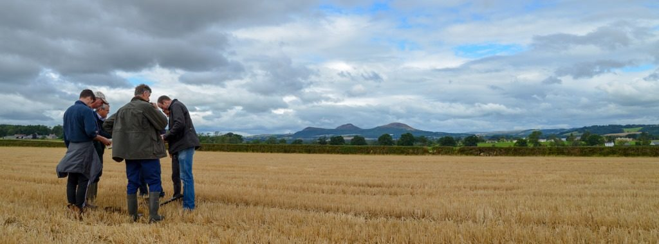
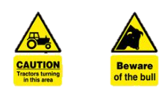

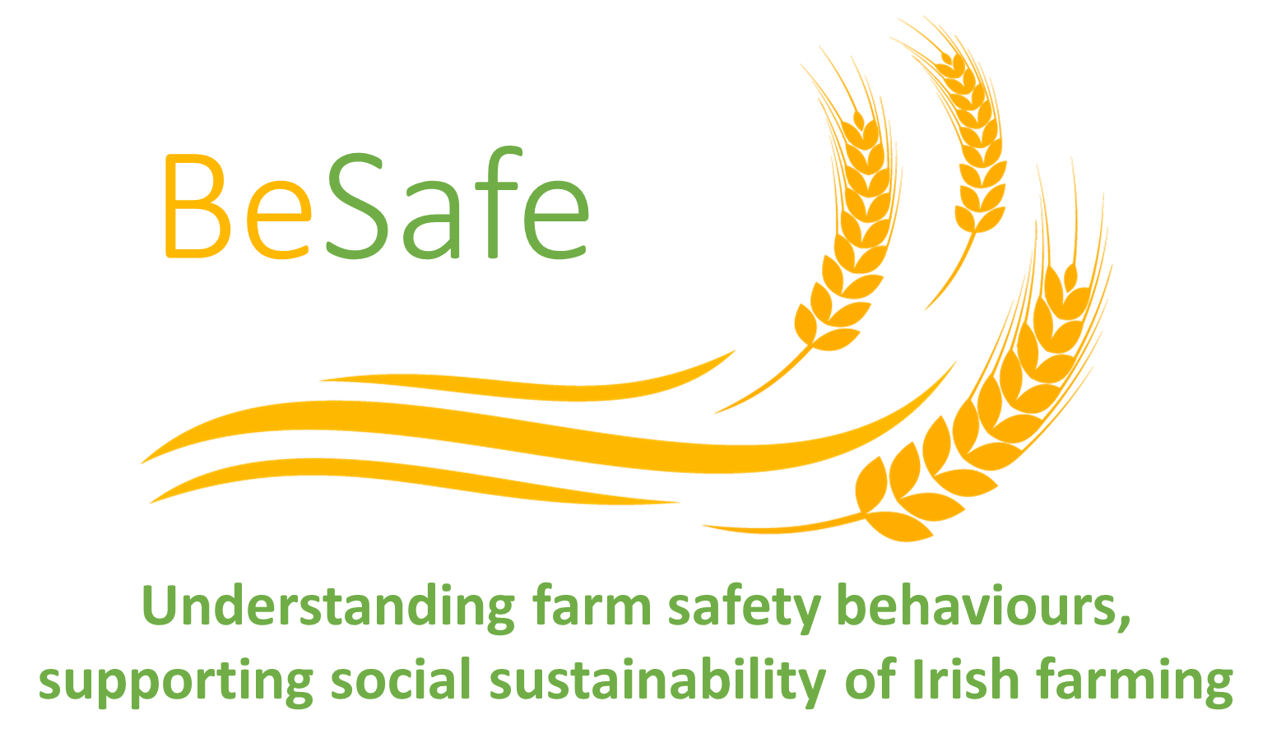
Dr Mohammad Mohammadrezaei, Dr David Meredith, and Dr John McNamara
Who is Safe?
Reshaping good farmer identity: a way to move form intention to sustainable action
?
Take risks
Behave safely

Slide 2
What our research says?
Roughly 60 % of farmers are unsafe, however most of farmers are willing to be safe in future
Farmers typically take risks as they believe that it is what a good farmer does and ‘important others’ in local community think safety isn’t a priority
They are also risk optimistic as they don’t think accidents will happen to them which is supported by ‘other important others’ in local community
But
Roughly 26% of farmers are safe mostly because they believe a good farmer is a safe farmers supported by ‘important others’ views/thoughts.
17% of farmers are slightly safe and behave safe regardless they still believe a good farmer is a risk taking farmers (if supported, they will be safer and sustainably behave safe).
Interestingly safer farmers are from all ages, genders, enterprises but they are less visible/connected to other farmers
Safe farmers and their ‘important others’ are the key social capitals to be effectively involved in in co-design community based interventions helping other farmers from the same background to change their mind

Slide 3
What is the issue?
Despite positive impacts of this approach, in particular, in identifying the risks and vulnerable groups
Push demand
Top-down approach
Awareness raising on risks,
safety skills/tools
Despite different
OHS acts
practices,
engineered solutions
and educational programmes targeting farm safety(OHS)
Targeting farmers’
safety Knowledge
Awareness
Perception
Attitude
Farming is still the most dangerous occupation
Technology adoption approach has been used
Being aware of risks/dangerous, tools and skills needed haven’t cause a safer behaviour
The extensive research has focused on understanding the characteristics of farm-related accidents rather than understanding farmers decision making towards farm safety.
As such, a more farmer centric approach based on decision making is needed.

Slide 4
How does decision making towards safety looks like?
Pro-environmental actions
Safety behaviour
Like almost all challenging behaviours
(known as new farming paradigms)
Typical Assumptions
Extrinsic motivators
One-way fellow training (formal education), upskilling farmers, easing the barriers (e.g. financial supports, incentives) can change the level of awareness/knowledge and values and perceptions
Knowledge and skill
They might be willing if the become aware of benefits, trained, and well competent (particularly for technology-based actions)/enhancing technical knowledge
Intention
Once farmers become willing, they will perform the behaviour can result in behavioural change
(farmers are not willing to perform a behaviour)
Less likely to change their behaviour
Now willing but not necessarily in the future
(inconsistent willingness) relied on short terms interventions/incentives (Trigger but nor more)
Why typical assumptions are not working when it come to farmers decision making?
Are social, cultural, and behavioural factors (intrinsic motivators) the game changers?

Slide 5

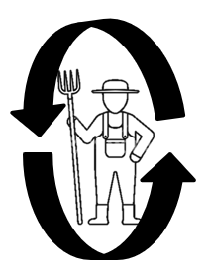
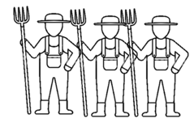
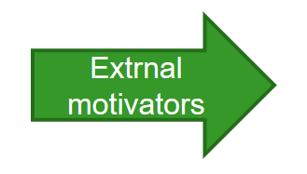
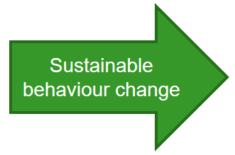
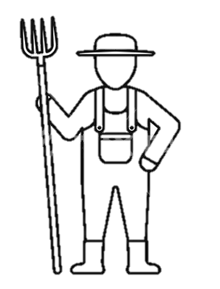

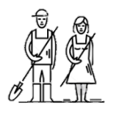
How does decision making towards safety looks like?
Pro-environmental actions
Safety behaviour
Like almost all challenging behaviours
(known as new farming paradigms)
Redefined Assumptions
Farm advisors/vets
Other farmers
Farmers may build up their values, norms, beliefs, perceptions collectively in the local community (where they belong)
Who are the important others in such environments? (formal bodies might not be the main)
How do the important other think and act?
Can we reach out the important others?
Farming environment is not a static environment
Farmers have already shaped their identity, values, beliefs, norms by communicating with key important others
(peer to peer learning, social acceptance, confirmation/pressure)
All new technologies/practices, might be perceived important/favourable, easy to preform, socially accepted, and finally what a ‘good farmer’ is expected to do
Leading farmers
Family members
If
They are well tailored to these values through involvement of ‘important others’
Accepted by leading farmers from local community (pro-environmental behaviours)
Facilitating communication between leading and the rest on target behaviour

Slide 6
Research design
How is safety decision making shaped?
What are the key social, cultural, psychological factors?
How we can maximise our impact on moving from intention to action?
Theory and approach
TPB
Nature of safety behavior
Designing
the stories
Screening all descripting of fatal accidents since 2004
Validating the final stories
Multiple meeting with advisors and experts
Need for accurate tool/approach
Validating the questionnaire
Survey implementation
List the most frequent accident scenarios
Draft the first stores (tractor/machinery, Livestock)
Sampling the proper stories
Framing the questions based on each story
Validating and piloting the questionnaire
Both online and printed questionnaire assigned to advisors
They were asked to circulate the survey to at least one lagging, conventional, and leading client
Farms where machinery/tractor and livestock might be risk factors where selected
It took almost 18 months but worthy
To think deeper in taking the proper theory and approach:
Contradiction between qualitative and quantitative findings (on the same issue and in the same community)
Quantitate studies: lack of accurate, validated tool (lack of nationwide study), resulting in optimistic responses (e.g. inaccurate general positive statements)
So it was like, no one think safety not important, all wishes to be safe but why they still get injured/killed?
Qualitative studies: farmers feel safety costly, time consuming, impossible, not important, poor risk perception, not valued by the whole community in different occasions etc.?!
Solutions:
Using the farmers’ values, beliefs, perceptions, (qualitative findings) in framing questions (quantitative study)
Defining the real life occasions where farmers are more likely to compromise safety and take risks (application of vignette for the first time!)
How are advisors’ intentions with regard to OHS shaped?
Descriptive analysis (who were surveyed?)
Causal correlational analysis (SEM analysis) (How do farmers make their decision?)
Cluster analysis (Who are safe and unsafe? What makes farmers to be in different cohorts? How we can deal with each cohort?)

Slide 7
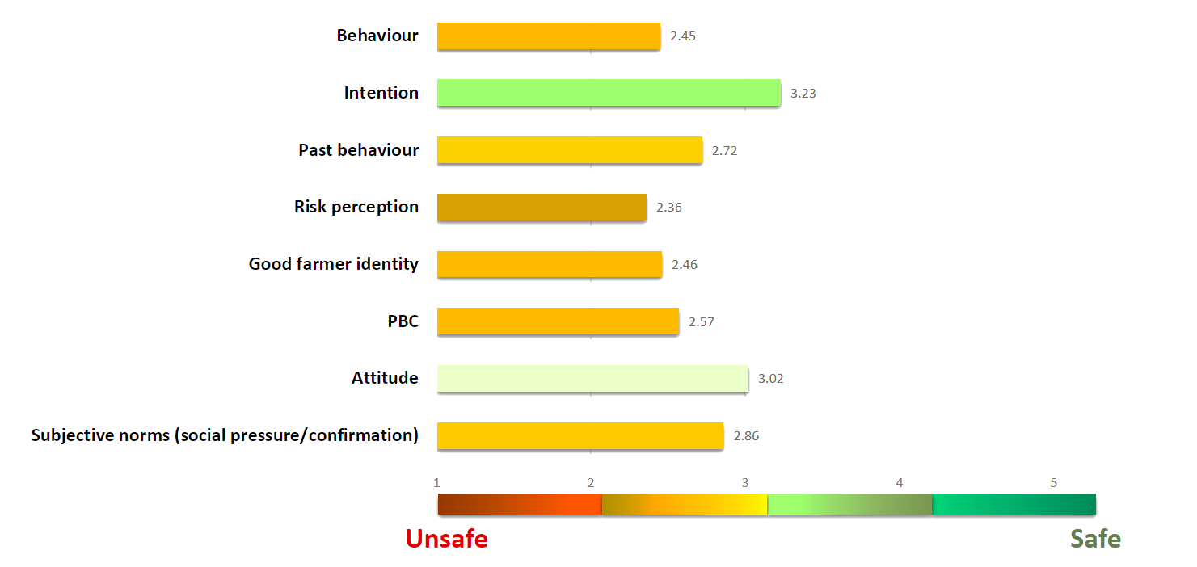
Behavioural and attitudinal factors
(On average)
Not safe
Slightly willing?
Safety is not a habit
Risk Optimistic
Unsafe farmer is a good farmer
It is not always possible to be safe
Safety not important nor unimportant
Safety isn’t what the important other think/do

Slide 8
Modelling farmers decision making towards farm safety
How are factors correlated?
Variables | Subjective norms | Attitude | PBC | Good farmer identity | Risk perception | Past behaviour | Intention | Behaviour
Subjective norms | 1 | 0.58** | 0.62** | 0.75** | 0.68** | 0.59** | 0.51** | 0.68**
Attitude |  | 1 | 0.36** | 0.56** | 0.61** | 0.40** | 0.48** | 0.38**
PBC |  |  | 1 | 0.54** | 0.69** | 0.48** | 0.59** | 0.51**
Good farmer identity |  |  |  | 1 | 0.69** | 0.59** | 0.68** | 0.73**
Risk perception |  |  |  |  | 1 | 0.49** | 0.63** | 0.65**
Past behaviour |  |  |  |  |  | 1 | 0.61** | 0.58**
Intention |  |  |  |  |  |  | 1 | 0.43**
Behaviour |  |  |  |  |  |  |  | 1
Subjective norms is strongly correlated with Good farmers identity
Good farmer identity is strongly correlated with behaviour
Intention is moderately correlated with behaviour?!

Slide 9
Modelling farmers decision making towards farm safety
(a bit complicated but important)
Past behaviour
(R² = 33%)
0.24**
0.29**
0.16**
Good farmer identity
(R² = 63%)
0.44**
0.23**
Risk perception
(R² = 62%)
0.38**
0.15**
0.44**
0.19**
0.14**
0.29**
0.43**
0.36**
Intention
(R² = 36%)
Behaviour
(R² = 51%)
0.53**
Attitude
(R² = 56%)
0.21**
0.16**
0.24**
Subjective norms
(R2 = 36%)
0.29**
0.34**
0.32**
0.18**
0.18**
0.10**
0.28**
Perceived behavioural Control
(R² = 44%)
0.33**

Slide 10
Who are safe?
Just a quarter of the population are safe
Is the transition happened?!
57% of farmers are still unsafe
26% of farmers are Safe
Unsafe
Safe

Slide 11
Who actually they are?
Safety cohorts | Very unsafe | Unsafe | Neutral | Safe | Very safe
Gender | Same | same | same | same | Same
Gender | same | same | same | same | same
Education | same | same | same | same | same
Work status | same | same | same | same | same
Enterprise | same | same | same | same | same
Farm size | same | same | same | same | same
Herd size | same | same | same | same | same
Work ours spent on farm/off farm | same | same | same | same | same
On farm employment/off farm employment | same | same | same | same | same
In fact, from all ages, genders, enterprises, education levels, and business factors you may safe or unsafe farmers
So, a leading farmers (pro-environmental) might be unsafe and vice versa.

Slide 12
Who actually they are?
Safety cohorts | Very unsafe | Unsafe | Neutral | Safe | Very safe
COP | Mostly no | Mostly no | Mostly yes | Mostly yes | Mostly yes
Severe injury | Mostly no | Mostly no | Mostly no | A few (yes) | A few (yes)
Sever injury to someone | Mostly no | Mostly no | A few (yes) | A few (yes) | A few (yes)
Hearing from injuries | A few (yes) | A few (yes) | Mostly yes | Mostly yes | Mostly yes
Hearing for deaths | A few (yes) | A few (yes) | Mostly yes | Mostly yes | Mostly yes
WOT | Mostly unorganised | Mostly unorganised | Slightly organised | Well organised | Well organised
Farmers (as important others) | Yes | Yes | Yes | Yes | Yes
Family (as important others) | Yes | Yes | Yes | Yes | Yes
Advisors (as important others) | Yes | Yes | Yes | Yes | Yes

Slide 13


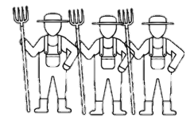
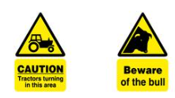
What is in their mind?
(Unsafe farmers)
Past behaviour
What I have been doing is fine even though it is not safe
Others confirm the way I do my job
We are used to this
Good farmer identity
So taking risk is expected to a good farmer does
A good farmer is who that take risks
I Take the risk
?
Current risky situation
A Trade off?
Other farmers
Family members
Farm advisors/vets
Think that
Safety is not a priority
It is important to take risk, to get the job done
It is waste of time/not possible always
I behave safe
Farmer
Intention
I will be safe in the future
I intent to take safety actions
Who doesn’t want to be safe in the future
Maybe next time
Optimistic risk perception
It is not that dangerous (it doesn’t happen to us)
It might happen to someone else
External motivators

Slide 14
What about safe farmers?
What is in their mind?
Past behaviour
What I used to do was too dangerous
I was doing thing in really hazardous ways
Good farmer identity
So being safe is expected to a good farmer does
A good farmer is who behaves safe at all time
I behave safe
?
Current risky situation
A Trade off?
Other farmers
Family members
Farm advisors/vets
Think that
Safety is very important and a priority
It is important to be safe even if it takes time, cost, etc.
Farmer
I take risk
Intention
I will be safe in the future
I intent to take safety actions
Who doesn’t want to be safe in the future
Risk Averse
Take risk may cause sever injure, deaths
The chance of incidents/accidents is too high
Not at al!
External motivators

Slide 15
Why safety behaviour is unique?
(challenging but different in the nature)
Applying this redefined assumption in farm safety studies
Novel but challenging!
Pro-environmental actions
Safety behaviour
Our literature review on the application of behavioural theories in explaining farmers decision making highlights that
Regarding pro-environmental behaviours,
To shape collective values, norms, beliefs, perceptions and finally ‘good farmer identity’
  Engaging leading/sustainable farmers in communicating and sharing their views. Thought. Values with the rest of community
  The change in definition of ‘good farmer identity’ and behaviour (transition from intention to action) has happened (not too much though!).
What about farm safety behaviour as
Being safe is what a good farmer is expected to do?
Why farmers which to be safe tomorrow not today?!
There is almost a clear definition of sustainable farmers
Highly educated, younger age profile
Better economic/business status
Leading in production, adoption of other technology
Socially supporting/impressing other farmers
Positive attitude, perception
Willing and performing the behaviour
Becoming a social value
Being recognised a part of exciting culture
A farmer might be leading (pro-environmental behaviour but lagging in ‘safety behaviour’
All ages (younger and older)
Male and female farmers
From high to less educated
From high to less experienced
From leading to conventional farmers
Safety is not a norm and socially valued
Safety is not the topic of discussion by all actors

Slide 16
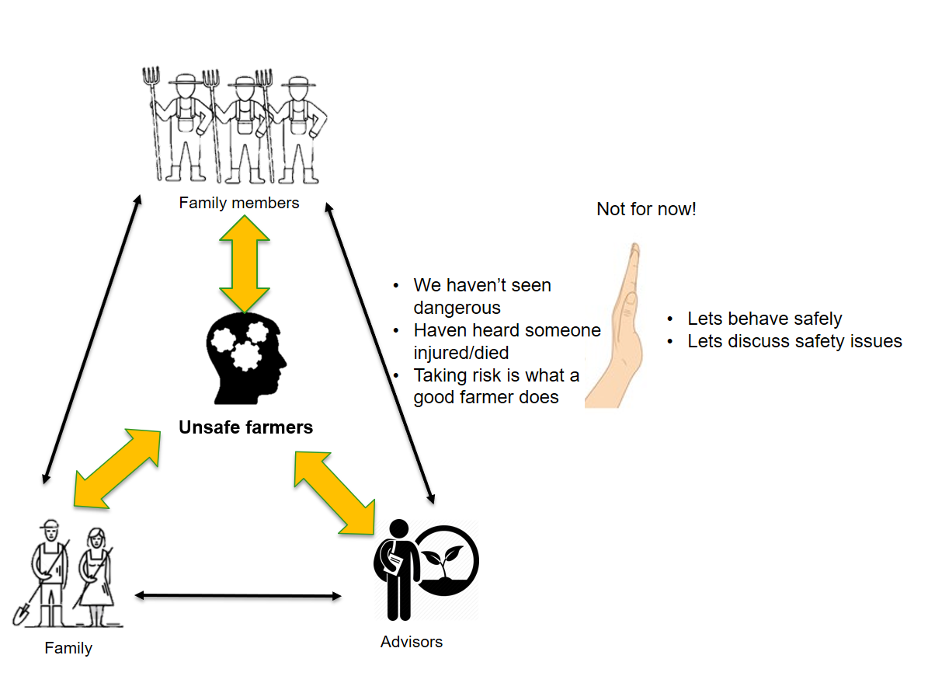
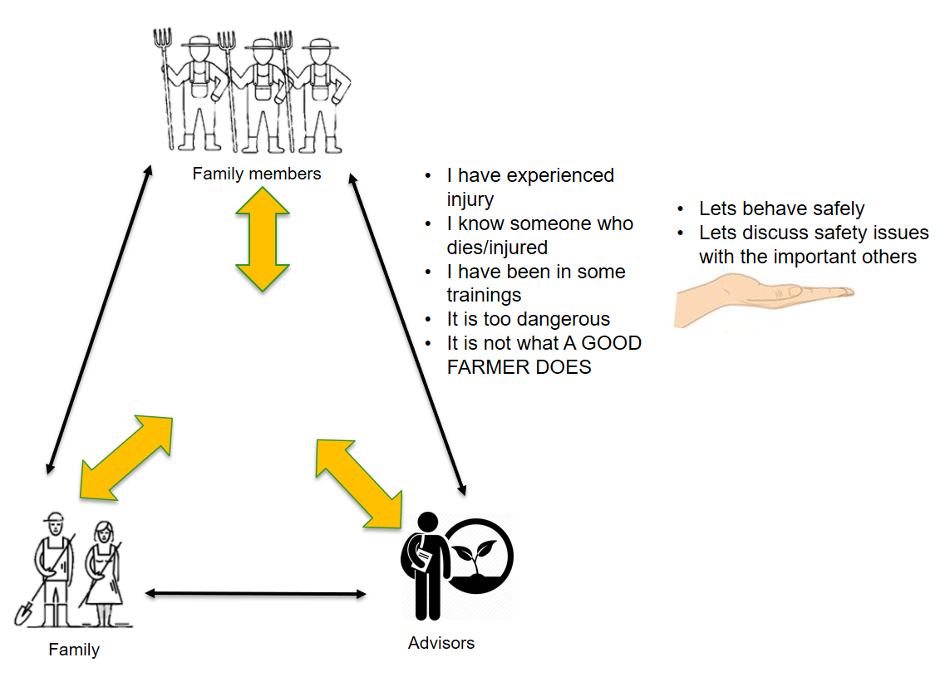



Recommendations
Communication and engagement
(consolidation)
Triggers
Neither safe nor unsafe
Safe farmers
Unsafe Farmers
Community based approach (Discussion groups)
In-formal talks (family members, farmers, advisors)
Hearing from incidents
Experiencing incidents
OHS training and programmes

Slide 17
How to accelerate the transition
(Using the social capitals)
They are safe but silent/not leading
Consolidation of identity
Empowerment
To facilitate farmers to tell their own stories and to share their similar experiences (establish their own safety network)
Important others (family, farmers, advisors) to involve in the discussion, co-design workshops or training
Empowering safe farmers and facilitating them to engage in farm safety community based programmes and trainings

Slide 18
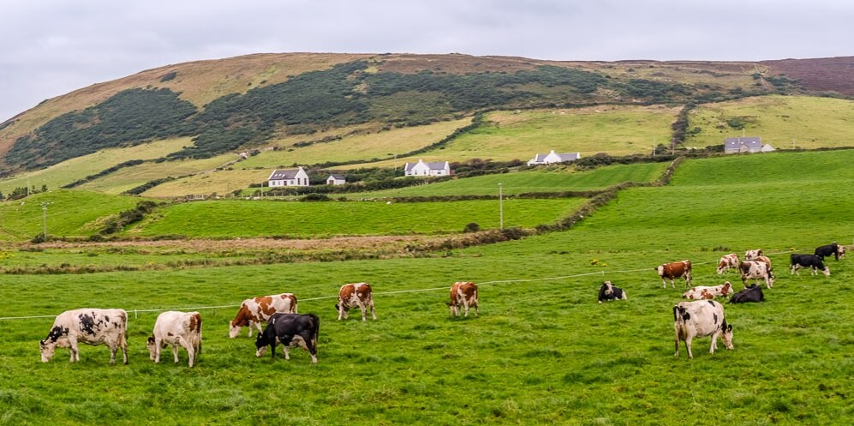
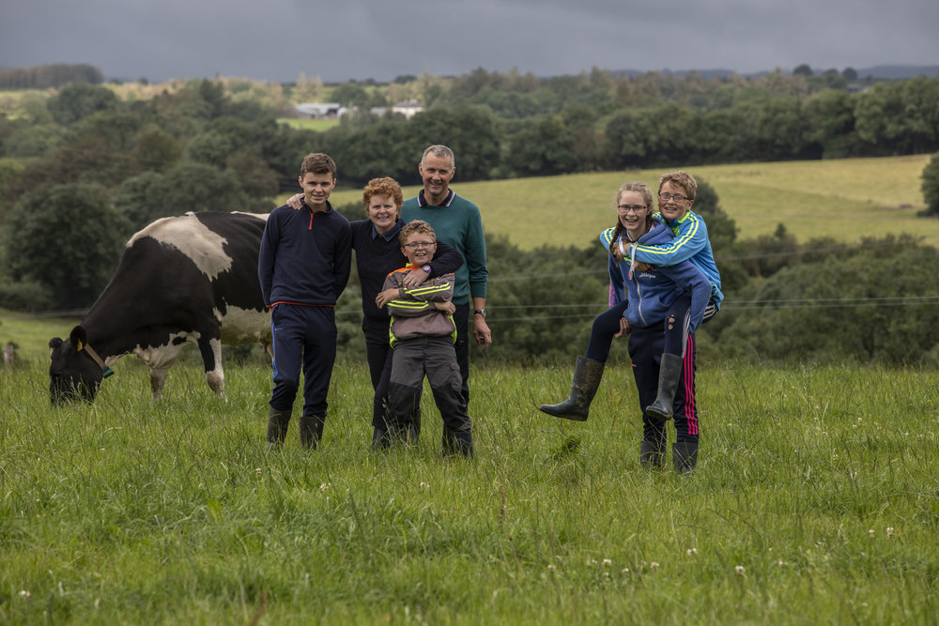
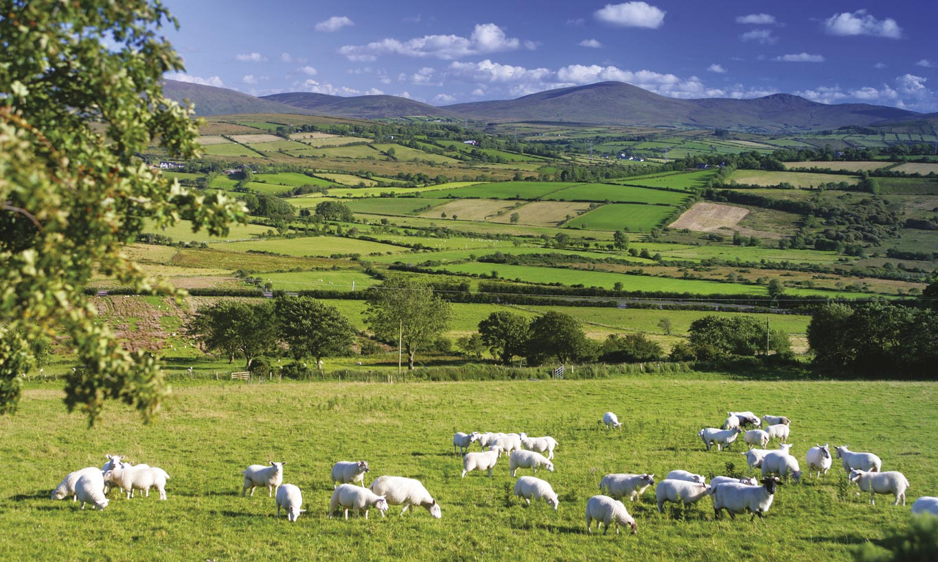
Thank you for your attention!
To know more about BeSafe :
https://www.teagasc.ie/rural-economy/rural-economy/besafe-project/

