Slide 1
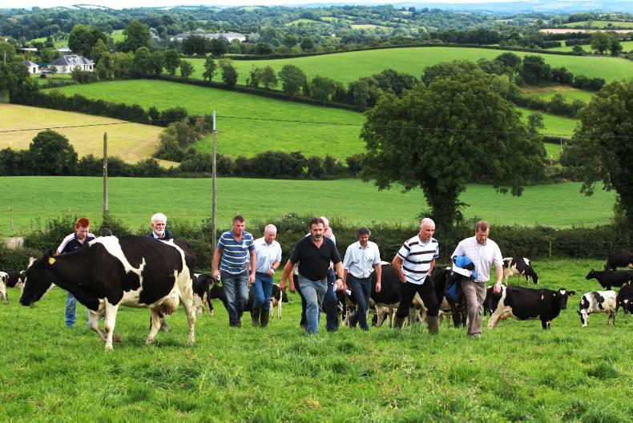
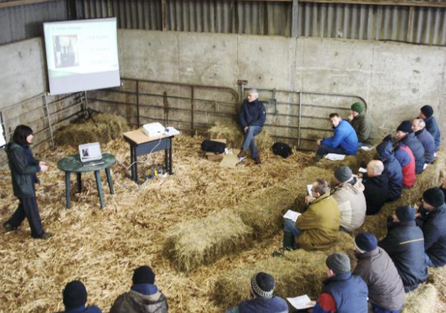

Dr Mohammad Mohammadrezaei, Dr David Meredith, and Dr John McNamara
Are farm Facilitators (Advisors/consultants) reluctant to discuss farm health and safety? A psychosocial assessment of intentions.

Slide 2
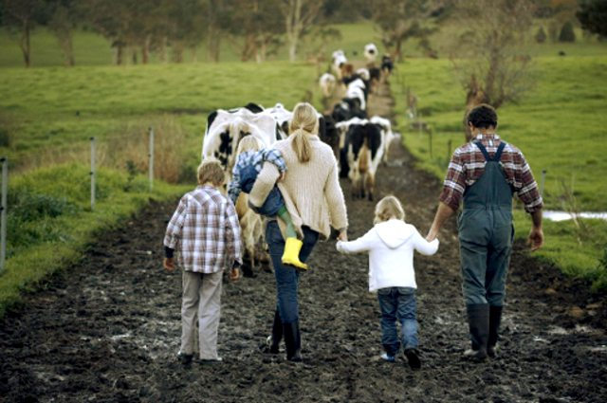
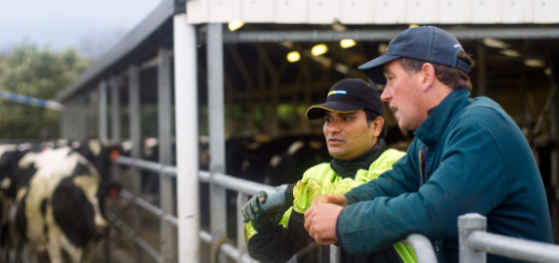
Background: Supporting Farm Safety Culture Change
The traditional information and knowledge tranfering
In tension with existing cultures
Very slow pace of change / not sustained / rejected
?
The role of cultural factors
Social influences
Different people in local community
Important in shaping attitudes, beliefs, perceptions
Recent research

Slide 3
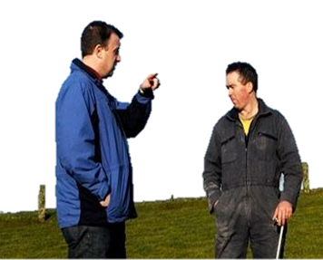
Background: The role advisors
Farm Health and Safety as new “Farming Paradigm”
Challenging for both Farmers and Facilitators
OHS traditional education approach
Adoption of Regulations
Effective tools for delivering
But
Due to social influences / existing culture there are barriers
Formal training / upskilling Facilitators (Advisors/Consultants)
Well-equipped to deliver and follow up on FHS Initiatives as part of their work
?
Farmers are aware of risks
Risk taking is in the nature of farming - sometimes rewarding

Slide 4
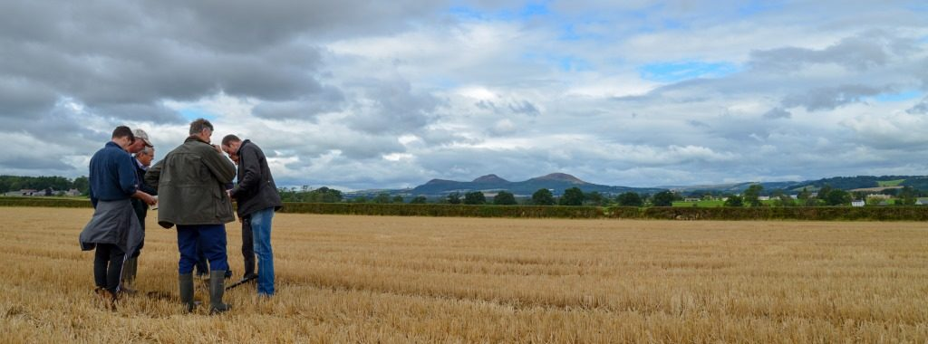
Background: Advisors and safety culture
The interactive nature of advisors roles has been overlooked
Push demand from government and organizations resulting in top-down training which seeks to support advisors engage farmers with FHS by improving awareness and attitude.
Little evidence demonstrating the impact of these types of initiatives on advisor’s intentions / behaviours challenging FHS issues
How are advisors’ intentions with regard to OHS shaped?

Slide 5
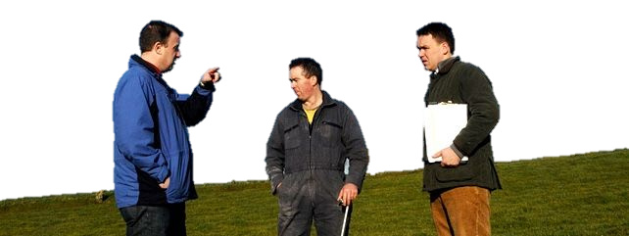
Background: Facilitators engagement in raising challenging issues
Some studies (mostly qualitative) highlight the role of psychosocial factors in shaping advisor’s intentions
In favour of the topic
Is it (culturally) acceptable to farmers?
Is there a possibility of losing clients, their trust or respect?
Is it a priority for farmers?
The topic aligns with their professional identity, however...
How do facilitators’ attitude, beliefs, perception, and identity influence their intention to engage in knowledge exchange.

Slide 6
The study objective
This study seeks to assess the role of psychosocial factors affecting facilitators’ intentions to discussing FHS
Theoretical background
Theory of planned behaviour (Ajzen, 1985, 2006)
It is a widely used theory explaining various farmers behaviours like FHS
It includes the role of social influences
Past study distinctively confirm the role of components in TPB even in advisors intention (e.g. qualitative ones) (Eastwood et al., 2019; Nettle et al., 2018; Klerkx et al., 2010; Hossain et al., 2009; Hansson, 2008)
There is a gap quantifying the direct and indirect effects of TPB components
No evidence understanding advisors intention

Slide 7
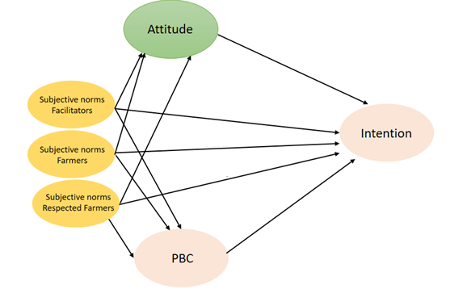
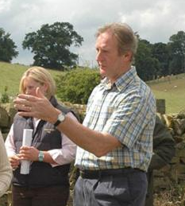
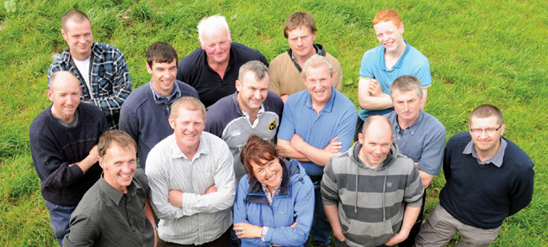
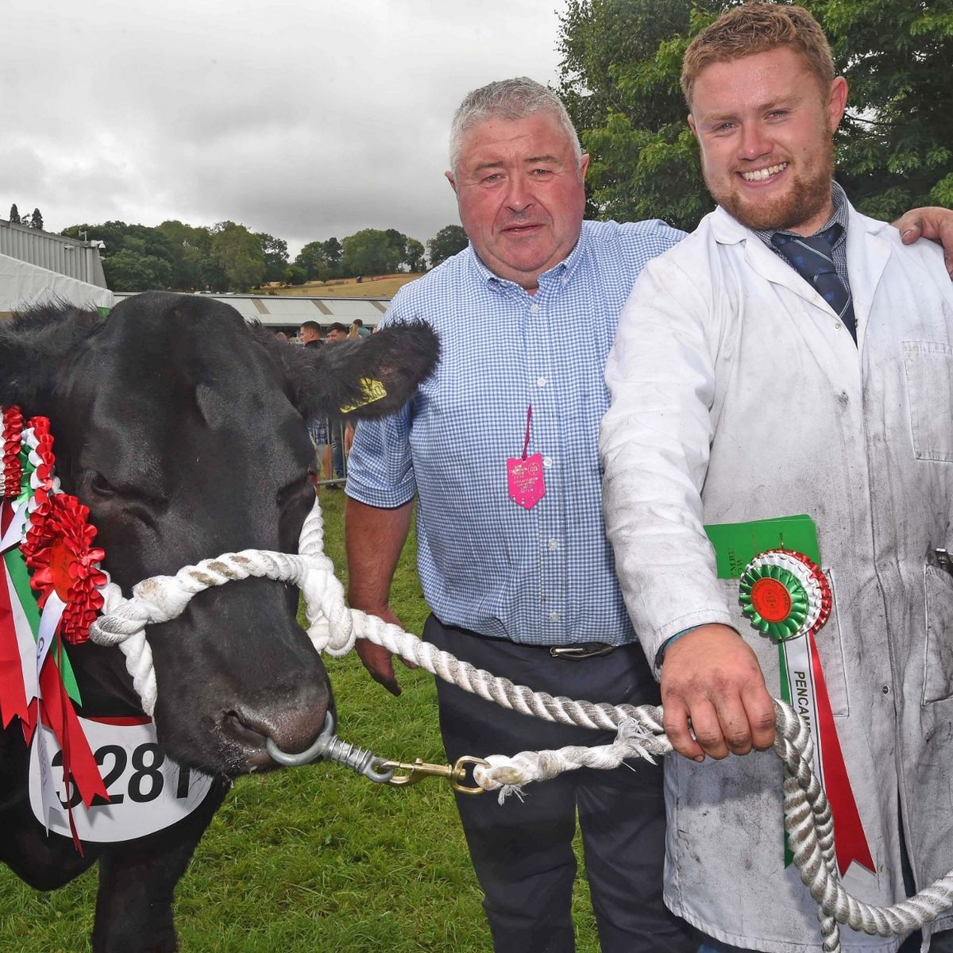
Materials and Methods
Hypothetical model
Behaviour
Data collecting technique
Cross-sectional online survey (139 advisor/consultants) in Ireland
Pilot test (30 advisors outside of study sample)
Confirmatory Factor Analysis (CFA)
Structural Equation Modelling (SEM)
SPSS (version 24), R studio, LISREL (version 18)

Slide 8
Results: Descriptive
Other factors are shaping their views
Advisors are reluctant to engage with the issue
(Low)
(High)

Slide 9

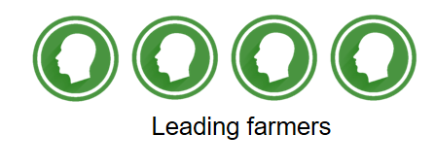
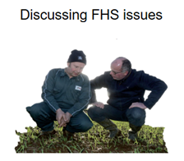



Results: SEM analysis (Experimental model)
.71**
.16**
.14**
R²=62%
.45**
.05**
Social confirmation/pressure
.68**
.26**
.29**
.13**

Slide 10
Results: in summary
This study was one of the first attempts showing how safety culture can affect advisors
Advisors are not socially confirmed by leading farmers or
other farmers
Perceive social pressure from leading and other farmers
Low social confirmation from other facilitators
There is also no social confirmation from other facilitators
They feel it is out of their control and confident to discuss
Fear of losing leading farmers, trust
Advisors are reluctant to discuss FHS
No pull demand
FHS is not favourable as they do not see FHS issue as a favour or priority of leading farmers and others

Slide 11
Implications and Recommendations
In this study we found that facilitators (advisors/consultant) are reluctant to engage with the issue of FHS
Activating the positive social influences from leading farmers is critical to influencing their intentions
Accordingly, there is a need to apply a socio-ecological model (interpersonal interaction) in designing FHS initiatives targeting advisors mainly through knowledge exchange (interactive, communicational, co-design interventions)
There is still a need to measure the impacts of different communicational skills and approaches between leading farmers and advisors in discussing challenging issues like FHS

Slide 12
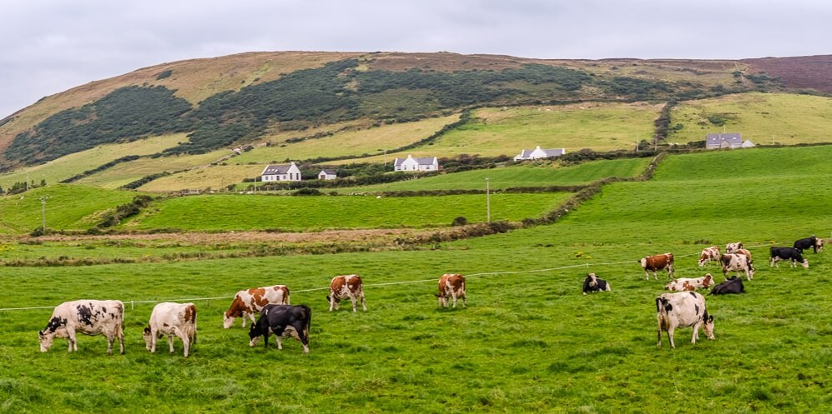
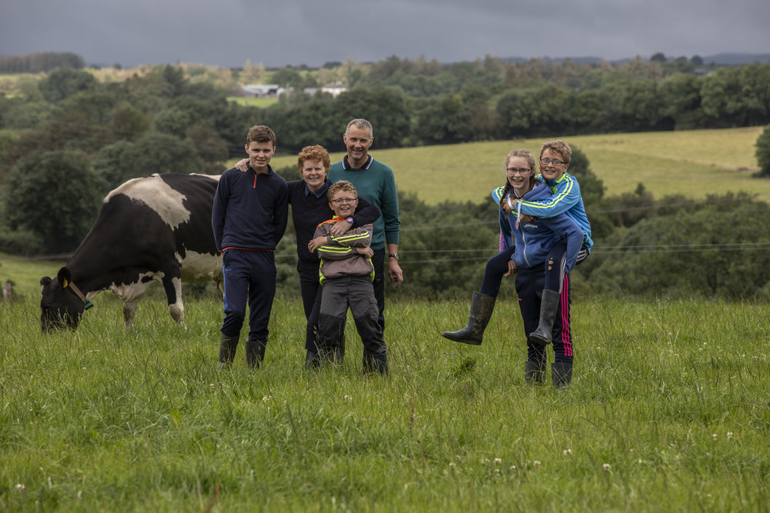
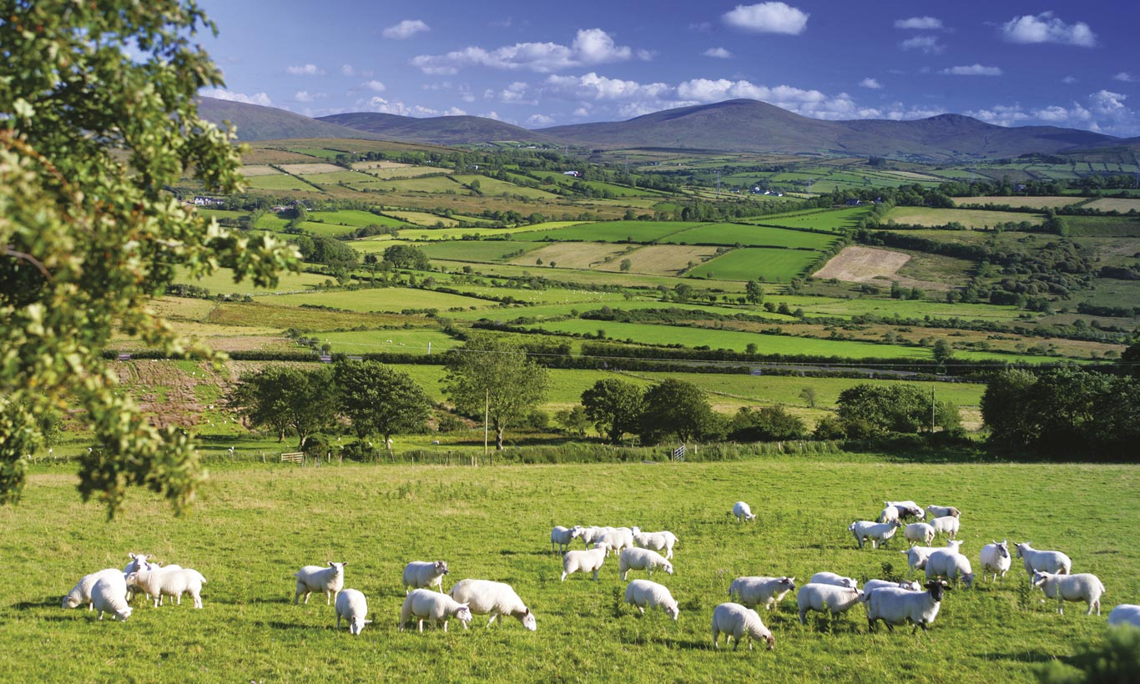
Thank you for your attention!

Slide 13
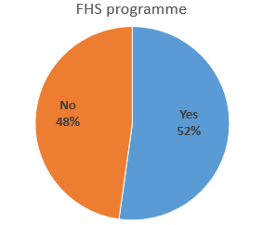
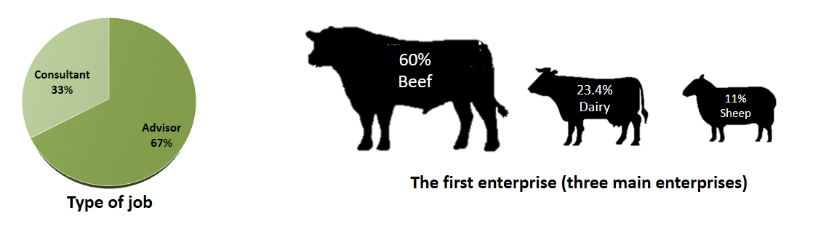
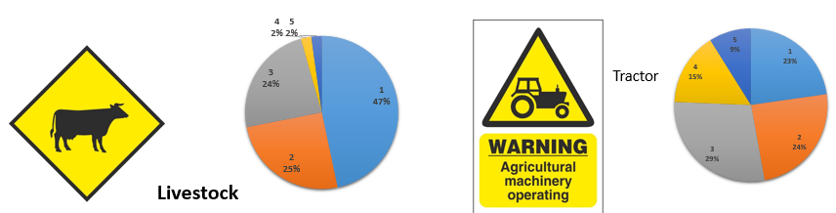
Findings
Descriptive

Slide 14
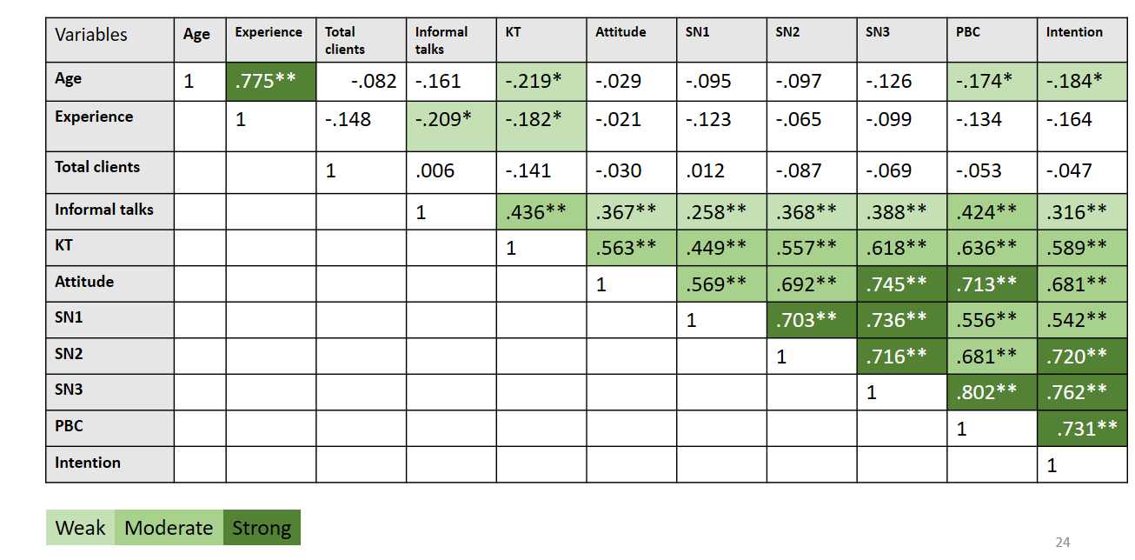
Results: Correlations
Intention is related to TPB components

Slide 15
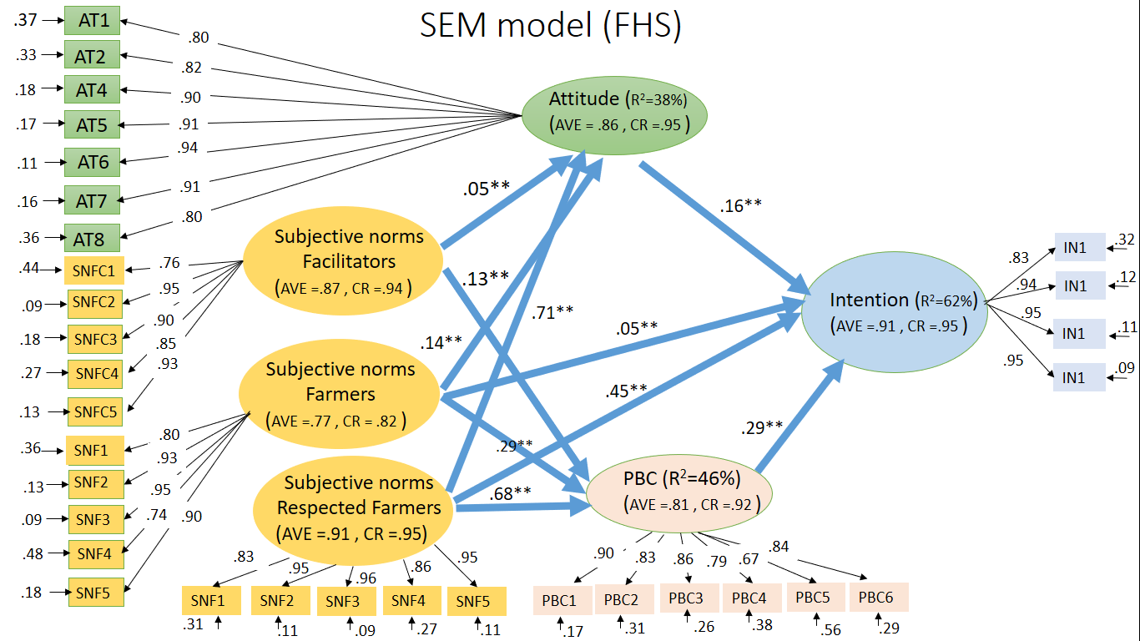
Findings
SEM analysis

Slide 16
Implications
To engage advisors
Push demands (FHS)
Pull demands
Government, extension organisation, etc.
FHS specialists
Third level FHS education
Variety and frequency of KT techniques
Delivering as a task
Balanced
Farmers demands
Of
FHS
To date, there is primarily formal education (push demands) aimed improving advisors awareness and attitude

Slide 17
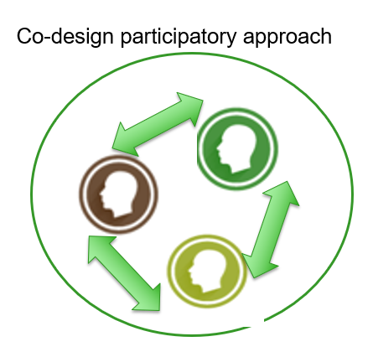
Implications
To engage advisors in discussing FHS
Push demands (government)
Pull demands
Participatory KT techniques relying on co-design approach would be needed specifically for discussing FHS in general
Discussion groups targeting FHS
Providing communicational skills helping advisors to know how they can initiate challenging issue with confident
Insert FHS as a farm management programme
Farm advisors should be a part of co-design not as facilitators but as more active participants
Farmers and advisors should be freely discuss their thoughts, beliefs, experiences about FHS

