Slide 1
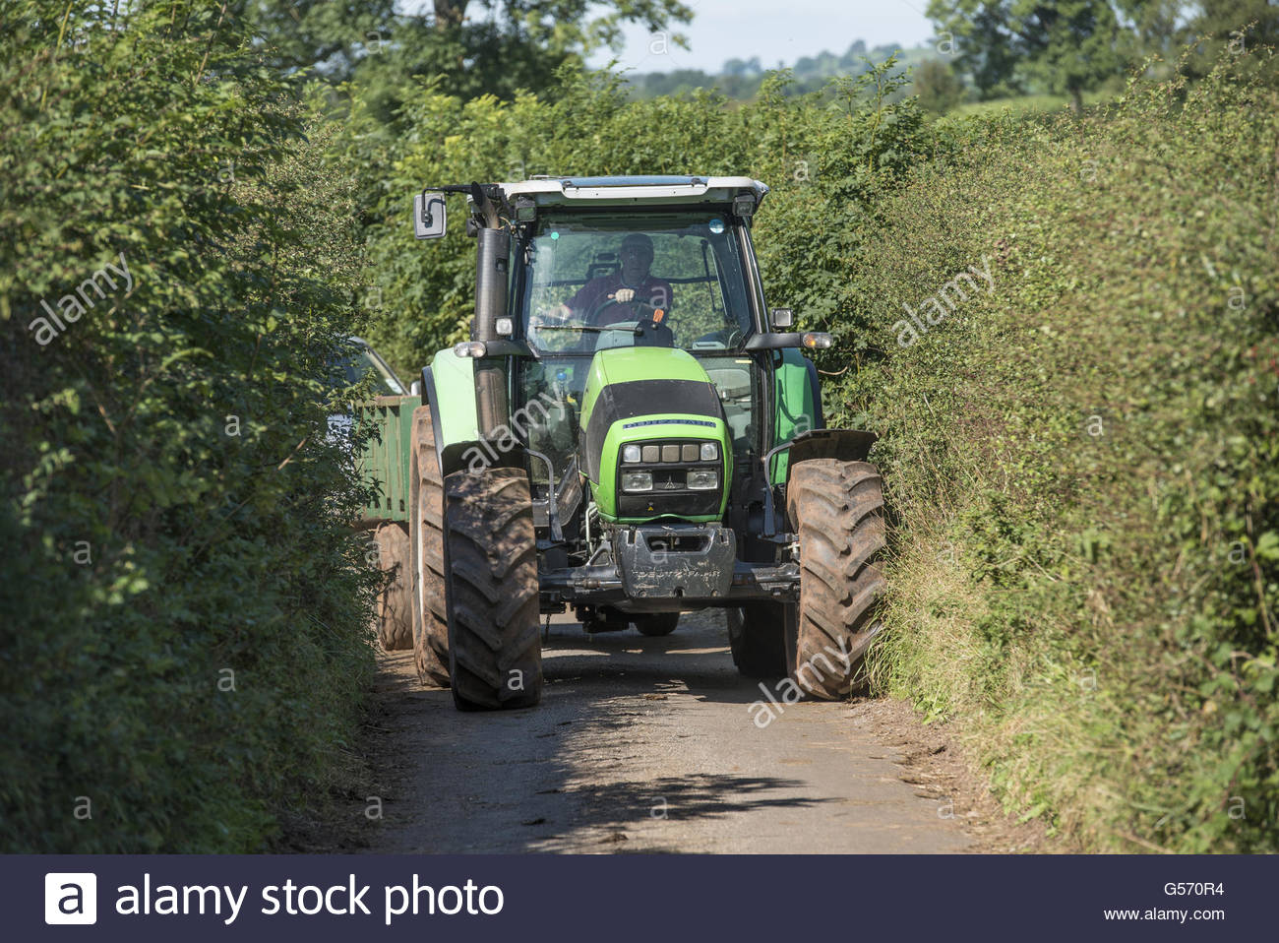
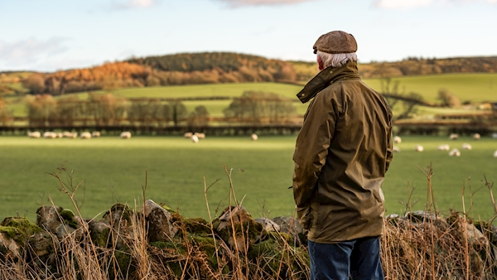
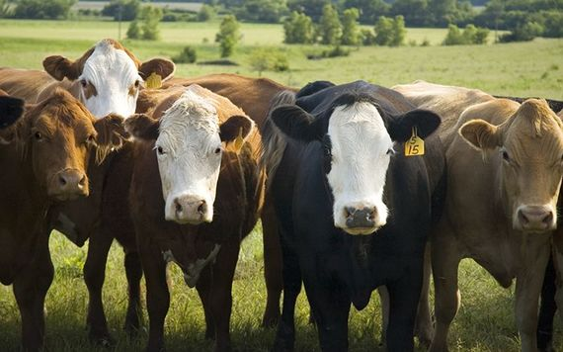

Dr Mohammad Mohammadrezaei & Dr David Meredith
Developing Safety Behaviour Prediction:
A Pathway Towards Farm Safety Culture in Ireland

Slide 2

Objectives
This work seeks to understand and develop farmers safety behaviour
Sustainable farm safety behaviour change
Which are the most important factors which shape safe behaviour
What influences safety behaviour?
Behaviour
Attitude
Perception
Subjective norms
Beliefs
Values

Slide 3
Nature of Farming
Sustainable farm safety behaviour change is challenging.
Farmers are unlike many other workers
Self-employed
Farmers
Learning by doing
Owner operated
Informal networking
Various farm activities
Various farm systems
Work alone for long time
Highly varied physical and environmental contexts
That is why many centralized, formal, incentive-based, and regulatory interventions have failed to result in sustainable farm safety behaviour
Notes:
Farms are complex social–ecological systems. They differ from most workplaces or work environments. Farming is different from most occupations by virtue of the range of tasks that farmers may have to undertake on any given day. These tasks are likely to vary in intensity, duration, location, physicality or use of machinery. This context presents substantial challenges to understanding and influencing farmer behaviour.
Many approaches and theories have been developed mainly based on centralised training and educational programmes to worker occupational safety behaviour. These theories have also provided some frameworks and interventions to change farmer behaviours whereas there are some critical differences

Slide 4
How to affect farmers behaviour
There have been many attempts to make consistent behavioural change
But
Farms are still unsafe and function within a complex socio-ecological contexts that are slow / hard to change
Environment
Subjective norms
Organisations
Environment
Behaviour
Experience
Knowledge
Farm community
Farm scale
Attitude
Intention
Farmer
Safety Culture
‘How things are done’
Perception
Interventions
Beliefs
Norms
Behaviour
Education
Awareness
Households
Regulatory systems
Training
Age
Farmers groups
Policy
Notes:
Ecological frameworks complement behavioural models of health which emphasise an individual’s characterises including education level, skills as the key determinants of safety behaviour. Ecological models extend the range of factors considered to include the social and cultural environment i.e. it emphasises the significance of understanding not only the drivers of individual behaviours but also the inter-personal, organisational, community and public policy dimensions as well (McLeroy et al., 1988; Lee et al., 2017). This perspective asserts that alignment of policy, contextual and individual-level interventions can deliver sustained behavioural change as interventions applied at one level, e.g. the farm, influence changes in the community and vice versa.
To shape safety culture, the role of socio-demographic on socio-psychological factors on behaviours need to be clearly understood

Slide 5
Socio-psychological factors
Whose opinion on farm do farmers value
How they think, a safety behaviour is beneficial, important, and favourable
How they perceive, safety behaviour easy/hard, up to them/out of their control,
Capacity - Capability
How farmers see themselves susceptible to an accident
How do farmers see the accidents
Willing to behave safely
Which stimulus Internal and External trigger a behaviour
How they see the risks
How they see themselves
How farmers regulate their behaviour
Which obstacles farmers feel
How much farmers know about safety behaviour
To Anticipate farmer safety behaviour
Susceptibility
Self-identity
Awareness
Intention
Attitude
PBC
Self-regulation
Severity
Cue to action
Barriers
Subjective norms
Self-efficacy
Knowledge
Farm Safety Behaviour
Notes:
Given the unique demands of farming there is a need to develop or adapt and evaluate a conceptual model that identifies those factors that shape farmer perception of risk and, consequently, their behaviour (Lee et al, 2017).

Slide 6
Key socio-demographic on socio-psychological factors
Whose opinion on farm do farmers value
How they think, a safety behaviour is beneficial, important, and favourable
How they perceive, safety behaviour easy/hard, up to them/out of their control,
Capacity - Capability
How farmers see themselves susceptible to an accident
How do farmers see the accidents
Willing to behave safely
Which stimulus Internal and External trigger a behaviour
How they see the risks
How they see themselves
How farmers regulate their behaviour
Which obstacles farmers feel
How much farmers know about safety behaviour
How important are these factors (total effect)
Identifying
the factors
Direct/indirect socio-psychological factors
Attitude
Subjective norms
PBC
Intention
Knowledge
Cue to action
Self-efficacy
Awareness
Severity
Self-regulation
Susceptibility
Self-identity
Barriers

Slide 7
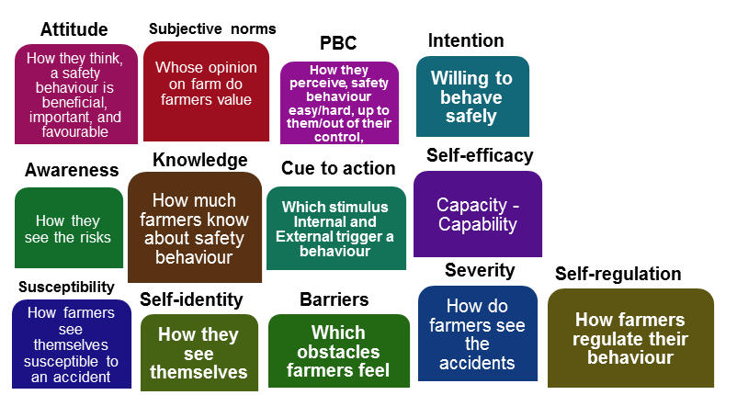
Key socio-demographic on socio-psychological factors
Different farmers group
(Socio-demographic)
Different behavioural change pattern
Education
Farm economic size
Farm size
Age
Experience
Family size
Location-community
Notes:
Given the unique demands of farming there is a need to develop or adapt and evaluate a conceptual model that identifies those factors that shape farmer perception of risk and, consequently, their behaviour (Lee et al, 2017).

Slide 8
Next steps
Identification of behavioural models appropriate to farmers in Ireland, e.g. TPB, HBM, COM-B etc. (Spring 2021)
Data collection (Summer 2021)
Data analysis (Winter 2021)
  Assess knowledge of farm safety issues, attitudes to farm safety, perceptions of risk and behaviours.
  Identify the social or cultural factors that are significant in shaping OHS behaviours.
  Estimate the effect of different factors influencing risk perception and behaviour.
  Group farmers in accordance with their level of risk perception and safety behaviours to facilitate targeting of policy and KT interventions to high risk groups.

Slide 9
Outcomes
Farmers safety behaviour, attitude, intention, perception and other socio-psychological aspects
Describing different farmers groups based on their behaviours
Determining the most important factor(s) on safety behaviour
Determining the patterns of behavioural changes amongst different farmers group
Providing recommendations in designing the most appropriate interventions involving all spheres

Slide 10
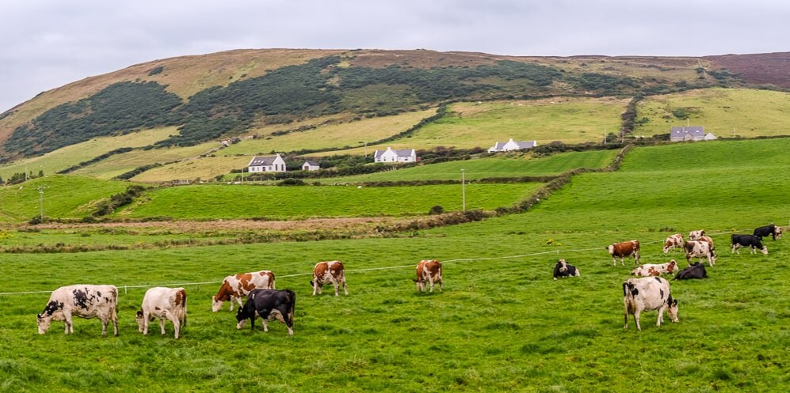
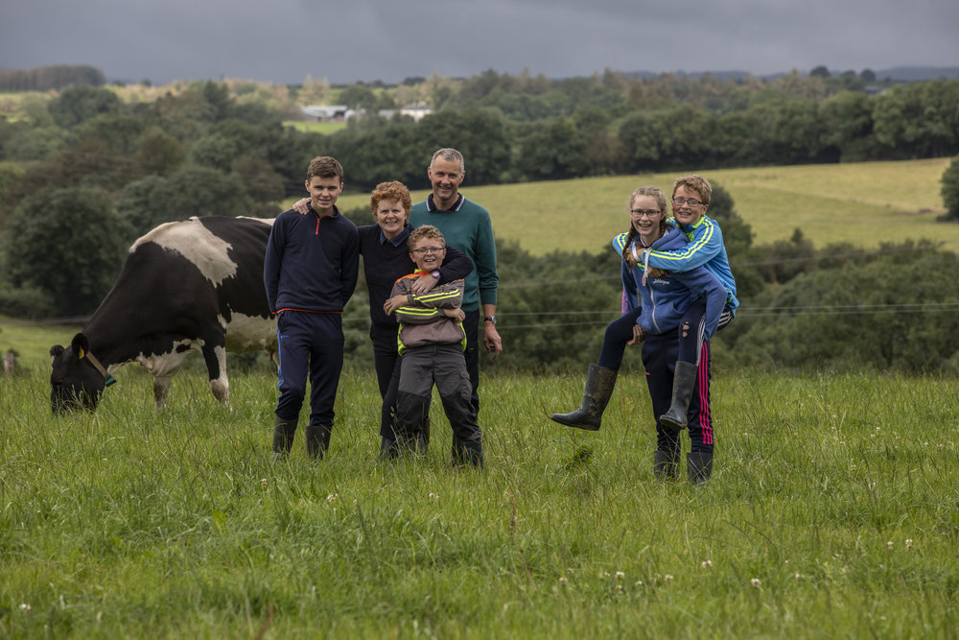
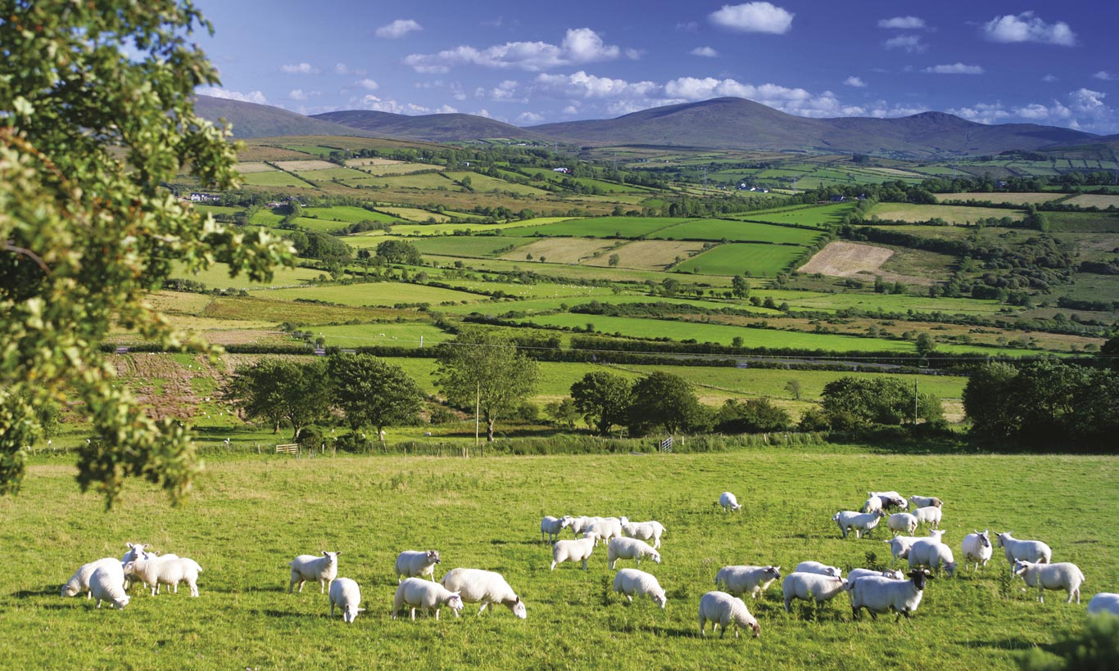
Thank you for your attention!

