Slide 1
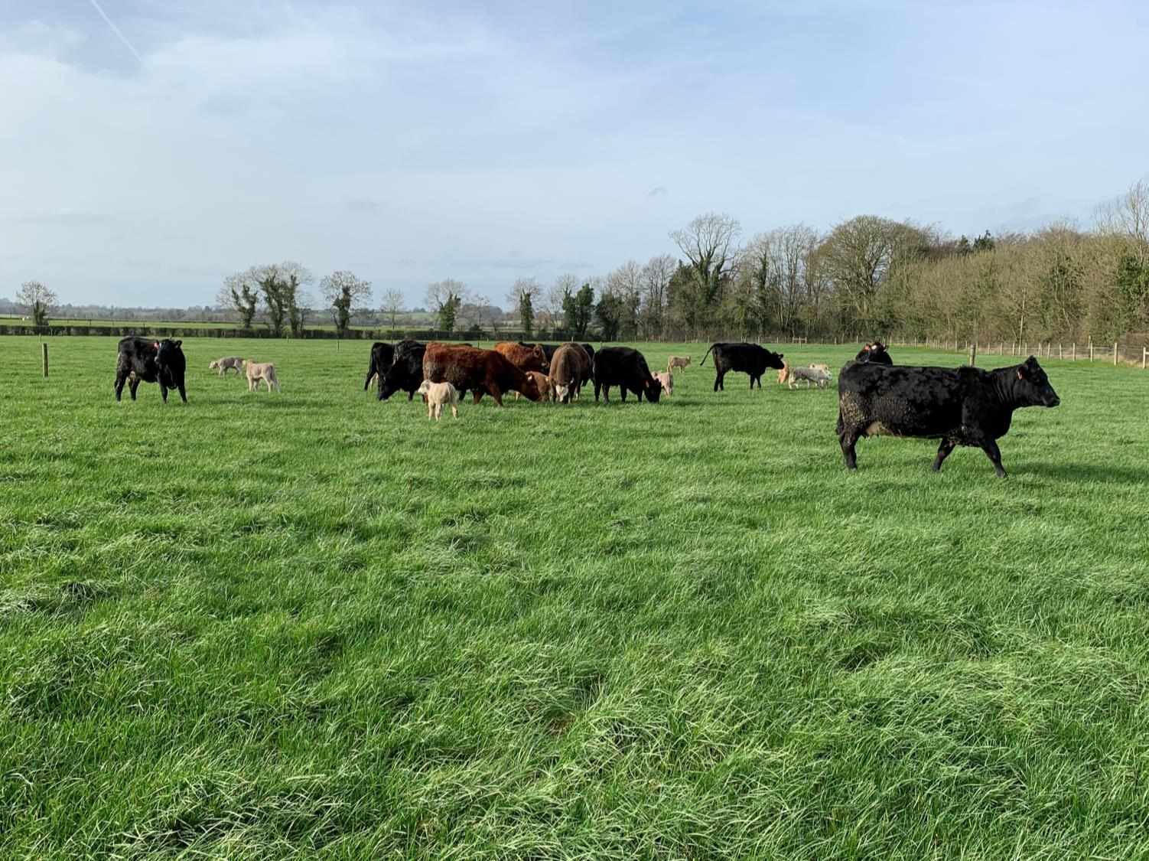


Human – Animal Relations, a key to safety
31st January 2020
Niamh Woods
Teagasc Supervisor: Dr. Bernadette Earley
UCD Supervisor: Dr. Marijke Beltman
Project Leader: Dr. David Meredith

Slide 2
Task Objectives
Describe the factors that contribute to farmers' adoption of recommended farm safety management strategies
Develop safer work systems on farms for livestock handling and management of facilities
Promote the adoption of safer systems for handling livestock on farms

Slide 3





On-Going Research
Farmer survey
Animal measures
  Temperament assessments
  Behavioural observations

Slide 4
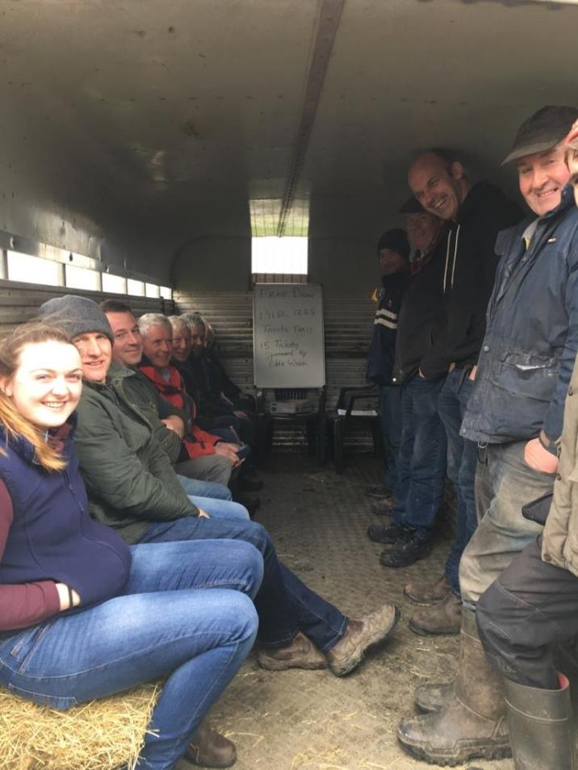
Farmer Survey
April → July
21 counties
34 group meetings
  32 knowledge transfer
  2 education groups
390 respondents
Data transfer
  Hard copy → Soft copy

Slide 5
Respondents Per County

Slide 6
Respondent Age

Slide 7
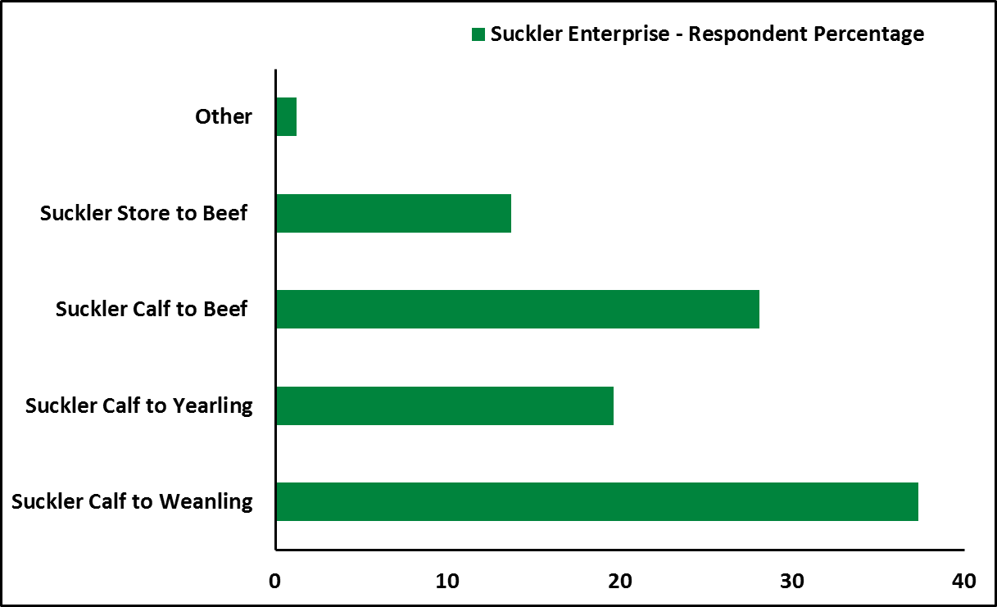
Enterprise – Suckler Bred

Slide 8
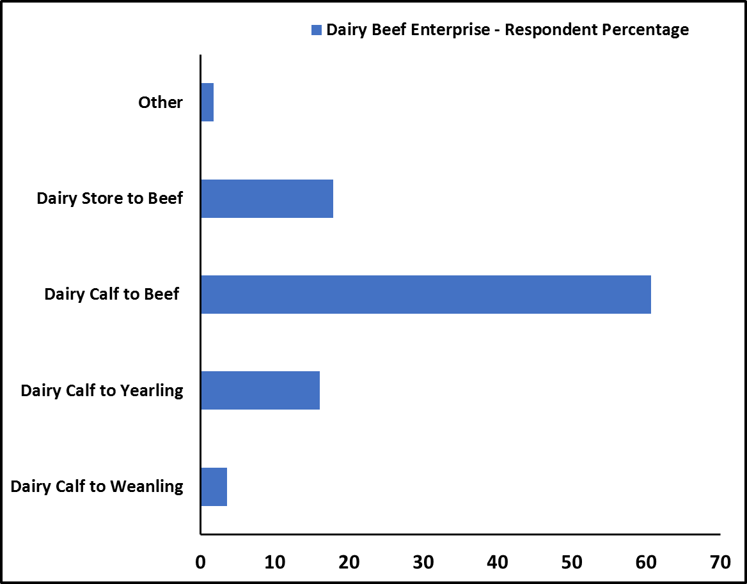
Enterprise – Dairy Bred

Slide 9
Farm Size
*Hectares
Full Time/ Part Time
Land Owned | 41.8 Ha*
Land Rented | 10.1 Ha
Total Farm Size | 46.8 Ha
Green Certificate
Notes:
National Average Farm Size- 32.4 Ha
Green Cert- FETAC Level 6- stamp duty exemption and dept. grants

Slide 10
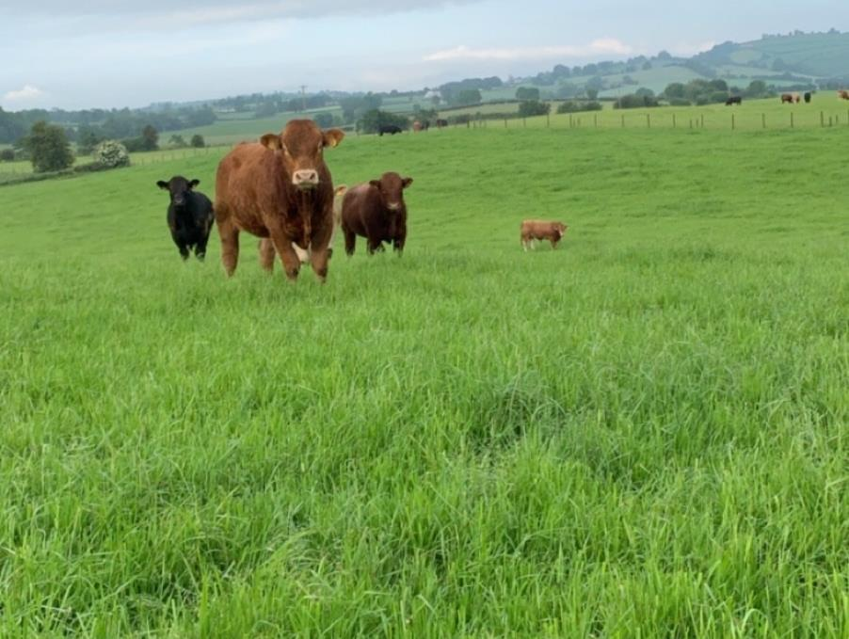
Animal Measures

Slide 11

An investigation of the human-animal relationship (HAR) using housed pregnant dairy and beef origin heifers
63 first-calving heifers
  20 Dairy bred origin
  43 Suckler bred origin
Temperament assessments
    Crush agitation (CA)
    Exit Speed (ES)
    Avoidance Distance (AD)
Days 43 & 86 post-housing
Days 51 & 99 post-housing

Slide 12
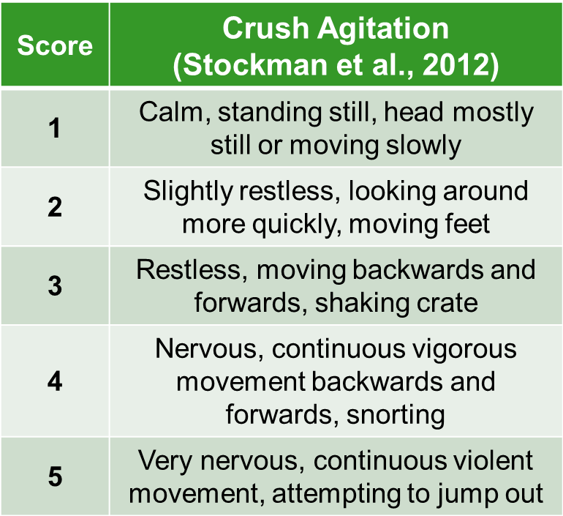
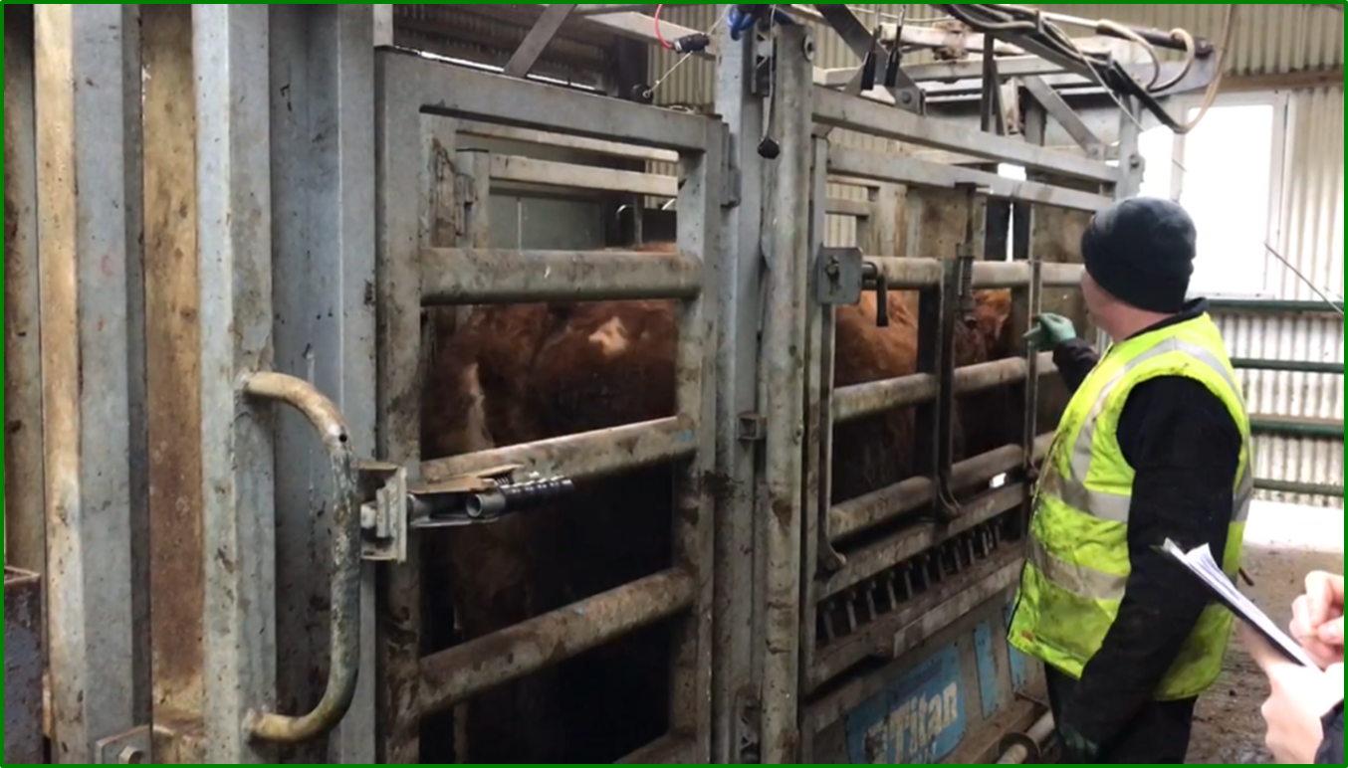
Temperament Assessments

Slide 13
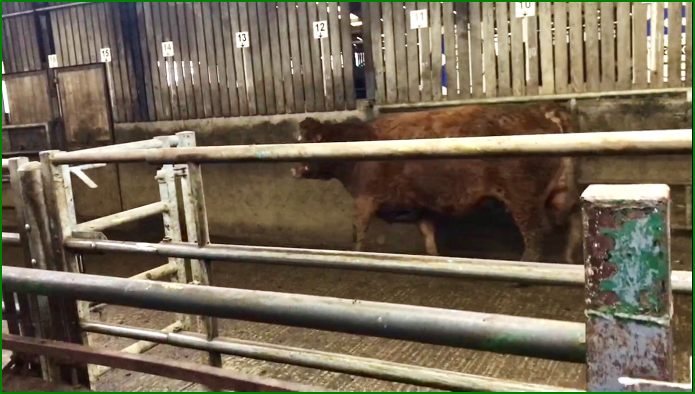
Temperament Assessments
Crush Exit
Distance reached (meters) and time spent travelling to that distance (seconds) were recorded
Assignment of scores to the measurements of the test variables (Mazurek et al., 2011)
 | Score
 | 1 | 2 | 3 | 4 | 5 | 6
Latency Time (s) | 0.1-5.0 | 5.1-10.0 | 10.1-15.0 | 15.1-20.0 | 20.1-25.0 | 25.1+
Distance (m) | 21+ | 16-20 | 11-15 | 6-10 | 1-5
Notes:
Latency is a time interval between the stimulation and response

Slide 14
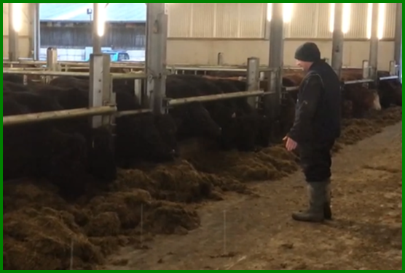
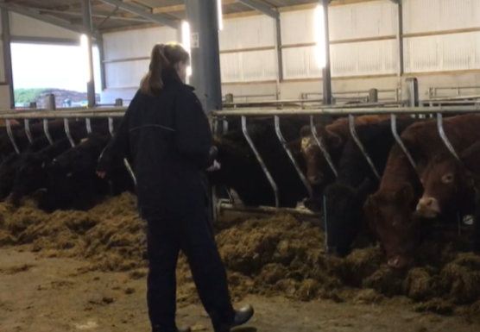
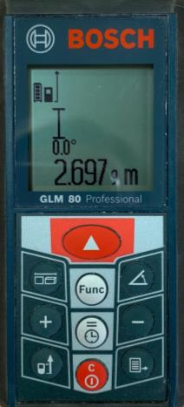
Temperament Assessments
Avoidance
Distance
Familiar
Unfamiliar
14

Slide 15
Results
Crush Agitation and Exit Speed
  No difference was found between dairy and beef origin suckler heifers at either time point
Avoidance Distance
  Mean AD to unfamiliar was greater for beef than dairy-origin heifers on day 51(P=0.01), but did not differ between the breed types on day 99
  On day 51 AD to the familiar human was similar for both beef and dairy origin heifers whereas on day 99 it was lower in beef than dairy-origin heifers (P=0.02)

Slide 16
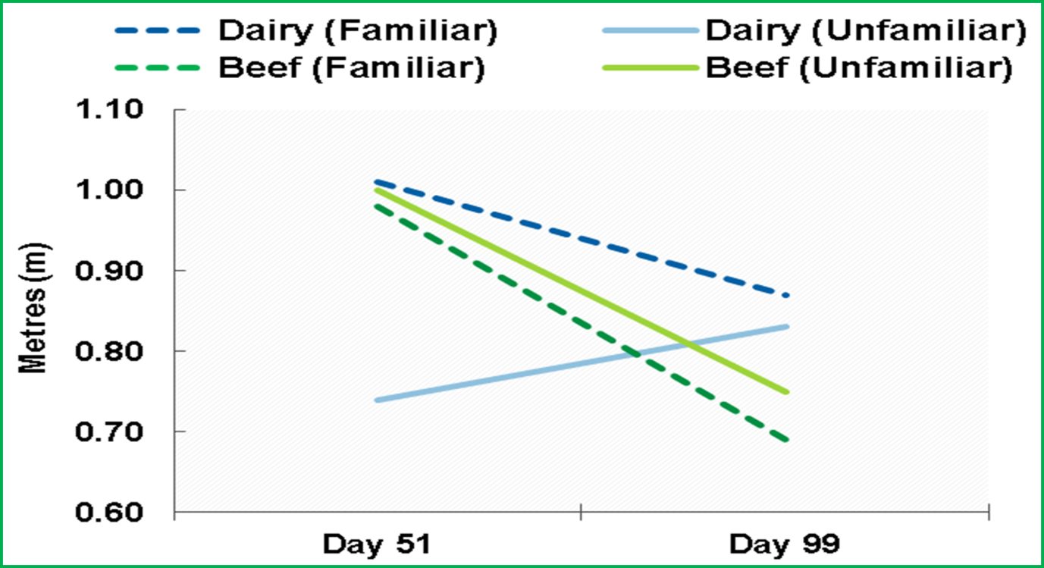
Results
Notes:
Mean AD to the unfamiliar human was greater for beef than dairy-origin heifers on d 51 (P=0.01), but did not differ between the breed types on d 99 (P>0.05) (Figure 3). In contrast, on d 51 AD to the familiar human was similar for both beef and dairy origin heifers (P>0.05) whereas on d 99 it was lower in beef than dairy-origin heifers (P=0.02).
From the three investigated tests, AD proved to be a more sensitive measure of the HAR and how cattle perceive humans, whether they are familiar or unfamiliar.

Slide 17
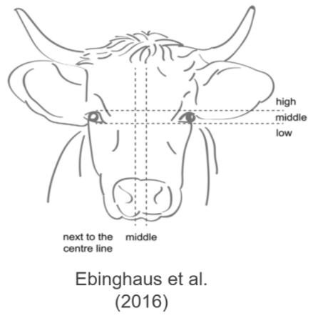
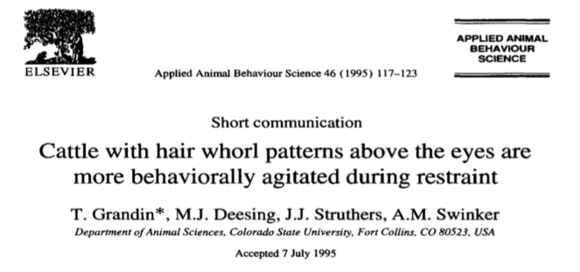
Facial Whorl
Numerous studies on facial whorl position & type in relation to temperament
Most easily observed in cattle that do not have daily close contact with people
Categorisation as high, middle, low, abnormal or non-existing and single, spiral, flared or double

Slide 18
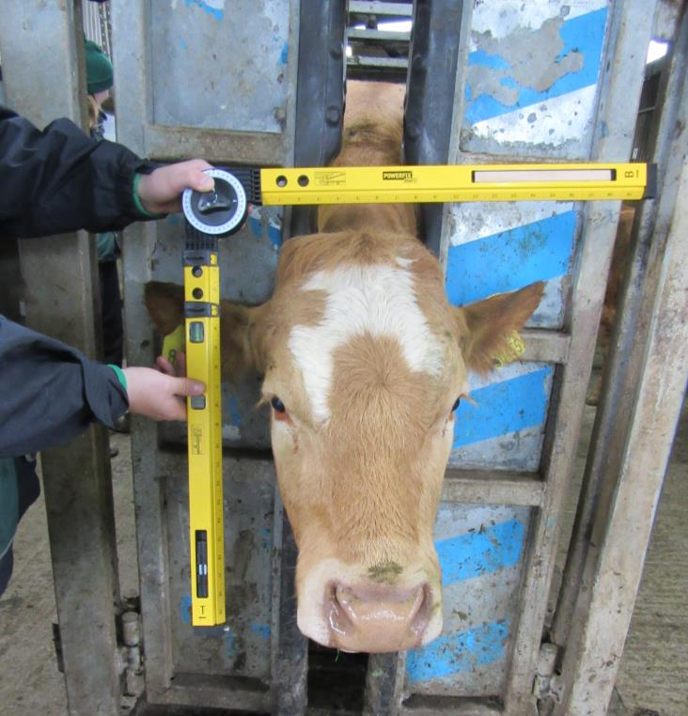
Facial Whorl
Photograph of each animal at a distance of 1.5m
Angle square used to determine scale
Crush agitation scoring repeated
Score allocated on exit from the crush
Flight Speed Score (Lanier and Grandin, 2002)
1 | Walk
2 | Trot
3 | Run
4 | Jump

Slide 19
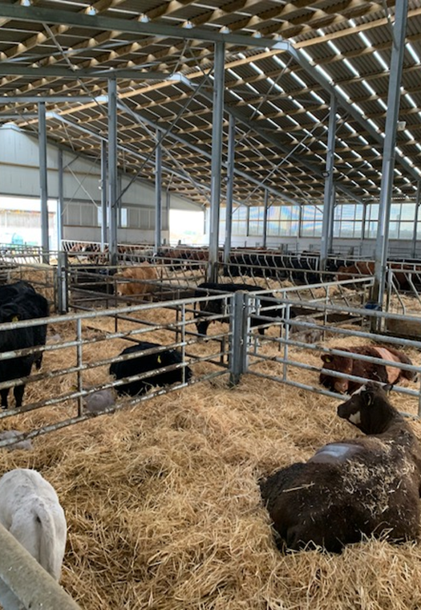
Observations at Calving
Calving 2019
  5th Feb to 4th May
CCTV recording of maternal behaviour post-parturition
Relationship between maternal behaviour and dystocia
Notes:
Dystocia is defined as a difficult birth

Slide 20
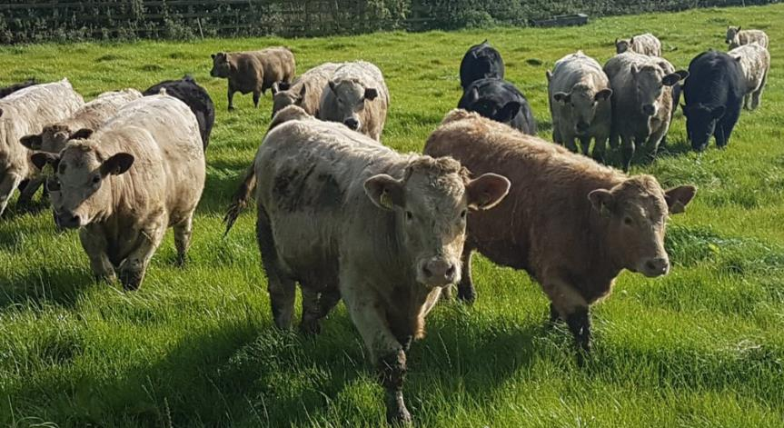
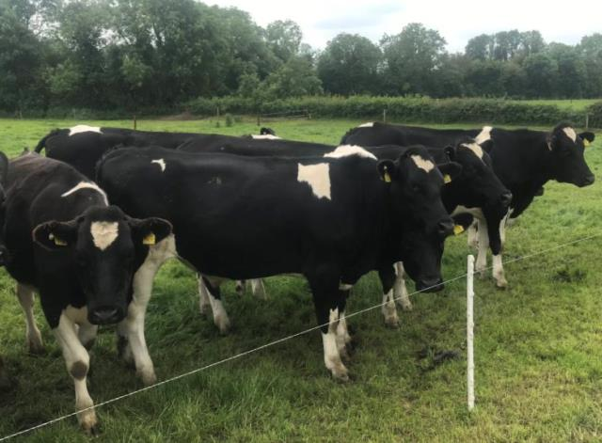
Temperament Assessments
150 male & female
Purchased
Suckler bred
160 male & female
Grange born
Suckler bred
120 male
Purchased as calves
Dairy bred

Slide 21
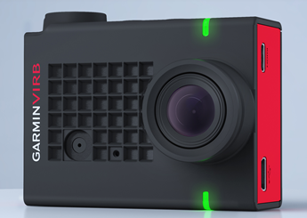
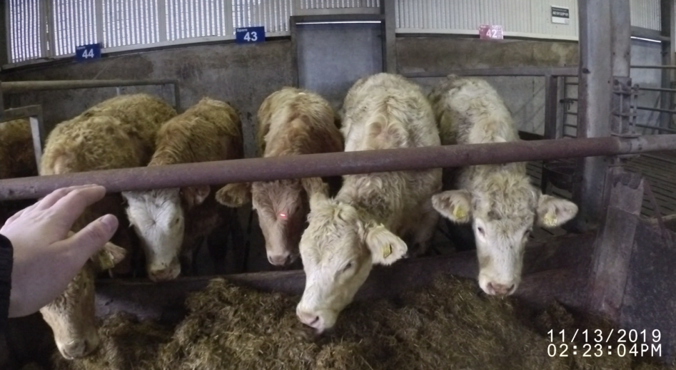

Temperament Assessments
Crush agitation score (1 – 5)
Exit score (walk, trot or run)
Exit speed (CCTV recordings)
Avoidance distance

Slide 22
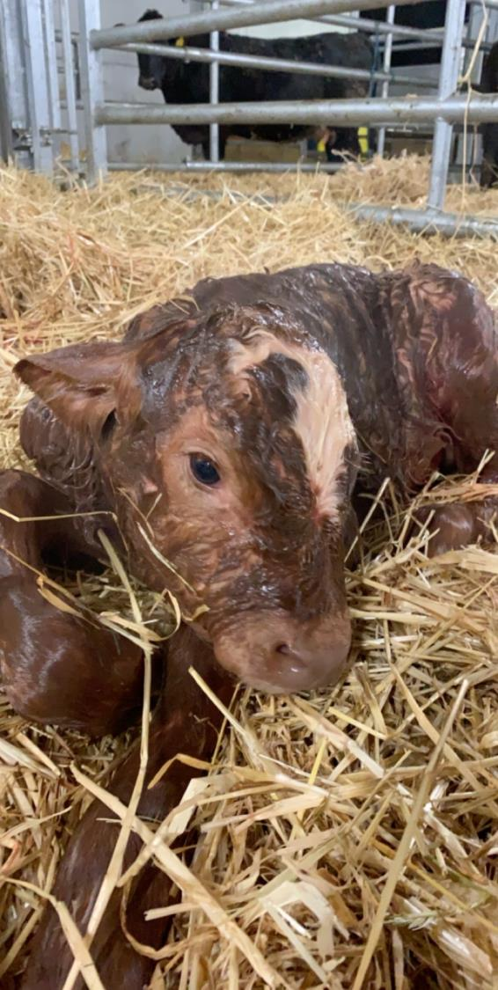
Future Work
Analysis of data collected
  Survey data & animal measurements
Continuing temperament assessments
  Grange animals vs purchased animals
Avoidance distance pre & post parturition
Maternal behaviour pre & post parturition
  Dairy origin vs Beef origin- Spring 2020

Slide 23
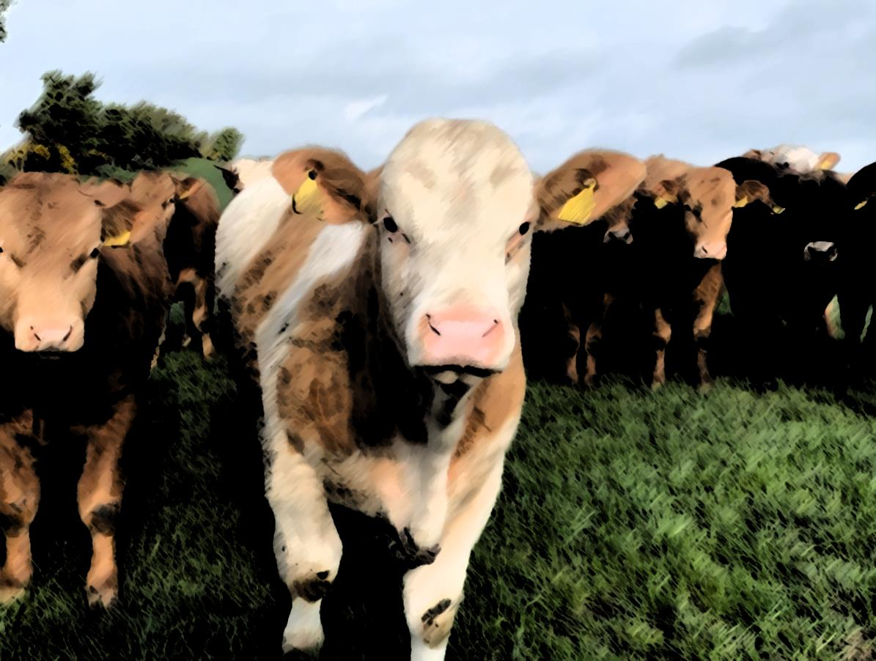

Thank You!

