Slide 1
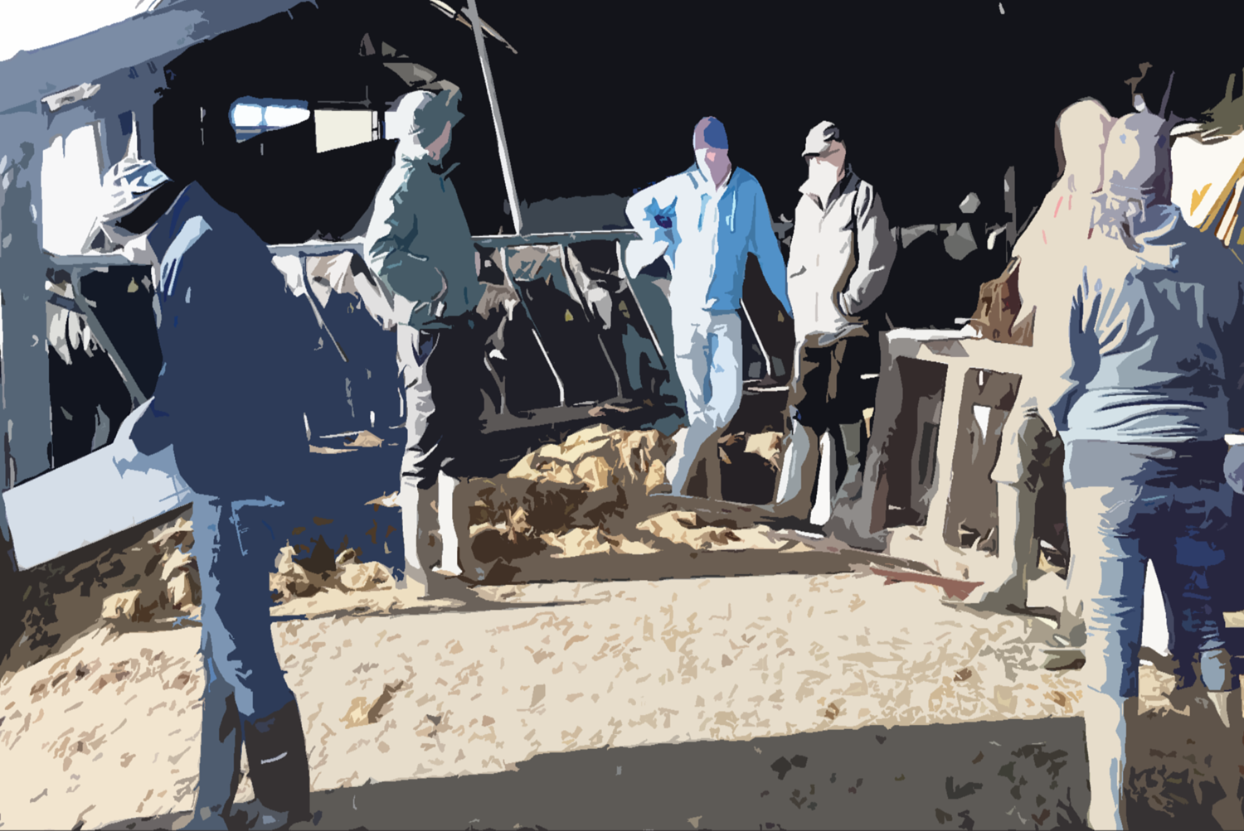



Farmer-to-farmer support stimulates safe and health-protective farming practices
Dr. Tracey O’Connor (UCD)
Under supervision of:
Prof. Jim Kinsella (UCD)
Dr. Denis O’Hora (NUIG)
Dr. David Meredith (Teagasc)
Dr. John McNamara (Teagasc)

Slide 2
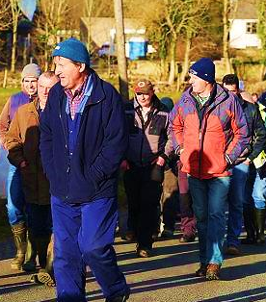
Introduction (I)
Many farm safety and health initiatives…
  Limited effect on injury & illness rates
Social context is key element in (un)safe behaviour
Group-based peer learning applied in other regions and industries for occupational safety and health promotion
  Agriculture (Finland, Sweden)
  Health (USA, Chile)
  Construction (USA)
  Police (USA)
Irish dairy farmer
discussion groups (DDGs)
2016: c.301 Teagasc DDGs c.4,515 dairy farmers (29%)
Similar influence on safety & health practices?
Notes:
DDGS: Peer-to-peer platform for farmer knowledge exchange; Associated with adoption of good farming practices; Established history & membership in some regions

Slide 3
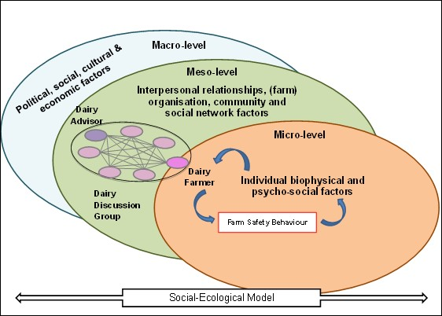
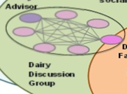
Methodology (I)
(COM-B Model)
Notes:
Research Questions:
Q. 1 : What is the relationship between OSH engagement in DDGs and farmers’ OSH-related behaviours?
Frequency, duration, and thematic content of DDG OSH engagement
Extent of past and intended implementation of OSH-related behaviour of dairy farmers in DDGs
Capabilities, opportunities, and motivations shaping OSH-related behaviour implementation and intentions
Methods
1a Online, paper—based and telephone survey of DDG chairpersons or members of at least one-year’s standing in the absence of a chairperson; sample = 121 DDGs (from facilitators), response = 96 (79%), 66% chairpersons
1b+c Paper-based survey of farmers in DDGs participating in intervention. Carried out in DDG/at home and returned to advisor by next meeting. Sample = 1220 farmers, responses = 462 (38%)

Slide 4
Key Findings
  DDG Farm Safety and Health Discussions
Widespread, voluntary engagement
  Particularly experience-sharing
  Safety behaviours
Most farmers considered themselves safe
Most farmers intended to increase safe behaviour implementation
Notes:
96% of DDGs discussed OSH issues at least once (includes casual discussion)

Slide 5
Methodology (II)
Academic & Grey
Literature
(COM-B Model)
FSH Intervention
Notes:
Inputs and grey and academic literature RE:Behaviour change techniques, farmer group facilitation and FSH best practices, intervention design
Research Questions:
Q. 1 : What is the relationship between OSH engagement in DDGs and farmers’ OSH-related behaviours?
Effect of OSH engagement in DDGs on dairy farmers OSH-related behaviours and intentions
Q. 2 : What lessons for promoting and enabling OSH-related behaviours can be learned from the experience of DDG facilitators and farmers that participated in this research?
What characterises a feasible and acceptable OSH promotion intervention in DDG context?
Methods
1d Post—trial Paper-based survey of farmers in DDGs participating in intervention. Carried out in DDG/at home in month after final month of intervention and returned to advisor by next meeting. Sample = 1220 farmers, responses = 325 (27%)
Q. 2 Acceptability and feasibility evaluation prior to intervention pilot (dairy advisors) and during pilot (dairy advisors, providing information about farmer experience and own experience)

Slide 6
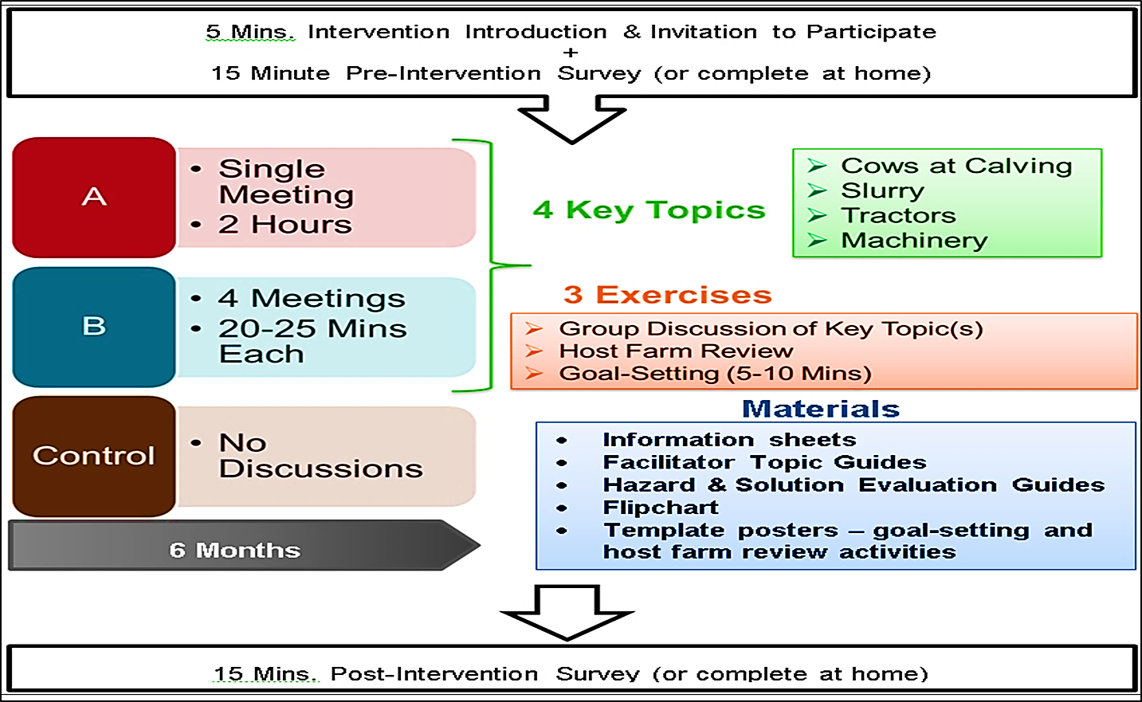
Methodology (III): Intervention Pilot
7
Notes:
Systematic, multi-actor, collaborative design approach resulted in two intervention protocols with similar topics and techniques
► Approach A: Infrequent, long duration ► Approach B: Frequent, short duration

Slide 7
Key Findings & Conclusions
  Intervention outcomes
Approach A: Significant increase in some implementation intentions
Approach B: Significant increase in implementation of some behaviours
COM Influences
  Skill gaps, knowledge gaps, social norms, motivation
  Conclusions
Positive changes in all groups
Consistent intention to improve safety
OSH promotion in DDGs can stimulate adoption of safe work practices
Discussion approach important for acceptability & outcomes
  Influences capability, opportunity and motivation concerning OSH behaviours
Notes:
96% of DDGs discussed OSH issues at least once (includes casual discussion)

Slide 8

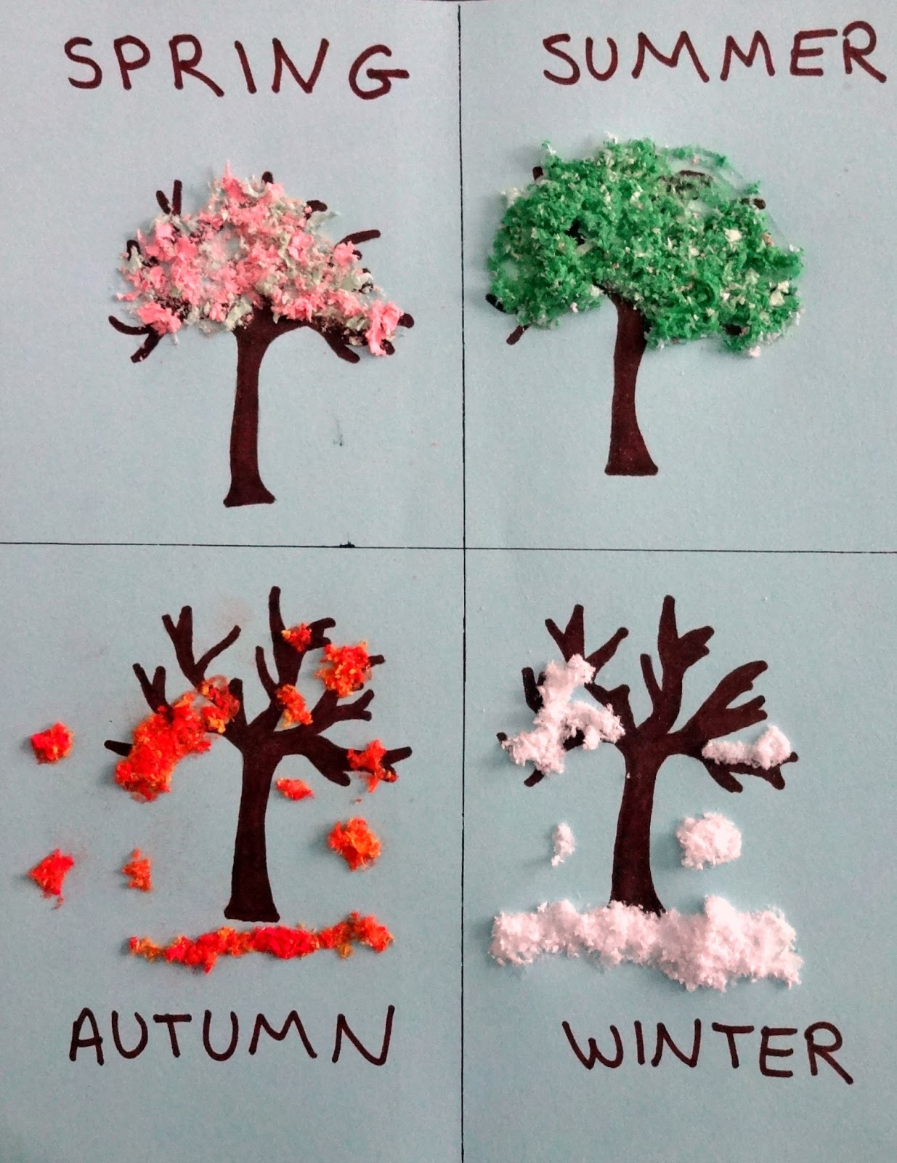
Practical Implications (I)
Group-based farmer-to-farmer discussions have value for farm safety and health promotion
  Support should continue - also beyond DDGs
Discussions should be adaptable to farmers needs
Discussions would benefit from planning
  Duration
  Timing
  Content
  Dynamic, connected, serial approach
Notes:
Beyond DDGs:
Other farmer groups, including women farmer groups, and alternative settings, both virtual and physical, such as FSH-focused workshops, or FSH-focused groups, e.g. associated with a particular milk purchasing cooperative, or aimed at farmers who are not Teagasc clients, farm-workers and farm family members, who may be beyond the usual scope of the DDG audience.

Slide 9
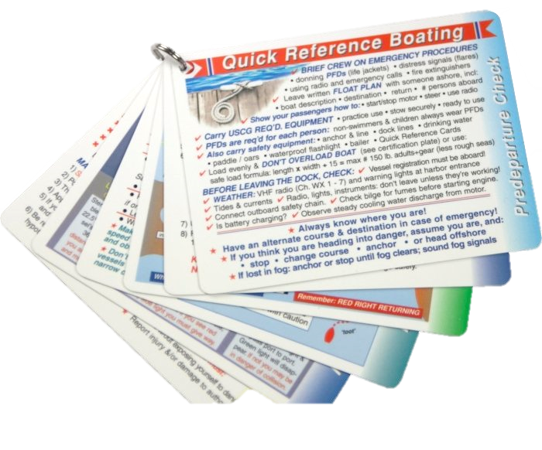
Practical Implications (II)
Facilitation is a key ingredient
  Familiarity with evidence for safe and health-protective farming practices
  Access to resources to support discussions
  Inclusive, engaging, informed
Alternative facilitators/influencers?
  Who plays a role in shaping a safer farming context?
  Social context matters
Notes:
Resources: Training, materials, rapid reference guides, sample discussion guides, worksheets – helping facilitators prepare for brief discussions as part of a broader meeting
The findings of this research suggest that the opinions of family and friends about safe tractor exit behaviour are influential for farmers. FSH promotion campaigns could benefit from identifying and targeting other safety culture influencers, such as feed merchants, machinery suppliers, livestock marts, community and farming organisations, and depictions of farming in advertising, news and entertainment media.

Slide 10
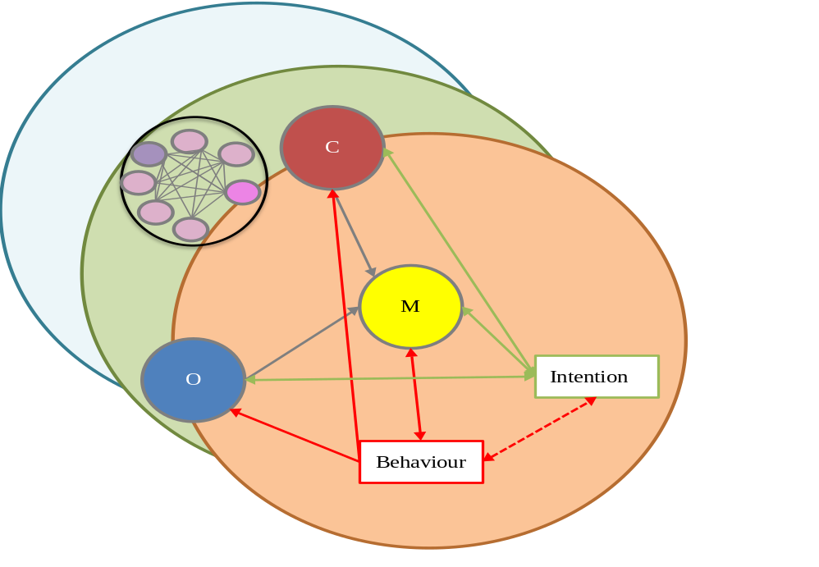
Future research
Optimise intervention
More farm safety and health baseline work: practices, perceptions, influencers
Focus on gender dimension
Further applications…
Other safety practices
Other farmer health issues
Other farm enterprises
Other farmer cohorts
Other aspects of sustainable farm management

Slide 11
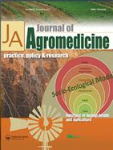
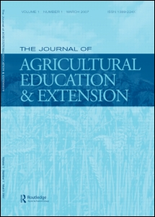


Research outputs
Research papers
O'Connor, T, D Meredith, J McNamara, D O'Hora, and J Kinsella. 2020. "Farmer discussion groups create space for peer learning about safety and health" Journal of Agromedicine (2020) https://doi.org/10.1080/1059924X.2020.1720882
O'Connor, T, J Kinsella, J McNamara, D O'Hora, and D Meredith. n.d. “Learning through design using collaborative Intervention Mapping with acceptability evaluation: the case of a group-based farm safety intervention” under review for publication in: Journal of Agricultural Extension and Education
O'Connor, T, J Kinsella, D O'Hora, J McNamara, and D Meredith. n.d. “Safer tomorrow: Irish farmers’ self-perception of their farm safety practices” under review for publication in: Journal of Safety Research
Conference papers
Addressing the socio-ecological context of farm safety and health through a co-design approach to a farm safety promotion intervention, 24th European seminar on Extension (and) Education, Acireale, Italy
O’Connor, T, D Meredith, J Kinsella, and J McNamara. 2018. “583 Evidence-Based Social Learning for Safety and Health Promotion among Irish Dairy Farmers” Occupational Environmental Medicine, 75:A477.
Conference presentations
Safer farming behaviour associated with safety engagement in dairy discussion groups, Teagasc Rural Economy Development Programme Walsh Fellowship Annual Seminar Series 2019, Dublin, IRE
Addressing the socio-ecological context of farm safety and health through a co-design approach to a farm safety promotion intervention, 24th European seminar on Extension (and) Education, Acireale, Italy
Evaluating the influence of dairy discussion groups on farmer occupational safety and health behaviour, UCD-Teagasc Knowledge Transfer Conference 2018, Dublin, Ireland
Evidence-Based Social Learning for Safety and Health Promotion among Irish Dairy Farmers, 32nd International Congress on Occupational Health 2018, Dublin, Ireland
Conference posters
Not all safety practices are equal for Irish dairy farmers, UCD School of Health and Agricultural Science Graduate Symposium 2018, Dublin, Ireland
Dairy Discussion Group Engagement with Occupational Safety and Health, Teagasc Knowledge Transfer Advisory Conference 2018, Kilkenny, Ireland
Group discussions of farm safety and health: No size fits all, but informed tailoring can help, Teagasc Walsh Fellowship Annual Seminar Series 2017, Dublin, Ireland

Slide 12
Phase 2: Intervention Design Process
Theory-driven intervention development process
8 member research team,
Intervention Mapping steps 1-5
Participant observation
Interviews
Literature review
Surveys
Practice-driven intervention development process
20 dairy advisors (and DDG facilitators)
1 DDG member & facilitator
2 dairy knowledge management specialists
Implementation phase (pilot)
84 DDGs & 29 dairy advisors
Initial Intervention Prototype
Final Intervention design

Slide 13
Phase 3: Evaluation of OSH Behaviours
Study population
Pre-trial: 84 DDGs, 1227 farmers; Post-trial: 76 DDGs, 1122 farmers
Survey of:
safety behaviour & intention (8 behaviours, 5-point frequency scale)
capabilities, opportunities and motivation (1 behaviour, 24 items)
demographic and farm characteristics (post-trial only, 17 items)
Anonymous: survey match based on response to 4 Qs
Farm hazard
Cows @ calving
Slurry agitation
Machinery
Tractors
Safe work practices
Culling aggressive cows
Identifying a way to protect self from cow before working with newly-born calves
Ensuring access points to slurry storage areas are securely closed after use
Agitating slurry on windy days
Checking power take-off shafts (PTOs) of farm machinery are covered
Checking machinery is in good working order before use
Looking out for people in the area (bystanders) when starting a tractor
Exiting the tractor backwards, with feet and two hands in contact with the vehicle

Slide 14
Phase 3: Post-trial surveys
325 farmers, 145 “matches”
    A: 52; B: 57; Control: 36
    139 male, >90% full-time farmers & farm owners
    83% with agricultural training
Characteristics | Mean
Age | 47
Self-reported health status | 4
Years farming | 30
Co-workers > Family > Non-family | 1.4 0.9 0.5
Milking platform (acres) | 116
Dairy cows | 121
Change in behaviour (mean frequency score)
Change in intention (mean frequency score)
    Student’s/Welch’s 2-sided t-test (paired)

