Slide 1
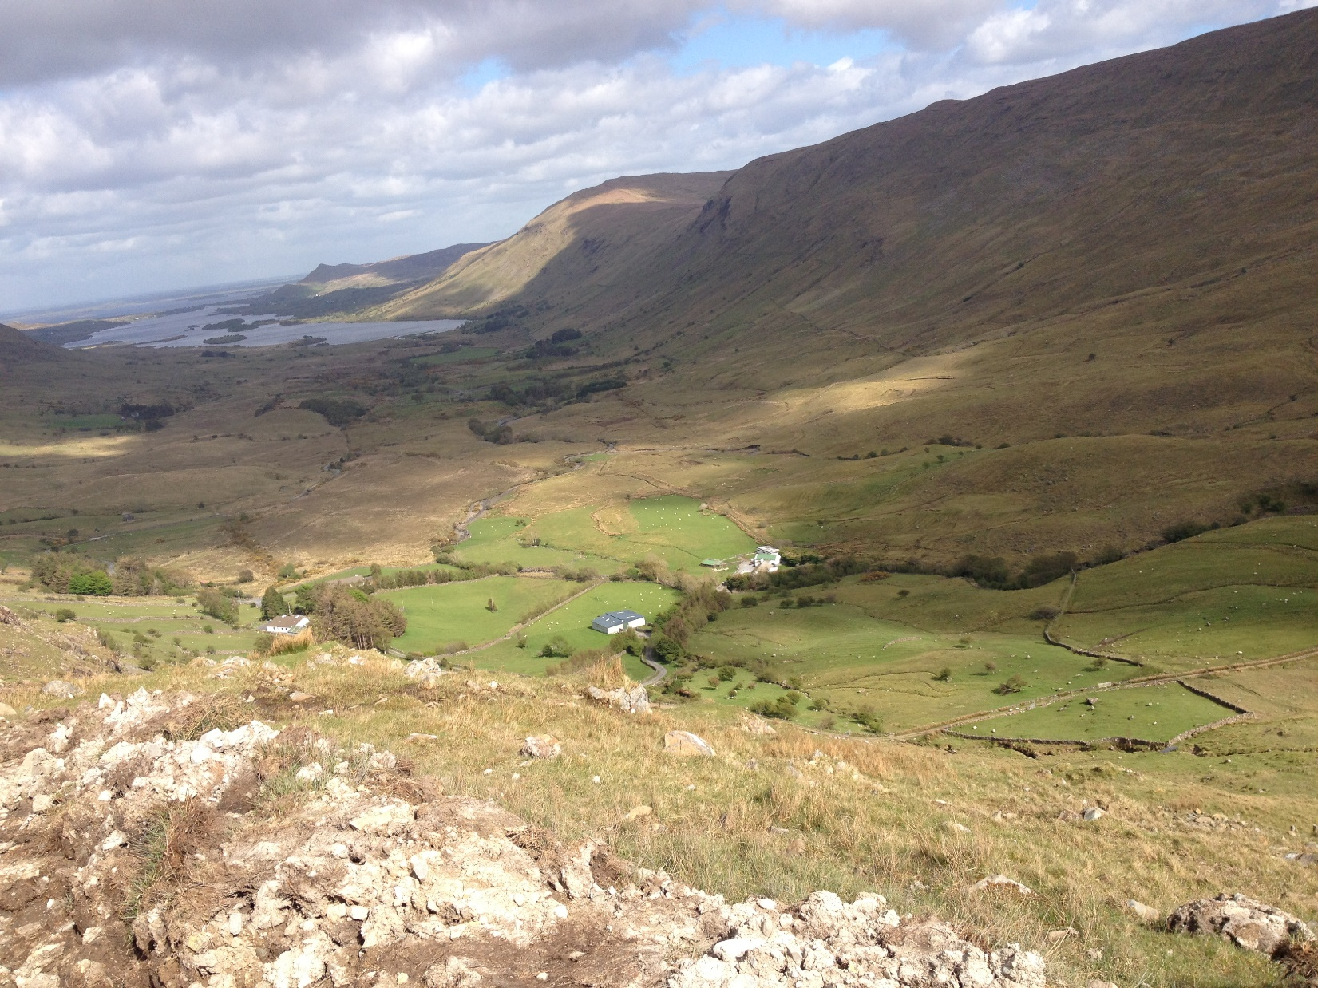

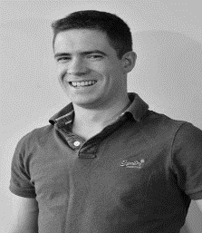
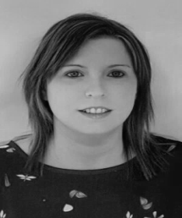
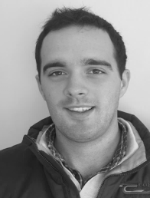
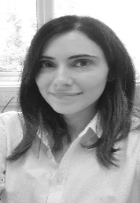

Management of Vegetation on High Nature Value Farmland in Connemara
Teagasc Galway/Clare are Holding a webinar on
Wednesday the 9th of December at 8 pm.
Upland grazing and the control of Bracken , Heather Rush & Rhododendron will be discussed
Streamed on Galway/Clare Teagasc Facebook and YouTube
Teagasc Advisors Mícheál Kelly, Marion Fox, Keith Fahy and Joanne Masterson will discuss the topics and show how local farmers control vegetation on their farms

