Slide 1





The Farmers Have Hearts -
Cardiovascular Health Programme
An outreach approach to engage farmers in cardiovascular health
Diana van Doorn
Dr Noel Richardson
Dr David Meredith
Dr John McNamara
Notes:
My presentation will outline factors underpinning farmers’ cardiovascular health; explain what the FHH-CHP is, briefly highlights the baseline results and then discuss engagement with and impact of the programme.

Slide 2
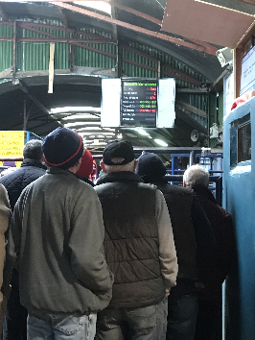

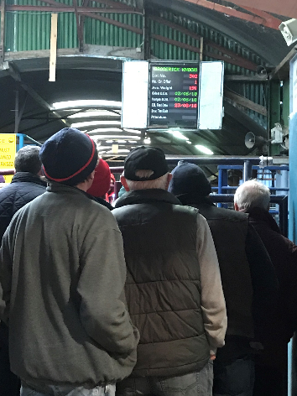
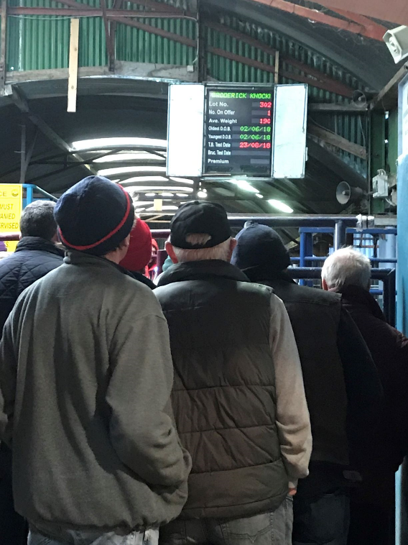
Farmers' Cardiovascular Health in Context
Factors underpinning farmers’ health
Gender
Socio-economic status
Educational attainment
Rural living and farming occupation
‘Hard to reach’ group
2
Notes:
When you look at this picture: what do you see? Farmers at the cattle ring: are they selling, buying or just browsing? What are the prices that day? Was it a good or bad day for business?
What I see is John. When I met John he had recently lost a younger brother, also a farmer, to heart disease, very unexpectedly. That was still very raw.
Irish farmers are a high risk group for premature CVD mortality compared to those in salaried jobs.
Lifestyle: 80% of CVD linked to unhealthy lifestyles such as … Although there’s an inclination to link unhealthy lifestyle choices to own responsibility, I think it is important to state lifestyle influenced by wider social, cultural and economic factors.
Gendered: Premature mortality from CVD higher among men compared to women.
Social gradient: higher among men in semi-skilled occupations
Farmers
Farming is predominantly a male occupation
Lower socio-economic group based on income (variety in farming income between the different sectors)
Farmers generally have a lower educational attainment compared to other occupation groups
Rural living – breakdown of rural IRL: younger people moving away; closure of social and health services;
Farming occupation: unsociable hours; social exclusion’ regulations and administration; low job control (weather, animal disease); occupational stress
Farmers perceived to be hard to reach with health interventions based on geographical, economical and social situation.
Going back to the picture – I also see the setting of 50% of my research. Describe mart as research setting

Slide 3
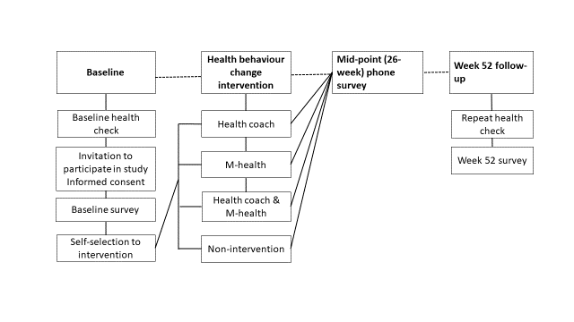
Farmers Have Hearts Cardiovascular Health Programme
The FHH-CHP aims to examine whether participation in the programme results in (i) effective follow-up use of GP services; (ii) health behaviour change and (iii) reduced CVD risk.
3
Notes:
What is the FHH-CHP programme? It’s a comprehensive health behaviour change programme targeted at male farmers. It consists of a baseline health check carried out by a nurse of the IHF. The health check measured …
A health behaviour change intervention: health coach by phone or M-health by text messages, a combination of the two or a non-intervention group. And a follow-up health check at Week 52. Survey research was carried out face-to-face at baseline and Week 52 after the health check and at Week 26 by phone.
With this research we aimed to …
I asked John if he wanted to take part in the health check with an Irish Heart Foundation nurse. Though he said that ‘doctors are for emergencies’ John agreed to take part. He came out relieved. The nurse had been very nice, had explained the risk factors for heart disease clearly and had provided good lifestyle advice. She also advised him to visit his GP for further medical examination. John signed up for the health coach in combination with the text messages

Slide 4
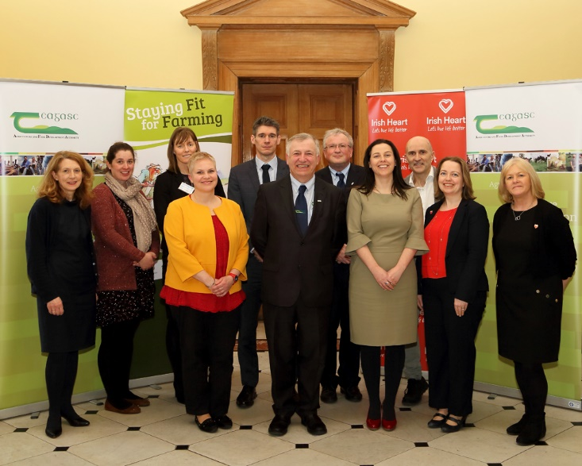






Transdisciplinary collaboration
Farmers
Industry
Research
Practitioners
Policy Stakeholders
Agri-branch
Mart
4
Notes:
An important building stone of this study was the transdisciplinary collaboration from the outset between Teagasc, the NCMH at IT Carlow, Irish Heart Foundation, HSE, Glanbia Ireland and UCD. Where we started as stakeholders, this collaboration has grown over the past years into a close working partnership. We share knowledge and have adopted a strength-based approach by tapping into each others specific expertise. As a results we broadened the reach of the programme and we carried the research out in a ‘real-world’ situation which directly impacted the participating farmers.

Slide 5
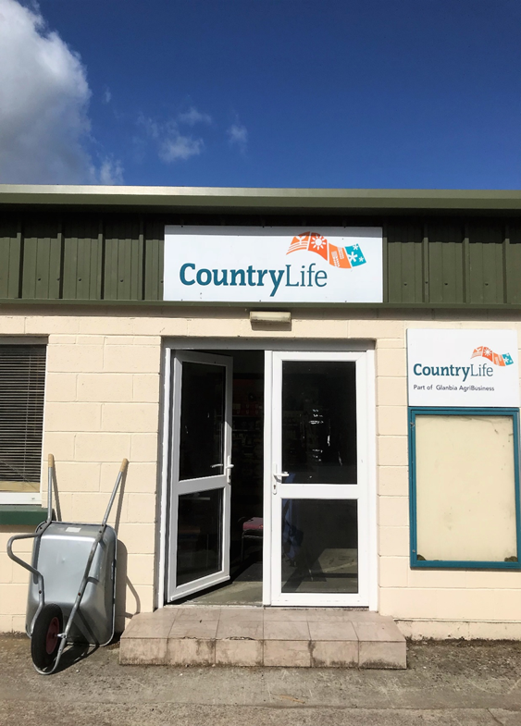
Research Overview
12 Counties – 32 marts / agri-branches
2 sub-groups of livestock farmers
  Marts – Cattle (49.4%; n=429)
  Agri-branches – Dairy (50.6%; n=439)
Participation rate: 86.4% (868/1005)
Study drop-out rate 1.3% (n=11)
5
Notes:
The FHH-CHP finished in March 2020. We have published the baseline findings in June 2020. I am working on the overall findings and they will be published next year. Today therefore I will focus on the baseline phase of the study.

Slide 6
Prevalence of risk factors for CVD (based on ESC guidelines)
Risk factors for cardiovascular health* | All farmers n | Risk factor prevalence n (%)
Blood pressure ≥ 140/90 mmHg*/** | 860 | 430 (50.0)
HDL cholesterol ≤1.0 mmol/L LDL cholesterol ≥3.0 mmol/L** | 859 822 | 264 (30.7) 501 (60.9)
Blood glucose levels ≥7.0 mmol/L/**/*** | 861 | 205 (23.8)
BMI kg/m² ≥ 25.0 Or Waist circumference >102 centimetres (in case of a BMI kg/m² <25.0) | 859 | 755 (87.9)
Family history of heart disease, stroke or diabetes | 799 | 514 (64.3)
Tobacco use | 848 | 79 (9.3)
Standard drinks per week >17**** | 455 | 47 (10.3)
Physically inactive - active on less than 5 days a week AND for less than 30 minutes on active days | 704 | 231 (32.8)
Stressed ‘often’/’all of the time’ | 800 | 104 (13.0)
Consumption of fruit and vegetables <5 per day | 822 | 652 (79.3)
6
Notes:
Twice as many mart farmers reported being single compared to agri-branch farmers (19.8%; n=84 vs 9.0%; n=39).
More agri-branch farmers than mart farmers reported farming full-time (84.3%; 63.1%;).
Agri-branch farmers reported working on average more hours on the farm compared to mart farmers (mean 60.4 vs 48.8 hours respectively)
Almost twice as many agri-branch than mart farmers reported farming ≥125 acres (60.4% vs 35.4%).

Slide 7
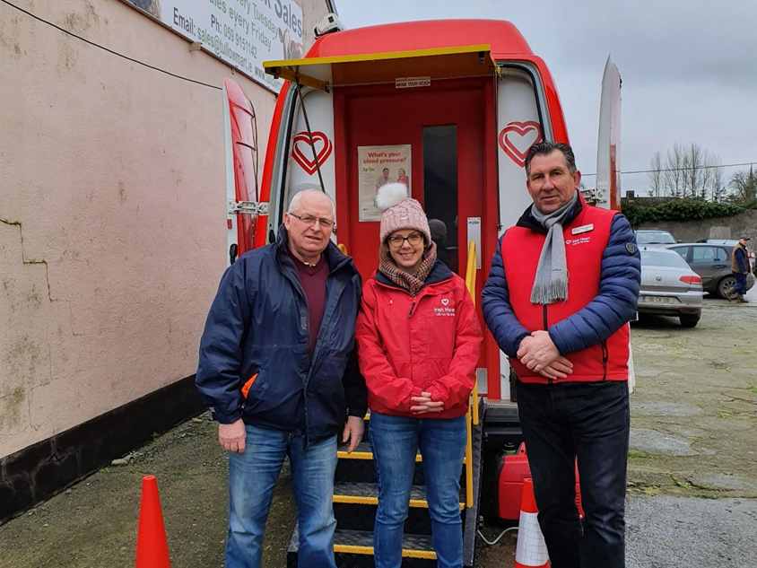
Multiple risk factors for CVD
73.9% of farmers (n=642) had four or more risk factors for CVD.
7

Slide 8




Key factors for engagement
Transdisciplinary collaboration
Strengths-based and gender-sensitive
  ‘Safe space’
  Building relationships
  Flexible
  Practical
  Choice
The locality and flexibility:
no preparation required
It was friendly and informative and not as dull and gloomy as doctors
8
8
Notes:
In line with john’s experience: farmers described key factors were the locality, a personal approach, information provided in clear and easy language and the flexibility of the programme.
If we’re looking at the programme design which was designed for maximal engagement important factors are:
Transdisciplinary collaboration from outset
Addressing Irish national health policies and ‘real world’ practice
Adopted strengths-based and gender-sensitive approach (based on best evidence derived from previous research on farmers’ health and men’s health research):
In workplace / community – ‘safe space’
Building of rapport – nurses / research team, outreach approach, personal contact, appropriate use of language, working with respect to farming characteristics
Flexible
Practical: use farm and farming as setting for health behaviour change
Based on choice – leading to increased feeling of autonomy
Focus on enhancing health awareness, self-efficacy to encourage sustainable health behaviour change

Slide 9
Research Impact
energy
Fitter
better sleep
memory
    Health and well-being farmers
    Reach
    Knowledge – attitude – practice
    Public health prevention
    Rural development
Lower cholesterol
Stopped smoking
positive mindset
Lost weight
Look better
agile
air
9
9
Notes:
I met John again at Week 52. He looked healthy, slimmer and happy. He told me that he had followed-up with his GP and is now using prescribed cholesterol medication. With the support of the interventions he made changes to his diet, he walks more and stopped smoking.
This programme directly impacted the health and well-being of farmers. Farmers said they [words in heart ].
Wider impact of the programme:
a. Successful in reaching those most at risk for cardiovascular disease and a group which would not engage in preventative health or health promotion programmes
FHH-CHP directly impacted health and well-being of farmers by:
Supporting healthy lifestyles by increased health knowledge, change in attitudes and health practice
The programme is in line with primary cardiovascular prevention strategy of early detection and prevention
Rural development by improving farmers quality of life
At the end of our concersation at Week 52, John said ‘you all showed interest in me and were concerned for my health. I realized this year, if others care about me, I should start taking more care of myself. What a shame the programme stops here.’

Slide 10
Research Application
    Adoption
    Up-scaling of the FHH-CHP programme
    Multi-actor approach
    Nation-wide roll-out
    Implementation
    Use of FHH-CHP learning to influence
    Maintenance
    Facilitation of follow-up research to evaluate the implementation of FHH-CHP
    Farmers health research network
10
10
Notes:
Adoption
Up-scaling of the FHH-CHP programme including other farming sectors
Based on a multi-actor approach
Nation-wide roll-out
Implementation
FHH-CHP evidence to inform policy in relation to Agricultural Occupational Health and Safety policies, Public Health Policy and Health Promotion Framework
Acknowledgement of a more holistic approach to occupation health and safety in farming by translation of FHH-CHP learning into to farming health & safety campaigns
Maintenance
Facilitation of follow-up research to evaluate the implementation of FHH-CHP
Farmers health research continuation
Creating an effective working network between farming organisations, policy makers, industry, health organisations and academic institutes to promote further research, adoption and implementation of research, knowledge dissemination and transfer to promote farmers’ (occupational) health and wellbeing, enhance quality of life in rural Ireland, impact health and agricultural policies and inform agricultural and health education.
John said: you all showed an interest in me and cared for my health. I realized that I should start taking care of myself as well. I’m sorry the programme stops here.

Slide 11
Farmers Have Hearts Cardiovascular Health Programme
11
Notes:
I wonder how you look at this picture now. Do you also see John? John’s story is a compilation of various reactions we gathered from farmers on the programme. For me, these illustrate the power of the FHH-CHP. We connect with farmers and offer them positive, non-judgemental tailored support with health behaviour change. We target something that is, or should be at the core of any sustainable farming business model – the FARMERS’ HEALTH. For all John’s out there, my hope for the future is that this programme will grow from strength to strength.

Slide 12
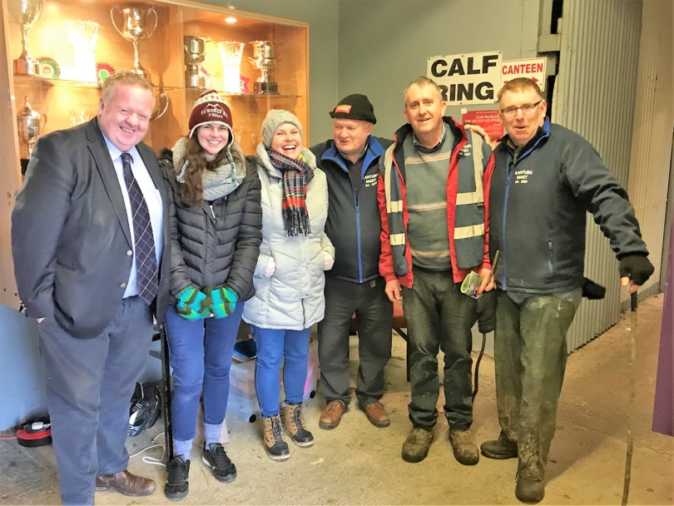
Thank you for listening.
12
12

