Slide 1



Human-animal interactions with implications for farmer safety during cattle handling
Farm Safety and Farmer Health seminar
September 29th 2020
Niamh Woods^{1, 2}, Mark McGee¹, Marijke Beltman², David Meredith³,
John McNamara⁴ and Bernadette Earley¹
¹AGRIC, Teagasc, Grange, Dunsany, Co. Meath, ²School of Veterinary Medicine, UCD, ³Teagasc, Rural Economy Development Programme, Ashtown, Dublin and
⁴Teagasc, Kildalton, Piltown, Co. Kilkenny.

Slide 2
BeSafe Task Objectives
Describe the factors that contribute to farmers' adoption of recommended farm safety management strategies
Develop safer work systems on farms for livestock handling and management of facilities
Promote the adoption of safer systems for handling livestock on farms

Slide 3
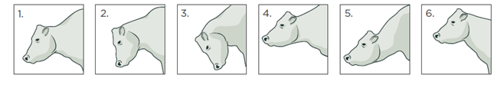

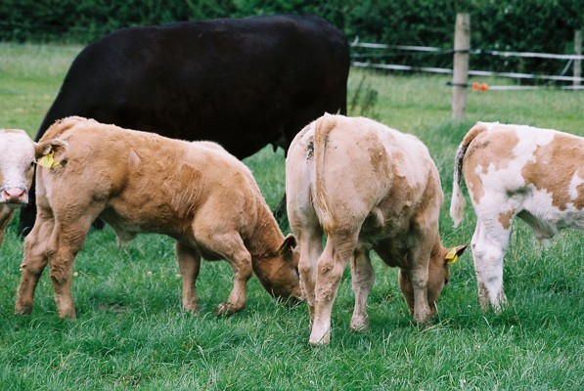
Communication
1
2
3
4
5
6
Postures
Odours
Sounds
Touch
Body postures of threats & aggression in animals
Neutral
Slightly antagonistic
Highly antagonistic
Confident approach
Submissive approach
Alert before flight

Slide 4
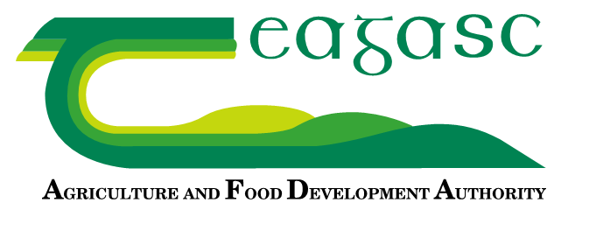
Objective
An investigation of the human-animal relationship (HAR) using housed pregnant dairy and beef origin heifers
To assess the fear/HAR responses over time in housed pregnant dairy and beef origin heifers using three behavioural tests; crush agitation (CA), exit speed from the crush (ES) and avoidance distance at the feed face (AD) to both a familiar and an unfamiliar person

Slide 5
Introduction
HAR: the perception between the human and the animal, which develops and expresses itself through their mutual behaviour (Estep, 1992, Waiblinger et al., 2006)
Ireland: Two replacement strategies used by suckler farmers to select replacement females
  Animals sourced within the suckler beef herd (SB)
  Animals sourced from the dairy herd (BDX)
No study to date has evaluated the HAR/fear responses of primiparous suckler cows of diverse genetic merit (GM) using standardised behavioural tests

Slide 6

Materials and Methods
63 first-calving heifers
  43 suckler herd (SB) origin
  20 dairy herd (DBX) origin
Observations and assessments
    Crush agitation (CA)
    Exit Speed (ES)
    Avoidance Distance (AD)
Days 43 & 86 post-housing
Days 51 & 99 post-housing

Slide 7
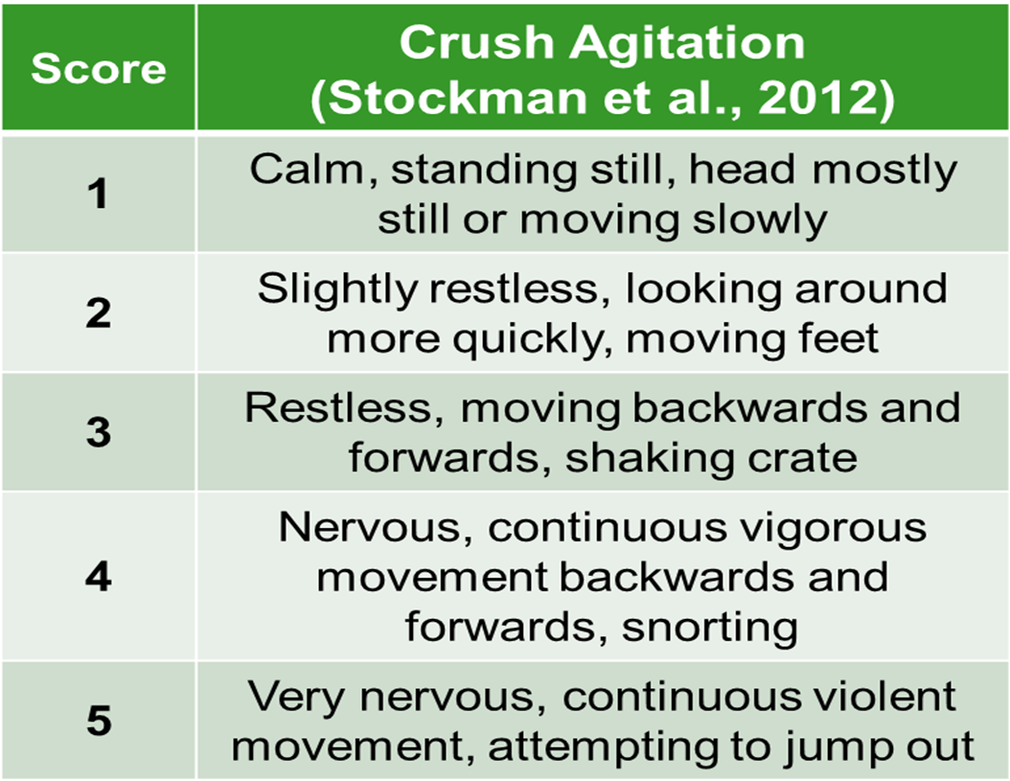
Materials and Methods

Slide 8
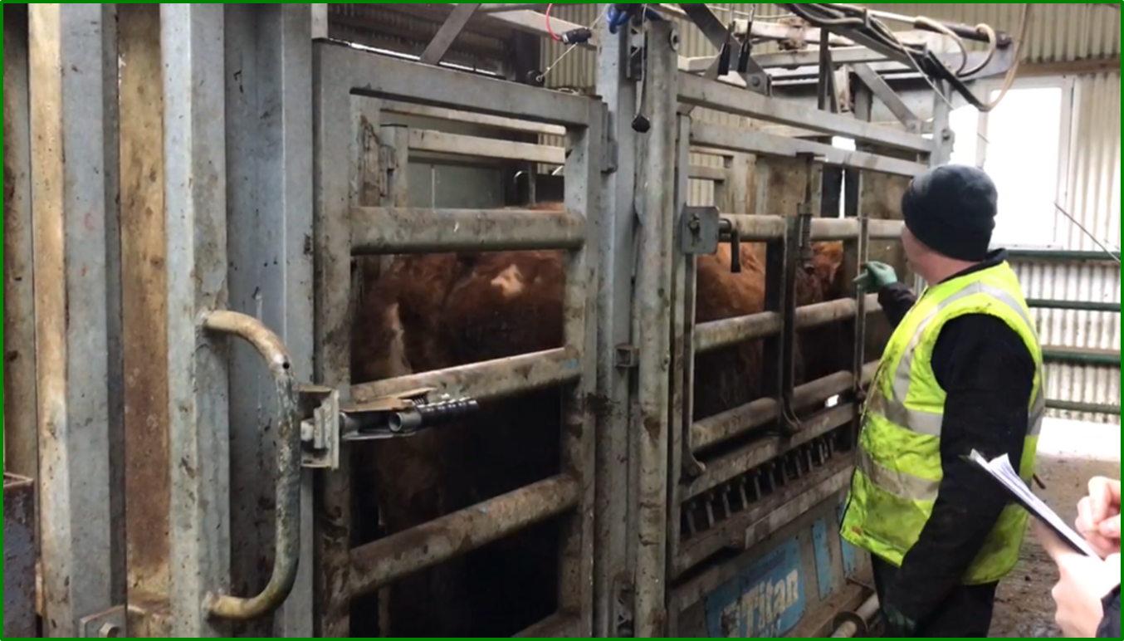
Crush Agitation

Slide 9
Materials and Methods
Crush Exit
Distance reached (meters) and time spent travelling to that distance (seconds) were recorded
Assignment of scores to the measurements of the test variables (Mazurek et al., 2011)
 | Score
 | 1 | 2 | 3 | 4 | 5 | 6
Latency Time (s) | 0.1-5.0 | 5.1-10.0 | 10.1-15.0 | 15.1-20.0 | 20.1-25.0 | 25.1+
Distance (m) | 21+ | 16-20 | 11-15 | 6-10 | 1-5
Notes:
Latency is a time interval between the stimulation and response

Slide 10
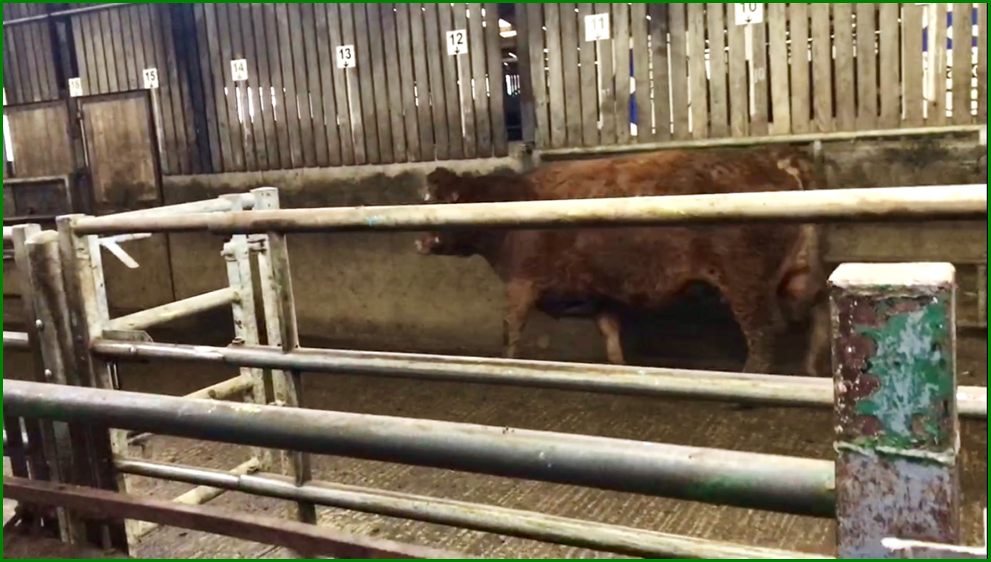
Crush Exit
Notes:
Latency is a time interval between the stimulation and response

Slide 11
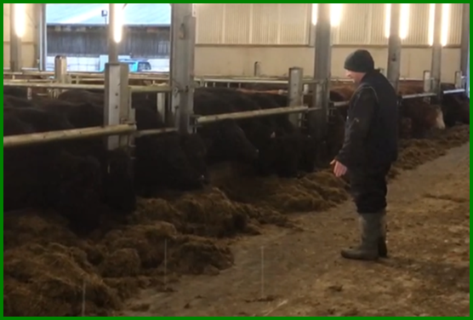
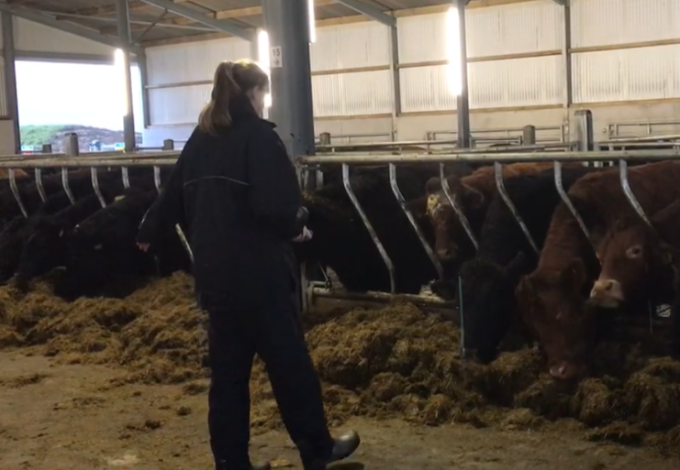
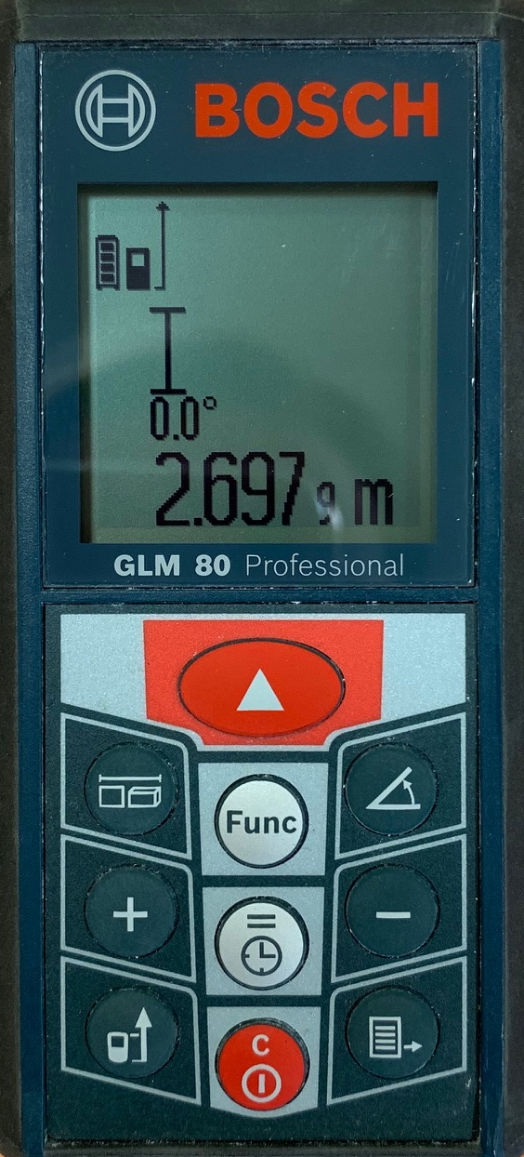
Materials and Methods
Avoidance
Distance
Familiar
Unfamiliar
11

Slide 12
Results
Crush Agitation and Exit Speed
  No difference was found between dairy and beef origin suckler heifers at either time point
Avoidance Distance
  Mean AD to unfamiliar was greater for beef than dairy-origin heifers on day 51(P=0.01), but did not differ between the breed types on day 99
  On day 51, AD to the familiar human was similar for both beef and dairy origin heifers whereas on day 99 it was lower in beef than dairy-origin heifers (P=0.02)

Slide 13
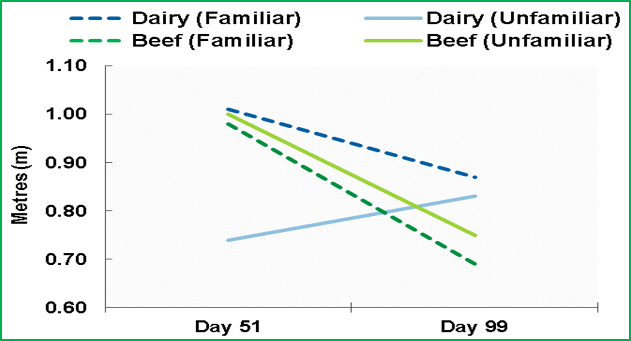
Results
Notes:
Mean AD to the unfamiliar human was greater for beef than dairy-origin heifers on d 51 (P=0.01), but did not differ between the breed types on d 99 (P>0.05) (Figure 3). In contrast, on d 51 AD to the familiar human was similar for both beef and dairy origin heifers (P>0.05) whereas on d 99 it was lower in beef than dairy-origin heifers (P=0.02).
From the three investigated tests, AD proved to be a more sensitive measure of the HAR and how cattle perceive humans, whether they are familiar or unfamiliar.

Slide 14
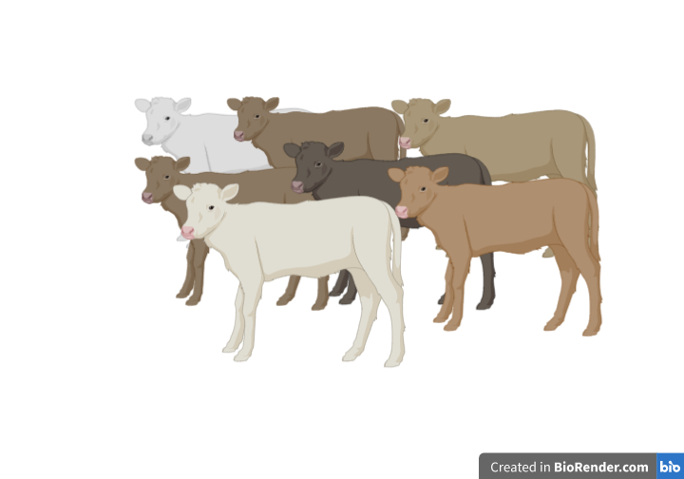
An assessment of purchased suckler bred cattle during routine handling procedures

Slide 15
Materials and Methods
Suckler Bred (n=153)
Early Maturing (n= 47), Late Maturing (n=106)
Female (n=74), Male (n=79)
Purchased 30/10/19 – 06/11/19
Mean Live Weight and Age (on arrival)
  307 (SD; 26) kg
  7.0 (SD; 1.2) months

Slide 16
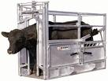
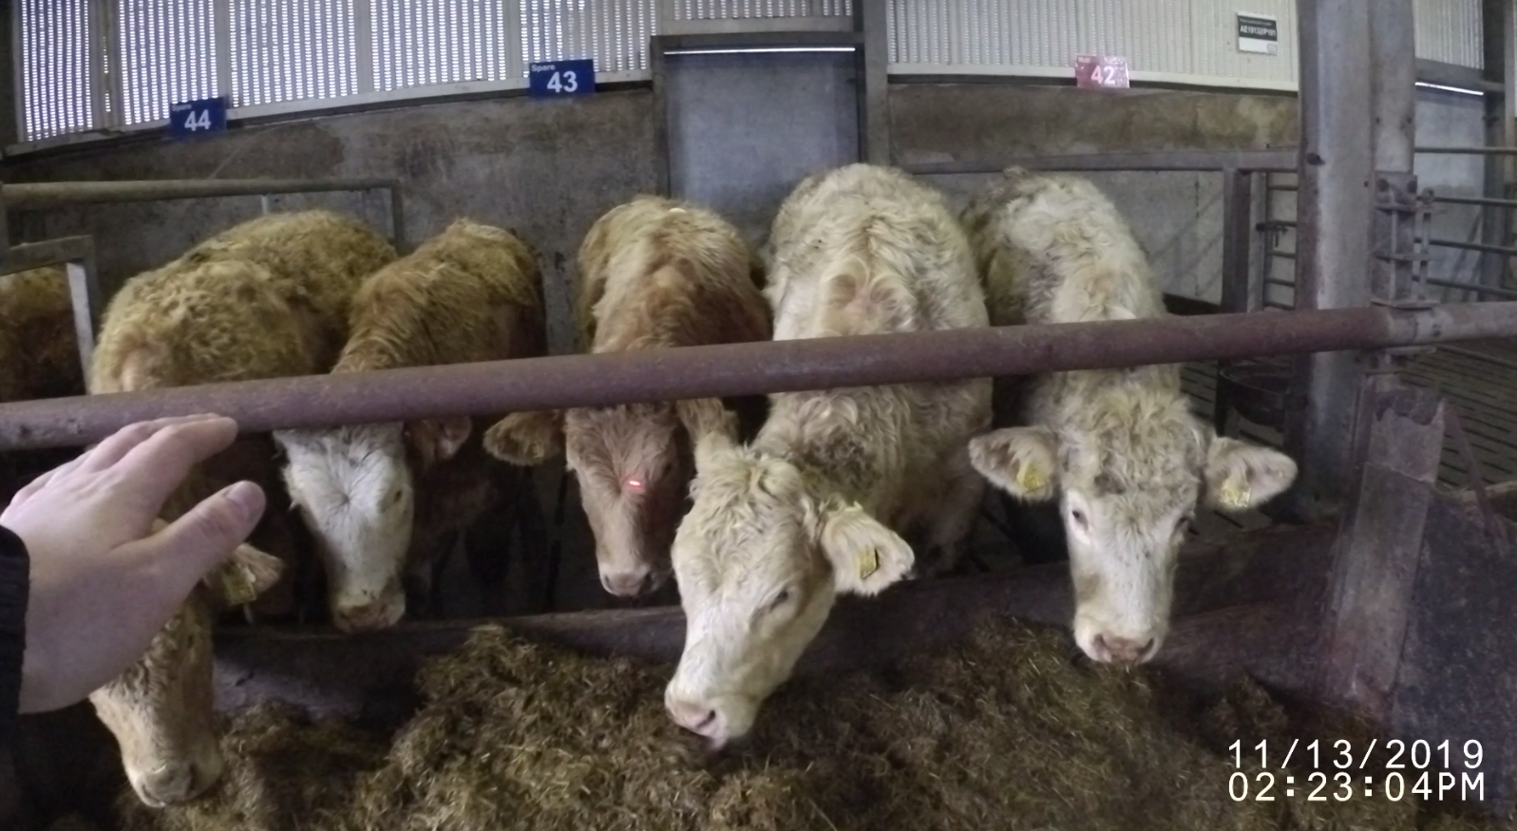
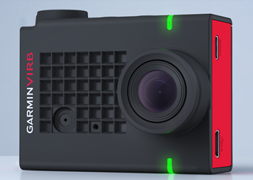
Materials and Methods
Crush agitation score (Stockman et al., 2012)
Exit score (Modified Lanier and Grandin, 2002)
Exit speed (CCTV recordings)
Avoidance distance (Modified Mazurek et al., 2011)

Slide 17
Materials and Methods
Exit Score
Scores were divided depending on whether each animal exited the crush freely or whether gentle persuasion was required to encourage the exit
Not Coerced |  |  | Coerced
Walk | Trot | Run | Walk | Trot | Run

Slide 18
Results

Slide 19
Results

Slide 20
Results

Slide 21
Conclusions
Animal Behaviour
Most animals respond to calm, gentle, and consistent handling.
Livestock become “flighty” when their ordinary routines or familiar surrounding change.
Understanding the behaviour of cattle and working with them slowly and quietly will reduce injuries on farm.

Slide 22
Acknowledgements
This research was supported under DAFM Stimulus funded project
(Ref: 17/S/269 RESL 0434)
We wish to acknowledge Mr. Eddie Mulligan for skilled technical assistance, and the farm staff at Teagasc, Grange for their care and management of the animals.

