Slide 1
MAgrSc Innovation Support Programme 2016-2018
Study title: Training Needs Evaluation of the Horticulture workforce in Leinster.
Student: Yvonne Grace
Supervisors: Dr. Caroline Elliott-Kingston, UCD and
Mr. John Mulhern, Teagasc.
Office location: Teagasc College of Amenity Horticulture, National Botanic Gardens. Dublin.

Slide 2
Objectives
A training needs analyses (TNA) will provide a snapshot of the skill level of the current horticulture workforce in Leinster.
Analyses of the data will discover;
  Are current employees and new graduates meeting the skills requirements
  of industry.
  Is training the answer to some of the issues experienced by industry stakeholders.

Slide 3
Methodology
The TNA sets out a framework, which employs a range of research tools
in order to collect data, which can be compared and contrasted.
Research tools;
  Interviews; Employees and members of Bord Bia, Teagasc, IFA, ALCI, GCSAI,
  and all levels of employees across the four sectors.
  Document analysis; National and European reports and legislation affecting
  the land sciences.
  Observations; site visits and placement in Teagasc.

Slide 4
Thesis Structure / Chapters
Contents
Abstract
2. Introduction
3. Literature review
3.1 Introduction
3.2 Document analysis
3.3 Horticulture education providers in Leinster
3.4 Horticulture industry sectors in Leinster
3.4.1 Turfgrass sector
3.4.2 Food producers
3.4.3 Garden centres
3.4.4 Nursery stock
3.4.5 Landscapers
4. Methodology
4.1 Introduction
4.2 Turfgrass sector
4.3 Food producers
4.4 Garden centres
4.5 Nursery stock
4.6 Landscapers
4.7 Document analysis
4.8 Interviews
4.9 Observations
5. Findings and analyses
5.1 Introduction
5.2 Turfgrass sector
5.3 Food producers
5.4 Garden centres
5.5 Nursery stock
5.6 Landscapers
6. Conclusion
7. Recommendations

Slide 5

Primary Findings
Gap Analyses
It can be difficult to have confidence in new employees.
There is a lack of motivation for employees to progress.
We need employees to bring real added value to the business.
Owner / managers find it difficult to delegate.
Supervisory skills and training.
Transparency around work place expectations and prospects.
Possibly untapped skills; social media, marketing, language.
People management skills.

Slide 6
Potential for knowledge transfer
Gap Analysis
Solutions
Identified need for people management skills.
Supervisory skills.
Transparency around work place expectations.
Possibly untapped graduate skills; social media, marketing, language.
People management training module.
Supervisory CPD training.
Teagasc can facilitate discussion groups.
Communication in the workplace, new framework.

Slide 7
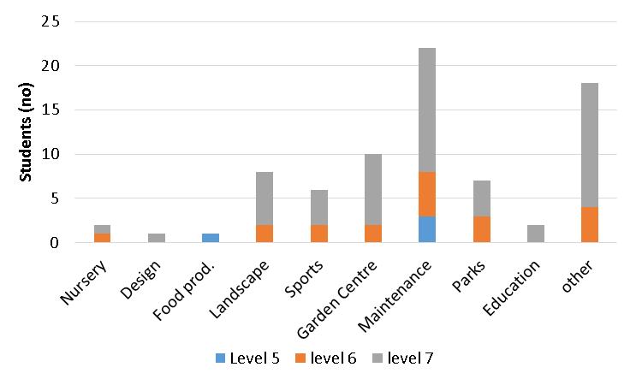
Key Findings
Student survey 2016
131 respondents
90% from last 5 years
70% from level 7
Source: Dr. Paul Fitters
Where did students find work

Slide 8
Conclusions to date
OECD research highlighted skills needed by industry for the future; human capital, creativity, advanced reasoning, complex judgment, emotional intelligence, social interaction and problem solving.
A the recent FoodWise 2025 Conference, the attendees were asked Which theme do you consider most important?; Results were; Sustainability 41%, Innovation 20%, Human Capital 16% , Competitiveness 13% and Market development 11%
                Recommendations will offer solutions regarding training, in order for stakeholders to remain competitive within their sector.

Slide 9
Steps to completion
October –December 2017
Interviews, transcription, data analyses.
January – March 2018
Conclusions, write up draft document.

Slide 10
Thank you for listening
                References
Dr. Paul Fitters
OECD (2017), Getting Skills Right: Skills for Jobs Indicators, OECD Publishing, Paris.
http://dx.doi.org/10.1787/9789264277878-en
The OECD Programme for the International Assessment of Adult Competencies (PIAAC) http://www.oecd.org/skills/piaac
Macroeconomic benefits of vocational and education training - www.cedefop.europa.eu/files/5540_en.pdf

