Slide 1
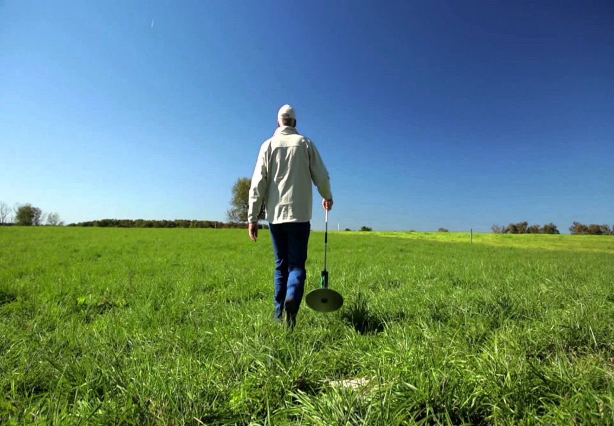
MAgrSc Innovation Support Programme 2016-2018
Study title: An examination of why dairy farmers who measured grass during their role as monitor farmers discontinued the use of this technology
Student: Padraig Fogarty
Supervisors: Dr. Karina Pierce(UCD) Mr. John Maher(Teagasc)
Office location: Kilmallock

Slide 2
Objectives
To investigate why farmers trained to measure grass, discontinued the use of the technology
To compare these reasons with farmers who continue to use the technology
To identify KT skills/supports to improve the uptake of the grass measuring technology using feedback from this study

Slide 3
Methodology
Semi-structured interviews (SSI’s) with farmers who discontinued & partially discontinued measuring grass (n=16)
SSI’s with farmers who continue to measure grass (n=8)
Focus group with farmers measuring grass & industry stakeholders
Focus group with farmers who discontinued and partially discontinued the use of measuring grass

Slide 4
Thesis Structure / Chapters
Introduction
Literature Review
Methodology
Study Findings
Summary of Main Findings, Conclusions and Recommendations

Slide 5
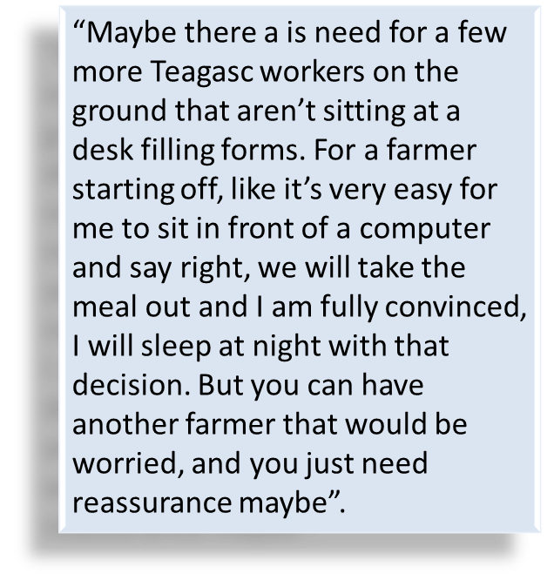
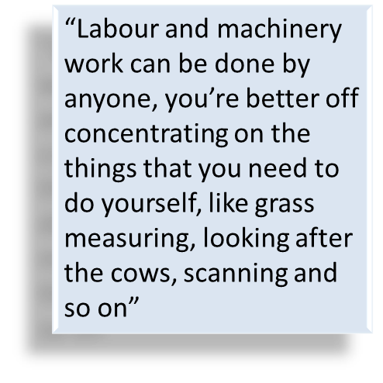
Farmers Measuring Grass
Extremely confident in using technology
Prioritise grassland management
Convinced of benefits
Recommendations:
KT impact- one to one support critical in teaching farmers
More emphasis needed at education level
These farmers believe more Teagasc workers needed “on the ground”

Slide 6
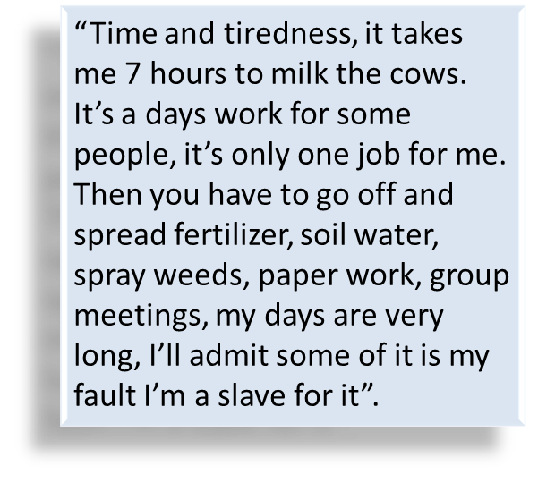
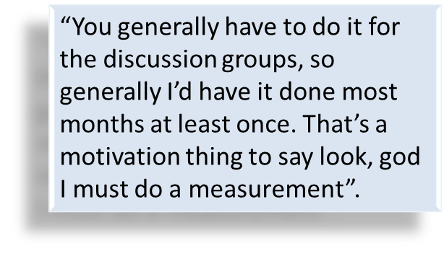
Farmers Partially Measuring
Reasons for not measuring consistently:
Lack of labour & time
Motivation
Confidence issue in decision making
However;
Generally have ambition to measure grass consistently in the future
Recommendations:
Make measuring technologies more reliable & user friendly
Facility needed where measuring is contracted out or purchase a measuring device on quad

Slide 7
Farmers Not Measuring
Lack of confidence in using the technology, especially decision making
Fear of running out of grass supply
Time is big factor, farmers doing a lot of machinery work
Don’t like the actual physical effort of going out walking the whole farm
Perception of circumstances
A lot of these farmers never measured grass consistently
“We weren’t using the information so there wasn’t much point in doing it really, not being experienced enough and not being used to it from day one, you would trust it then like”.
“You would be working off your own initiative more than looking at the figures. You would be always playing it safe more than taking chances of taking out too much ground”.

Slide 8
Conclusions to date
Farmers who measure grass prioritise grassland management
Farmers who partially measure grass don’t prioritise grassland management
Farmers that don’t measure grass have a lack of confidence in the technology
One to one support and grass groups are critical in the adoption of grass measuring

Slide 9


Steps to completion
December Finish 6 remaining SSI’s
December 19th Carry out focus group
January & February Carry out 2nd focus group, finish transcribing & analysing data
March to June Thesis write up

