Slide 1
MAgrSc Innovation Support Programme 2016-2018
Study title: An examination of categories of dairy farmers in Mayo based on their adoption of certain farming technologies
Student: Wesley Fennell
Supervisors: Jim Kinsella (UCD) and Mark Moore (Teagasc)
Office location: Ballinrobe, Co. Mayo

Slide 2
Objectives/Research Questions
To identify categories of Mayo dairy farmers based on their adoption of selected technologies
To relate the categories of dairy farmers identified to Rogers’ categorisation and other categories identified in the literature
To identify factors affecting the uptake of particular technologies for the identified categories of farmers

Slide 3
Methodology
Postal Questionnaire to 189 dairy clients in Mayo. Received 95 questionnaires. A response rate: 50.2%
Follow up period of 4 weeks – Reminder text sent out week 1 + 2 from postage. Phone calls carried out in week 3 + 4
Questionnaire collected data on: socio-economic characteristics, communication, intentions and uptake of grass measuring, EBI and e-Profit monitor
Interviews to identify factors affecting the uptake of these particular technologies for the identified categories of farmers
Notes:
Mention response rate, piloting, description of questionnaire
Brief mention of the scoring method and one or two examples as to why a farmer may get a 6 vs 0 etc.
If five categories confirmed there will be 2 interviews with 2 farmers from each category randomly sampled
Postal questionnaires have proven to be an efficient way in collecting data of farmers in assessing adoption of particular innovations (Tate, et al., 2012) (Marshall, 2009) (Best, 2009)
Scoring method has also been used in research to measure adoption, knowledge and social values of farmers (Agbamu, 1995) (Duguma and Hager 2011) segmentation within agriculture (Hossain, et al., 2009)
And semi structured interviews have also proven to be a productive method in gaining a qualitative insight of farmers (Lindahl and Lundqvist 2010) (O'Keeffe, et al., 2016) (Chowa, et al., 2013) I aim to interview two farmers from each category

Slide 4
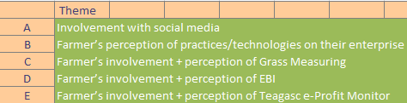
Measuring Innovation: Themes and Scores
In scoring each theme:
0 – most negative perception/involvement/intentions
6 – most positive perception/involvement/intentions

Slide 5
Categories of Dairy Farmers
Advanced, Progressive, Sustainable, Deliberate and Conservative
Names derived from other categorisation studies e.g. (Barnes et al., 2011) (Galdies et al., 2016) (Cummins, 2007)
These category names ‘grouped’ into positive/negative group
Brainstormed for similar or commonly occurring names

Slide 6
Category Scores
Advanced farmer (n=8) – Average score of 23.87 (range 27 – 23)
Progressive farmer (n=16) – Average score of 19.75 (range 22 – 19)
Sustainable farmer (n=31) – Average score of 15.83 (range 18 – 14)
Deliberate farmer (n=24) – Average score of 11.54 (range 13 – 8)
Conservative farmer (n=16) – Average score of 4.68 (range 7 – 2)
Notes:
Description of each category

Slide 7
Characteristics of Farmers in each Category
 | Advanced farmers | Progressive Farmers | Sustainable farmers | Deliberate farmers | Conservative farmers
No. of farmers | 8 | 16 | 31 | 24 | 16
Age of farmers (yrs) | 50 | 47 | 53 | 55 | 53
Farm size (ha) | 48 | 55 | 49 | 48 | 61
Herd size (no. of cows) | 48 | 76 | 62 | 57 | 74
3rd level education (%) | 38 | 38 | 25 | 25 | 43

Slide 8
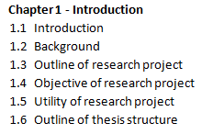
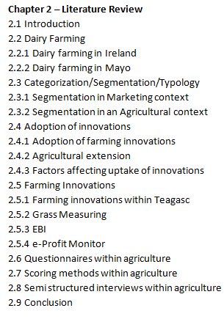
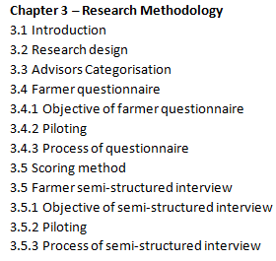
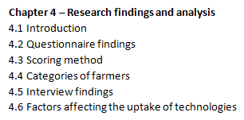
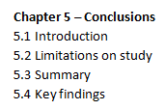
Thesis Structure / Chapters

Slide 9
Conclusions to date
There is a range in how innovative dairy farmers are within Mayo
The more innovative the farmer, the more important they perceived sources of information
Within the population of respondents, almost 3 in every 4 farmers are interested or very interested in taking on new farming technologies/practices

Slide 10
Steps to completion
December/January: Pilot Interviews – 3 pilot interviews
January – February: Carrying out 10 interviews (2 per category)
March: Data analysis
April – June: Thesis write up

Slide 11
Thank you for your time…
Questions?

