Slide 1


MAgrSc Innovation Support Programme 2016-2018
Study title: Determination of what is needed to enhance access and participation for learners with diverse ability levels in agricultural education programmes.
Student: Gráinne Mc Grath
Supervisors:Dr. Donna Deegan (Teagasc)
Dr. Karen Keaveney(UCD)
College location: Kildalton Agricultural College
Research Study Report
1

Slide 2


Research Objectives
Explore the attitudes /needs of students of diverse abilities
Critically assess the attitudes of staff towards students of diverse abilities
Identify training & supports needs of staff when teaching a diverse class
Provide recommendations for student supports

Slide 3
Methodology
Students
Students of diverse needs- Specific Learning Difficulty informed by initial survey
14 Interviews in TOTAL to be held throughout the months of Sept/Dec
Access Officers
2 Preliminary Explorative Interviews completed
Focus group was held with all access officers on Sept 8th
Educators
Identify attitudes of staff members towards students of diverse needs
Focus groups to be held in Jan
7 Students: College A
7 Students: College B
Experiences as access officer with students of diverse needs
Focus groups to be held with both newly appointed staff and experienced educators

Slide 4


Thesis Structure
Chapter 1:
Introduction
Background to study
Chapter 2:
Literature review
Diverse Learners
Specific Learning Needs
Universal Design for Learning
Chapter 3:
Research methodology
Source & collection of data
Analysis of data
Chapter 4:
Research Analysis & Findings
Student Perspective
Chapter 5:
Qualitative Analysis
College Perspective
Teacher and Access Officers
Chapter 6:
Discussion, Conclusions and Recommendations
Conclusions from study
Implications of study
Recommendations & Suggestions for further research

Slide 5
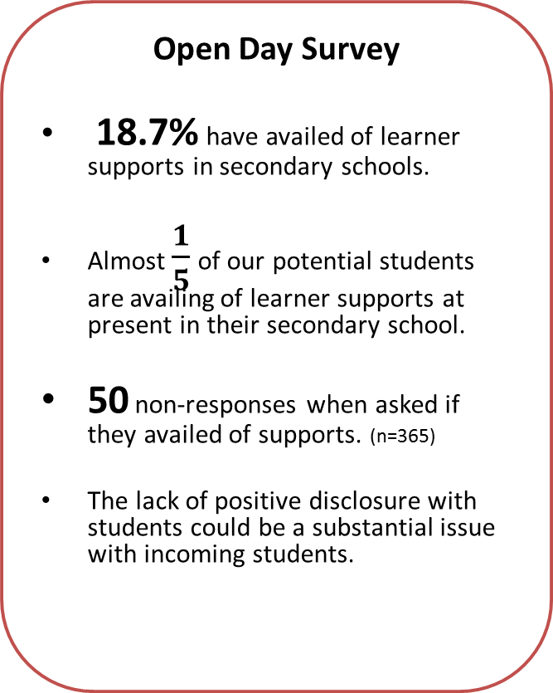
Preliminary Findings To Date
Access Officer 1:
“yea, oh 100%, I really do think so, like I think for somebody to come in and try and do it from the very start , your very much being thrown into the deep end”
“….maybe if you had training at the very start where people are to you; look this isn't going to be plain black and white” “Training is a must.”
Open Day Survey
18.7% have availed of learner supports in secondary schools.
Almost $\frac{1}{5}$ of our potential students are availing of learner supports at present in their secondary school.
50 non-responses when asked if they availed of supports. (n=365)
The lack of positive disclosure with students could be a substantial issue with incoming students.
Preliminary Explorative Interviews
Benefits from some type of training
Resources to support students
Access Officer 2:
“ No, first of all I think that access in its very simple form should be a college community based support, ok? It takes all of the team, its takes everybody from admin. to Principal to teacher to everybody, we’re all on board to support that student”

Slide 6
Preliminary Findings
“Oh no just because of my uncle, I never heard anything like that or about that from college.”
Access Officer Focus Group
What was highlighted?
The need for:
More communication between college AOs
More training available for AOs
Standardisation across ALL colleges
Student Interviews
Main themes emerging so far….
Agricultural college/nature of course works well for students with SLD
Not enough emphasise on Assistive Technologies
A lot of dyslexic students learn only by listening.
Standardisation of what ?
College A
College B
Education Psychologist
Report= SUPPORTS
No Education
Psychologist
Report= SUPPORTS
“Yep, like if I was in a class sitting down listening and a teacher asked us what we done 5 weeks ago I could say about 70% of it like, but after that, handouts or whatever no way, it’s just completely by listening like”

Slide 7
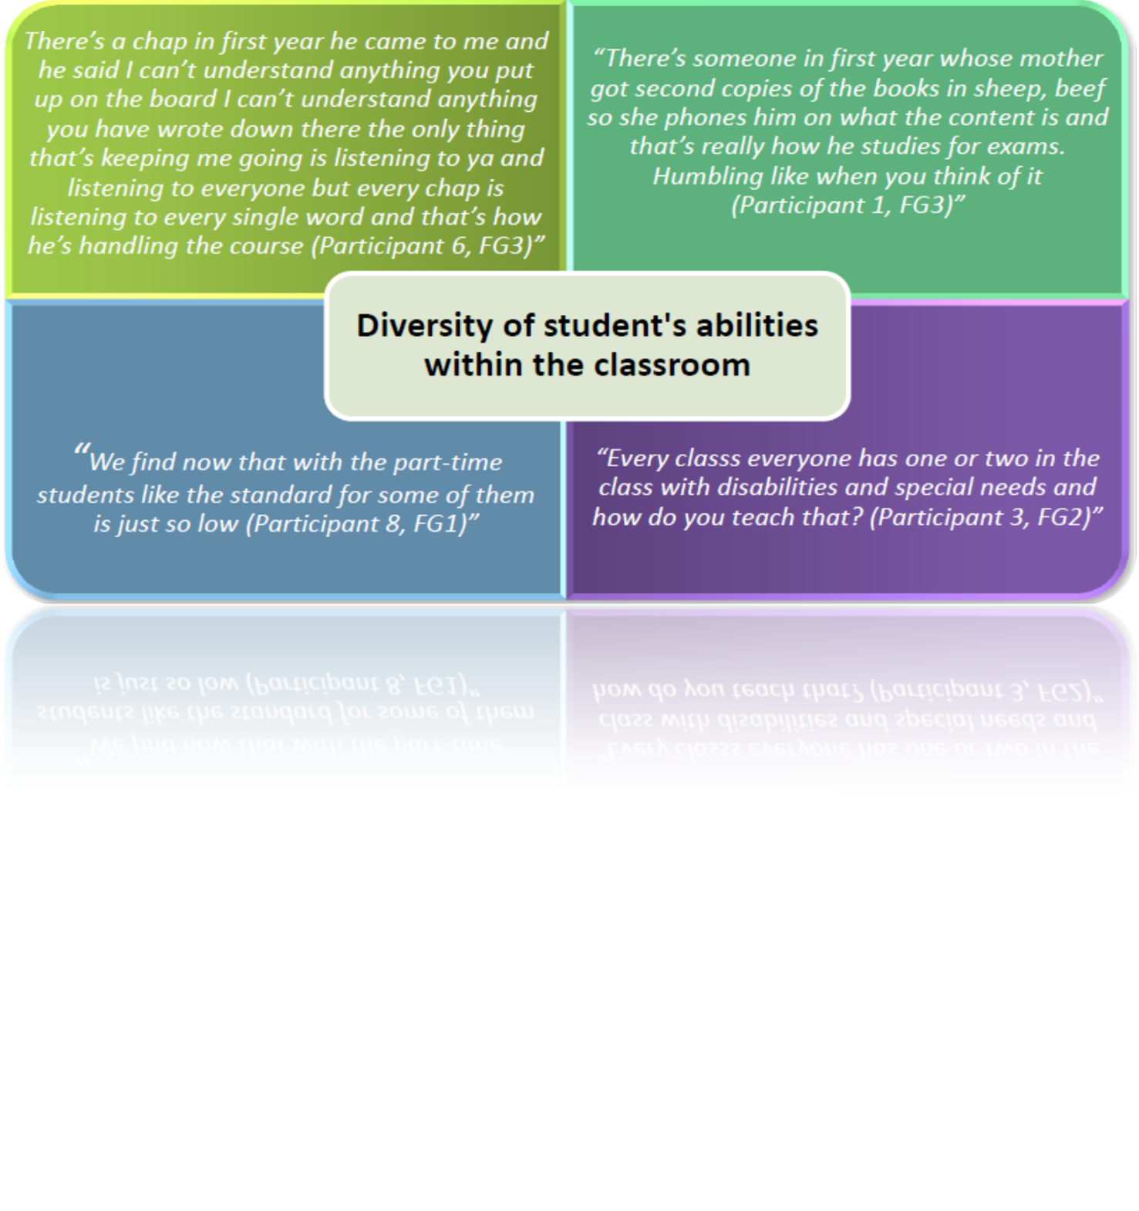
Secondary Data
Sinead Flannery; PhD MAIS Student
“I would have loved if the lecturers all had a little voice recorder yoke in their top pocket or their chest pocket there like and when they are reading out the book, or reading out the PowerPoints .. Like I was leaving the phone on the table same way as you were like in some lectures its hard like.. you can’t hear anything. But I suppose with the teacher if they only had one in their pocket that only catches sound very close like.”

Slide 8
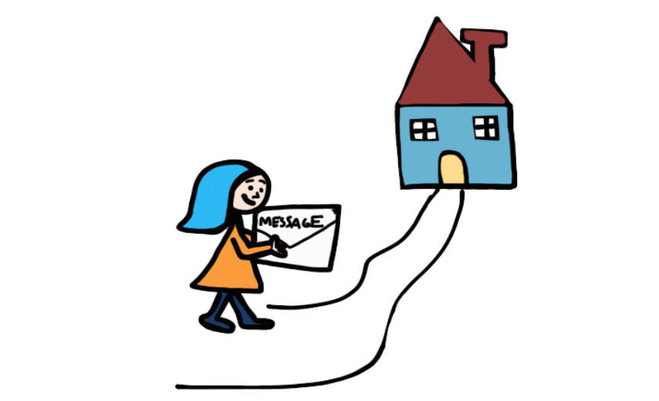
Conclusions To Date
S
U
P
P
O
R
T
TANDARISATION
NITY
ROMOTION OF ASSISTIVE TECHNOLOGIES
OSITIVE DISCLOSURE
RGANISATION
EFORM OF CURRICULUM
RAINING NEEDS

Slide 9
Steps to Completion
December
Complete Student Interviews
January
Complete transcription of interviews
February
Literature Review
Develop Literature review further
Analysis of data
Second Focus Group:
No Teaching Hours from this point on.
Complete Methodology Chapter
Add to Literature review
2. Inexperienced Staff
1. Experienced Staff

Slide 10
Steps to Completion
March
Analysis of data
April
May/June
Write up & Corrections
Write Up
Review Project Proposal
Complete Results Chapter
Complete Recommendations Chapter
Hand-up

Slide 11


Thank You
For Your Attention.

