Slide 1
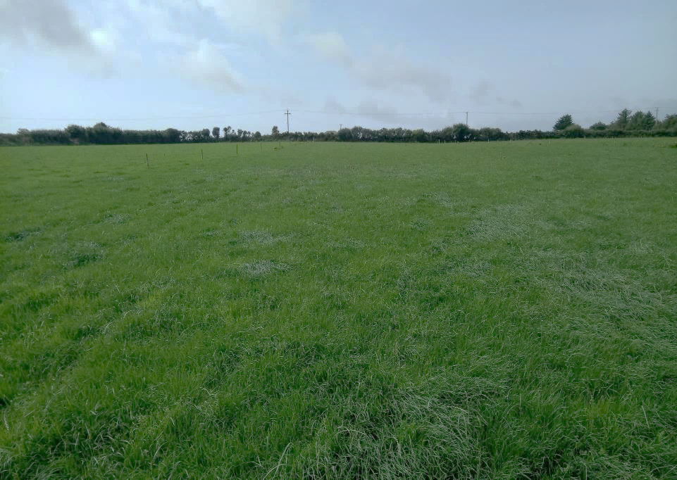
Study title: Assessing extension methods to promote uptake of computer aided grass management in dairy discussion groups
MAgrSc Innovation Support Programme 2016-2018
Student: Niamh Garvey
Supervisors: Dr. Bridget Lynch (UCD) and George Ramsbottom (Teagasc)
Location: Johnstown Castle Advisory Office, Co. Wexford

Slide 2
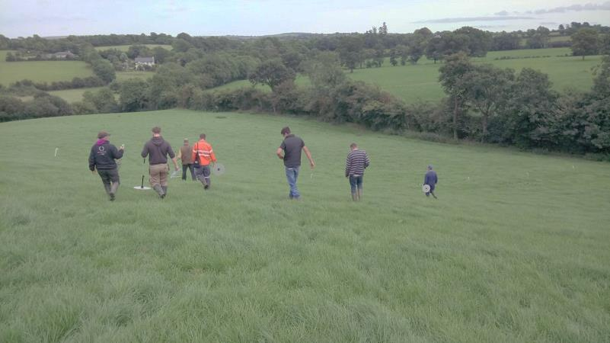
Study design
Quasi -experiment
Intervention Category | n= | Extension methods applied
Intensive Year 1 | 17 | Grass focused DG meetings each month One to one support available to farmers Group messaging between meetings – “virtual DG”
Semi-intensive Year 2 | 14 | Grass focused DG meetings each month Group messaging between meetings – “virtual DG”
Extensive | 44 | General dairy DG meetings Grass discussed along with other topics including breeding, financial management, labour, health and safety.

Slide 3
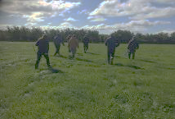
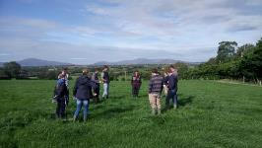
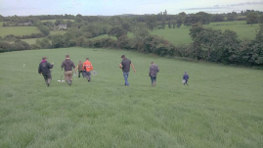
Overall Aim: to examine the level of adoption of grass measuring and internet based grassland management support tools among dairy farmers in Discussion Groups with different levels of extension support available
1. Which extension method is the most effective, what are it’s characteristics?
2. What attitudes and beliefs affect adoption behaviour?
Research questions
3. Are the findings of this study applicable to other technologies?
4. What resources are required?
Notes:
Say the overall aim and go through research questions,

Slide 4
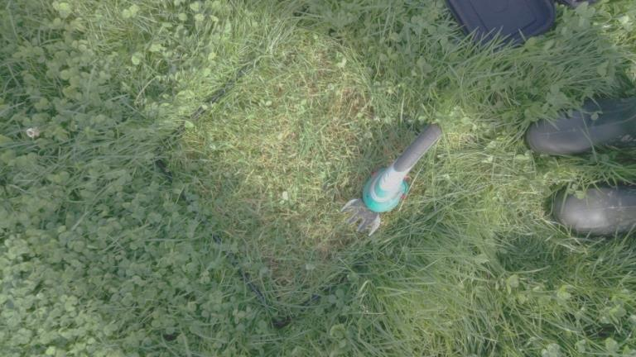

Questionnaires
5 Focus groups
Semi- structured interviews
Methodology
Questionnaires
69 farmers
Focus groups with farmers
X 5
Semi – structured interviews
9 farmers
4 facilitators
Questionnaires
69 farmers
Focus groups with farmers
X 5
Semi – structured interviews
9 farmers
4 facilitators
Notes:
(1min)
Explain: started with questionnaires – covering : Measuring, budgeting, support for adoption and demographics , piloted, administered during group meetings, n=67 group participants
Mention: attendance at groups during the year – allowed me to understand – design focus groups and interviews more effectively
Focus groups used to provide supplementary info to the results of the questionnaires with each of the three categories,
Semi-structured interviews
9 farmers selected for interview, 3 from each category, min , max and average number of measurements to date, Interview guides were designed based on the theory of planned behaviour and semi-structured, Theory of planned behaviour – explain briefly – Behavioural belief, Normative belief and Control Belief. Advisors interviewed (n=4) – covers facilitators of all three categories and allows comparisons between them.
PastureBase – level of use

Slide 5
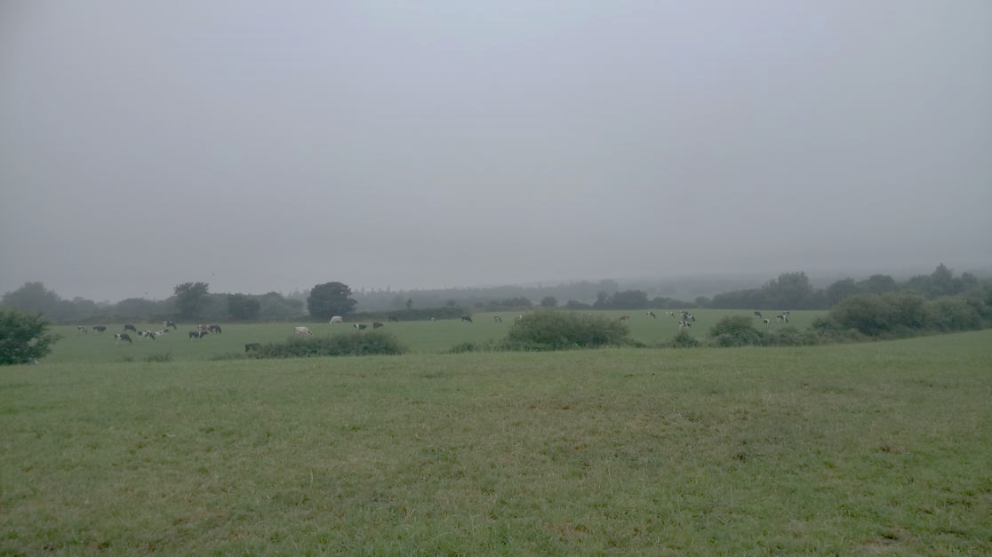
Thesis Structure
Chapter 1: Introduction
Chapter 2: Literature review
Chapter 3: Methods
Chapter 4: Research findings
Chapter 5: Discussion and conclusion
Chapter 6: Recommendations and implications
Notes:
(<0.5 mins) No need to read these out - time??

Slide 6
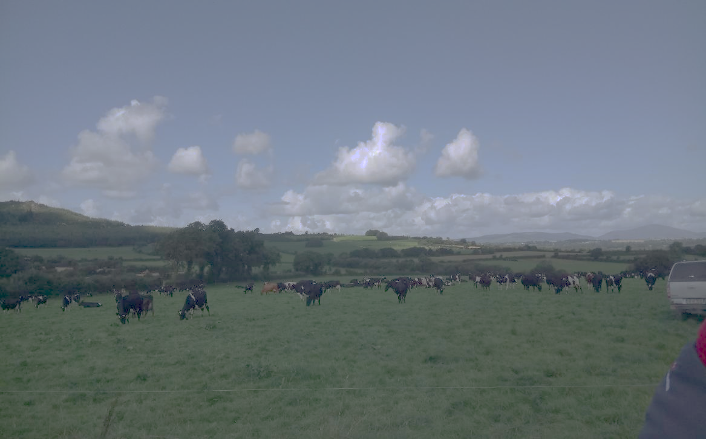
Key Findings
All agree potential benefits "We agree with the theory”
All agree both grass measuring and PBI are useful
Intervention category | % who felt grass measuring was easy to do | % who felt PBI was easy to use | % who felt adequate support could come from a DG | % who felt they were getting the necessary support
Intensive | 100% | 92% | 69% | 100%
Semi-intensive | 93% | 64% | 62% | 92%
Extensive | 87% | 62% | 55% | 68%
“It’s easy put the measurements in, but it’s not easy to know what to do with them”.
“In a progressive group it can be (enough support from a DG alone) if all participants are focused on grass measuring”
Notes:
1 min
(Davis 1989) Useful and easy to use All believe in “the theory” , more individual support is needed by some but only 54% availed of this in I,
The majority of farmers in all categories felt grass measuring is easy to do, The majority in all categories felt PBI was easy to use however this was highest (92%) in category I – getting the support, Lower in SI - ‘It’s easy put the measurements in, but it’s not easy to know what to do with them’. They have moved from input of a grass cover to using other aspects of PBI, including the feed budget and are ‘finding it hard to learn’. As a result, 36% of SI felt that PBI is not easy to use.
Know if asked
85.71% in I members of a discussion group previously (n=14).
92.3% in SI(n=13).
81.08% in E
Years in a DG Mode bands : E 5-6, SI 5-6, 9-10 and >10, I 3-4
“In a progressive group it can be (enough support from a DG alone)if all participants are focused on grass measuring” – Participant in SI Questionnaire”
“People can do it if they really want to, mabye support in regards the computer aspect”. I

Slide 7
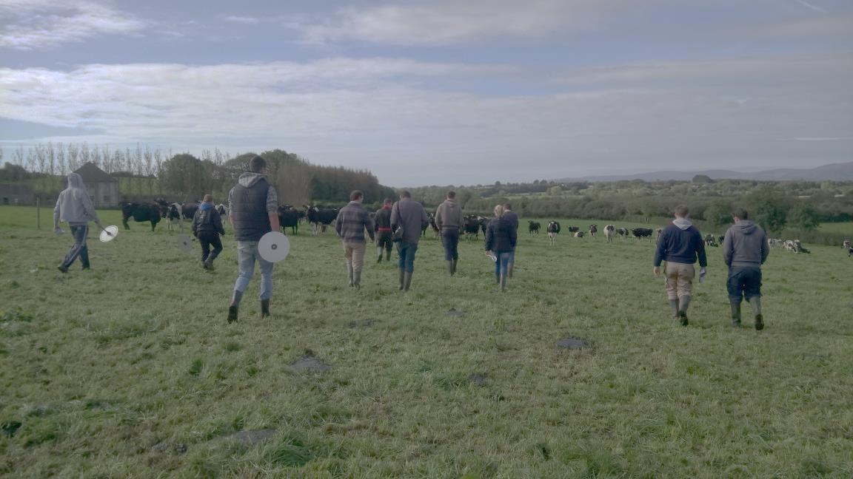
Key Findings
Intervention category | % who used PBI | > 10 grass measurements | Av. number measurements recorded
Intensive | 100% | 35% | 12
Semi-intensive | 100% | 79% | 18
Extensive | 25% | 11% | 2
Of the 25% in the Extensive category using PBI –average number of measurements was 9
Notes:
1 min
Farmers in the SI category had the highest level of adoption of PBI during this study.
All participants in I and SI intervention categories used PBI to some degree. Range 1-48.
While the average number of measurements in the E category was 2, the 25% of farmers in this category who used PBI averaged 9 measurements in 2017 (to 21/11/17)
Recorded grass measurements in SI in 2017 to date are 44% higher than in 2016 (average of 8 measurements recorded).
When recorded grass measurements by SI in 2016 were compared to I in 2017, farmers in the latter category recorded 66% more measurements to the 21/11/17 than those in the SI category in 2016 (their first year using PBI).

Slide 8
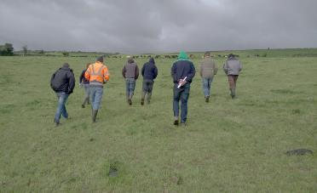
Key Findings
Time
Time to do the walk :“Its prioritizing jobs”
Time to use computer : I don’t always go back to the computer, … an app would help”
Computers
“You have to turn on the computer… and that’s not on with me”.
Experience with KT groups – major issue – general computer skills
Adoption increases when other elements of the farmers’ environment make it easier to follow through on decisions (Garforth et al., 2004)
Jargon/understanding
“The easiest part is measuring the grass”
“your not going to do it if you don’t know what it means”
“It’s like learning a new language” - Repetition and time
Notes:
1.5 min
App – can reduce time and computer skills barriers – ability to use technology is something we can’t overlook – computer session at the end of DG meetings run in Johnstown castle last week- level of computer skills in KT groups was shocking – can’t expect these people to use PBI or jump to talking to them about grass budgets etc. if general computer skills are not there.
App- came up in all focus groups
18.42 % of the Extensive category had no agricultural qualification. None of the Intensive o r Semi-intensive category choose this option- all had at least a cert in ag/ green cert.
If asked/time
The average age of the all participants (n=67) was 41, with a range from 18 to 65. The average ages in each category was 35 (n=14), 39(n=14) 44 (n=39) in Intensive, Semi-intensive and Extensive respectively.
Years dairy farming – same trend as age 10, 17, 20
(One person in the Extensive category had a level 9 qualification, an Msc. This person had no PBI use in 2017 and was not previously on PBI. One farmer in the Extensive category did not answer this question)
55.55% of (n=14) in the Intensive category had children. 71.28% in the Semi-intensive category had children and 57.89%(n=14) in the Extensive category (n= 38) – Much lower average age in the Intensive category, - having children-leading to more financial pressure came up as a reason to measure grass as part of maximising farm output.
42.85% of both the Intensive and Semi-intensive categories did not have an identified successor. 14.28% of the Intensive category did, 35.71% of the semi-intensive did, however this question was not applicable to 42.87% of the Intensive category and to 21.43% of the Semi-intensive category. 35.14% (n=37) of the Extensive category had an identified successor but 48.65% did not, question was not applicable to 13.51% of the Extensive category.
Full quotes :
“Its prioritizing jobs” like at times of the year I would be focused on other things”
Low control belief, with computer skills - major barrier for some farmers
“AFC there 1,000…..but what does that mean?”
“The easiest part is measuring the grass” knowing how to use the information then is different”

Slide 9
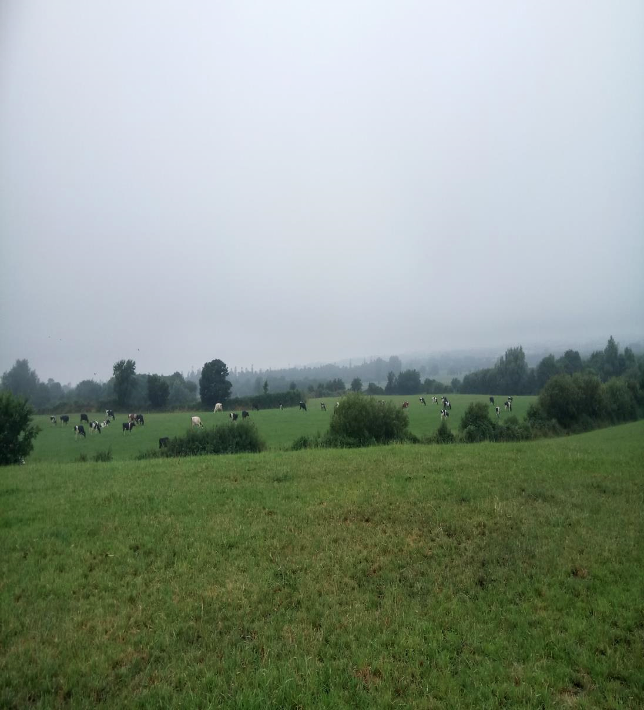
Key Findings
Different farmers – different barriers – need different supports
“the most important job…every week… what makes me the most money”.
“well sure I know what they are talking about , I’m able to talk about it now anyway”
“happy enough with what we are doing with that end of things (grass)”
Notes:
1 min
Those measuring that need continued support to continue to do so and improve ‘the most important job…every week… what makes me the most money’. Farmer started measuring this year, was not doing so previously – 48 recorded measurements – theory of planned behaviour interview- linked it straight to milk solids – profit, associated use of the technology with the DG, as did all three farmers in the SI category.
“well sure I know what they are talking about , I’m able to talk about it now anyway” – in I
Those who are not but want to learn – computer, jargon and time issues -
Those that do not see measuring and budgeting as a priority- still agree it is important and that using this technology would be beneficial. Do still see grass as important and feel they are measuring it, A farmer in I availed of one to one support yet still held low control belief in relation to computer skills, yet he felt his ‘(grassland) management has improved’ as a result of being in the group.

Slide 10
Conclusions to date
Farmers in discussion groups are aware of and believe in the benefits of grass measuring and internet based tools.
Barriers: computer skills, time and understanding related jargon but different barriers for different farmers
Adequate support for adoption can come from a discussion group; individual support is not always necessary.
Computer training - skills and understanding needed by some.
A mobile app for PBI would reduce computer skill and time barriers.
Notes:
(0.5 mins)

Slide 11
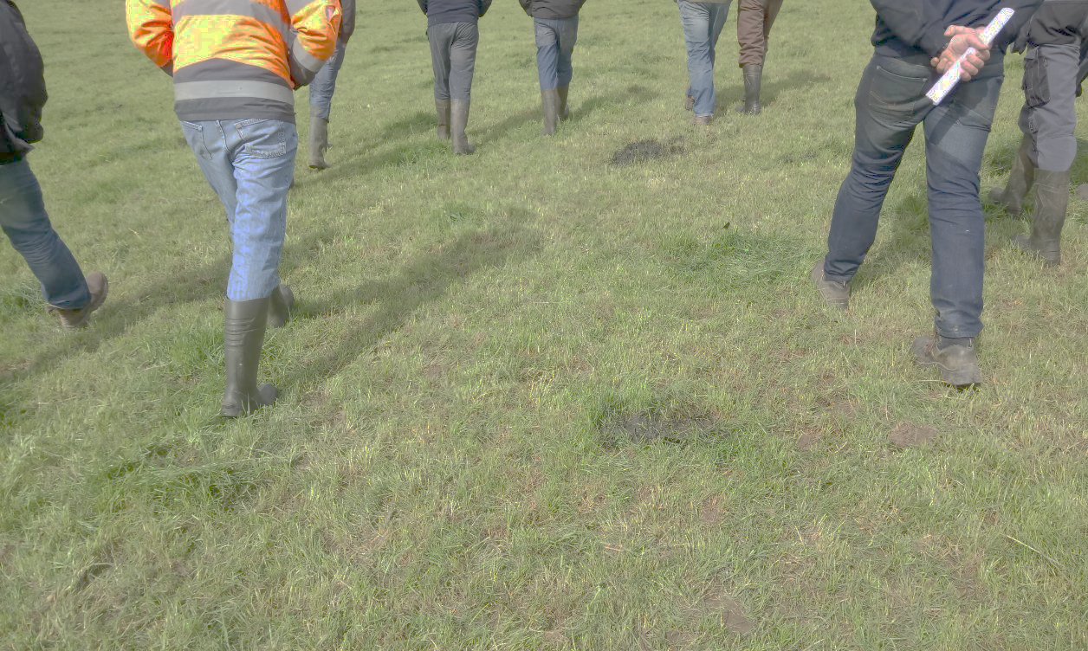
Steps to completion
December/January | Finish transcription Methods chapter Research Findings chapter
February/March | Research Findings chapter Draft 2 Literature review Discussion, Conclusions and Recommendations Chapters Paper submitted to European Grassland Federation 2018 – decision on acceptance in February France 26th - 30th of March
April | Transcription and analysis from trip – add in to thesis Discussion, Conclusions and Recommendations Chapter
May/June | Finish wright up European Grassland Federation ?
Notes:
<0.5 min

Slide 12
Thank you

