Slide 1
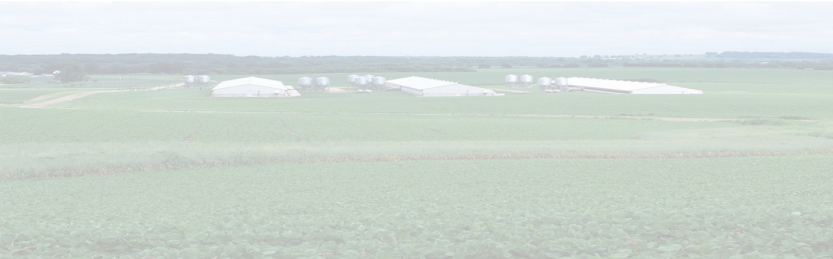
MAgrSc Innovation Support Programme 2016-2018
Study title: Develop & assess visual & digital tools for KT in the pig Industry
Student: John Moriarty
Supervisors: Dr. Aoife Osborne UCD
Dr. Amy Quinn Teagasc
Office location: Pig Development Department,
Teagasc, Moorepark

Slide 2
Study Objectives
Identify requirements of Teagasc advisors & clients
2. Develop tools for use in pig advisory & pig education services
3. Pilot & evaluate tools with farmers & advisors
4. Create templates for future development
2

Slide 3
Study Methodology
Population
PDD Advisors
Farm
Managers/Owners
Farm Staff
Sample
6 PDD Advisors
5 Discussion Groups
3 QQI Level 5 groups
Tool Development
Pilot with focus groups & administer questionnaire
Templates available for future development
3

Slide 4

Thesis Structure / Chapters
Chapter 1 – Introduction
  Background, rationale, study aim, study questions, objectives, utility
Chapter 2 – Literature review
  Irish agricultural sector, agricultural extension, visual/digital methods
Chapter 3 – Methodologies
  Data collection, tool development, evaluation
Chapter 4 – Results
  Results of focus groups & questionnaires
Chapter 5 – Discussion, conclusions & recommendations

Slide 5
Key Findings – Tools
  Based on 9 Focus groups completed
    1 x Specialist Pig Advisor (6)
    5 x Farmer/Manager (28)
    3 x Farm Staff (25)
  Frequency determined using Nvivo 11 software for;
    17 Tools
    42 Topics/Content
    26 Delivery Methods
as listed by respondents in group work sessions
Video
Infographic
Factsheet

Slide 6
Key Findings - Tools
Farm staff respondent felt video would assist in training new colleagues;
& for upskilling;
While an advisor saw a role
in research dissemination
  ”Somebody new comes & they could watch it to see how to treat pigs & how to use the handling facilities”
“for ourselves maybe if we’re doing something wrong, so we won’t be doing it wrong”
“What the research was on … the benefit and what the farmer should be doing as a result”

Slide 7
Key Findings – Content & Delivery

Slide 8
Key Findings – Content & Delivery
Farmers suggested number of areas to cover
Topical content
Website was favoured delivery method among farmers
While staff favoured social media
“Infographics that you can put up around the yard… production targets… safety tips… the area of health… production tips”
“something that each advisor could do in their own area as they see a need for it”
“website of course”
“Facebook is the biggest platform at the moment”
“If it was on Facebook, I’d watch it probably or twitter”

Slide 9
Key Findings
Tools & content selected to develop and assess with focus groups
Video | Factsheet | Infographic
Conference Presentation & review | Skills Split suckling Fostering Colostrum | Herd Performance 2016
 |  | Health & Safety
Skills AI Piglet processing
 | Research Outcome Technology Report
Careers Farmer interview
Research outcome Researcher interview
Video | Factsheet | Infographic
Conference Presentation & review | Skills Split suckling Fostering Colostrum | Herd Performance 2016
 |  | Health & Safety
Skills AI Piglet processing
 | Research Outcome Technology Report
Careers Farmer interview
Research outcome Researcher interview
Complete
Partially Complete
Not Started

Slide 10
Conclusions to Date
Video most popular tool across all demographics
Farmers & staff focused on video advisors more evenly focused on top 3 tools
Farrowing/lactation, research & skills most popular content
Farmers & staff want simple practical information

Slide 11
Steps to completion
Task; | Completed by;
Chapters 2 & 3 (drafts) | Drafts submitted by Christmas
Tool Development | Mid January
Design Questionnaire | Mid January
Administer Questionnaire | End of February
Questionnaire analysis | Mid March
Write up | Ongoing throughout

