Slide 1
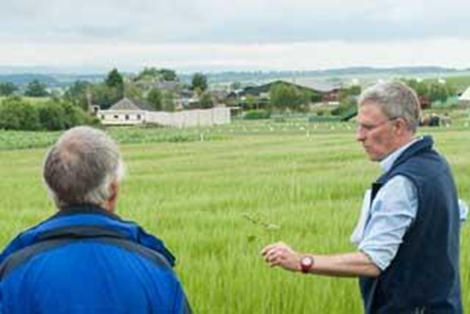
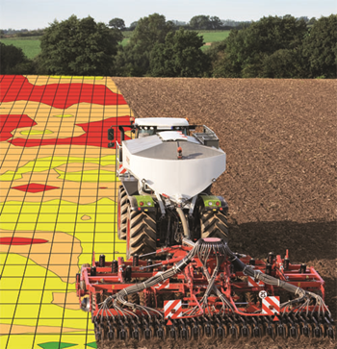
Identifying how to improve Knowledge Transfer of Integrated Pest Management (IPM) on Irish arable farms
Student:
Brian Duggan
Supervisors:
Dr. Angela Feechan (UCD)
Mr. Michael Hennessy (Teagasc)
Dr. Henry Creissen (SRUC)
Dr. Steven Kildea (Teagasc)
Ms. Anne Markey (UCD)
Office location:
Kilkenny

Slide 2
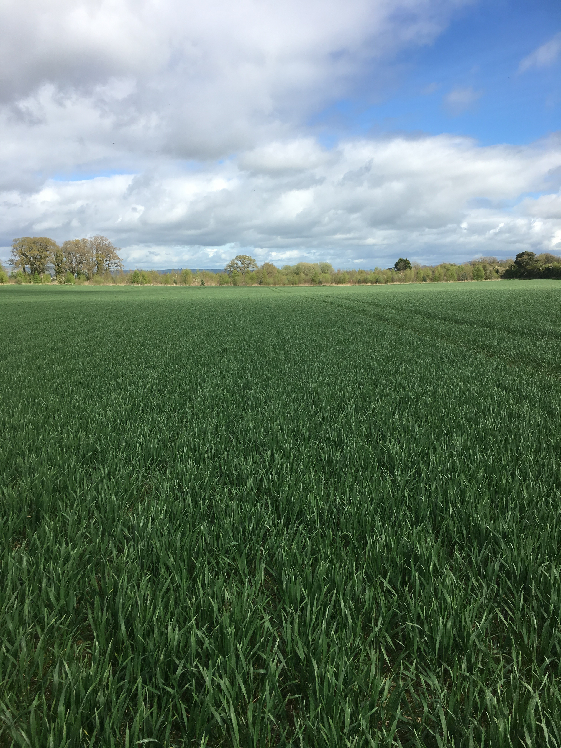
Introduction
Pests (weeds, diseases, insects & molluscs) have always been a challenge in crop production to both yield and quality
Decreasing availability of pesticides from regulation and/or resistance development
IPM is the use of an optimal mix of pest control techniques and tools including cultural, physical and biological in the first instance – chemical control a last resort
Increased need for IPM at farm level

Slide 3




Study Objectives & Methods
Objectives | Methodologies
 | Background | Farmer Survey | Categorisation of farmers | Semi-structured interviews*
Understand grower perceptions and practice | ✓ | ✓ | ✓ | ✓
Pest management decision making, advice and information | ✓ | ✓ | ✓ | ✓
Barriers to uptake of IPM | ✓ |  |  | ✓
KT gaps and improvement of advisory service | ✓ | ✓ |  | ✓
*In progress – Piloting & completion by end of January 2018

Slide 4

Farmer Survey
Survey questions relating to perception and practice.
Profile of survey respondents
Arable area (n=227):
Average 124 ha vs 58 ha (National average)
Min: 8 ha, Max: 720 ha
Age Profile (n=227)
33% <40 years vs 67% >40 years
Questions focusing on practice were selected towards a score to quantify IPM best practice.
Part of a wider study – EPIC.
Stakeholder workshop held in Ireland in June 2017.
Participants asked to rank question answers in terms of importance to IPM best practice.
Score operates on a scale of 0-100%.

Slide 5
Low Score <40%
Medium Score 40-60%
High Score >60%

Slide 6
*Preliminary Findings – Farmer Practices
High Group (n=34) Medium group (n=98), Low group (n=55)
    Utilising more on farm information sources – crop walking data (88%H vs 63%M vs 33%L)
    More likely to use a pest management plan (97%H vs 87%M vs 62%L)
    Lower proportion of land in continuous cereals (75-100% continuous – only 6%H vs 20%M vs 40%L)
    More likely to be a member of a discussion group (82%H vs 76%M vs 67%L)
Overall Self-Reported Specialist Tillage (n=187):
    Disease management – Resistant varieties 72%, Seed treatments 55%
    Weed management – Hand rouging 48%, Stale seedbed 44%, Headland management 36%, High weed level fields harvested last 8%
    Insect & mollusc management – Seed treatments 67%, Avoid BS insecticides 25%, Thresholds 18%, Preparations for mollusc control 14%, Encourage beneficial insects through planting habitat 19%

Slide 7
*Preliminary Key Findings
IPM Best Practice Score
Attitude
Age
Self reported familiarity
Education
Arable farm size

Slide 8
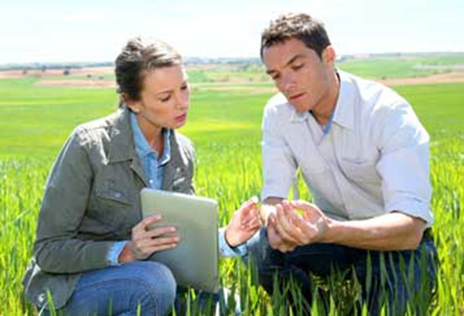
* Preliminary Key Findings
98% of respondents are using a crop protection advisor to some extent
Relationship can vary from total reliance to more involvement from farmer
Survey highlighted a mix of relationships
Overall Self-Reported Specialist Arable (n=187)
3% - Tell advisor what they want and advisor responds to meet their wishes
15% - Listen but adjust if needed in the field
20% - Decide on pest management strategy together with advisor
23% - Rely on them and act on their suggestions
27% - Listen to their advice but always consult other sources of information

Slide 9
* Preliminary Findings - Pilot Interviews
Both farmers use an agronomist as a service from where they buy their spray
PF1: “I would be taking a recommendation from the agronomist”
PF2: “There is a good guy there that comes and tells me what I should do and what I shouldn’t do and all of that”
Farmers taking recommendation from agronomist but might verify it with others i.e. Teagasc, other farmers
PF1: “I buy my chemicals through X, and I know the agronomist quiet well and find them very helpful. I also bounce stuff off Teagasc advisor which is also helpful”
PF2: “I would listen to the agronomist but may run it by Teagasc as well”
Reason for using agronomist
PF2 “These guys are far better versed than I am at these kind of things”
PF2 “They are far better informed than I would be, you know”
Sample interviews will use the best practice scoring categories for selection of farmers.
9 in total – 3 from each group (Low, Medium and High)

Slide 10
* Preliminary - Conclusions to date
Based on the survey:
Farmers are adopting certain IPM practices but at different levels
Personal & farm characteristics such as age, education and farm size are not related to IPM best practice adoption
Perception, attitude, and self-reported familiarity of IPM are significantly related to IPM best practice adoption
Agronomists have an important role in dissemination of IPM best practice to farmers
What do we need to find out in the interviews?
Are agronomist recommendations in line with Teagasc best practice and research or are there differences?
Are current methods of disseminating IPM best practice working?
Do farmers understand recommendations provided – Level of knowledge?
Is there a need to improve the KT chain or farmer knowledge?

Slide 11
Thesis Structure / Chapters
Chapter 1 - Introduction
Chapter 2 - Literature Review
Chapter 3 - Methodology
Chapter 4 - Research Findings & Analysis
Chapter 5 - Discussion
Chapter 6 - Conclusion & Recommendations
References
Appendix

Slide 12
Steps to completion
Complete pilot interviews, transcription & analysis
Adjust interview guide & process accordingly
Complete main sample interviews (9 in total – 3 Low, 3 Medium, 3 High) to be completed by the end of January
Interview transcription & analysis
Results write up
Findings, conclusions & recommendations
Complete write up

Slide 13
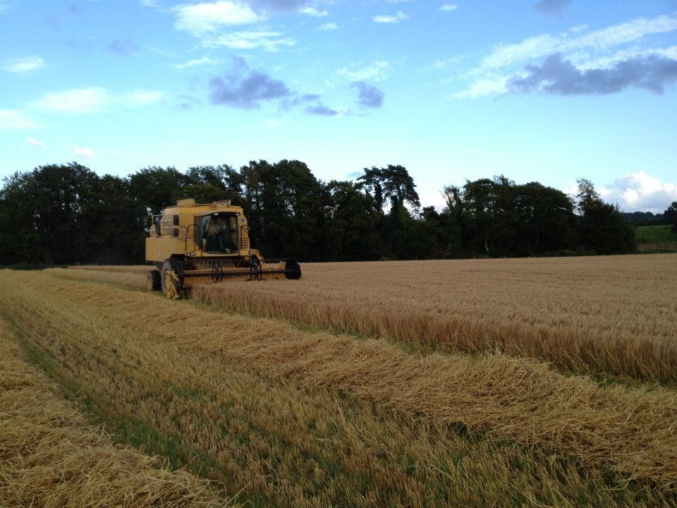
Thank You For Listening

