Slide 1


P Build-up Training - FAS Advisors
under Ireland’s
4th Nitrates Action Programme
2018 -2021
Seamus Barron
DAFM Nitrates Div
Johnstown Castle
Wexford

Slide 2
Water Quality
Water quality has improved since the introduction of the Nitrates Directive
Stabilised in recent years, with improvements and declines being offset
Issues in hot spot areas to be resolved
43% of monitored river water bodies are less than good ecological status, equates to 1,015 river water bodies.
Dairying intensification is a challenge

Slide 3
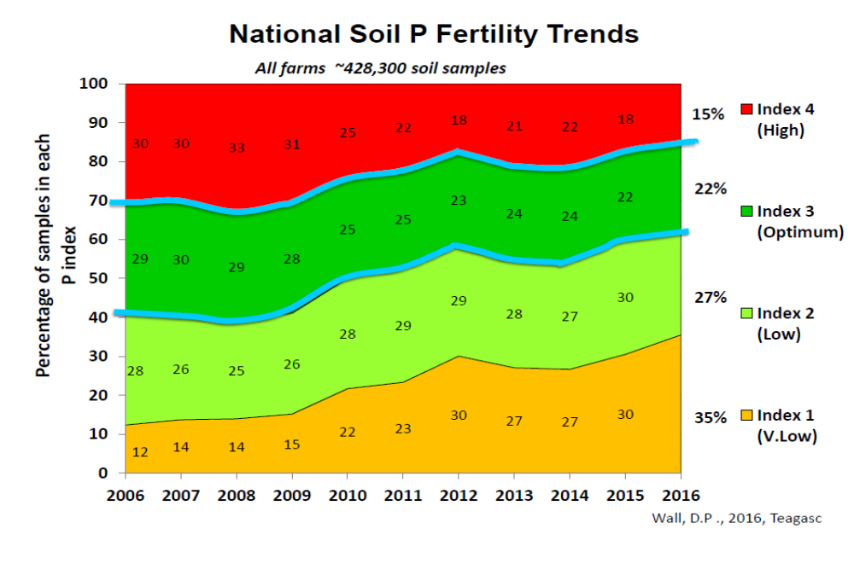
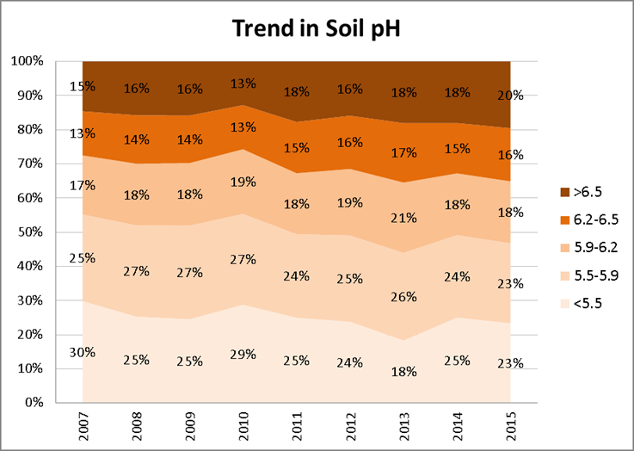
Irish soil fertility trends
10% of soils good overall fertility
62% very low to low P status
Lime usage - fallen significantly

Slide 4
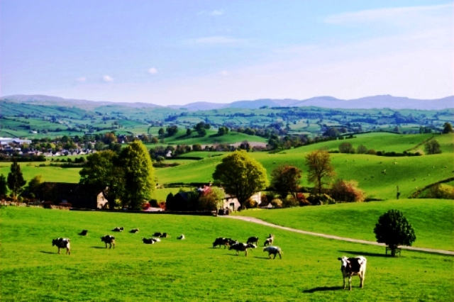
Nitrates Action Programme (NAP) Review
Review Group
  Department of Housing, Planning and Local Government,
  Environmental Protection Agency,
  Department of Agriculture, Food and Marine,
  Teagasc
Public consultation
Expert group report
  https://www.agriculture.gov.ie/ruralenvironment/environmentalobligations/nitrates/
New Nitrates Regulation (2018-2021)
- S.I. No. 605/2017

Slide 5
The main changes to the 4th NAP
New strengthened water protection measures to break nutrient and transport pathways
Enhanced Knowledge Transfer
Simplification of the regulations for improved implementation
Targeting improved soil fertility - Phosphorus

Slide 6
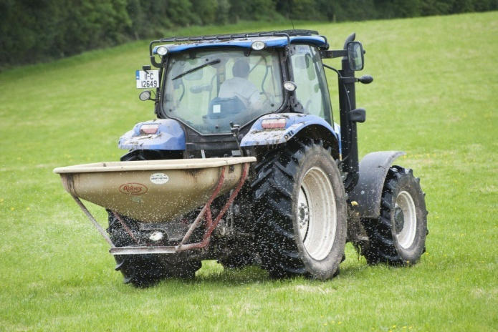
Phosphorus build-up
Currently 62 % of Irish soils in P index 1 and 2
Previous build-up rates not sufficient to increase P in reasonable timeframe
  Index 1 – extra 20 kg P/ha/year
  Index 2 – extra 10 kg P/ha/year
New build up rates for farms > 130 kg N/ha stocking rate
  Index 1 – extra 50 kg P/ha/year
  Index 2 – extra 30 kg P/ha/year
  New table 13B (P build up)
Built in safeguards to prevent P transfer to water
  - NMP
  - KT
  - Four year programme

Slide 7
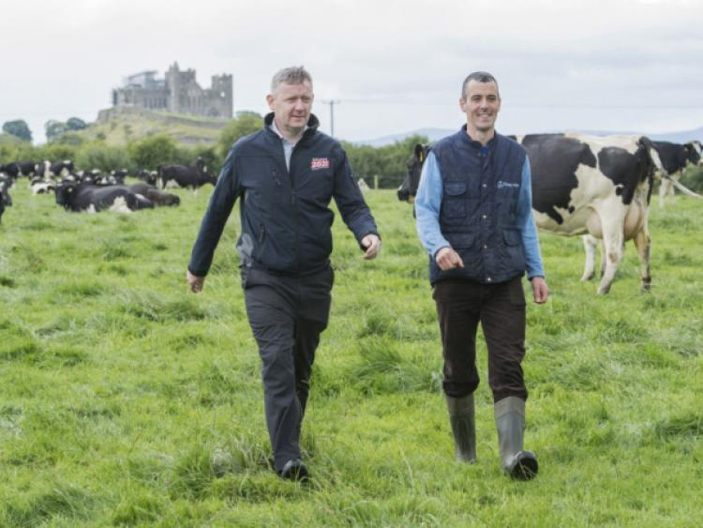
Phosphorus Build-Up
Farmers availing of P build-up allowances required to undertake NMP & participate in KT programme
  Soil analysis incl SOM
  SOM not required where mineral soils certified
  NMP submitted to DAFM
  Derogation NMP
  Non derogation – email to pbuildup@agriculture.gov.ie by 31 Dec 2018
  Farmers must attend training by approved FAS advisor by 31 Dec 2018
  List of farmers attending training to be submitted to DAFM (Nitrates Div)

Slide 8
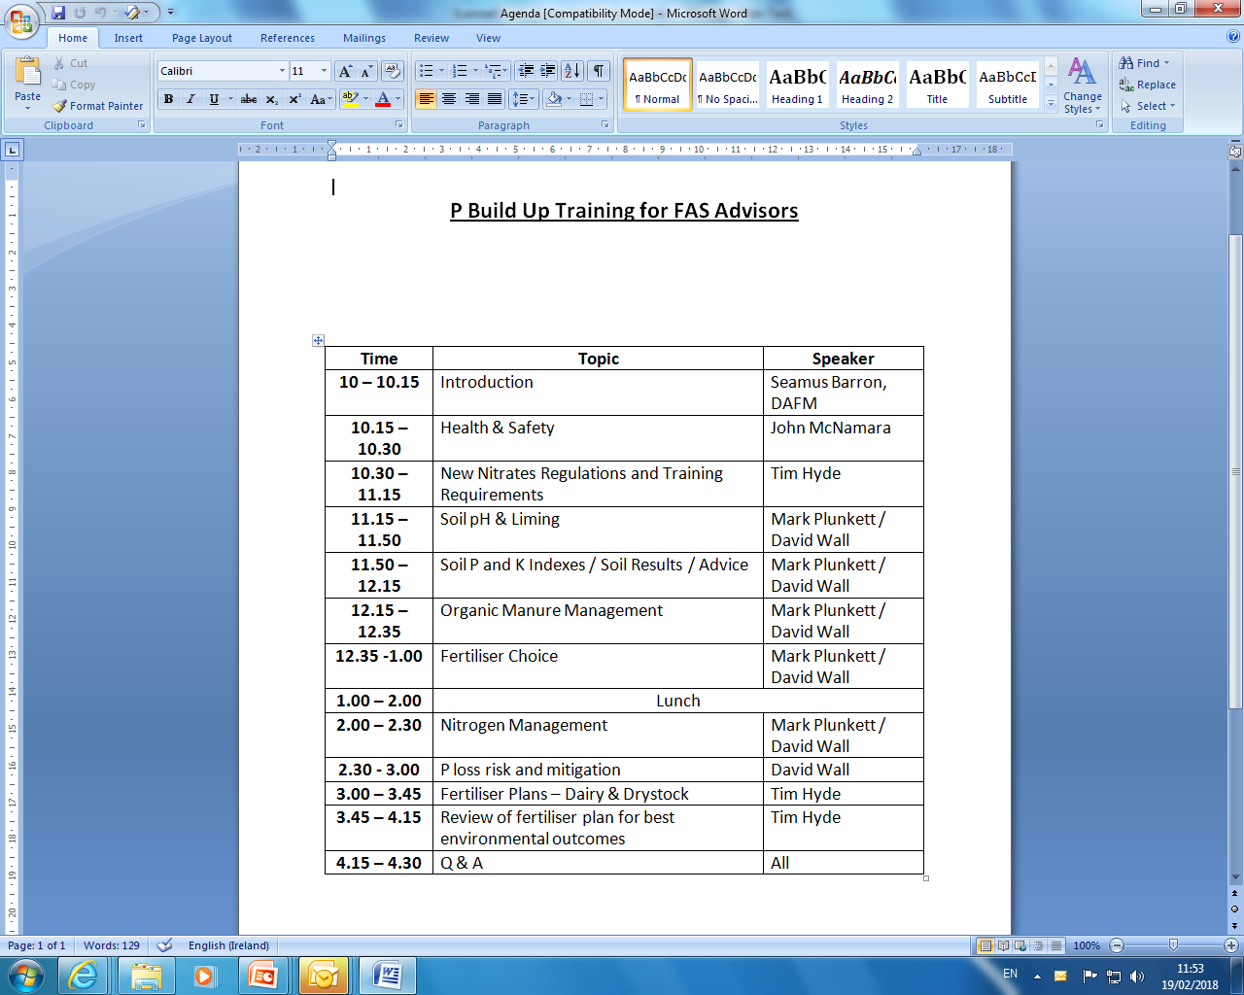

Slide 9
Soil OM testing in designated peaty areas
  Minimising the risk of P losses from risky peaty soils
When soil testing in in designated peaty areas (Teagasc – EPA subsoils map), test must include soil OM testing unless assume P index3.
OM layer on LPIS mapping & NMP on-line

Slide 10
4th NAP
  Strong action programme
  New measures breaking the loss pathway
  Addressing soil fertility
  Simplification
  KT

Slide 11
Derogation
The new conditions applying for derogation
50% of all slurry produced on a derogation farm must be applied by the 15th June annually. After this date slurry may only be applied using low emission equipment.
Derogation farmers must have sufficient storage for all livestock manure and soiled water produced on the holding.

