Slide 1
‘Advise on Farm Safety’
John McNamara
Health and Safety Specialist
Teagasc
john.g.mcnamara@teagasc.ie

Slide 2
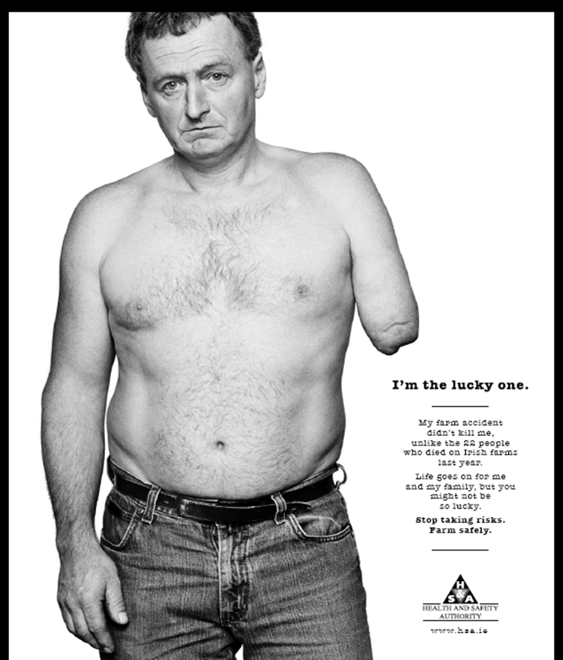
Consequences of Injury and Ill Health
- ‘Zero Vision’ needed at all times.
- Salute Accident Victims.
- Work with H.S.A and Partnership

Slide 3
Farm Deaths-5yr moving Av.

Slide 4
Farm Deaths by Age Category

Slide 5
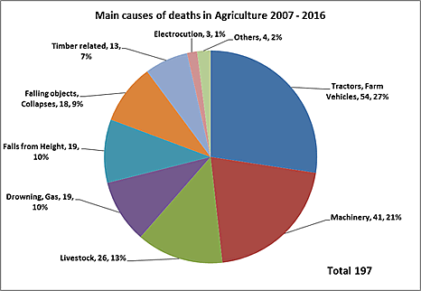
Causes of Farm Deaths

Slide 6
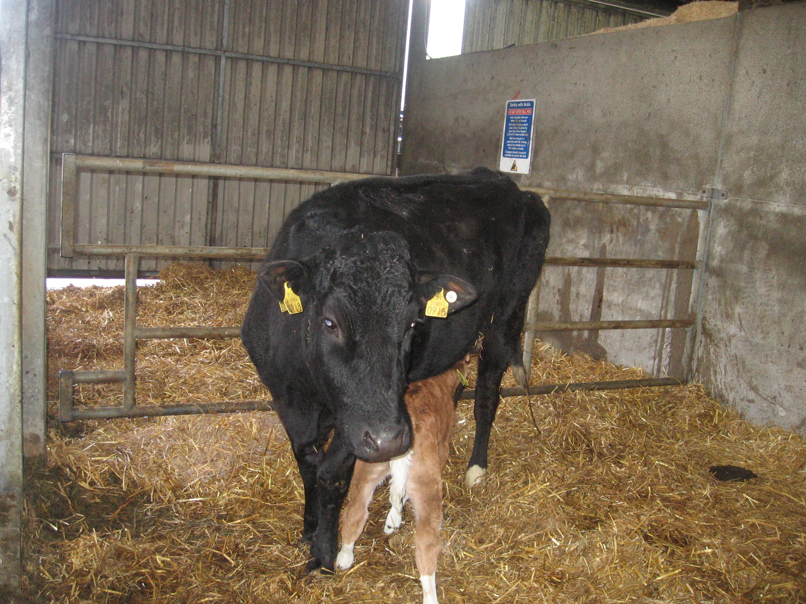

Slide 7
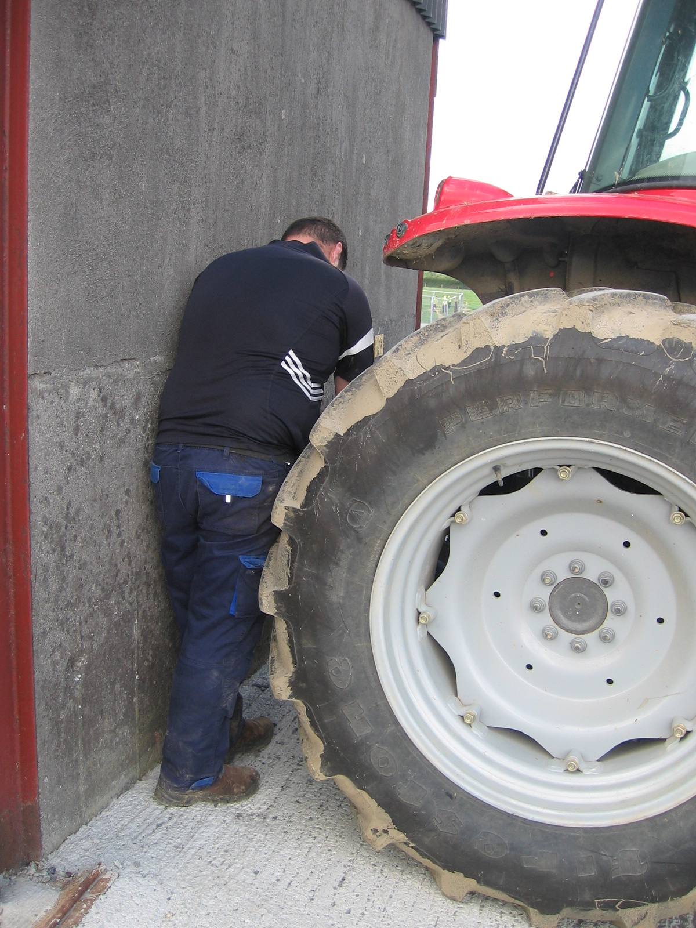
Crush Zone

Slide 8
Farm Accidents ( NFS) 2017
(Previous 5 years)

Slide 9
Farm Accident Victim
PERSON | %
Farmer | 80
Spouse/ Family | 12
Worker | 5
Other | 3

Slide 10
Farm accident categories

Slide 11
Accident Occurence (%) by Farm systems

Slide 12
Fig. 6: Accident occurrence (%) by age categories

Slide 13
Work Time Loss
Days | %
60+ | 21
30-60 | 9
11-29 | 13
4-10 | 22

Slide 14
Medical Treatment
Treatment | %
Hospital | 73
Doctor | 19
1sT Aid | 4
Fatality | 1
None | 2

Slide 15

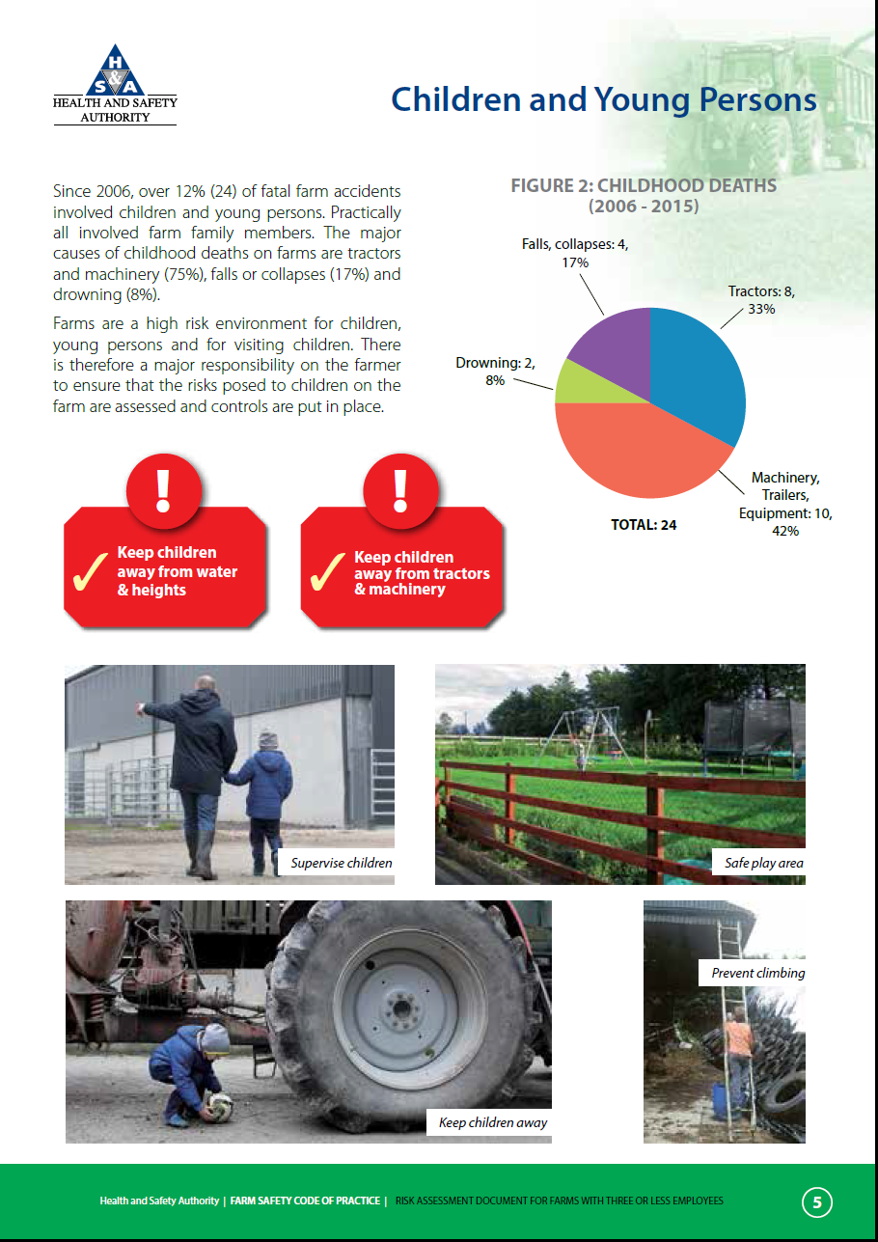
Farm Safety COP Risk Assessment
(Available at www.hsa.ie)

Slide 16
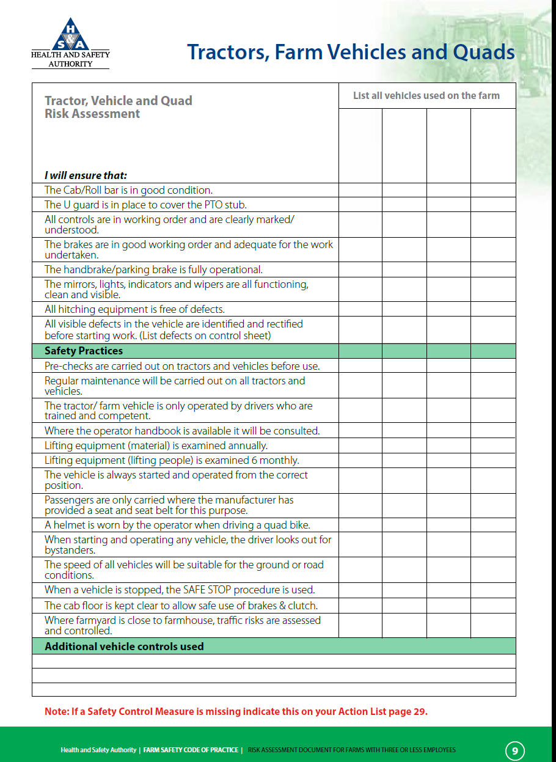
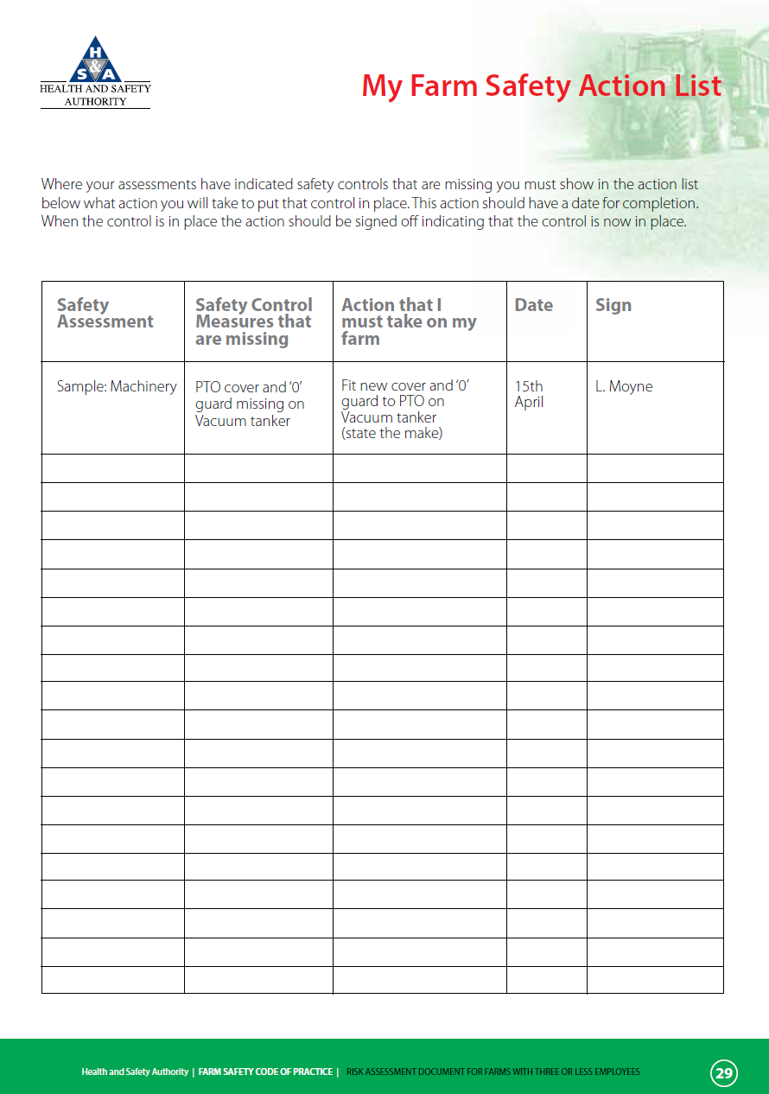
Farm Safety Code of Practice

Slide 17
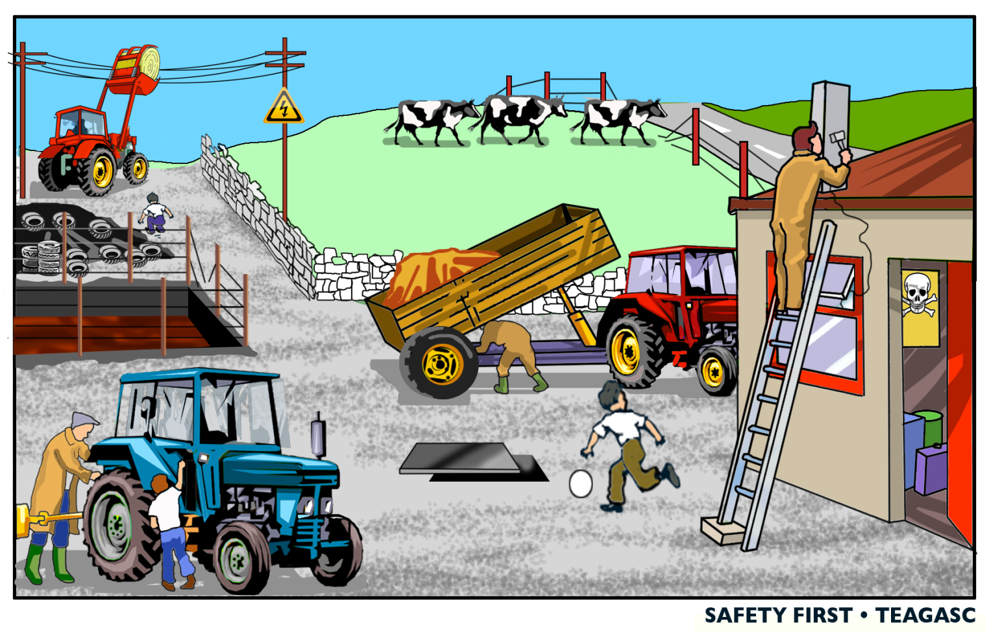
Farmer Management/ Behaviour

Slide 18
Prevention
Physical Controls
Behaviour
Work Organisation

