Slide 1

Nitrogen Management
Selecting a suitable N fertiliser type
David P. Wall
Teagasc, Johnstown Castle, Co Wexford

Slide 2
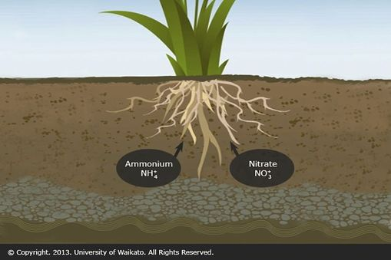
Nitrogen (N) uptake and assimilation by plants
Agricultural crops take up mainly:
Nitrate (NO₃⁻)
Ammonium (NH₄⁺)
Assimilation of these nutrients are some of the most energy consuming
biochemical reactions in living organisms
Wall, D.P., Johnstown Castle, January 2018

Slide 3
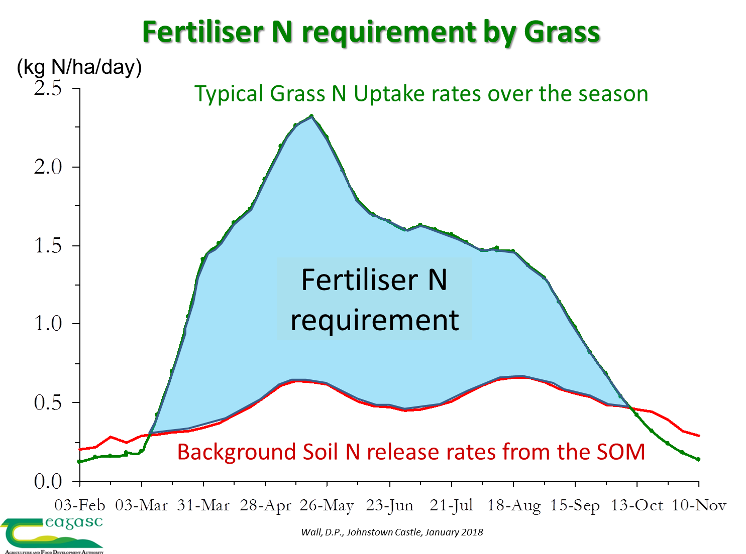

Slide 4
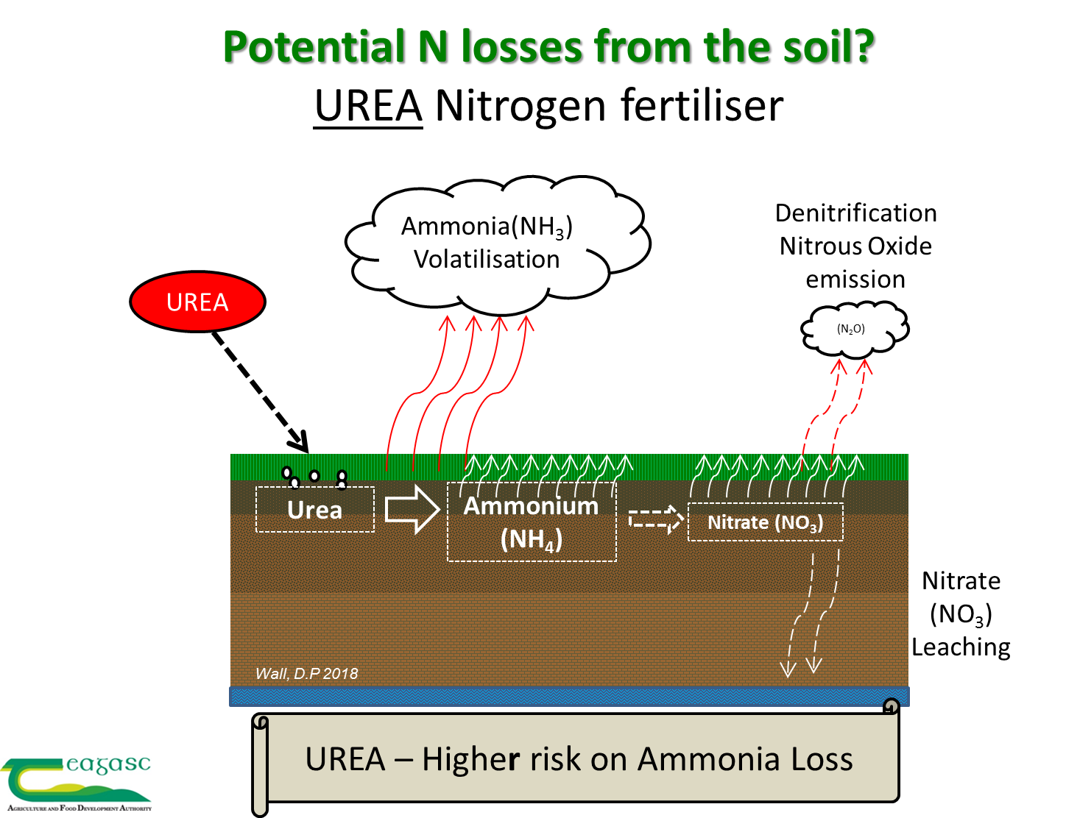

Slide 5
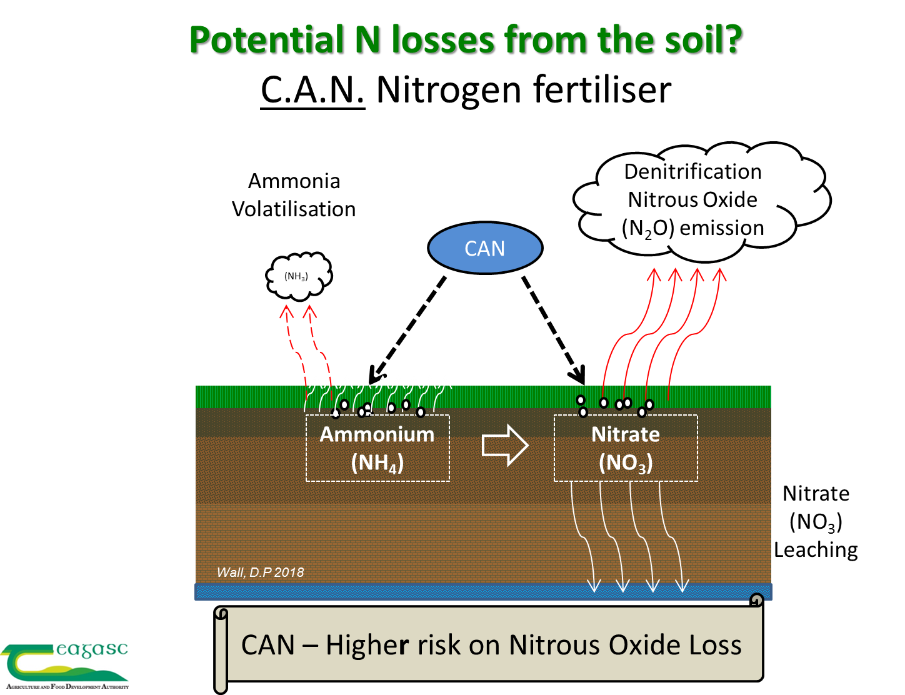

Slide 6
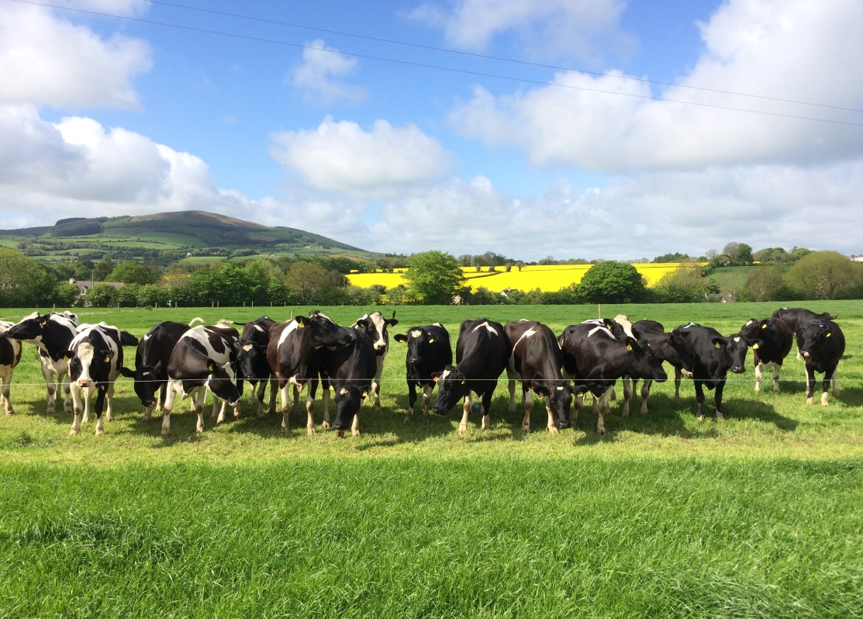
How can we apply fertiliser N in Ireland while balancing the challenges of:
Grass Yield Targets
N fertiliser Efficiency
Ammonia emissions
Greenhouse gas
Leaching
Cost
Gaseous Emissions Targets 2030
  Reduce GHG emissions by 30%!
  Reduce Ammonia (NH₃) emissions by 5%!
Wall, D.P., Johnstown Castle, January 2018

Slide 7
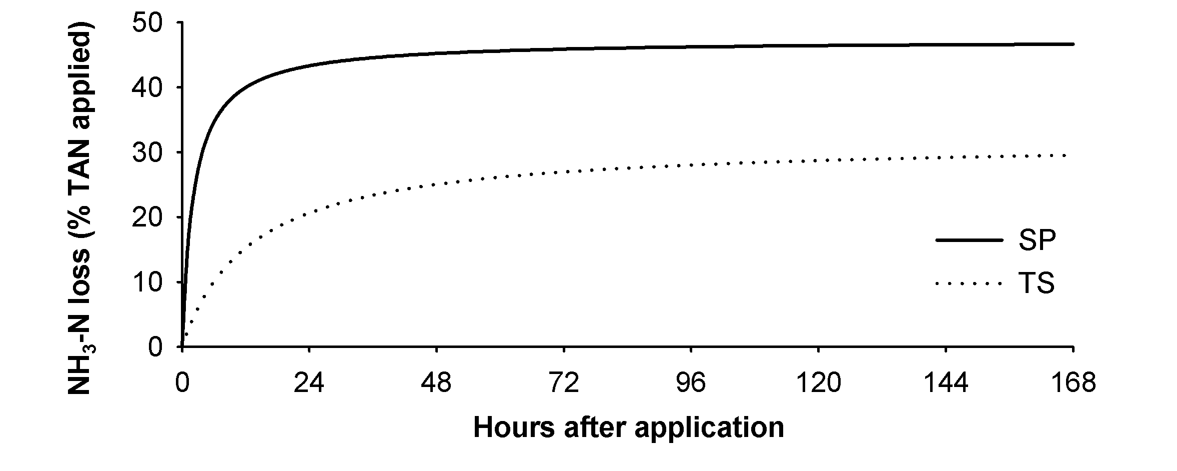
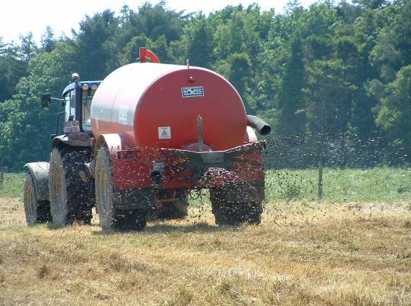
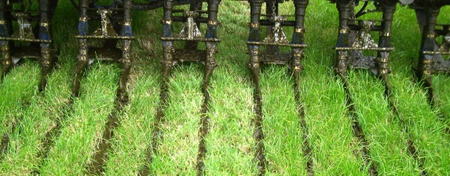
Reducing Ammonia Loss
Slurry Application method
Dowling et al.
10 Experiments 2006-2008
  TS reduced emissions by 34% compared to SP
  Reductions with TS of up to 65% found with other studies
  Wide variation with weather conditions
  Sward height had no significant effect (3 experiments with TS)
Wall, D.P., Johnstown Castle, January 2018
Notes:
Emissions profile
33 m3/ha of slurry

Slide 8
Reducing Ammonia Loss
Urea vs. Protected Urea (Urea + NBPT)
Protected Urea Reduced Ammonia loss by 70%
Roche & Wall et al., 2015
Wall, D.P., Johnstown Castle, January 2018

Slide 9
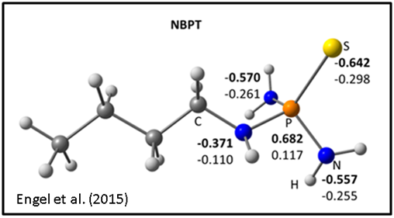
Protected Urea (Urea + NBPT)
Urease inhibitor
N- (n-butyl) thiophosphoric triamide (NBPT) AGROTAIN®
Protected Urea
NBPT coat on Urea fertiliser
at a rate of
0.66 kg a.i. / metric tonne
Urea applied at a rate of 200 kg N /ha
= 0.287 kg a.i. /ha
Wall, D.P., Johnstown Castle, January 2018
Notes:
Agrotain dry 1.1.kg/ metric tonne at 60% a.i. = 0.66 kg a.i./mt. 200kgN/ha urea = 434.8 kg urea = 0.287 kg/ha

Slide 10
Protected Urea
Why look at it now?
Cost & yield
Urea-N costs less than CAN-N: 26% less (CSO, 2014)
Is there a yield penalty?
Internationally Urea is more available than CAN
GHG
Ag. approx. 1/3 national emissions
Committed to reduce by 20% by 2020
Fertiliser N application can lead to N₂O loss
Smart solutions??
Ammonia (NH₃)
Ag. accounts for c.98.5% of national emissions
Committed to reduce by 5% by 2030
Urea looses NH₃!
Wall, D.P., Johnstown Castle, January 2018

Slide 11
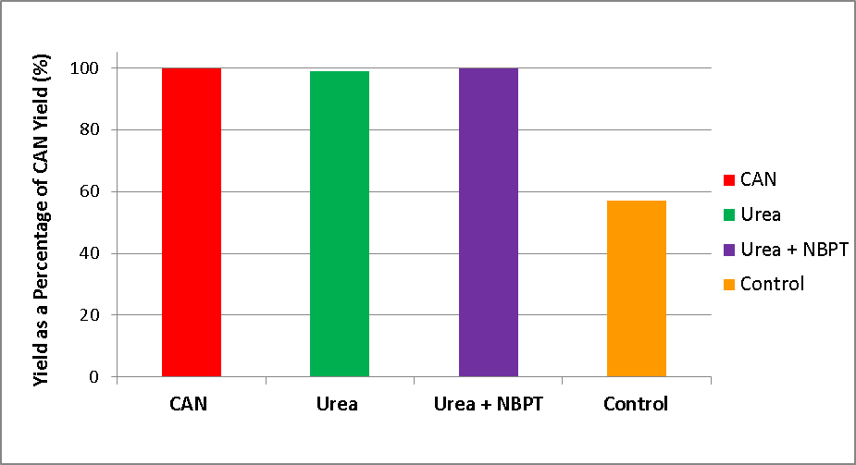
N fertiliser Type - Grass Yield Comparison

Slide 12
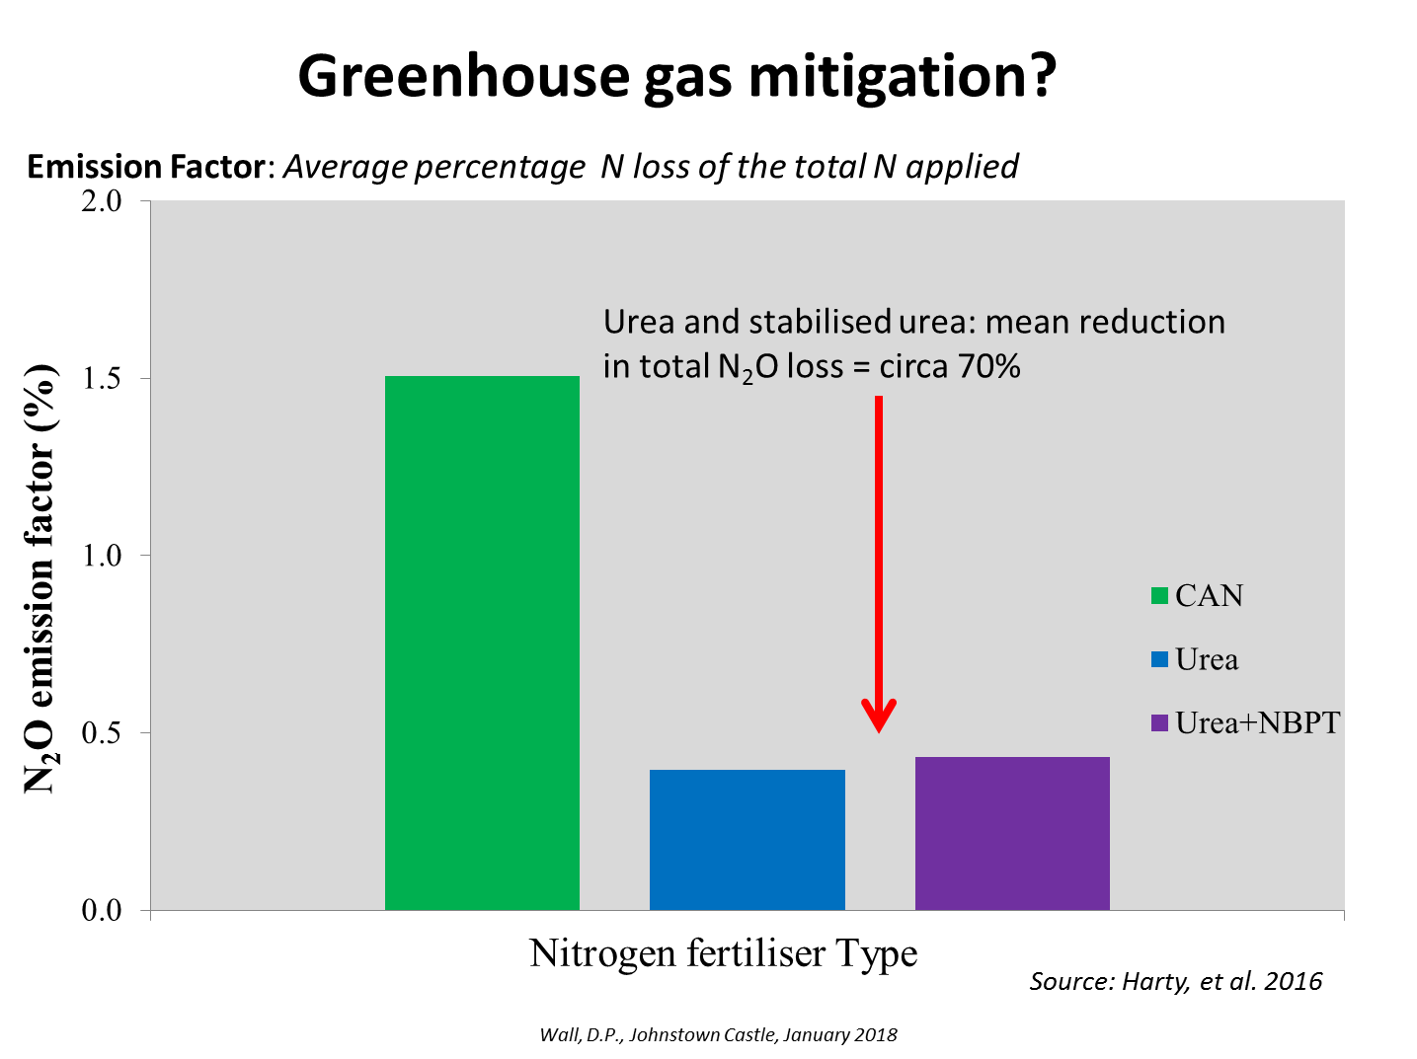

Slide 13
Research Conclusions: Grassland
Cost & yield
Urea costs less, is more available on international markets and gives comparable yield performance to CAN.
Without urease inhibitor total N recovery is lower!
GHG
Protected Urea based N offers potential to sustain or increase national N usage with reduced N₂O (GHG) emissions
Ammonia
Effective ammonia abatement can be purchased by stabilising urea with a urease inhibitor (Protected urea)
Wall, D.P., Johnstown Castle, January 2018

Slide 14
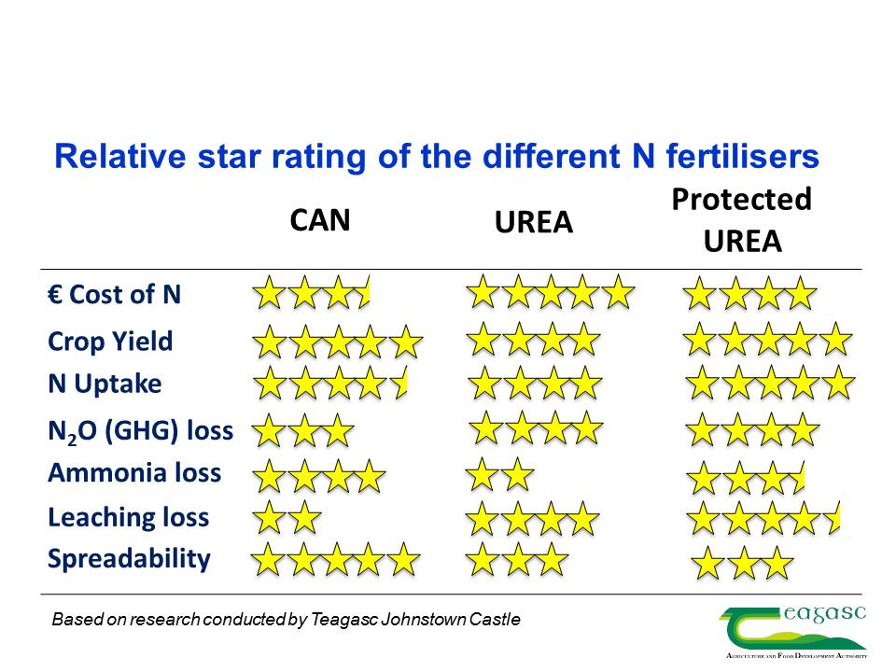
Wall, D.P., Johnstown Castle, January 2018

