Slide 1

Phosphorus Loss Risk & Mitigation from Agricultural Landscapes
David P. Wall
Teagasc, Johnstown Castle, Co Wexford

Slide 2
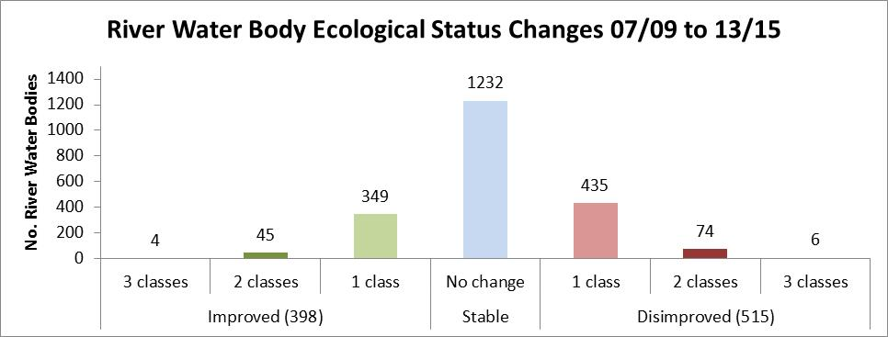
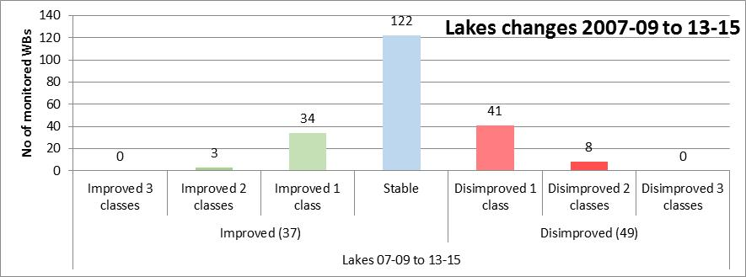
WB status changes 07/09 to 13/15
Little net change between 2007 and 2015
But 515 waterbodies have disimproved. These have been offset by 400 that have improved.
Not an artefact of the monitoring programme. Real changes.
What can we learn from this?

Slide 3
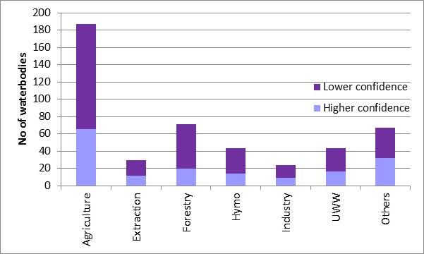
Significant pressures in the 511
deteriorated river WBs

Slide 4
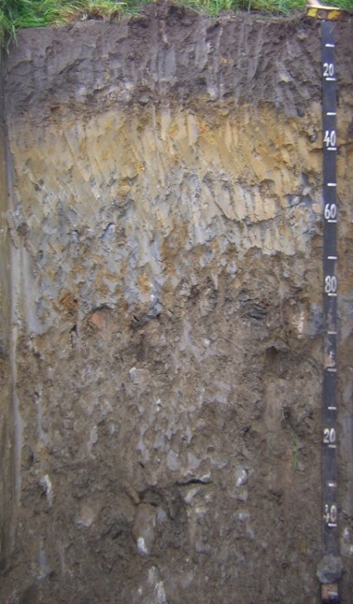
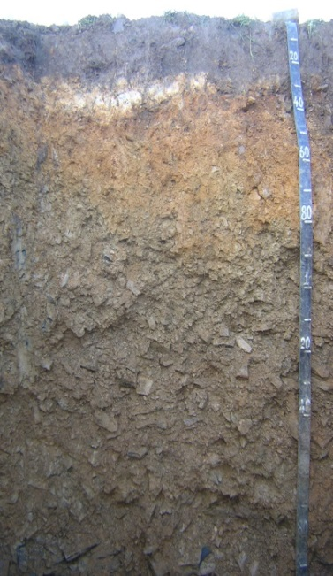
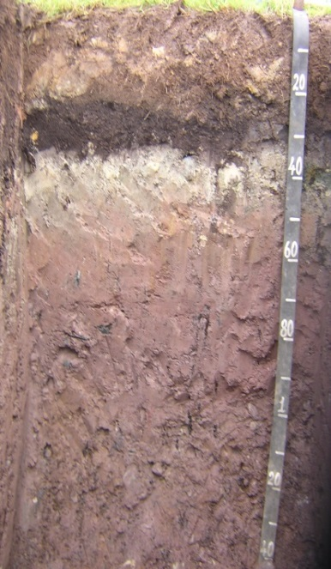
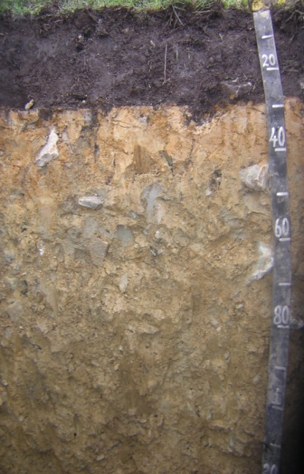
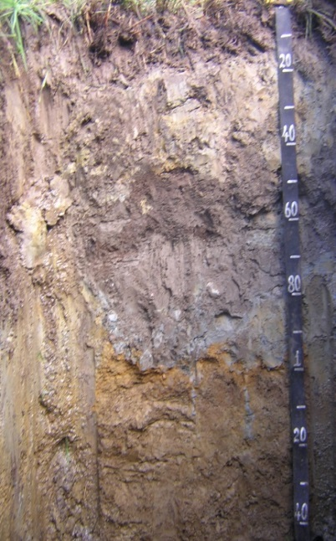
Phosphorus loss
Issue – Water Quality
  A relatively small quantity of P loss can cause negative environmental effect in surface water bodies (rivers & freshwater lakes)
  Phosphorus: source of diffuse pollution from agricultural landscapes
Main Pathways of P loss:
  >>Runoff from soil surface to drainage ditches, streams & lakes
  < Leaching to drainage systems or to groundwater
Soil type and chemistry informs the potential for P loss by each pathway

Slide 5
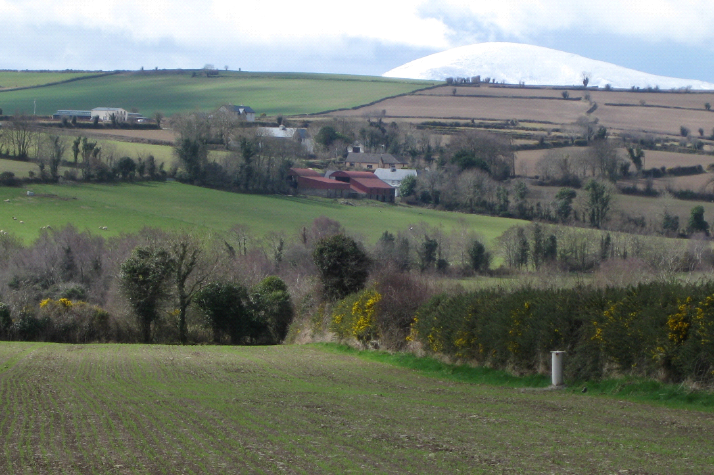
Phosphorus management to reduce P loss
Nitrates Directive Aim: To reduce soils with excessive soil P levels and minimise the potential for P loss to water bodies
Source
Source
Source
e.g. soil, fertilizer, manure,
e.g. soil, fertilizer, manure,
e.g. soil, fertilizer, manure,
pesticide, cow
pesticide, cow
Mobilisation
Mobilisation
Mobilisation
e.g. erosion, leaching,
e.g. erosion, leaching,
e.g. erosion, leaching,
spreading, solubilisation
spreading, solubilisation
spreading, solubilisation
Pathways
Pathways
Pathways
e.g. overland, soil drainage,
e.g. overland, soil drainage,
e.g. overland, soil drainage,
tile drains, aquifer fissures
tile drains, aquifer fissures
tile drains, aquifer fissures
Delivery
Delivery
Delivery
e.g. nutrients & pollutants in
e.g. nutrients & pollutants in
e.g. nutrients & pollutants in
groundwater, lakes,
groundwater, lakes,
groundwater, lakes,
estuaries & rivers
estuaries & rivers
estuaries & rivers
Impact
Impact
Impact
e.g.
e.g.
e.g.
eutrophication
eutrophication
eutrophication
, aquatic
, aquatic
, aquatic
weeds, sedimentation
weeds, sedimentation
Wall et al, 2011 ES&P
Notes:
The main question of this study

Slide 6
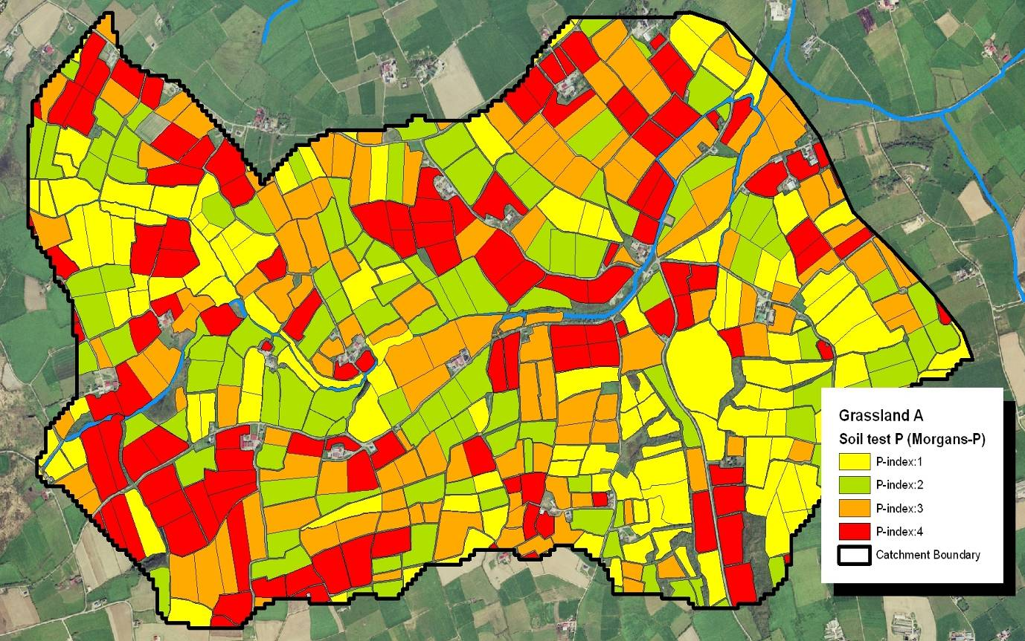
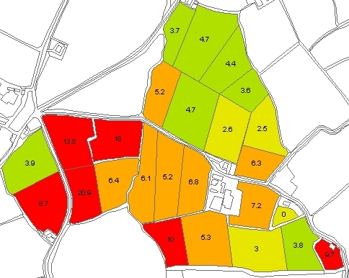
Soil P Index 4 soils – higher P risk loss risk potential!
Field-by-field soil testing
Soil testing for P required (5 ha area every 4 years(
  Derogation holdings (> 170 kg/ha org N)
  Holdings using higher P build-up allowances (Table 13B - SI 605 of 2017)
Assume P index 3 (replacement) on non-soil sampled holdings
Farm P Distribution
Morgan’s P levels
“Printed under Licence No. 6155 from the Ordnance Survey Ireland”

Slide 7
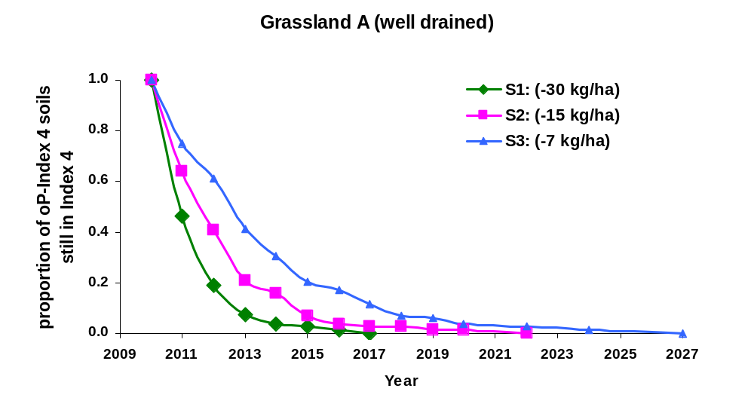
Soil P Decline is linked with P offtake
How quickly would soil P decline under different off-take levels?
Grassland Dairy Catchment
P index 4 soils
No fertiliser P allowed!
Phosphorus off-take scenarios
2 cut silage
Dairy 2 cows/ha
Dairy 2 cows/ha
with 2000 gals slurry applied
26% P-Index 4 soils in 2009
Wall et al., 2013
Wall, D.P., Johnstown Castle, January 2018

Slide 8

Soils have different P Retention Capacity
(Soil P fixation Capacity)
Wall, D.P., Johnstown Castle, January 2018

Slide 9
How much P fertiliser does it take to build-up soil fertility levels?
Irish studies showing the soil test P response to build-up P applications
Reference Studies Conducted across a range of soils | Land Use type | P build-up required to achieve 1mg/L STP
Culleton et al. 2001 Long term Cowlands, Johnstown Castle | Grassland (grazing – beef) | 59 kg/ha P for Index 1
Sheil et al., 2016, Long term P fertiliser study | Grassland (simulated grazing) | 56kg/ha P for Index 1 40 kg/ha for Index 2
Wall et al., 2017, Heavy soils study (5 dairy farms ) | Grassland (grazing – dairy) | 76 kg/ha at P Index 1 50 kg /ha at P Index 2
P fertiliser allowances under new Build up P rates
P index 1 soils : 50 kg /ha P build–up allowance
P index 2 soils : 30 kg /ha P build–up allowance
How quickly: ~4 years to build up one soil P Index (3 ppm)
Wall, D.P., Johnstown Castle, January 2018

Slide 10
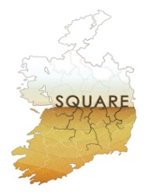
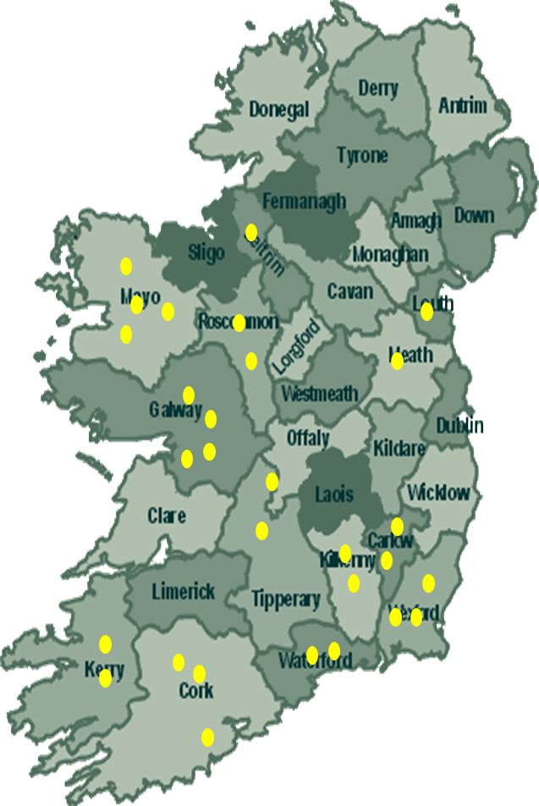
Phosphorus pools in Grassland soils
Typically there is up to 1 tonne of total P per ha in grassland soils
Majority of soil P is stored in no available forms
Phosphorus pools in Irish soils
(Graca et al., 2018)
Total P inorganic= Sum individual P inorganic pools
Total P organic = Sum individual P organic pools
Composite soil samples (0-10 cm)
Wall, D.P., Johnstown Castle, January 2018

Slide 11
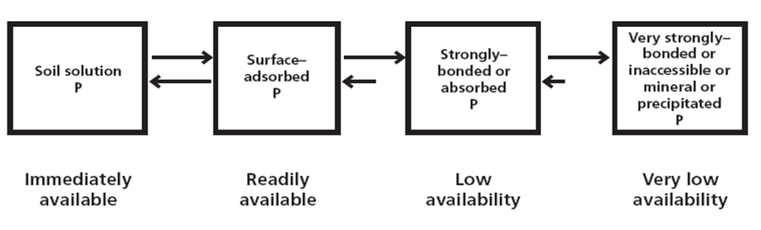
Soil Phosphorus pools: Mineral Soils
Inorganic
Water soluble & potentially plant available
Soil P which is not directly water soluble
Syers, Johnston & Curtin, 2008
Wall, D.P., Johnstown Castle, January 2018

Slide 12
Inorganic P pools in Grassland soils
Fixed P at high pH
(Graca et al., 2018)
Fixed P at low pH
Wall, D.P., Johnstown Castle, January 2018

Slide 13
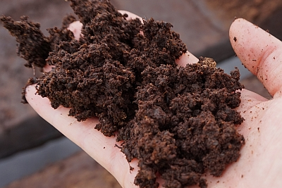
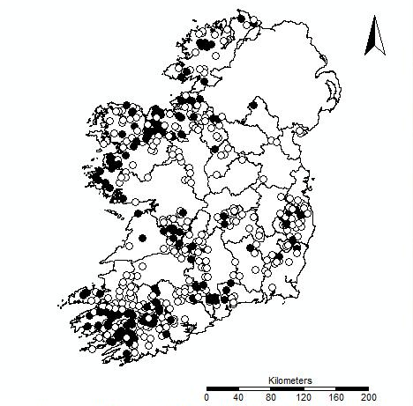
High Organic Matter Soils (>20% OM)
  Water Framework Directive
  Issue: Steady decline in the number of high status water bodies in Ireland.
  Highest rates of WQ decline along the western seaboard, in upland areas
  Predominant soils in High status sites are peats and other organic matter-rich soils
(Daly et al., 2017)
EPA Water Quality Monitoring
High Status rivers (black dots).
Sites that varied their status (white dots).
Period 2001-2012
Wall, D.P., Johnstown Castle, January 2018

Slide 14
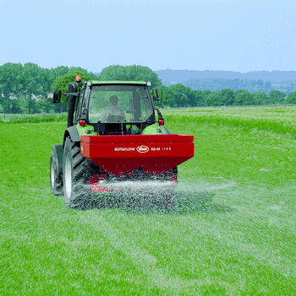
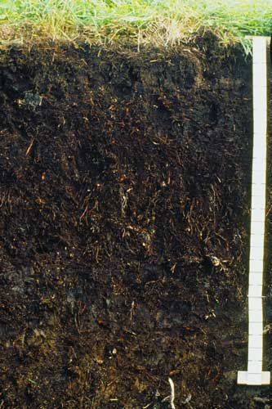
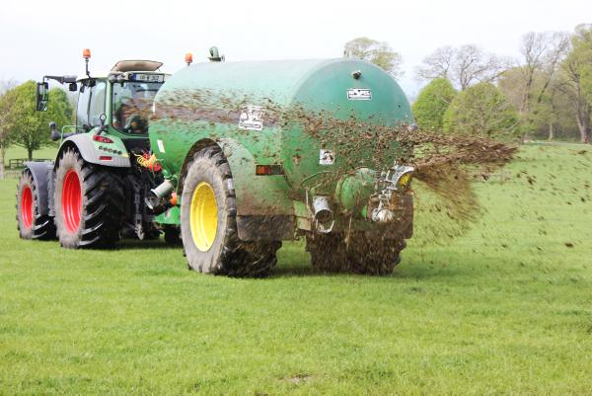

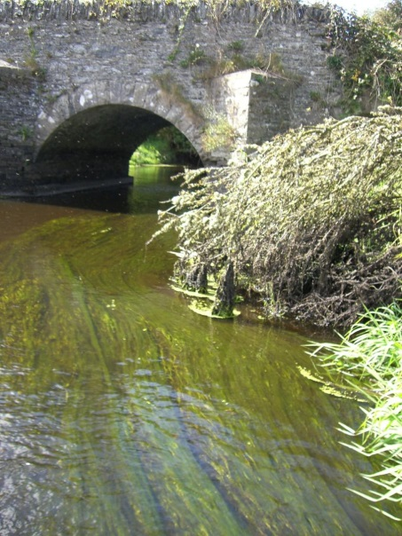
High Organic Matter Soils
PO₄⁻
PO₄⁻
PO₄⁻
PO₄⁻
K⁺
H⁺
Na⁺
H⁺
H⁺
H⁺
Mg⁺⁺
Na⁺
Humus-clay particle
PO₄⁻
NO₃⁻
Ca⁺⁺
Ca⁺⁺
K⁺
H⁺
K⁺
H⁺
Mg⁺⁺
PO₄⁻
PO₄⁻
PO₄⁻
Poor P retention capacities in organic matter rich soils !
Maintenace P fertiliser only – No P build-up

Slide 15
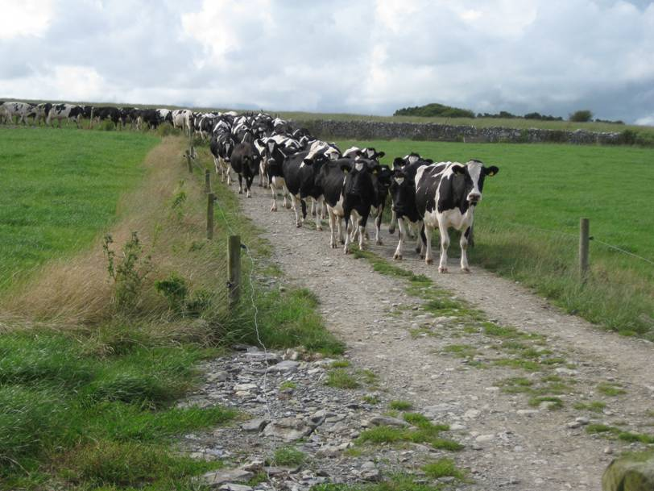
Transport
Factors
Transport
risk of loss
Source
Source Factors
Notes:
Most nutrient stay where we want them - The risk of nutrient loss is influenced by climate, landscape and management of the land.
If source and transport factors occur together, nutrient loss will also occur,

Slide 16
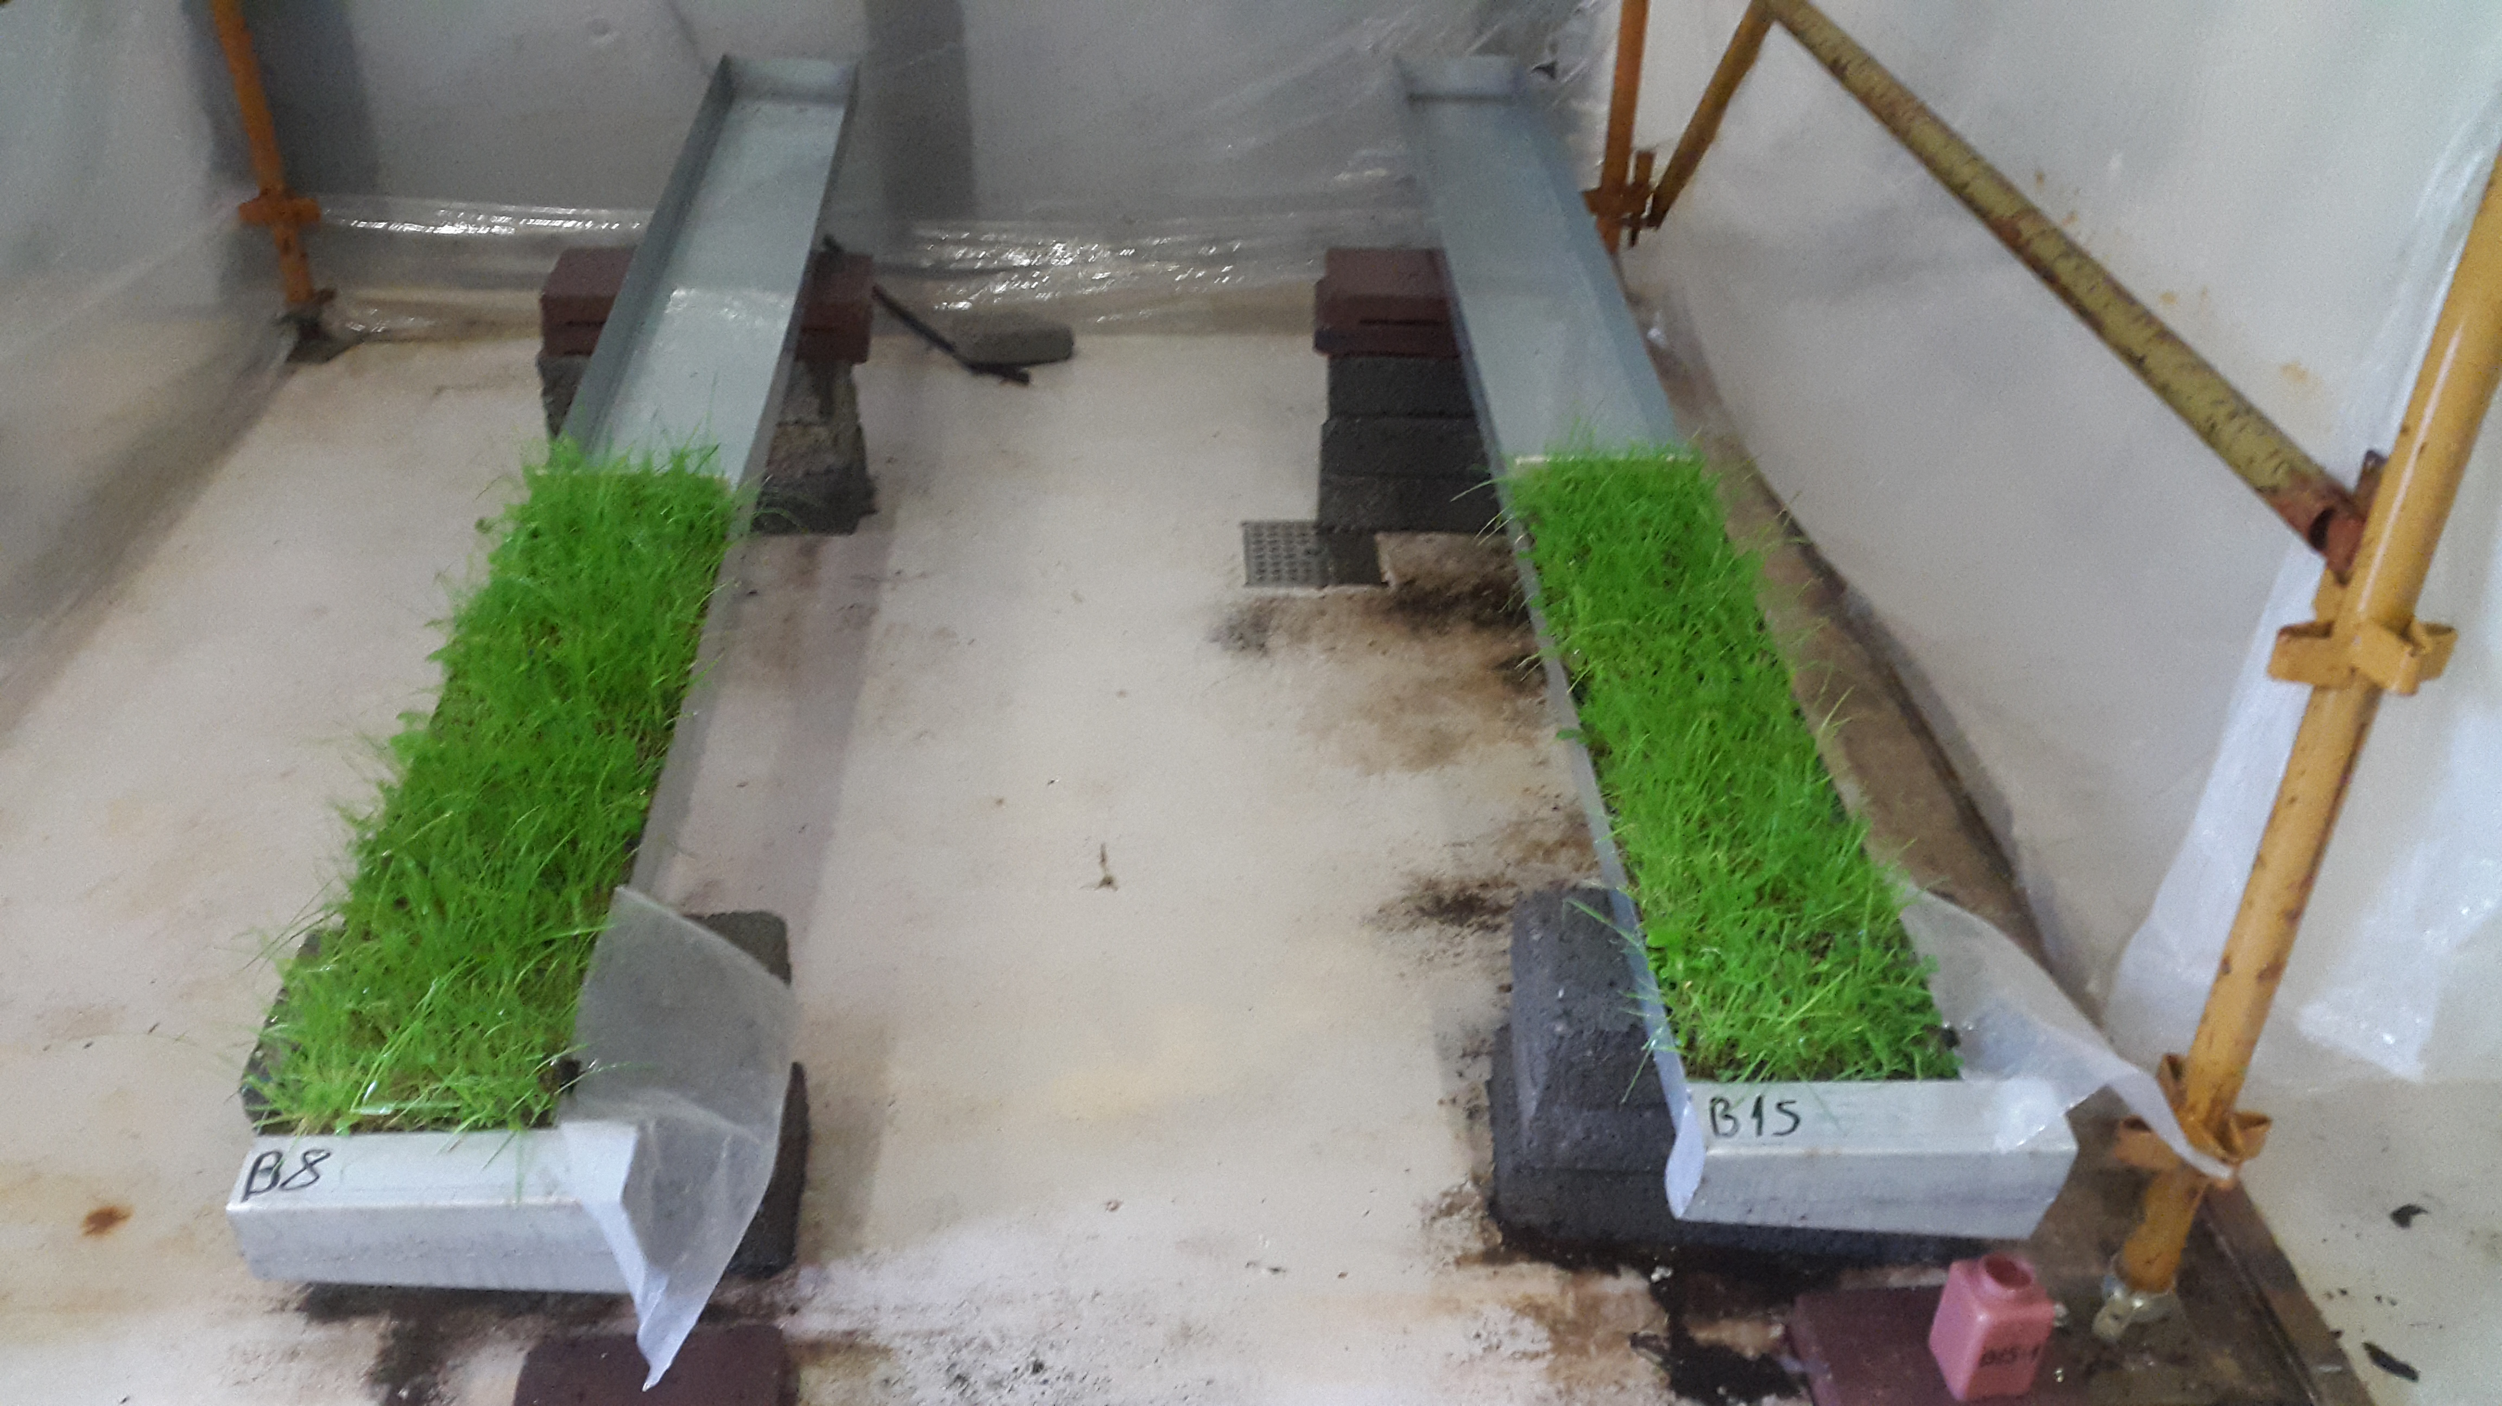
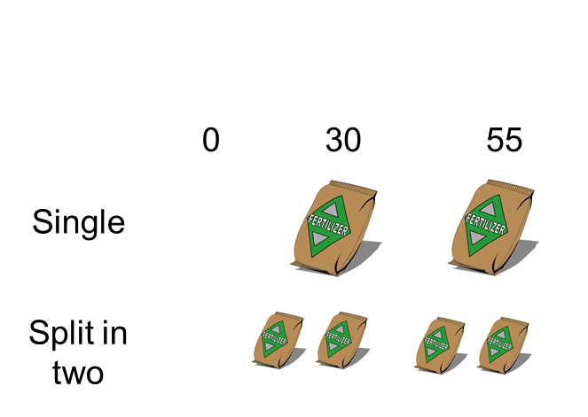
High OM Soils:
Reducing P loss by Splitting P fertiliser applications
1st P application
P Rate (kg/ha)
2nd P application
(Gonzales et al., PhD Thesis
Teagasc, Johnstown Castle)
P losses proportional to the amount of P fertiliser applications
Higher overall P losses from single P applications than two applications

Slide 17
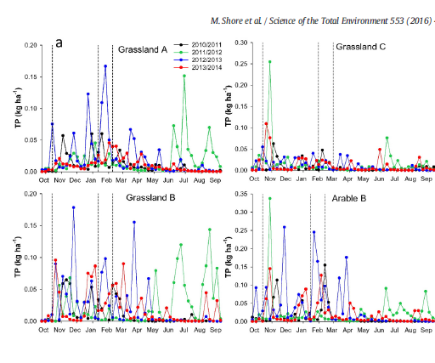
Potential P losses from river catchments
Closed Period
Closed Period
(Shore et al., STOTEN 2016)
Total Phosphorus Loss (kg/ha)
Disproportionately high nutrient loss during the closed period
43% of total P loss (0.28 to 1.17 kg P/ha)
& 45% of N loss (9.6 to 23.8 kg N/ha)
in c.25% year
Wall, D.P., Johnstown Castle, January 2018

Slide 18

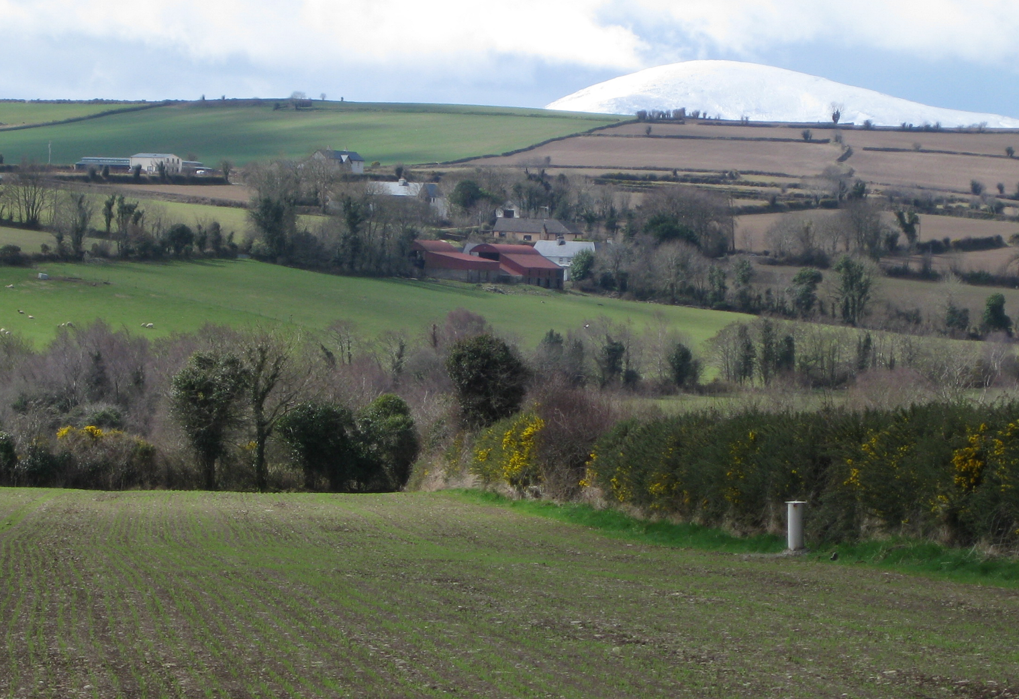
Effect of season on P leaching
Summer event (Jun 2012)
SMD = 31 mm
Rainfall = 25 mm
Stream flow = 2 mm
P loss = 1.6 g TRP/ha
Winter event (Nov 2012)
SMD = 0 mm
Rainfall = 29 mm
Stream flow = 20 mm
P loss = 6.5 g TRP/ha
25 mm
29 mm
31 mm
0 mm
2 mm
Four times higher P loss in the winter event!
20 mm
1.6 g TRP/ha
6.5 g TRP/ha
(Mellander et al., HP 2015)

Slide 19
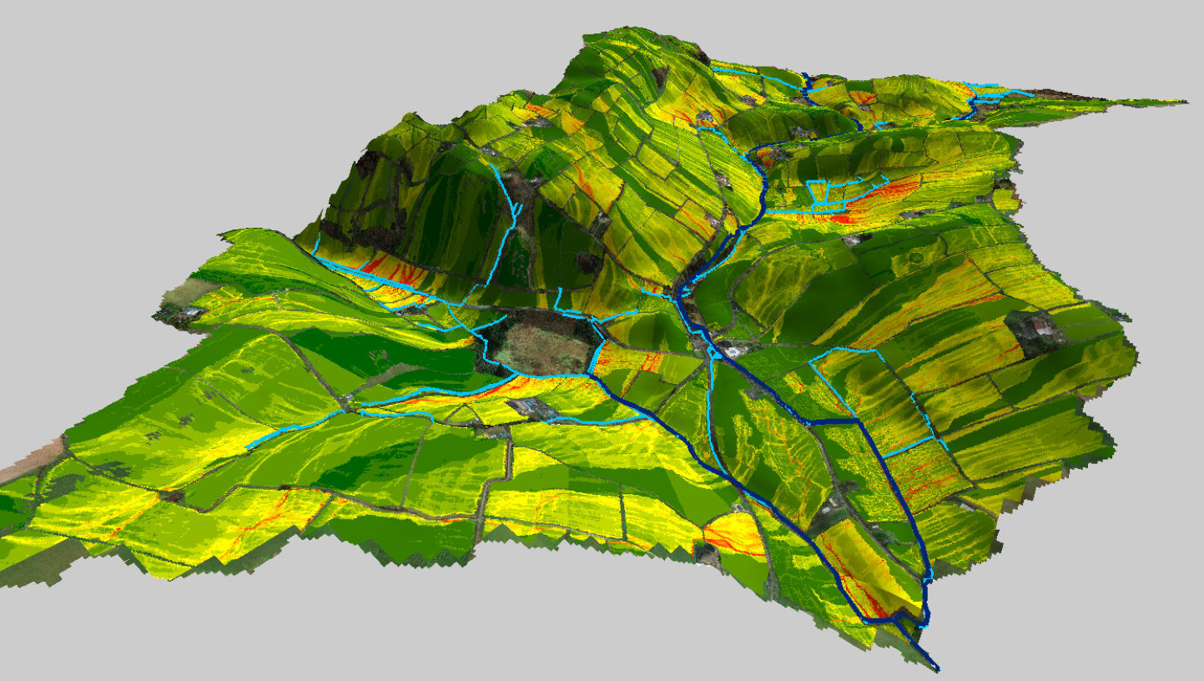
Critical Source Areas (CSA’s)
Targeted & cost efficient mitigation mgt.?
(Thomas et al., STOTEN 2016)
Soil P concentration
Erosion risk
Mobilisation potential
Hydrological Sensitive Areas (TWI, Soil drainage and flow sinks)

Slide 20
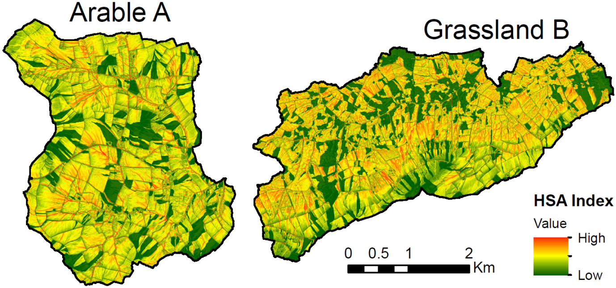
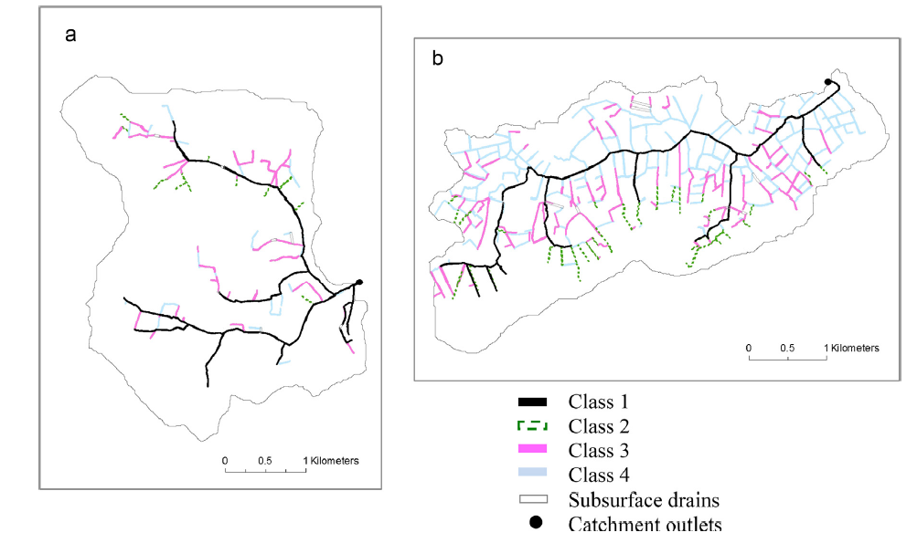
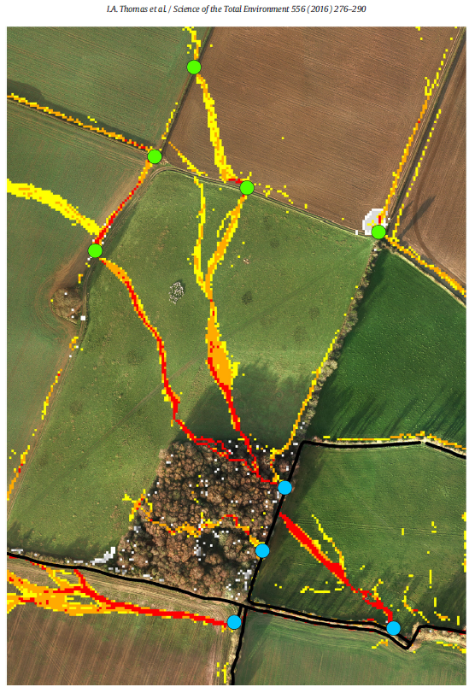
Classification of ditch network categorised risk of nutrient loss based on physical properties
COMPLETE PICTURE OF CATCHMENT SURFACE PATHWAY CONNECTIVITY –
CHEMISTRY OF SOIL/SEDIMENT CAN CAUSE DIS-CONNECTIVITY FOR PHOSPHORUS
Ditch
pathway
Shore et al., 2014 AGEE

Slide 21
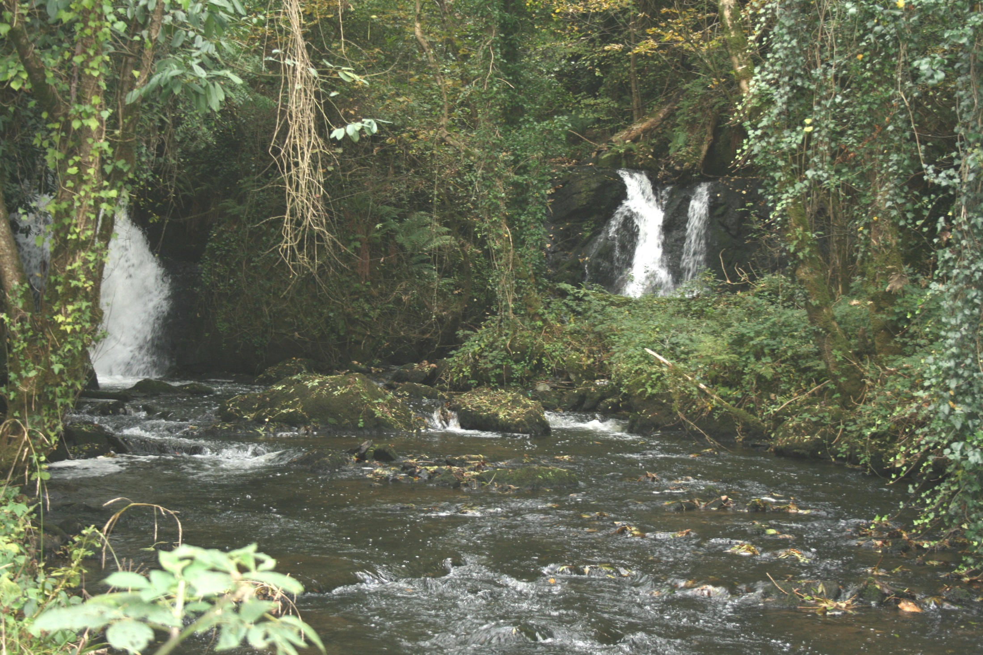
Thank you

