Slide 1
‘Advising on Farm Health & Safety’
Dr John McNamara
Health and Safety Specialist
Teagasc
john.g.mcnamara@teagasc.ie

Slide 2
Current Issues
Farm Accident Levels
Completion of New Risk Assessment
Risk Assessment training
Dealing with Stress among Farmers
Providing H&S Advice to Farmers

Slide 3
Current Issues
Currently 16 Fatal Farm Issue (12th Oct)
10: 65 year old+/ 1 <16 years/ 5 16-64 y.o.
Key Issues
- Tractor and Machinery
- Older Farmer issue
Non Fatal Accidents
- Major rise among Dairy Farmers

Slide 4
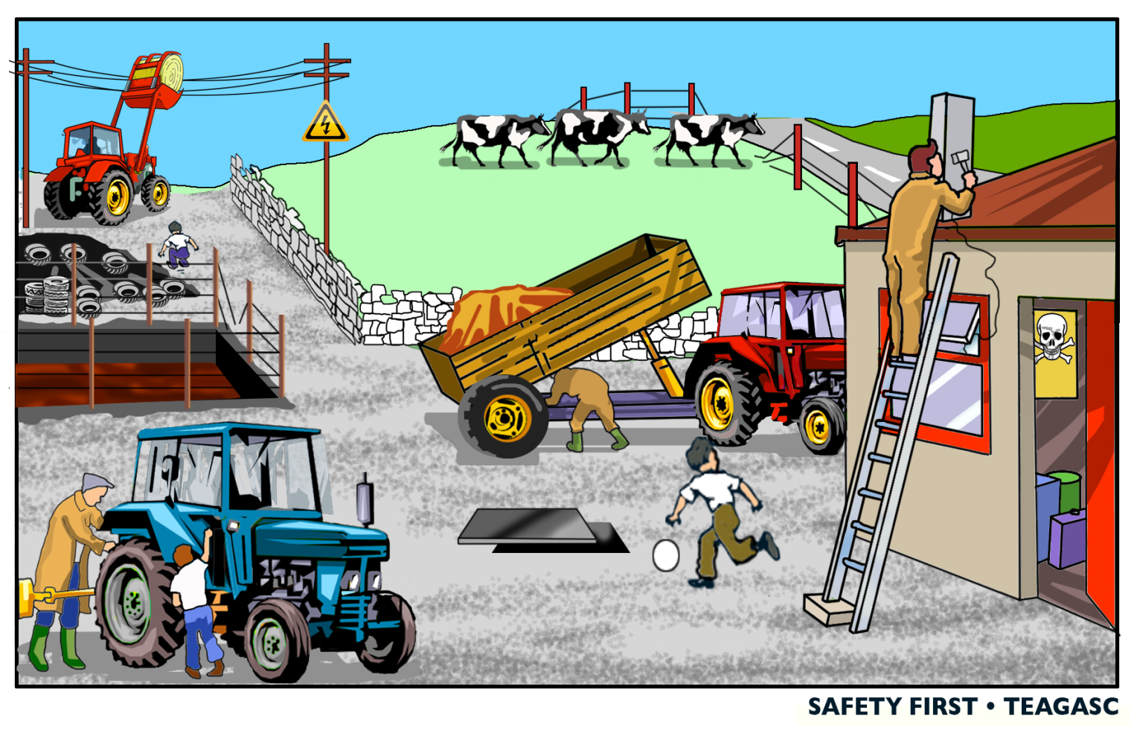
Farmer OHS Management the Issue !
UK HSE Farmer Study (2017)
- 45% Planners
- 14% Pragmatists
- 18% Risk Takers
23% Unclear
‘Unclear’ need
on-going support
Teagasc Advisors – ‘Farmers forget about Safety when pressure comes on’.

Slide 5
Use of COP Risk Assessment
New Version ( Green) legally required to be completed by 31st December 2018
Completed RA document required for Quality Assurance Schemes
Half-Day Training on RA document required for TAMS11 Grant Aid

Slide 6
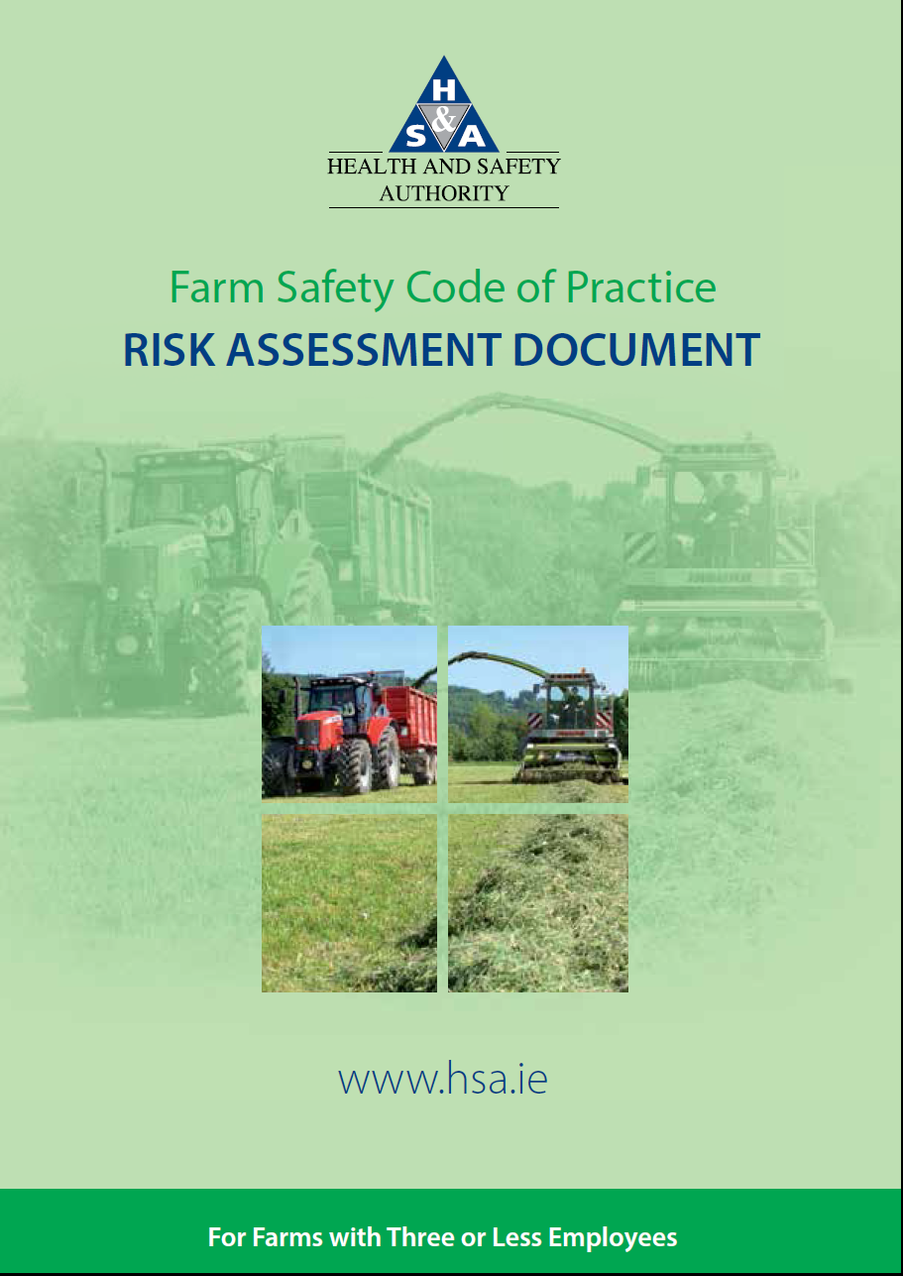
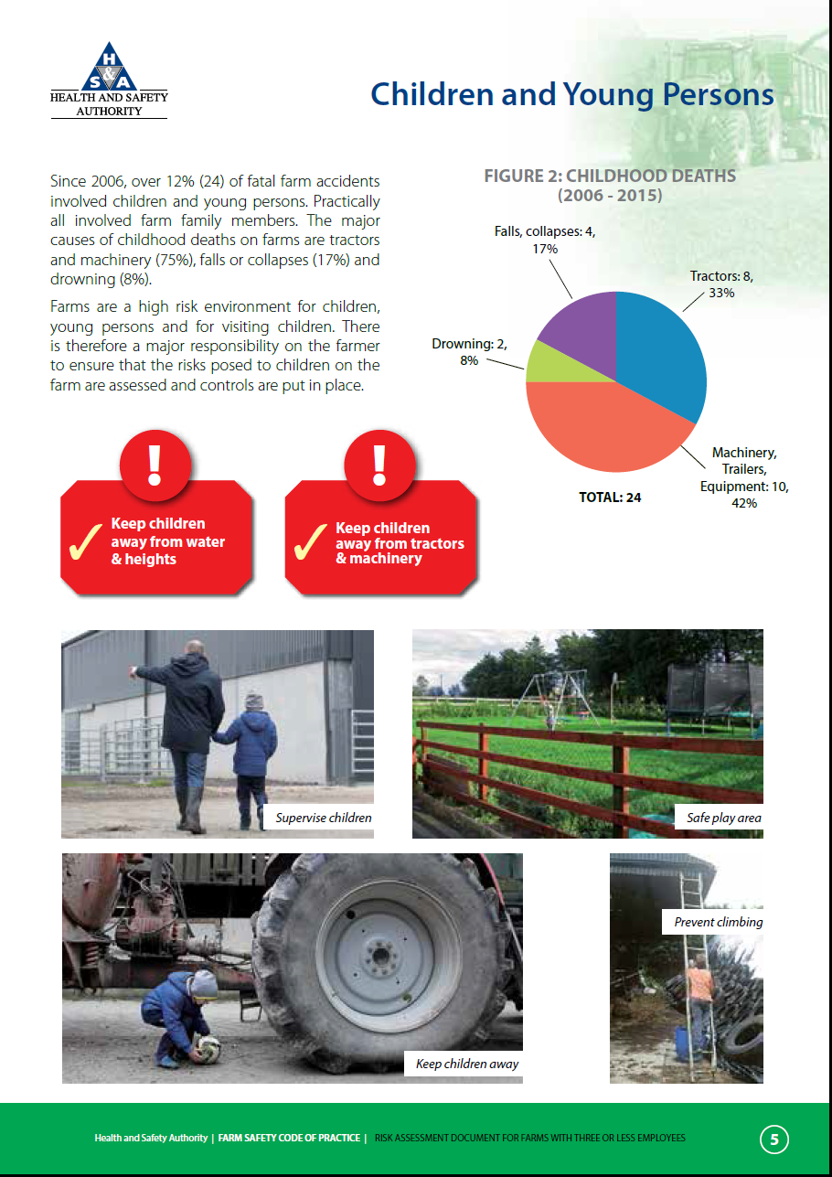
Farm Safety COP Risk Assessment
(Available at www.hsa.ie)

Slide 7
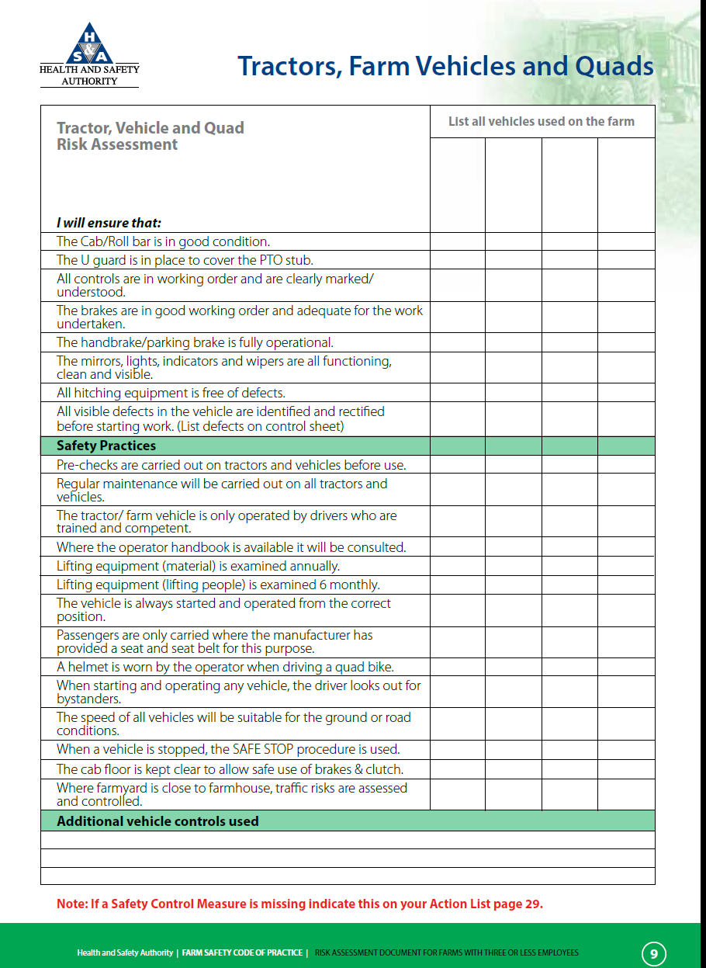
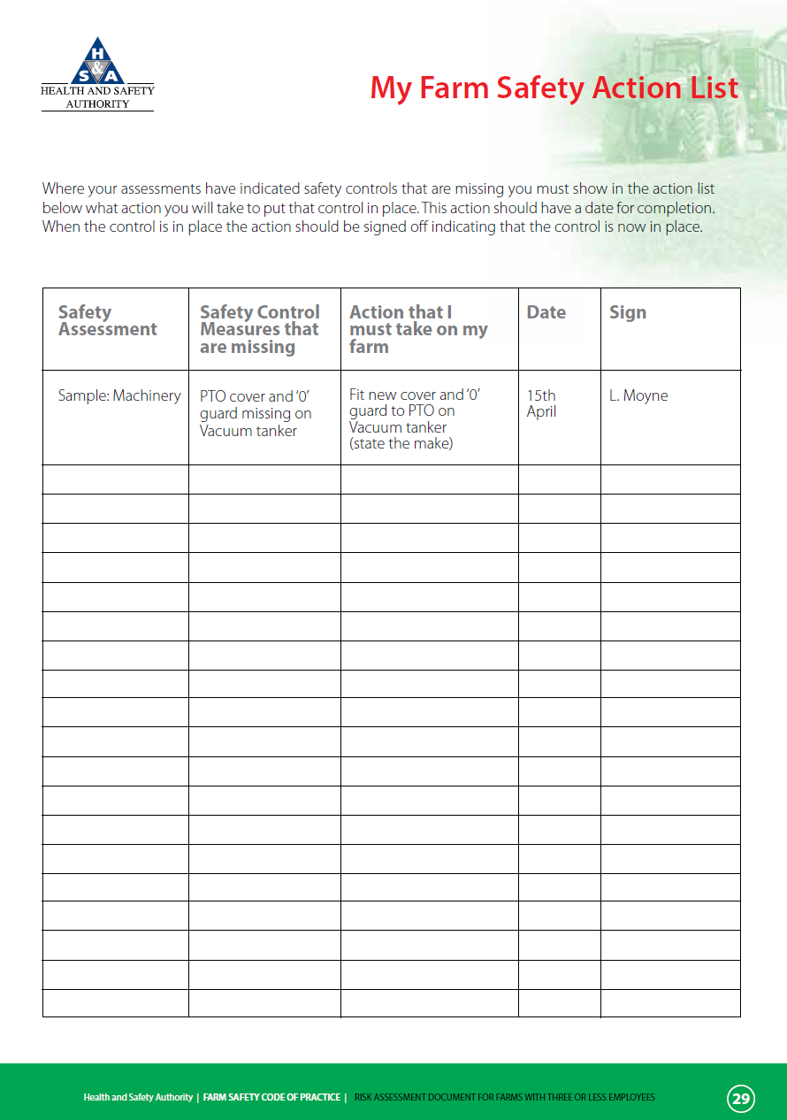
Farm Safety COP Risk Assessment

Slide 8
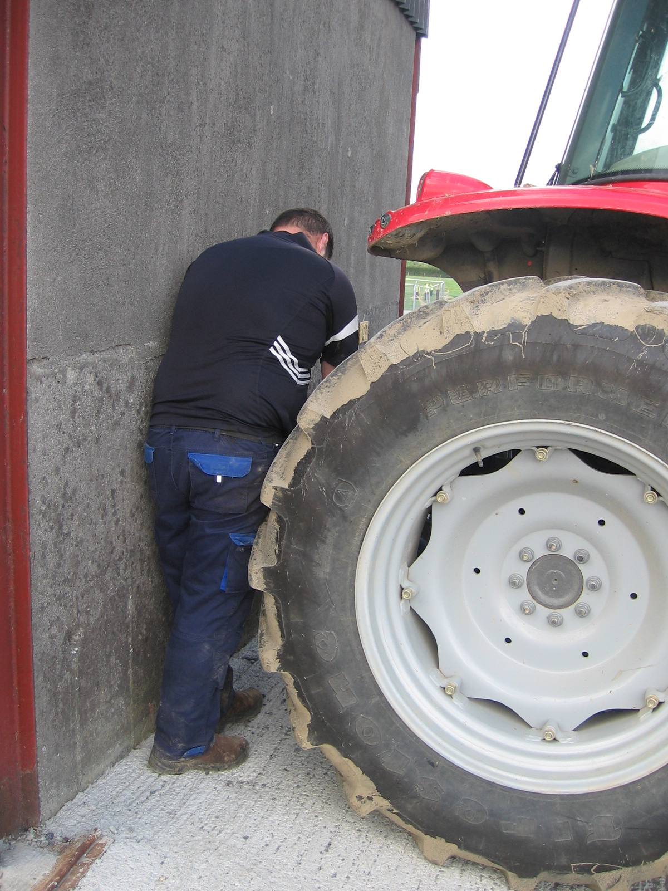
Crush Zone

Slide 9
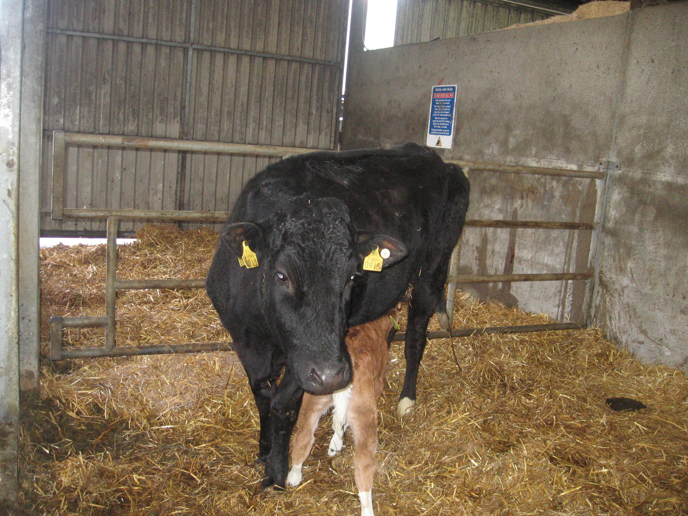

Slide 10
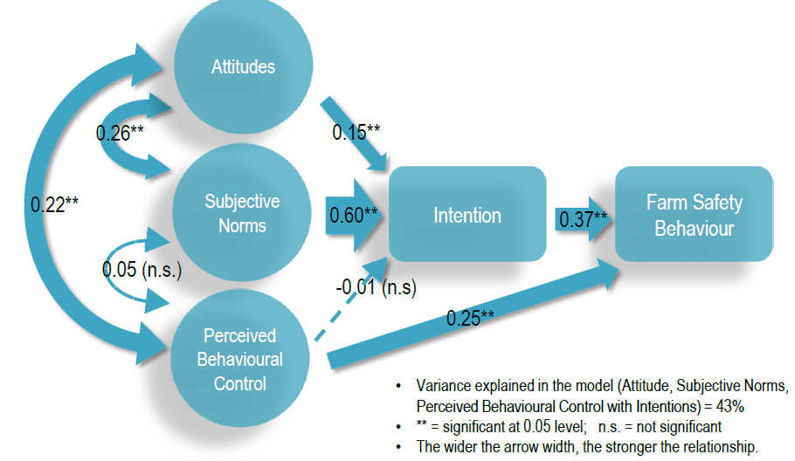
Theory of Planned Behaviour (Irish study for H.S.A.)

Slide 11
Prevention
Physical Controls
Behaviour
Work Organisation
Motivate H&S Action.

Slide 12
Dealing With Farmer Stress
Major Stressors: Forage; Finance; Workload; Paperwork; Health, Relationships.
New leaflet/ Booklets available.
Advisors/ Consultants are an approachable source who can assist with farming problems.
If you have ‘serious’ concern – recommend farmer to see GP

Slide 13
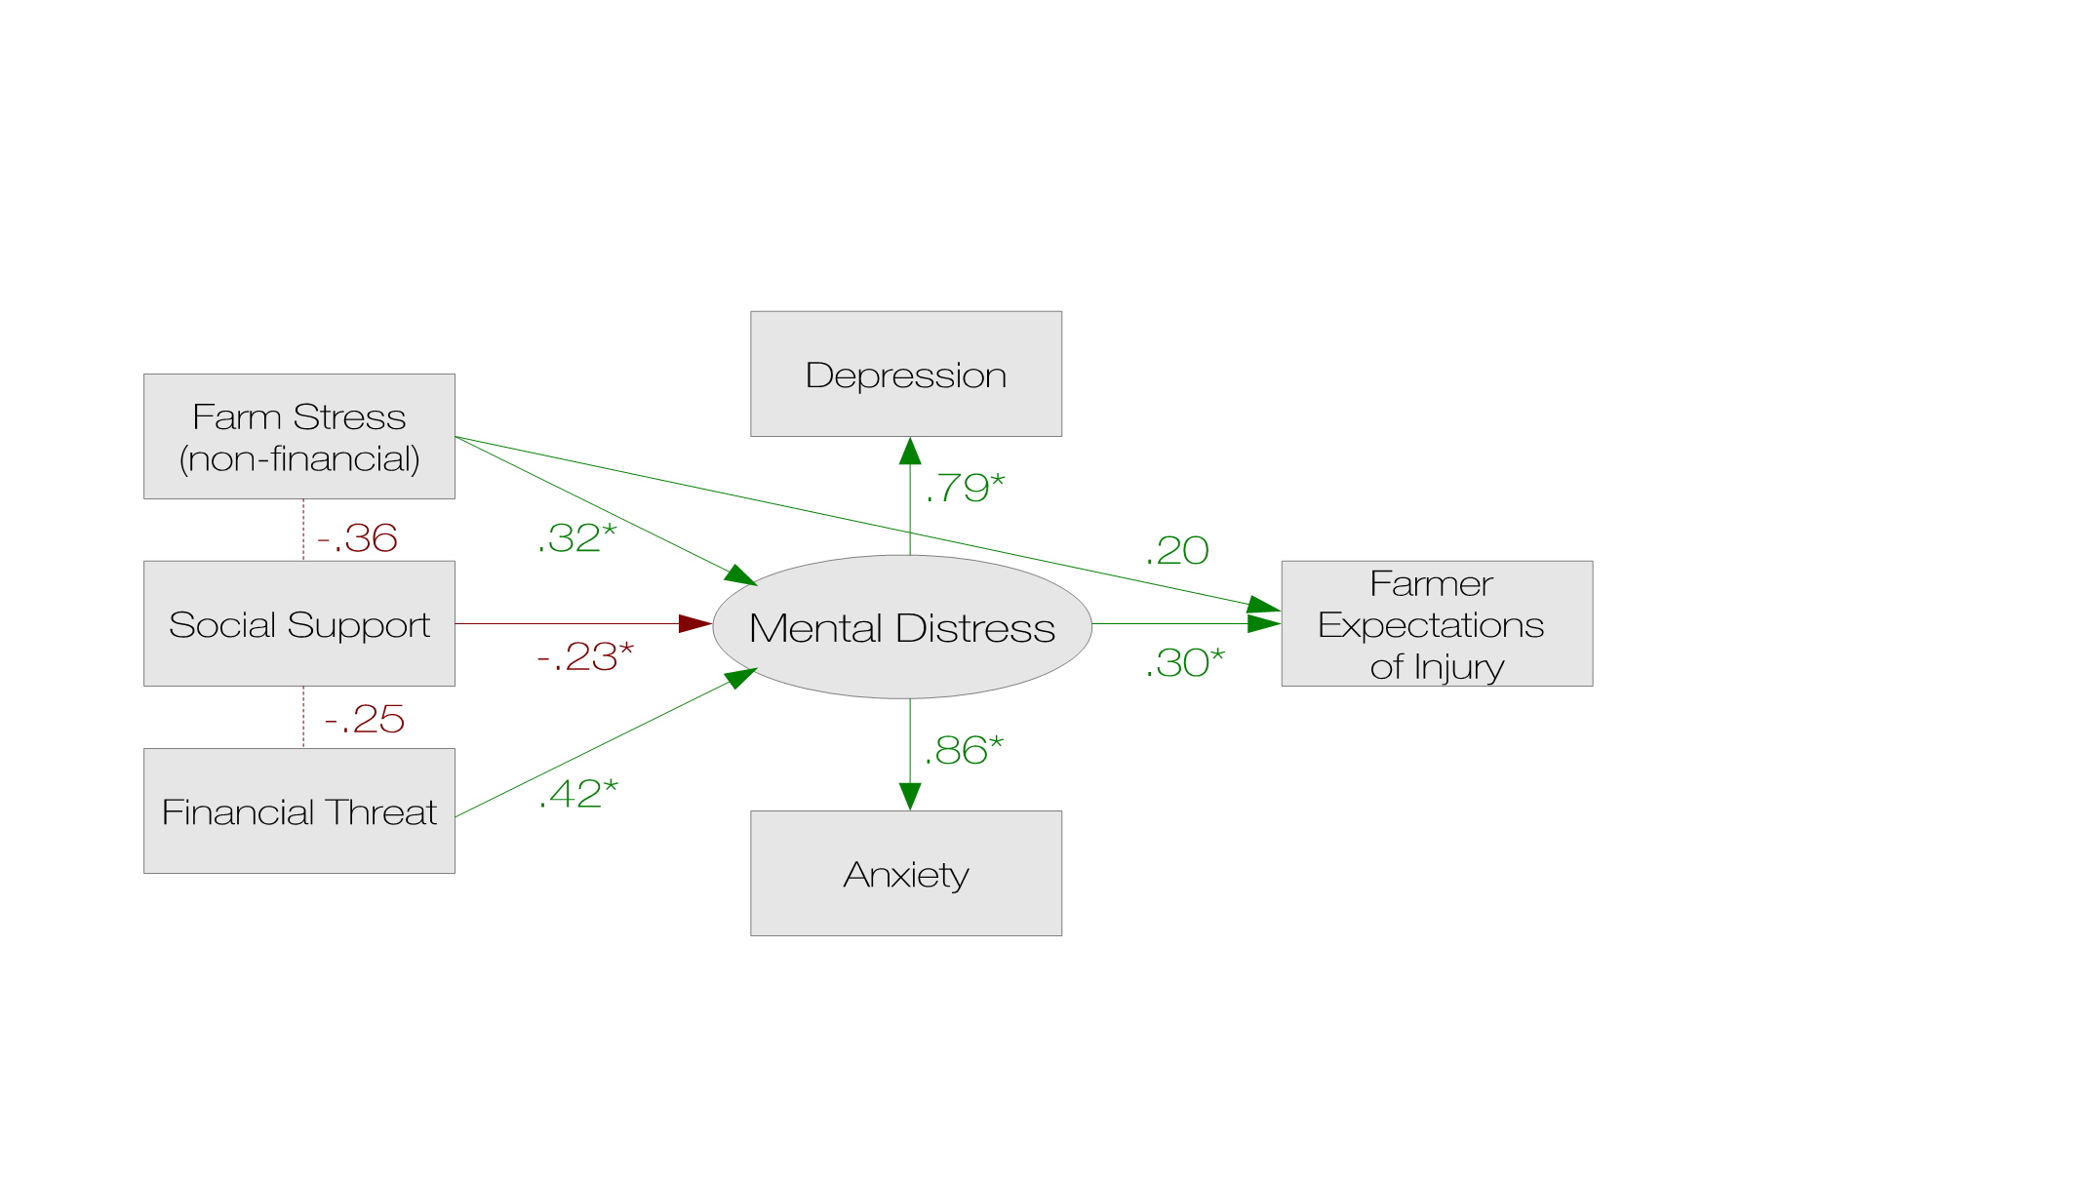
Injury-Stress: Structural Equation Model
Furey et al, 2016

Slide 14
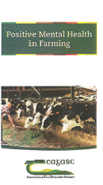



Slide 15
Links
Farm Safety Risk Assessment document.
https://www.hsa.ie/eng/Your_Industry/Agriculture_Forestry/Overview/Agriculture_Code_of_Practice/
Article Theory of Planned Behaviour
https://www.teagasc.ie/media/website/publications/2015/TResearch-Autumn-15.pdf

Slide 16
Links
Injury Stress Model:
https://www.frontiersin.org/articles/10.3389/fpubh.2016.00126/full
Positive Mental Health in Farming
https://www.teagasc.ie/media/website/publications/2018/Positive-Mental-Health-in-Farming.pdf

