Slide 1

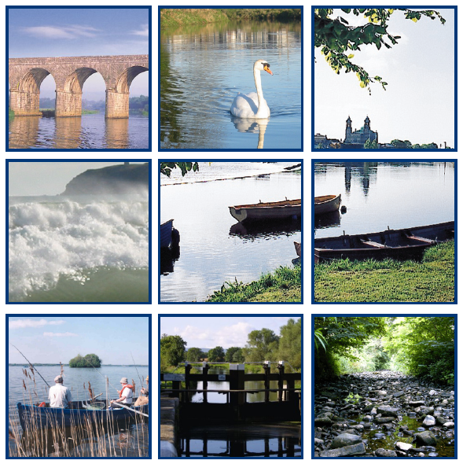
P Build-up Training - FAS Advisors
under Ireland’s
4th Nitrates Action Programme
2018 -2021
Leanne Roche
DAFM Nitrates Div
Johnstown Castle
Wexford

Slide 2
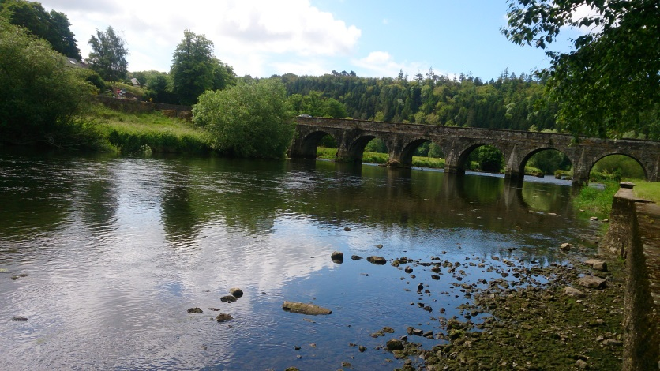
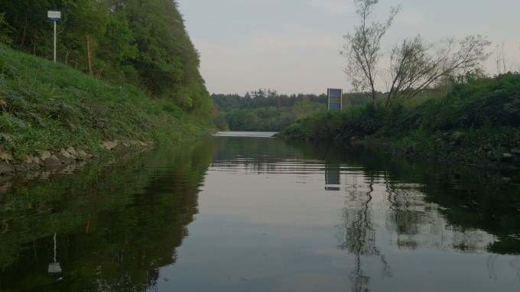
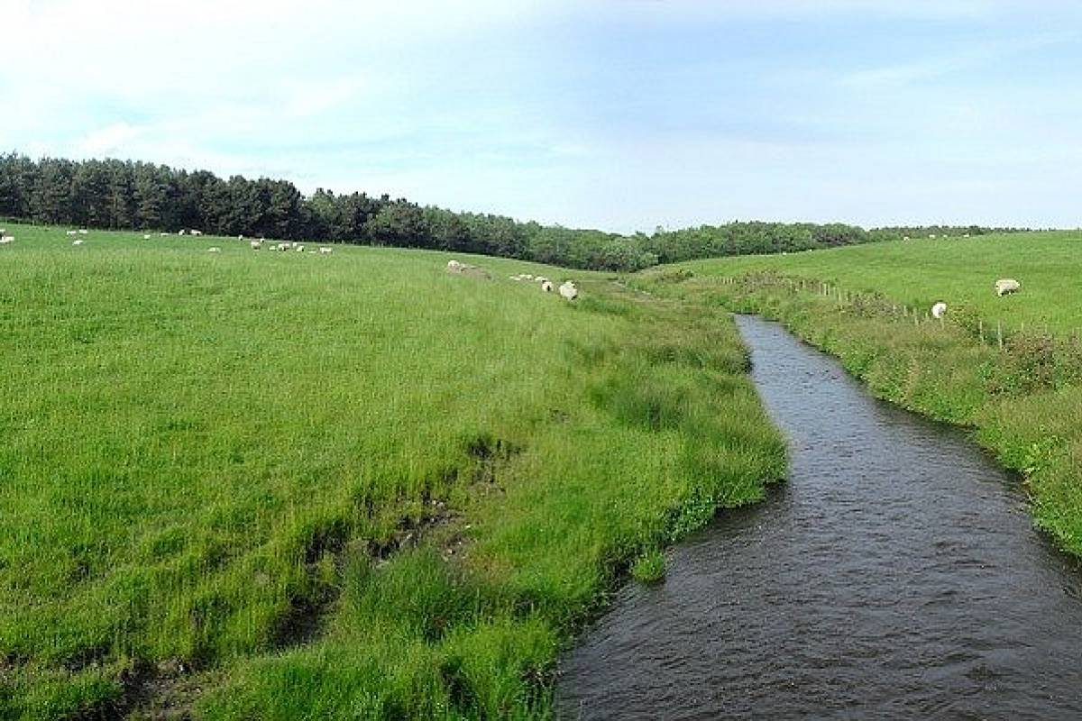
Presentation Overview
Water Quality
Soil Fertility
Nitrates Action Programme
P build up measures
Nitrates Derogation
P Build up Training Schedule
Conclusions

Slide 3
Water Quality
Water quality has improved since the introduction of the Nitrates Directive
Stabilised in recent years, with improvements and declines being offset
Issues in hot spot areas to be resolved
43% of monitored river water bodies are less than good ecological status, equates to 1,015 river water bodies
Dairying intensification is a challenge

Slide 4
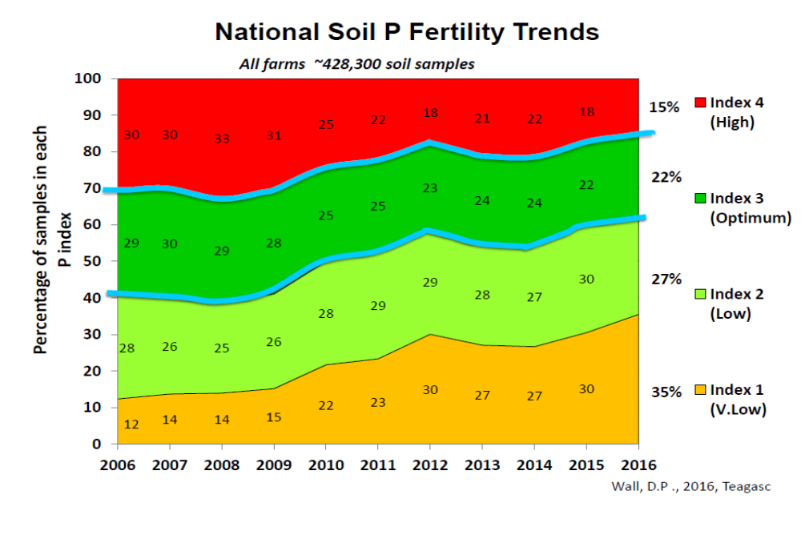
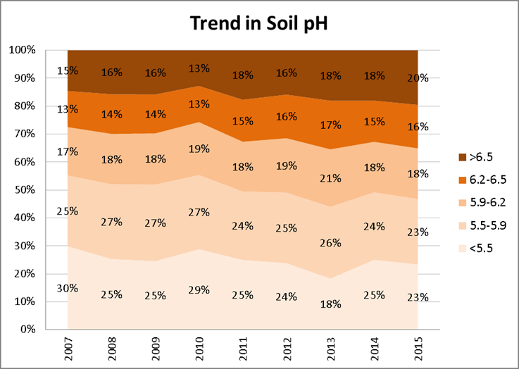
Irish soil fertility trends
10% of soils good overall fertility
62% very low to low P status
Lime usage - fallen significantly

Slide 5
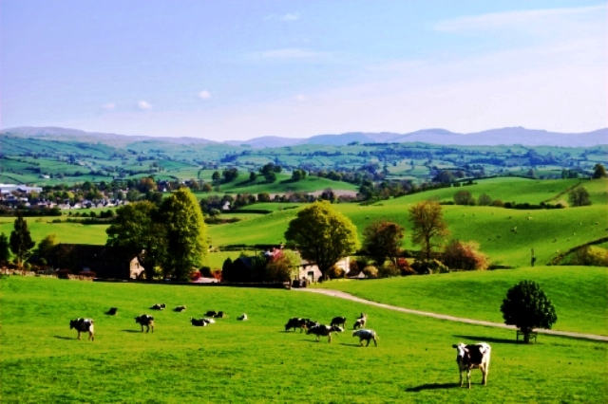
Nitrates Action Programme (NAP) Review
Review Group
  Department of Housing, Planning and Local Government,
  Environmental Protection Agency,
  Department of Agriculture, Food and Marine,
  Teagasc
Public consultation
Expert group report
  https://www.agriculture.gov.ie/ruralenvironment/environmentalobligations/nitrates/
New Nitrates Regulation (2018-2021)
- S.I. No. 605/2017

Slide 6
The main changes to the 4th NAP
New strengthened water protection measures to break nutrient and transport pathways
  Exclusion of bovines from watercourses
  Prevention of run-off from farm roads
Enhanced Knowledge Transfer
Simplification of the regulations for improved implementation
Targeting improved soil fertility – Phosphorus
  P Build up rates for index 1 and 2 soils

Slide 7
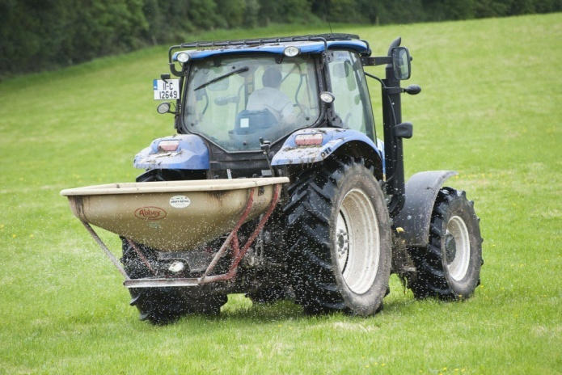
Phosphorus build-up
Currently 62 % of Irish soils in P index 1 and 2
Previous build-up rates not sufficient to increase P in reasonable timeframe
  Index 1 – extra 20 kg P/ha/year
  Index 2 – extra 10 kg P/ha/year
New build up rates for farms > 130 kg N/ha stocking rate
  Index 1 – extra 50 kg P/ha/year
  Index 2 – extra 30 kg P/ha/year
  New table 13B (P build up)
Built in safeguards to prevent P transfer to water
  - NMP
  - KT
  - Four year programme

Slide 8
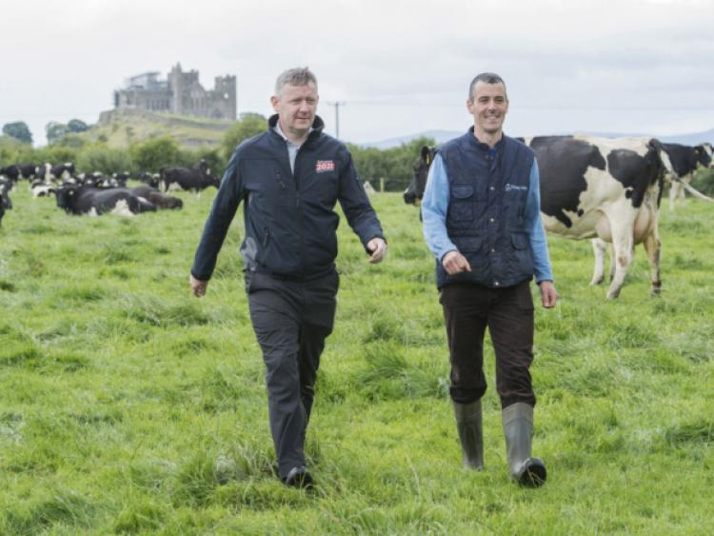
Phosphorus Build-Up
Farmers availing of P build-up allowances required to undertake NMP & participate in KT programme
  Soil analysis incl SOM
  SOM not required where mineral soils certified
  NMP submitted to DAFM
  Derogation NMP
  Non derogation – email to pbuildup@agriculture.gov.ie by 31 Dec 2018
  Farmers must attend training by approved FAS advisor by 31 Dec 2018
  List of farmers attending training to be submitted to DAFM (Nitrates Div)

Slide 9
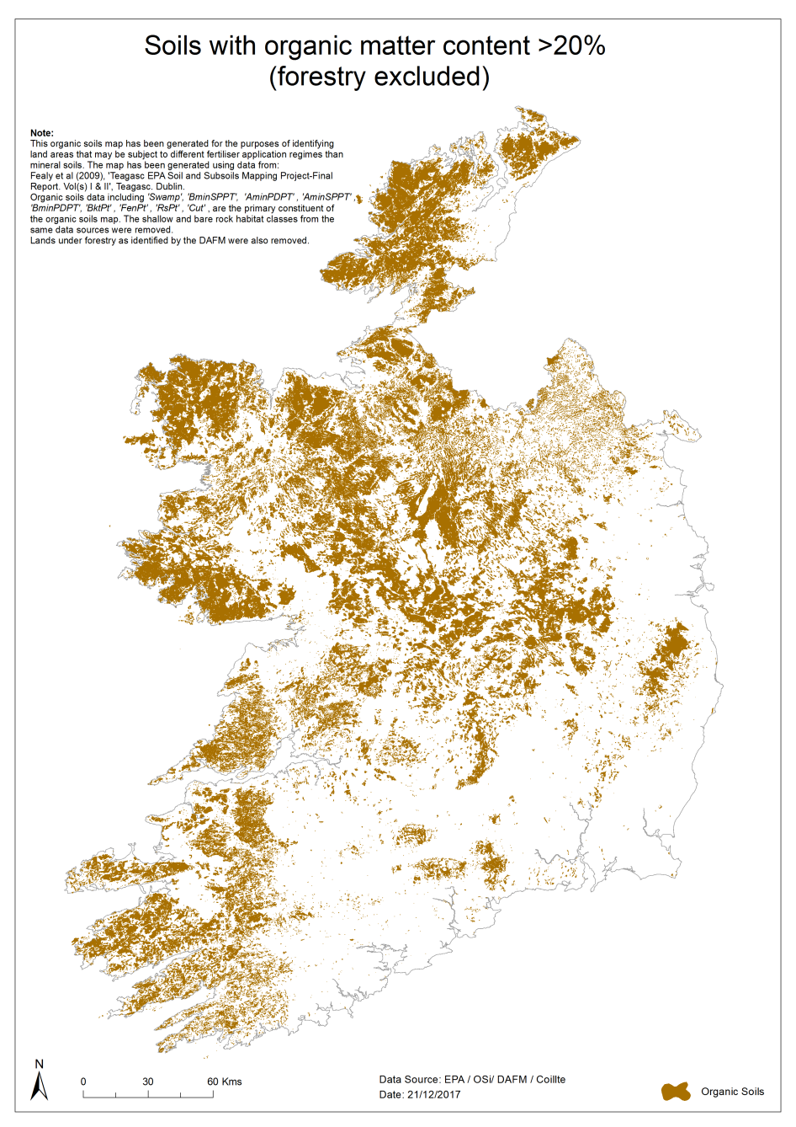
Soil OM testing in designated peaty areas
  Farmers located in designated peaty areas (Teagasc – EPA Indicative soils map) must test for OM when soil testing
  No soil test – assume P index 3
  Minimising the risk of P losses from risky peaty soils

Slide 10
4th NAP
  Strong action programme
  New measures breaking the loss pathway
  Addressing soil fertility
  Simplification
  Knowledge transfer

Slide 11
Nitrates Derogation
The new conditions applying for derogation
50% of all slurry produced on a derogation farm must be applied by the 15th June annually. After this date slurry may only be applied using low emission equipment.
Derogation farmers must have sufficient storage for all livestock manure and soiled water produced on the holding.

Slide 12
Time | Topic | Speaker
10.00 – 10.15 | Introduction 1. Intro P Build-Up Training (Powerpoint) | Leanne Roche, DAFM
10.15 – 10.30 | Health & Safety 2. Health and Safety (Powerpoint) | John McNamara
10.30 – 11.15 | New Nitrates Regulations and Training Requirements 3. Water Quality and NAP Regulations (Powerpoint) | Tim Hyde
11.15 – 11.50 | Soil pH & Liming 4. Lime Advice P Build- Up (Powerpoint) | Mark Plunkett / David Wall
11.50 – 12.15 | Soil P and K Indexes / Soil Results / Advice 5. P & K Advice (Powerpoint) | Mark Plunkett / David Wall
12.15 – 12.35 | Organic Manure Management 6. Organic Manures (Powerpoint) | Mark Plunkett / David Wall
12.35 -1.00 | Fertiliser Choice 7. P & K Fertiliser Choice (Powerpoint) | Mark Plunkett / David Wall
1.00 – 2.00 | Lunch
2.00 – 2.30 | Nitrogen Management 8. Nitrogen Management | Mark Plunkett / David Wall
2.30 – 3.30 | Fertiliser Plans – Dairy & Drystock 9. NMP Online Updates for Soil P Build Up Training (Powerpoint) | Tim Hyde
3.30 – 4.00 | P Mobilisation and Mitigation 10. P Mobilisation & Mitigation P Build Up training | David Wall
4.00 – 4.30 | Review of fertiliser plan for best environmental outcomes 11. Review of Fertiliser Plan | Tim Hyde
4.30-5.00 | Q & A | All

Slide 13
Conclusions
Strong NAP programme
P build up to address soil fertility
Farmers must have NMP submitted to DAFM
  pbuildup@agriculture.gov.ie
Farmers must attend training before 31/12/2018
Advisor to inform DAFM of training
List of participants to be submitted to DAFM

