Slide 1
NMP Online Updates
&
Review of Fertiliser plan for best environmental outcomes
Tim Hyde
Teagasc
15th October 2018

Slide 2
NAP Changes built into NMP online
Table 12 Annual Maximum Fertiliser rates of N
Table 13A Annual Maximum Fertiliser rates of P
Table 13B Annual Maximum Fertiliser rates of P
  Soil P Build-up (Optional Settings)
  OM map >20% (Map Viewer)
  Previous Years GSR (General settings)
  Derogation application 2018 takes precedence

Slide 3
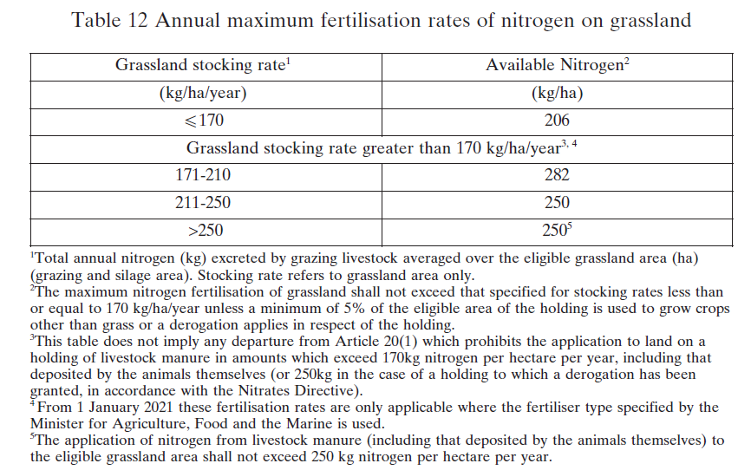

Slide 4
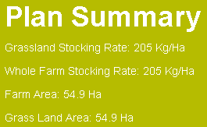

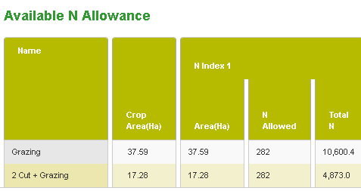

Slide 5
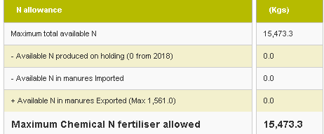
Available N Table 12 - 54.86ha x 282kg/ha

Slide 6
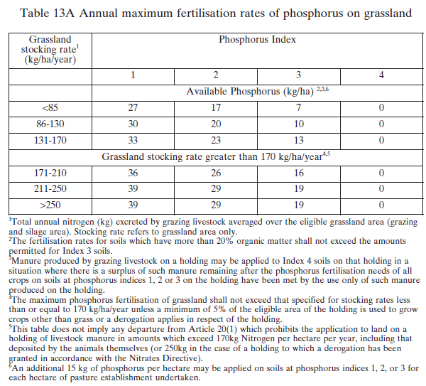

Slide 7
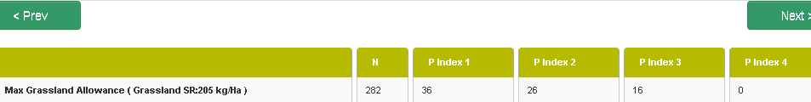
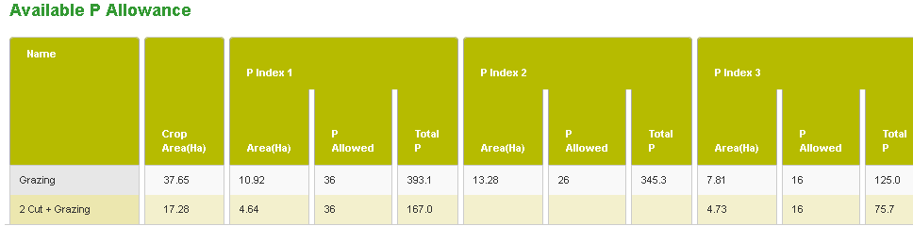

No P Build-up

Slide 8
Soil Phosphorus Build-Up Programme
Under article 16(5) of the Good Agricultural Practice for Protection of Waters Regulations (S.I. No 605/2017), effective from 1 January 2018, grassland farmers now have the option of using increased Phosphorus (P) build-up levels to rectify soil phosphorus deficiency. This new provision applies only to the more intensively stocked grassland farmers, with Grassland stocking rates of 130+ kg N/ ha.

Slide 9
DAFM Nitrates Div. Circular No. 01/2018
Soil Phosphorus Build-Up Programme
Soil analysis is required including for soil Organic Matter (OM) content unless it is certified that soils on a holding are mineral soils, or the advisor certifies they are organic soils and build up rates will not be used.
P Buildup only applies to mineral/clay/loam Grassland soils
For those farmers applying for a Nitrates Derogation in 2018 and who wish to use the new P build-up rates, on-line NMP uploaded to Derogation AgFood satisfies DAFM notification requirements.
For non-derogation farmers who wish to use the new P build-up rates, a copy of the Teagasc on-line NMP must be emailed to DAFM at pbuildup@agriculture.gov.ie by 31 Dec 2018.
To ensure the protection of the environment, farmers using the increased P build-up rates are required to participate in a dedicated KT programme, delivered by a FAS advisor, by 31 December 2018.

Slide 10
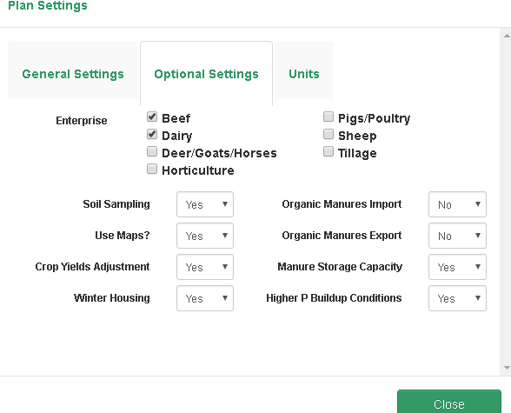
How to change plan to Soil P Build-up

Slide 11

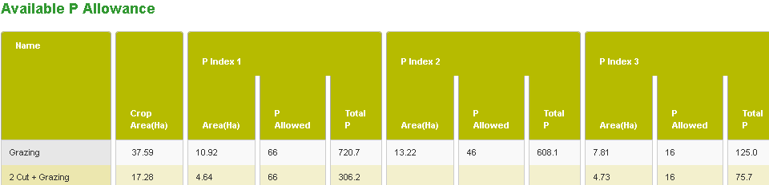
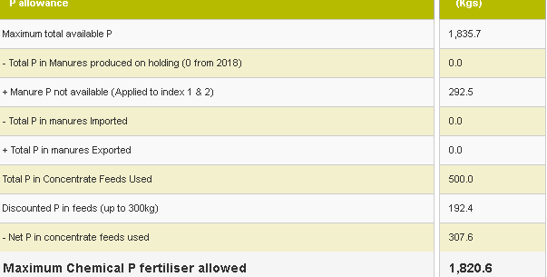
P Build-up

Slide 12
In this case study % increases in N and P
  P increase will depend on % P index, 1 – 4 soils?
  Will P index 1 & 2 soils receive organic manures?
  Table 9 Nutrient availability in fertilisers
  Warning! Higher P Buildup Conditions selected and no soil sample area can exceed 5 Ha on the entire farm
Rates etc | Max chemical N Total Kgs | % increase | Max chemical P Total Kgs | % increase
SI 31/2014 | 10,111 | N/A. | 917 | N/A.
New Table 13A | 10,222 | 1.5% | 1090 | 18.50%
New Table 13B | 10,222 | 1.5% | 1820 | 98% (67%)

Slide 13

Derogation report for P Buildup
Manure Storage Capacity needs to be completed
Soiled water, Slurry and FYM sections
P Build-up will appear on front page of reports
Derogation – Fertiliser Plan 2018 (Soil P Build-up)

Slide 14
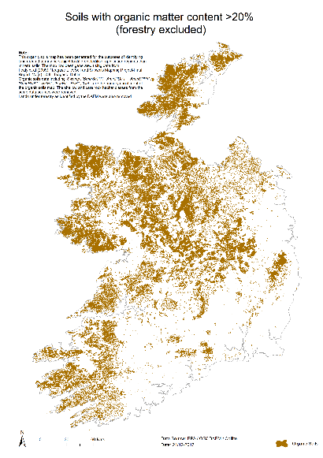
  Available on NMP
  Available on AgFood
  3 options
  Take OM for all plots in high OM map
  FAS sign off on plots that are non high OM
  Assume P index 3 for all soils concerned and no OM test required
  Assign Peat as soil type and NMP defaults P index 1 and 2 soils to P Index 3

Slide 15
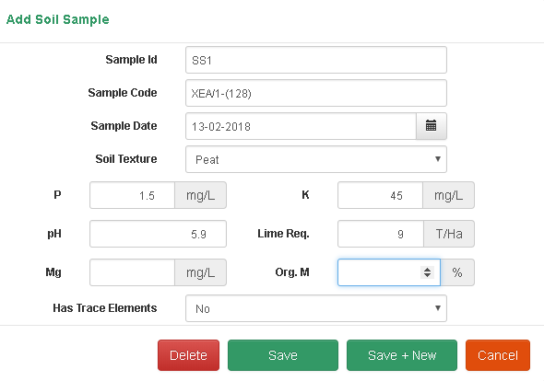
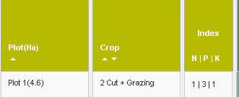

Slide 16
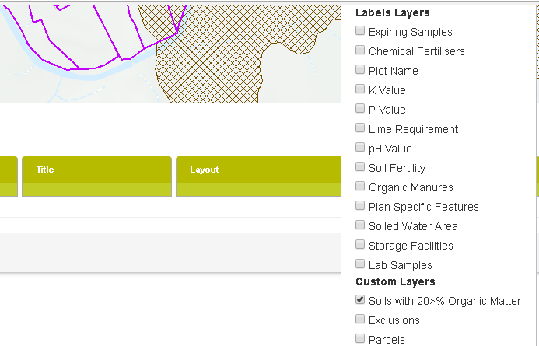
How to find this on NMP Online
  Map Viewer – select Layer Control
  Layer appears as brown hatched layer

Slide 17
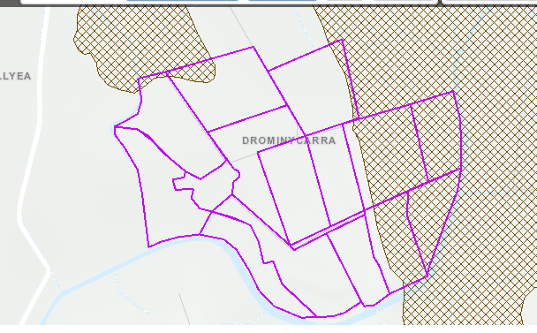
OSI Layer

Slide 18
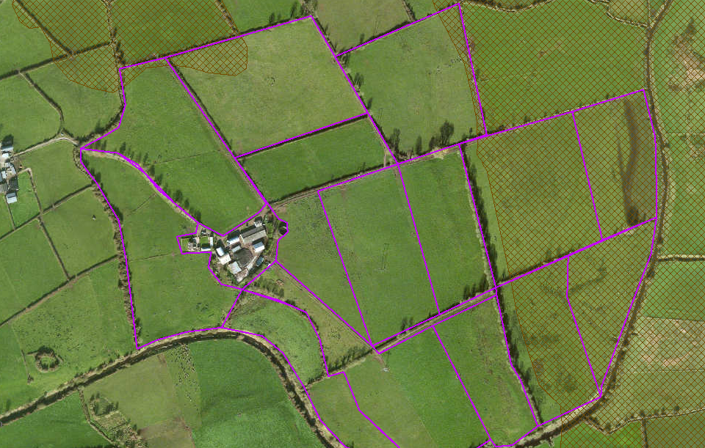
Ortho Layer

Slide 19
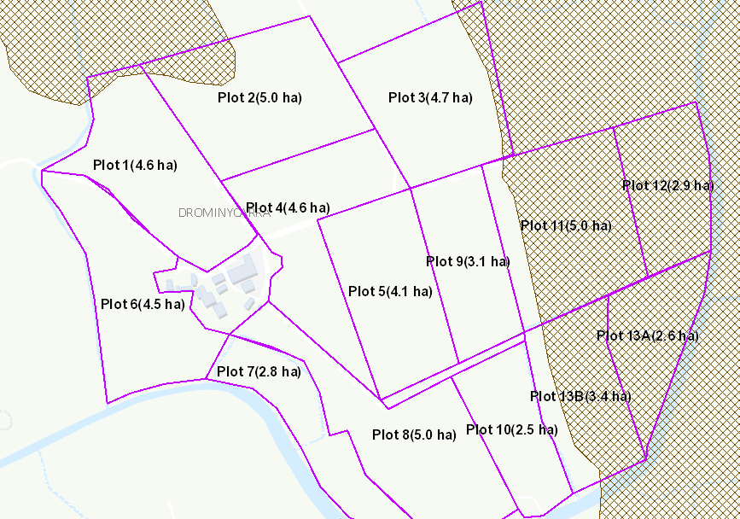
Plots 1, 2, 11, 12, 13A and 13B??

Slide 20
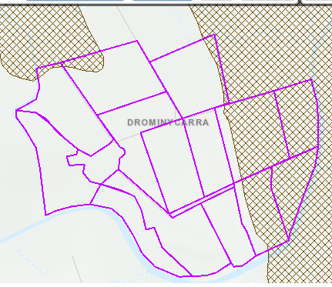
Mineral soil
Peat soil OM>20%
Mineral soil
Peat soil OM>20%
Peat soil no OM test

Slide 21
Previous years GSR
Not applicable to new derogation applicants in 2018 as they can use the predicted GSR
Except if in derogation in 2017 and will be changing bands within derogation from <210 to >210 – these must use previous years GSR
Non-derogation farmers 2018 will all use previous years GSR
Can select either function in NMP Online

Slide 22
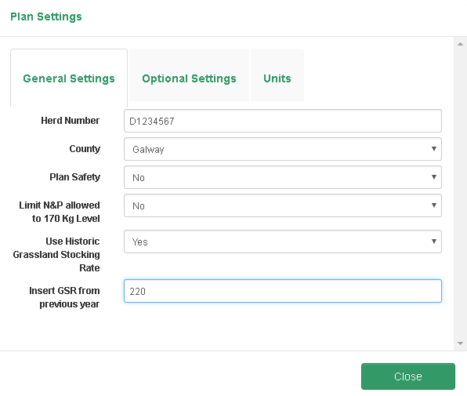

Slide 23
What to consider when completing NMP’s
“Sources”
OM maps
Watercourses, streams and dry drains
Sloped fields and fields prone to waterlogging
Wells and water abstractions points
Critical Source Areas
Water quality in the area
Farm roads/out-wintering/Farmyards
Application of organic and chemical manures to low risk fields

Slide 24
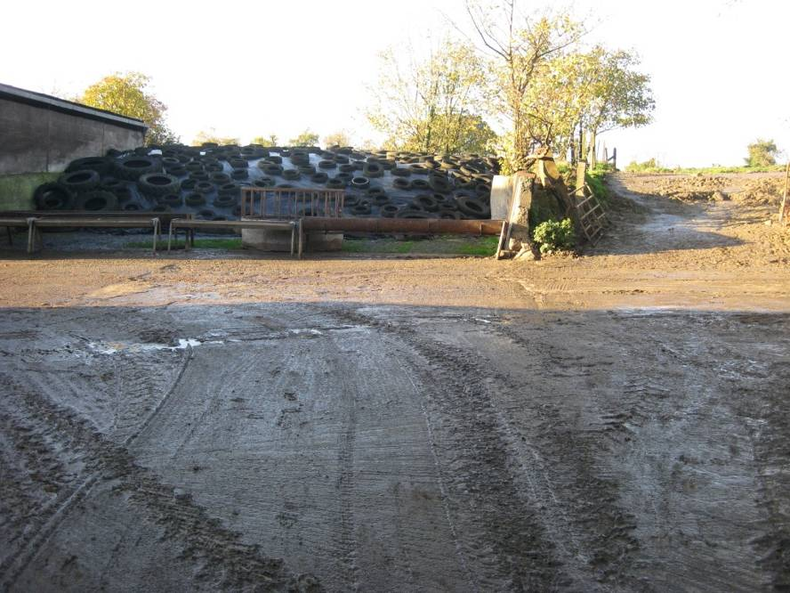

Slide 25
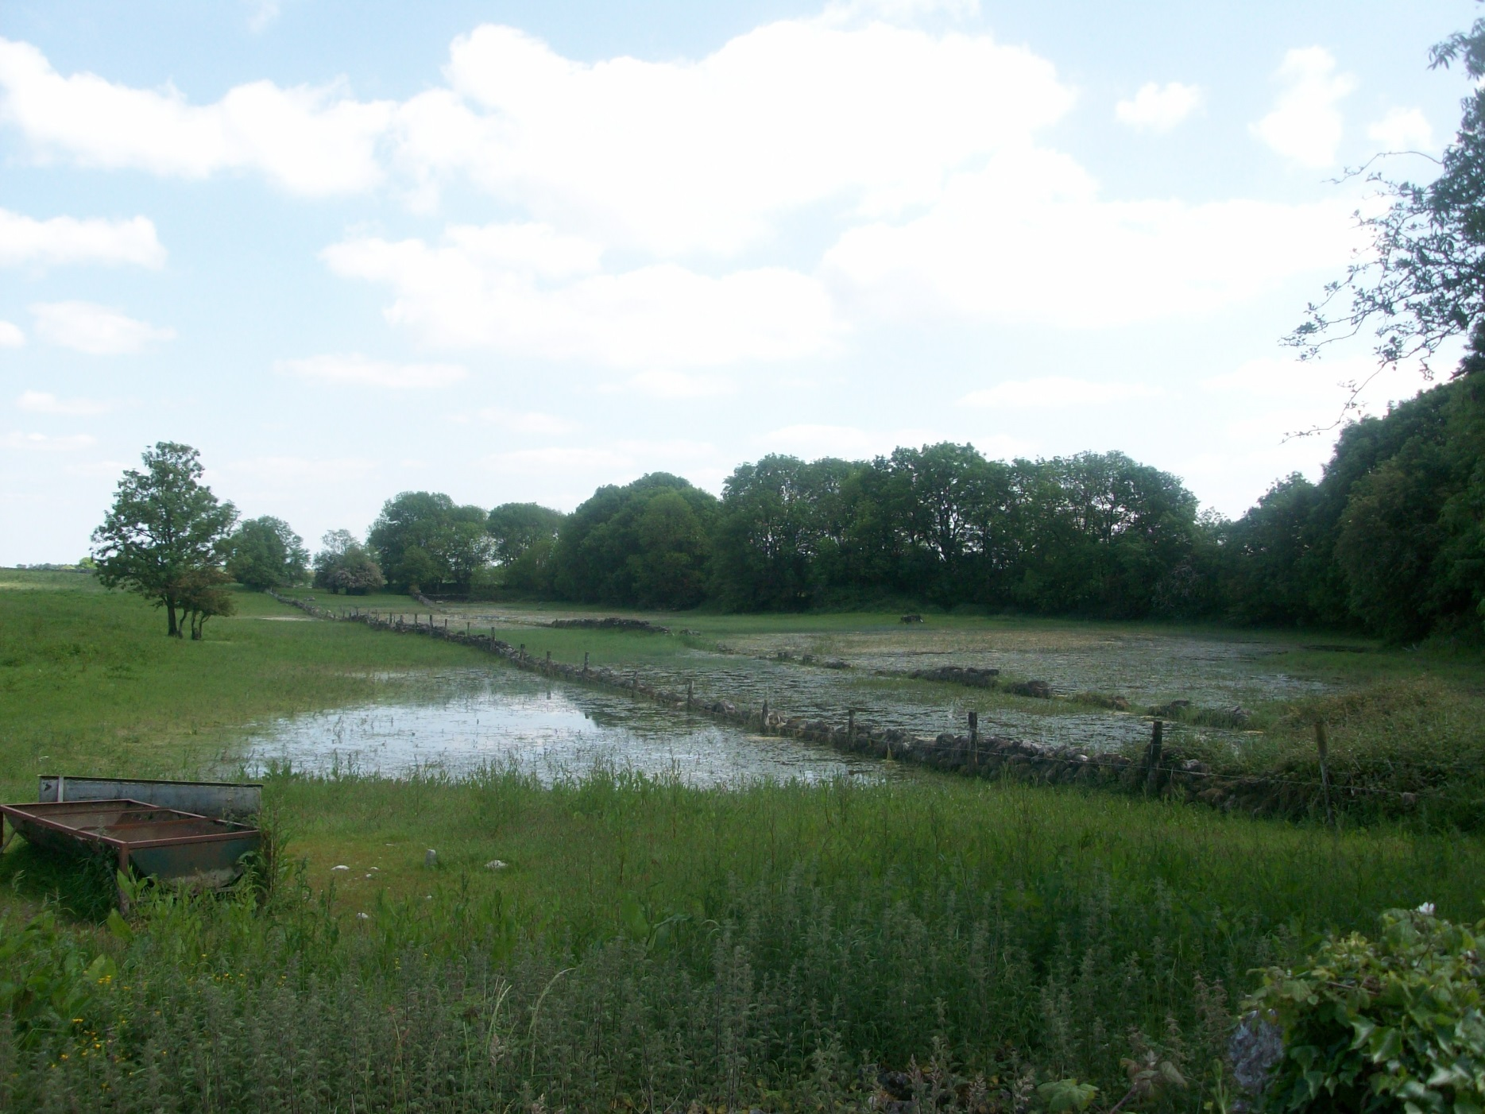

Slide 26
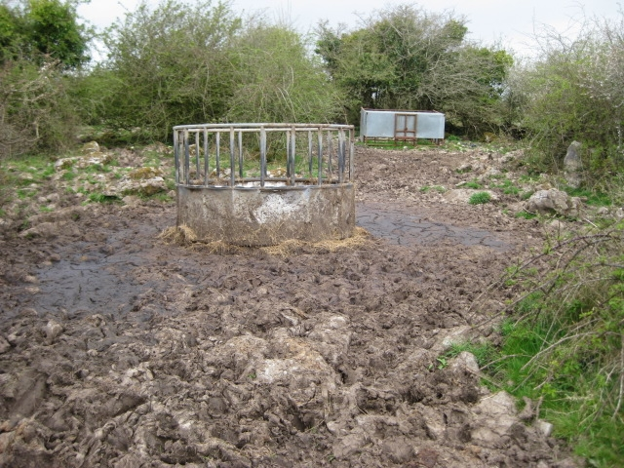

Slide 27
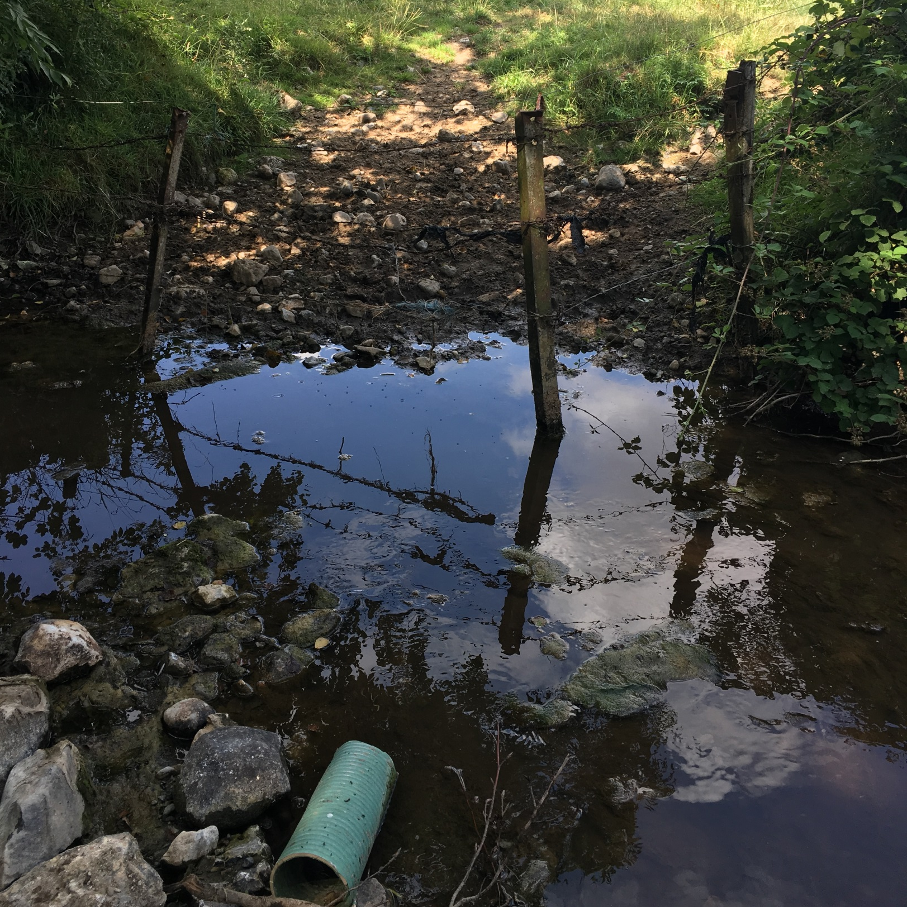
Dinking point Sources
Livestock access direct deposition to water and sedimentation

Slide 28
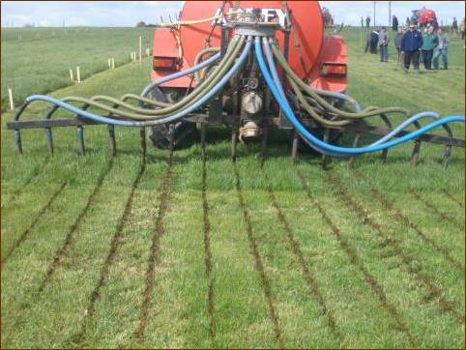
Dribble Bar on conventional vacuum tanker

Slide 29
OM Layer – No P Buildup on >20% OM soils

Slide 30
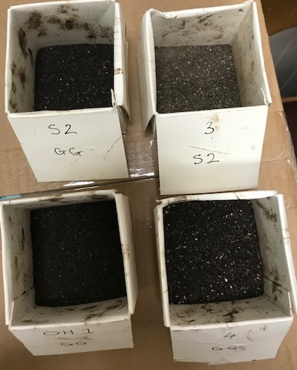

Slide 31
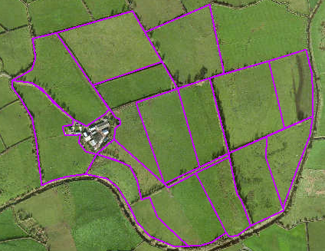
Consider drains/watercourses & buffer zones

Slide 32
Buffer Zones
Buffer zones for spreading organic fertilisers
Water body/Feature | Buffer zone
Any water supply source providing 100m³ or more of water per day, or serving 500 or more people | 200 metres (or as little as 30 metres where a local authority allows)
Any water supply source providing 10m³ or more of water per day, or serving 50 or more people | 100 metres (or as little as 30 metres where a local authority allows)
Any other water supply for human consumption | 25 metres (or as little as 15 metres where a local authority allows)
Lake shoreline | 20 metres
Exposed cavernous or karstified limestone features (such as swallow holes and collapse features) | 15 metres
Any surface watercourse where the slope towards the watercourse exceeds 10% | 10 metres
Any other surface waters | 5 metres*

Slide 33
Buffer Zones
*The 5 metre buffer zone is increased to 10 metres for a period of two weeks preceding and two weeks following the periods when application of fertilisers to land is prohibited
The objective of increased setback distances at the shoulders of the closed period is to help retain as much of the applied nutrient in the field as possible thereby reducing its risk of loss through overland flow.
In the case of water for human consumption, the Local Authority may vary buffer widths from those specified
  Application of fertilisers at correct times of years – avoid rainfall events (at any time of the open period)

Slide 34
Buffer zones applicable when farmyard manure is stored in a field
Water body/Feature | Buffer zone
Any water supply source providing 100m³ or more of water per day, or serving 500 or more people | 250 metres
Any water supply source providing 10m³ or more of water per day, or serving 50 or more people | 250 metres
Any other water supply for human consumption | 50 metres
Lake shoreline | 20 metres
Exposed cavernous or karstified limestone features (such as swallow holes and collapse features) | 50 metres
Any other surface waters | 20 metres
Silage bales
Silage bales may not be stored outside of farmyards within 20 metres of waters or a drinking water abstraction point in the absence of adequate facilities for the collection and storage of any effluent that may arise.
Supplementary feeding
No supplementary feeding points may be located within 20 m of surface water or on bare rock

Slide 35
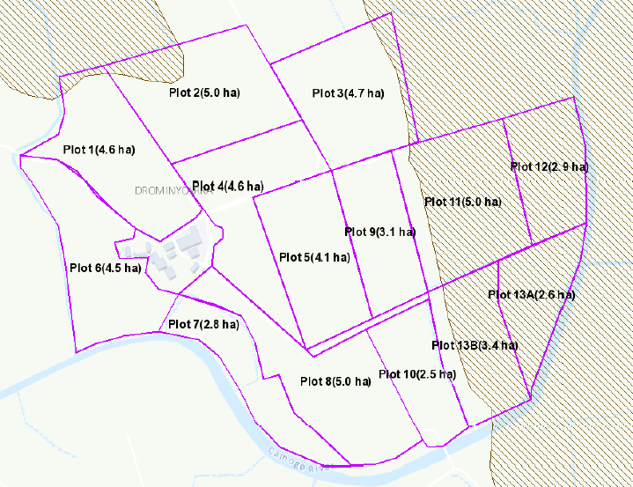


250m buffer zone excludes organic fertilisers from plots 11, 12 and northern part of plot 13A
Need to consider Wells and water abstraction points

Slide 36
Need to consider sloped fields near watercourses and drains

Slide 37
Critical Source Area
Heavy clay soil
Slopes from other fields into this area
Prone to occasional flooding from River

Slide 38
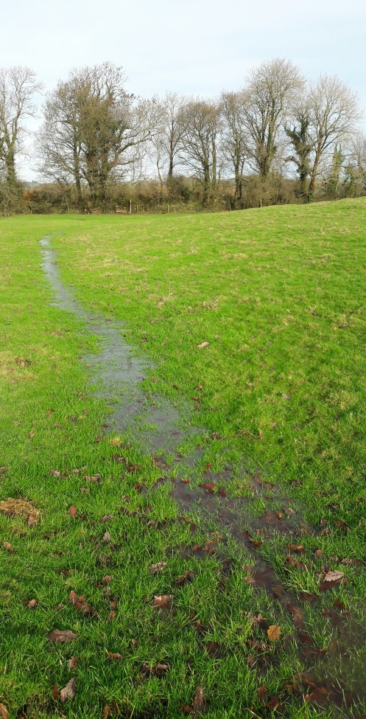
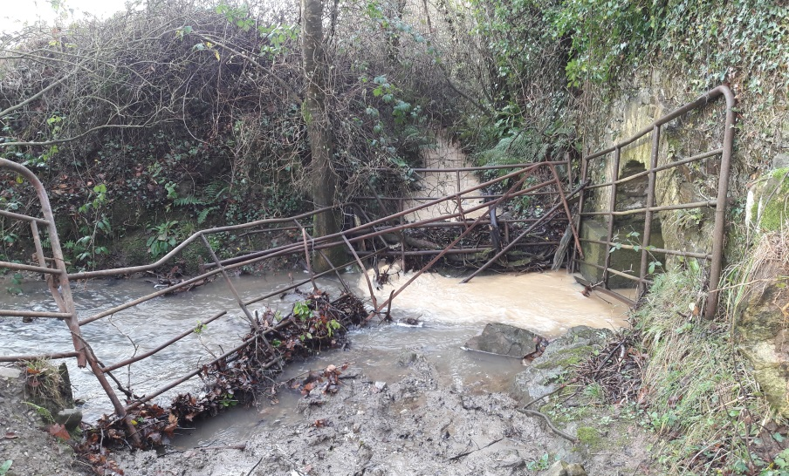
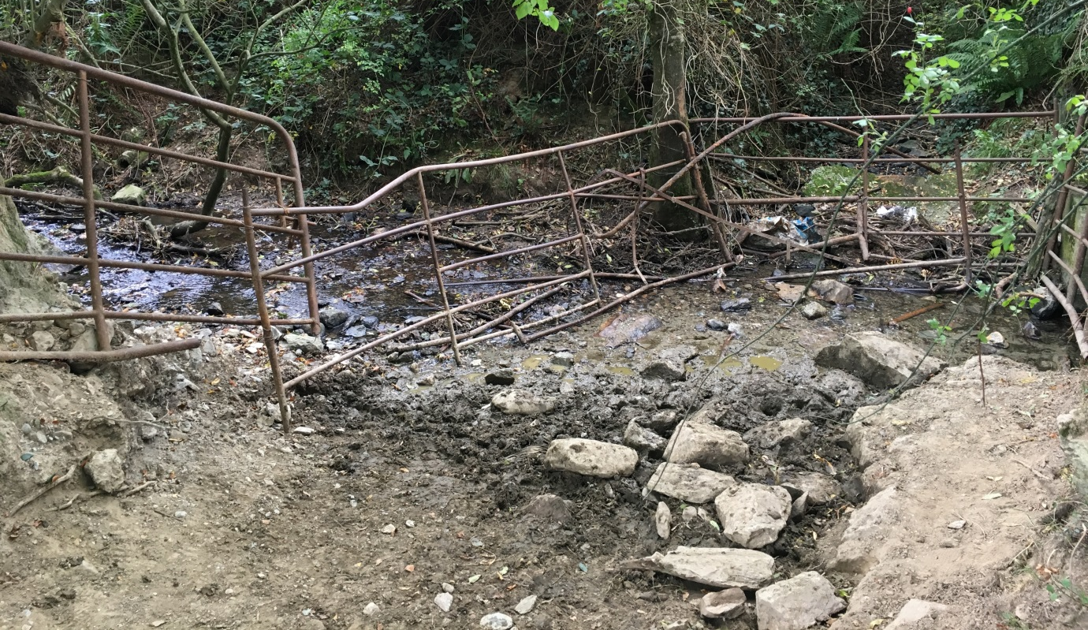

Slide 39
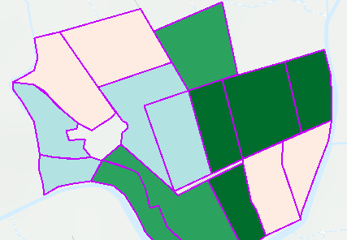
Tradition was to spread on the driest fields
Field to the east is a peat soil with P index 4
Field to the south is a CSA
P Index 4 soil

Slide 40
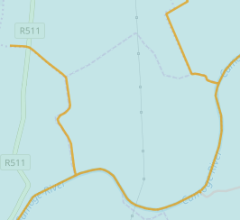
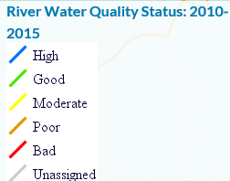
Need to use other Mapping layers www.catchments.ie

Slide 41
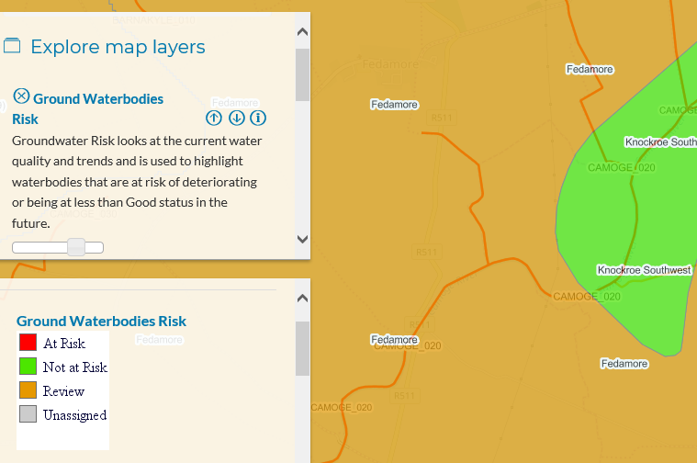
Groundwater Waterbodies Risk

Slide 42
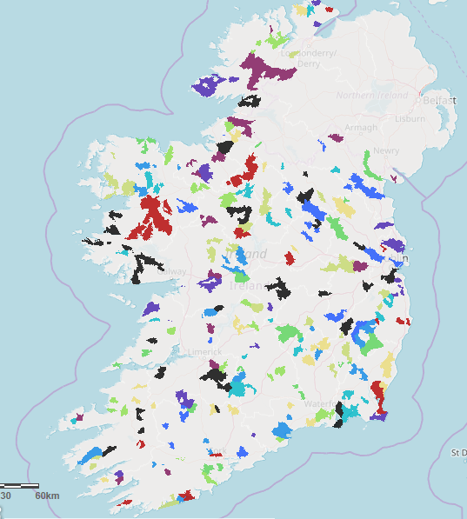

Slide 43
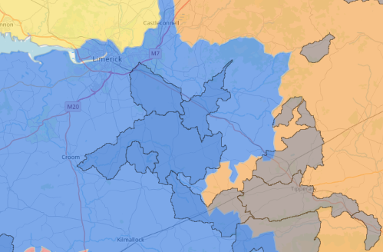
http://watersandcommunities.ie/areas-for-action/
Farm is located here

Slide 44
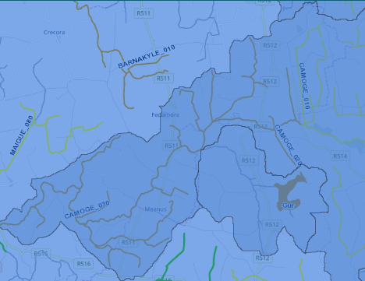
Poor Water Quality

Slide 45
Pollution Impact Potential Maps (PIP Maps)
Critical sources areas (CSA’s) are areas that deliver a disproportionally high amount of pollutants compared to other areas of a water body or subcatchment, and represent the areas with the highest risk of impacting a water body. In order to determine where critical source areas are located, we need to determine the hydro(geo) logical susceptibility of the water body and also the nutrient loadings applied to that water body.

Slide 46
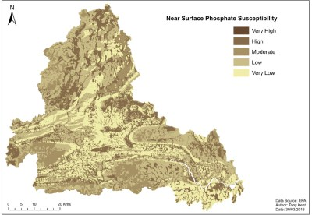
Susceptibility maps
  linking data on soils, subsoils, groundwater vulnerability and aquifer types with nutrient attenuation & transport factors.
  phosphate along the near surface pathway, and for nitrate along the near surface and groundwater pathways.
  Example of P map Suir Catchment

Slide 47
PIP Maps – Pollutant Impact Potential Maps
The susceptibility maps are combined with nutrient loadings data provided by DAFM and the CSO to produce Pollutant Impact Potential maps.
The darkest blue areas (PIP rank 1) are the critical sources areas (or the highest risk areas) and all areas are ranked relative to this area.
These high risk areas for phosphate to surface water coincide with poorly drained areas, meaning that in these areas phosphate is more likely to flow overland to surface waters rather than being retained in the soil and subsoil.
Similar maps are available for nitrate in surface water and groundwater.

Slide 48
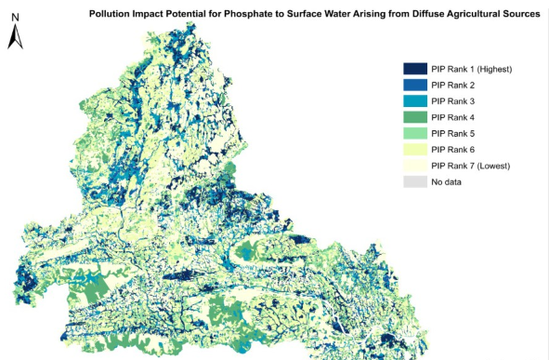
PIP Maps – Pollutant Impact Maps

Slide 49
PIP Maps – Pollutant Impact Maps
Available at 1:20,000 will be available on NMP online
The maps act as a signpost to where there is a potential critical source area
For phosphate, point sources are more likely to be an issue in high risk areas (PIP Rank 1-3) as these areas are likely to have a higher density of drains and ditches acting as a pathway from farmyards to water bodies
Indicator maps only and are to be used with field and farm assessments

Slide 50
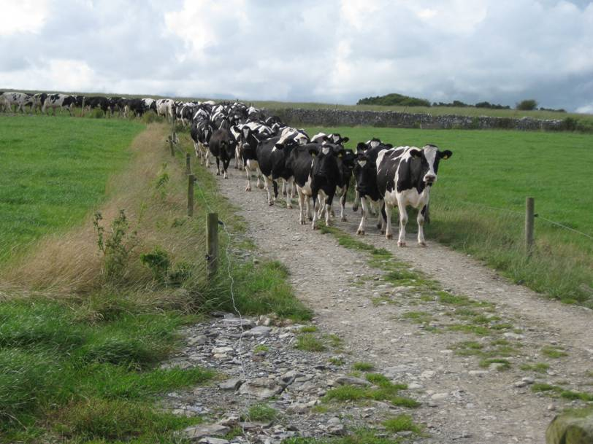
Dairy Farm example
55ha’s of a spring calving dairy herd 100 cows + replacements
Rivers, sloped fields and water abstraction points = no organic manures on plots 6A and 7 (sloped and watercourses), plot 10 CSA, plots 11 -14 (Water abstraction points, river and high OM soils)
Stocked at 205NpH

Slide 51
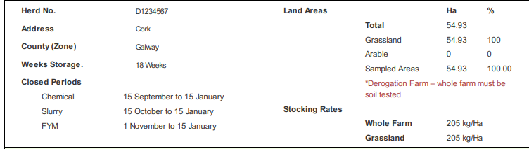
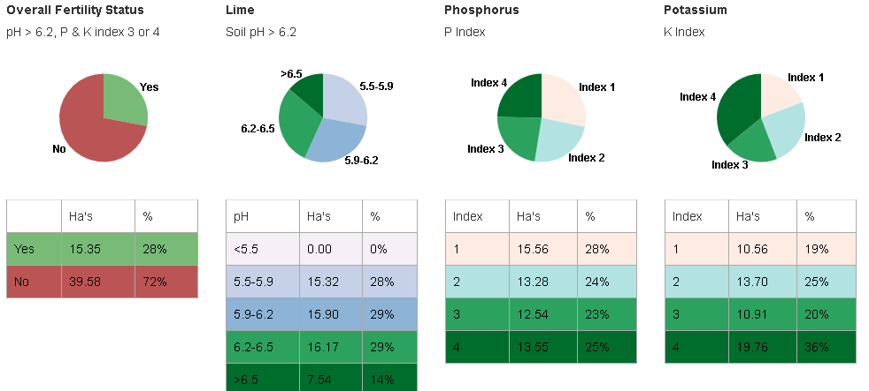

Slide 52
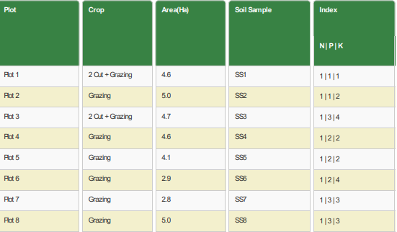

Organic manures plan

Slide 53
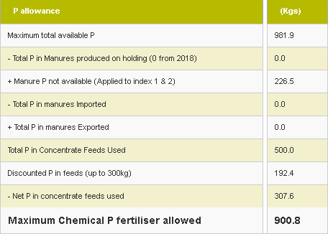
Drystock Farm 165 NpH – No P Buildup

Slide 54
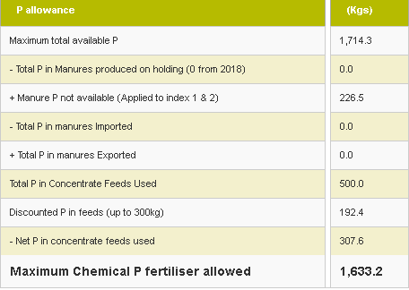
Drystock Farm 165 NpH – Yes P Buildup

Slide 55
N & P Mobilisation
N & P Mobilisation is influenced by:
  Soil type and rainfall
  Soil moisture deficits
  Soil chemistry – Fe, Al & Ca in free draining soils
  Form N is present in soils
  Hydrogeological features
  Peat – high OM soils
  Loading - stocking rates/rates per Ha
  Timing
How do we Mitigate for these scenarios?

Slide 56
Nitrogen advice for Areas Susceptible to Nitrate Leaching
Source → Mobilisation → Pathway → Receptor
To reduce losses of Nitrate it is important to consider all these aspects
Early Spring Advice
No January / early February Nitrogen applications due to poor responses and greater risk of nutrient loss
Avoid spreading when heavy rainfall is forecast and when soils are waterlogged.
Do not apply chemical or organic manure until growth begins and soil temperatures are greater than 6⁰C
Use Protected urea for early spring application. Urea is less susceptible to leaching than CAN
Target your driest fields for fertiliser application in spring.
To maximise N availability from slurry use trailing shoe or other low emissions spreading methods
Apply slurry for silage at closing. Wait 10 days before applying nitrogen (or compounds) to avoid excess nitrogen in the soil and possible losses.

Slide 57
As and growth rates increase nutrient application needs to meet crop demand.
Risk of ammonia (from urea and slurry) & greenhouse gasses (from slurry and CAN) losses to atmosphere increase.
Late Spring / Early Summer Advice
CAN leads to higher GHG losses (nitrous oxide) and is more expensive than protected urea. Protected Urea gives the same grass yield as CAN
Low emissions slurry technology results in lower nitrogen losses and increase availability for crop uptake.
Use of protected urea and low emissions slurry technology will reduce chemical N requirement
More frequent applications at lower rates reduces the risk of loss

Slide 58
Growth rates and crop nutrient requirement are reducing
Excess N in soil in Autumn / Winter is at greater risk of leaching
Late Summer / Autumn Advice
Apply all slurry and ensure all tanks are empty before 31 August.
Apply chemical N to build-up autumn covers of grass using appropriate rates and taking into account N mineralisation.
Don’t spread when soil is saturated or when heavy rain is forecast
Apply lime as recommended and apply K to build up soil fertility
Spring reseeding facilitates greater N uptake than reseeding later in the year
Using Direct Drilling or Min Till to minimise organic soil N release
Incorporate clover to reduce chemical N requirements
Constantly move the target area for soiled water when using irrigation/sprinkler systems.

Slide 59
Land Spreading of Manures/fertilisers - Actions
Use LESS Methods – now mandatory for derogation farmers after July 15
Using LESS can reduce ammonia Nitrous oxide emissions (GHG)
Improves fertiliser N efficiency by 20 to 40%
Early slurry application could reduce ammonia loss by 30%
Using protected Urea reduces ammonia loss compared to normal urea
Protected Urea contributes less to GHG’s than CAN
Precision Agriculture and spreading chemical fertilisers – GPS tractor systems
Increased utilisation = increased grass growth/utilisation and increased animal performance
Win Win – Greater farm efficiency, less pollutants, lower input costs, reduced GHG’s and Ammonia

Slide 60
N & P Mobilisation Mitigation
Crop Management
Winter
  Green cover/catch crops – protect against N leaching and P runoff, soil erosion, increases infiltration rates
  Timing of sowing important to improve effectiveness
Spring
  Spring cultivation reduces nitrate leaching
Crop Type
  Some crops leave higher residual nutrients
  Can improve soil infiltration rates

Slide 61
N & P Mobilisation Mitigation
Soil Management
Min Till
  Helps to preserve soil structure
  Reduces soil erosion and improves water infiltration
Contour Ploughing
  On sloping fields can reduce risk of overland flow/soil erosion
Autumn Sowing
  Rough seedbeds improve water infiltration
Soil Structure
  Aid good soil structure with targeted use of deep ploughing, sub soiling, low pressure tyres, disc & tine harrows
  Avoid rolling and power harrows
  Liming and alum application can reduce P availability

Slide 62
NMP - Action
Do NMP for farmer to improve water quality, delivering improved farm efficiency, increasing grass growth, reducing inputs, reducing GHG’s / Ammonia and breaking the pathway
NMP’s not for compliance or regulatory reasons
Win Win
Thanks for your attention

