Slide 1
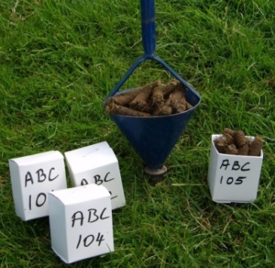
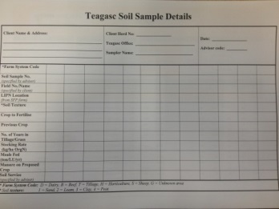
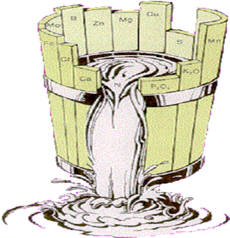
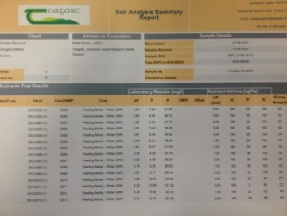
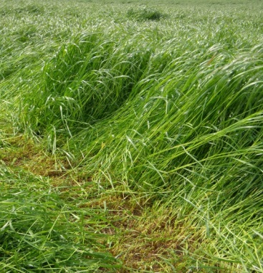
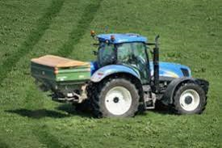
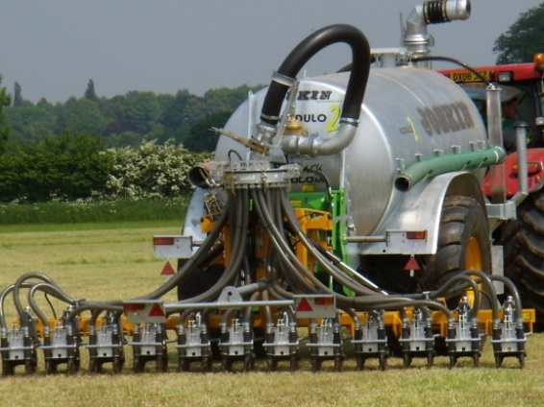
Delivery of P & K
Slurry / FYM / Fertilisers
Mark Plunkett, Teagasc,
Johnstown Castle, Wexford
Mark Plunkett, Teagasc

Slide 2

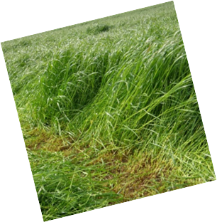
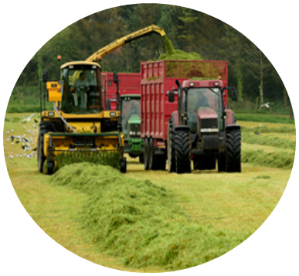
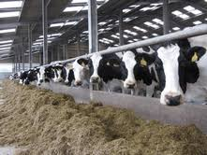
Where should Cattle Slurry Go?
Recycle on Silage Fields
Mark Plunkett, Teagasc
Notes:
Ideally slurry should be recycled on silage areas

Slide 3
What's the N – P – K of Manures?
Available N, P & K values for a range of organic manures
 | Units/1,000 gallons
Manure type | N | P | K
Cattle slurry (7% DM) | 6 | 5 | 32
Cattle slurry (3.5% DM) | 5 | 3 | 15
Pig slurry (4% DM) | 19 | 7 | 20
 | Units/tonne
FYM | 3 | 2 | 12
SMC | 3 | 3 | 16
Poultry Manures
Broiler/Deep Litter | 28 | 12 | 36
Layers (30% DM) | 14 | 6 | 12
Layers (55% DM) | 23 | 11 | 24
Turkeys | 28 | 28 | 18
Mark Plunkett, Teagasc

Slide 4
How to Maximise Recovery of N?
Aim to limit Ammonia losses
  Lower slurry DM content
  Application timing → Spring
  Low emission spreading techniques
  Weather conditions - Cool & Damp
Mark Plunkett, Teagasc

Slide 5
Manure P & K as Nutrients
P & K:
  Valuable source of P & K
  No losses to air (like N!)
  Available once applied to the soil
  P & K from organic manures can replace chemical fertiliser
  Index 1 & 2
    → P assumed to be 50% available
    → K assumed to be 90% available
Mark Plunkett, Teagasc

Slide 6
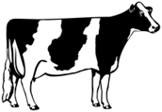
Cattle Slurry – A Variable Fertiliser
 | Average | Range
DM % | 6.9 | 0.4 | 11.9
N (kg/t) | 2.4 | 0.2 | 5.2
P (kg/t) | 0.5 | 0.1 | 1.1
K (kg/t) | 3.5 | 0.5 | 7.7
Ideally Test Slurry
Green Book, 2016
Mark Plunkett, Teagasc

Slide 7
Slurry Dry Matter Content
1 %
DM
3.5 %
DM
7 %
DM
N P K
N P K
N P K
4 - 1 - 9
5 - 3 - 15
4 - 5 - 32
50 kg
50 kg
50 kg
Hot / dry weather → - 3 units N
Trailing shoe / Bandspreader → + 3 units N
Mark Plunkett, Teagasc

Slide 8
Fertilizer Value – Other manures
Solid Manures (1 ton)
Poultry Litter (Layer)
SMC
FYM
N P K
N P K
N P K
23 - 11 - 24
3 - 5 - 18
3 - 2.5 - 12
50 kg
50 kg
50 kg
Slurry (1000 gallons)
Beware of
Variability
Pig Slurry
N P K
19 - 7 - 20
50 kg
Mark Plunkett, Teagasc
Notes:
FYM – 30% in nitrates
Very slowly available – hard to predict

Slide 9

Effect of Dry Matter % on N – P – K
& Meeting 1st Cut Silage Requirements
App. Rate | 4% DM Slurry |  |  | 8% DM Slurry
 | Kg/ha
 | N | P | K | N | P | K
11t/ha | 5 | 4 | 23 | 10 | 7 | 40
22t/ha | 11 | 7 | 47 | 20 | 13 | 80
33t/ha | 16 | 11 | 70 | 30 | 20 | 121
50% P Req. @ Index 3
100% P Req. @ Index 3
K Levels Tend to be lower in silage fields
Mark Plunkett, Teagasc

Slide 10
Cutting Grazing Plots for Silage
Taking out bales removes P & K ‘s
Each tonne of Grass DM removes
  4kg P/ha
  25kg K/ha
For example 2t Grass DM / ha removes:-
  8kg P/ha (6.5 units /ac)
  50kg K/ha (40 units/ac)
1,250gals/ac Cattle slurry (7% DM)
Or
2 bags/ac 15-3-20
Mark Plunkett, Teagasc

Slide 11

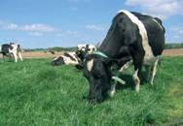
P & K in Slurry
Silage:
Slurry on silage ground → closing nutrient cycle
  P:K supply ratio of slurry ≈ 1:6
  P:K requirement ratio for silage (Index 3) ≈ 1:6
  → Well balanced
Grazing:
  P:K supply ratio of slurry ≈ 1:6
  P:K requirement ratio of grazing ≈ 1:3
→ Poorly balanced
  Excess K
→ Luxury K uptake & Mg levels
→ K might be required elsewhere
  Pig Slurry Ideal for Grazing Ground (1:3)
  Pig Slurry 19-7-20
Mark Plunkett, Teagasc
Notes:
Assuming P and K index of Index 3, Slurry is a better balanced fertilizer for a silage sward than for a grazed sward.
Consider P and K requirement of all the farm.
The increasing value of P and K fertilizer may warrant examining how far you can afford to transport slurry – it might be worth your while drawing it to the out-farm

Slide 12
Slurry Questions?
  1) Where to apply?
        Where on the farm needs both P and K
        Target low P fields
  2) What application rate?
        How much P and K are required – avoid excess if needed elsewhere
  3) When and How should it be applied?
        Spring time
        Low emission
Mark Plunkett, Teagasc

Slide 13
Methods of Applications
Mark Plunkett, Teagasc

Slide 14
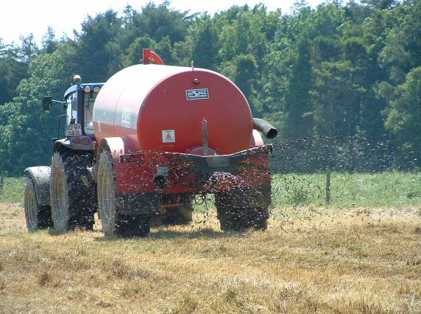
Splashplate
Low maintenance
High Ammonia losses
N Loss during drying
Grassland contamination
Mark Plunkett, Teagasc

Slide 15
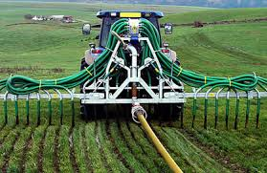
Band Spreader
Reduced Ammonia losses
Less maintenance than TS
Tend to be lighter than TS
Precise application of N/P/K
Less grass contamination
Mark Plunkett, Teagasc

Slide 16
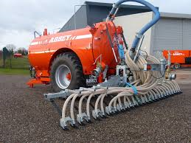
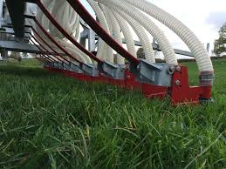
Trailing Shoe
Reduced Ammonia losses
Precise application of N/P/K
Work in higher grass covers
Better soil conditions
Grass contamination is reduced
Mark Plunkett, Teagasc

Slide 17
In Summary
Recycle slurry on silage fields
Check slurry DM%
Apply manures to Index 1 & 2 fields first
Aim to maximise slurry application in springtime
Low emission spreading with increase N efficiency & reduce GHG’s
Mark Plunkett, Teagasc

