Slide 1
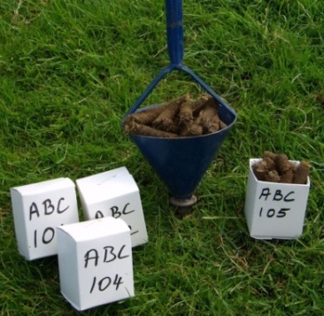
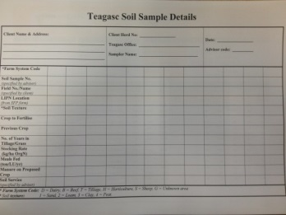
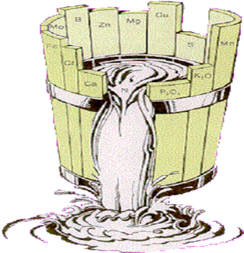
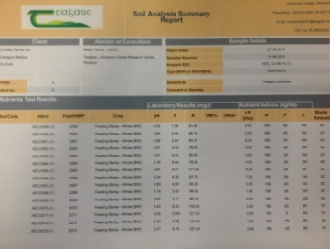
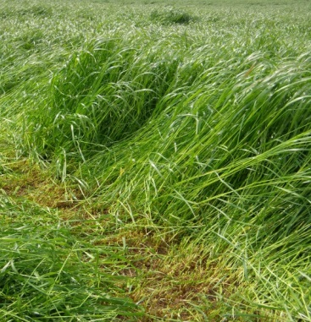
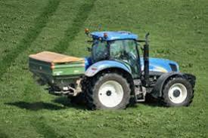
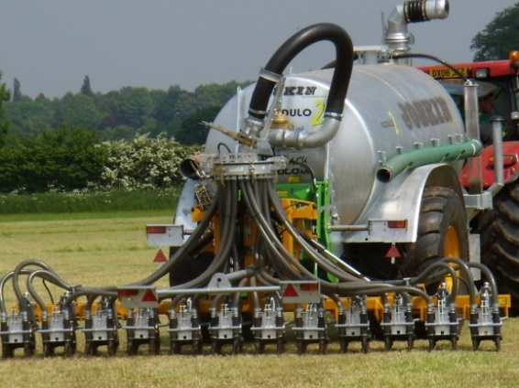
Delivery of P & K
Slurry / FYM
Mark Plunkett & David Wall, Teagasc,
Johnstown Castle, Wexford

Slide 2

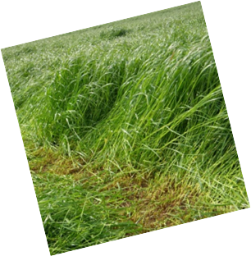
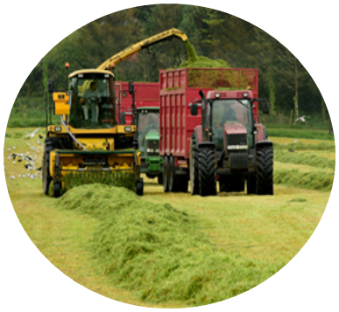
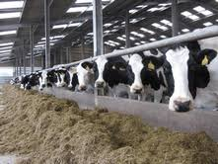
Where should Cattle Slurry Go?
Recycle on Silage Fields
Notes:
Ideally slurry should be recycled on silage areas

Slide 3
What's the N – P – K of Manures?
Available N, P & K values for a range of organic manures
 | Units/1,000 gallons
Manure type | N | P | K
Cattle slurry (7% DM) | 6 | 5 | 32
Cattle slurry (3.5% DM) | 5 | 3 | 15
Pig slurry (4% DM) | 19 | 7 | 20
 | Units/tonne
FYM | 3 | 2 | 12
SMC | 3 | 3 | 16
Poultry Manures
Broiler/Deep Litter | 28 | 12 | 36
Layers (30% DM) | 14 | 6 | 12
Layers (55% DM) | 23 | 11 | 24
Turkeys | 28 | 28 | 18

Slide 4
How to Maximise Recovery of N?
Aim to limit Ammonia losses
  Lower slurry DM content
  Application timing → Spring
  Low emission spreading techniques
  Weather conditions - Cool & Damp

Slide 5
Manure P & K as Nutrients
P & K:
  Valuable source of P & K
  No losses to air (like N!)
  Available once applied to the soil
  P & K from organic manures can replace chemical fertiliser
  Index 1 & 2
    → P assumed to be 50% available
    → K assumed to be 90% available

Slide 6
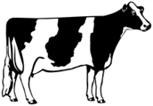
Cattle Slurry – A Variable Fertiliser
 | Average | Range
DM % | 6.9 | 0.4 | 11.9
N (kg/t) | 2.4 | 0.2 | 5.2
P (kg/t) | 0.5 | 0.1 | 1.1
K (kg/t) | 3.5 | 0.5 | 7.7
Ideally Test Slurry
Green Book, 2016

Slide 7
Slurry Dry Matter Content
1 %
DM
3.5 %
DM
7 %
DM
N P K
N P K
N P K
4 - 1 - 9
4 - 3 - 15
7 - 5 - 32
50 kg
50 kg
50 kg
Hot / dry weather → - 3 units N
Trailing shoe / Bandspreader → + 3 units N

Slide 8
Fertilizer Value – Other manures
Solid Manures (1 ton)
Poultry Litter (Layer)
SMC
FYM
N P K
N P K
N P K
23 - 11 - 24
3 - 5 - 18
3 - 2.5 - 12
50 kg
50 kg
50 kg
Slurry (1000 gallons)
Beware of
Variability
Pig Slurry
N P K
19 - 7 - 20
50 kg
Mark Plunkett, Teagasc
Notes:
FYM – 30% in nitrates
Very slowly available – hard to predict

Slide 9

Effect of Dry Matter % on N – P – K
& Meeting 1st Cut Silage Requirements
App. Rate | 4% DM Slurry |  |  | 8% DM Slurry
 | Kg/ha
 | N | P | K | N | P | K
11t/ha | 5 | 4 | 23 | 10 | 7 | 40
22t/ha | 11 | 7 | 47 | 20 | 13 | 80
33t/ha | 16 | 11 | 70 | 30 | 20 | 121
50% P Req. @ Index 3
100% P Req. @ Index 3
K Levels Tend to be lower in silage fields

Slide 10
Cutting Grazing Plots for Silage
Taking out bales removes P & K ‘s
Each tonne of Grass DM removes
  4kg P/ha
  25kg K/ha
For example 3t Grass DM / ha removes:-
  12kg P/ha (10 units /ac)
  75kg K/ha (60 units/ac)
2,000gals/ac Cattle slurry (7% DM)
Or
3 bags/ac 15-3-20

Slide 11

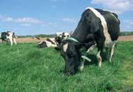
P & K in Slurry
Silage:
Slurry on silage ground → closing nutrient cycle
  P:K supply ratio of slurry ≈ 1:6
  P:K requirement ratio for silage (Index 3) ≈ 1:6
  → Well balanced
Grazing:
  P:K supply ratio of slurry ≈ 1:6
  P:K requirement ratio of grazing ≈ 1:3
→ Poorly balanced
  Excess K
→ Luxury K uptake & Mg levels
→ K might be required elsewhere
  Pig Slurry Ideal for Grazing Ground (1:3)
  Pig Slurry 19-7-20
Notes:
Assuming P and K index of Index 3, Slurry is a better balanced fertilizer for a silage sward than for a grazed sward.
Consider P and K requirement of all the farm.
The increasing value of P and K fertilizer may warrant examining how far you can afford to transport slurry – it might be worth your while drawing it to the out-farm

Slide 12
Slurry Questions?
  1) Where to apply?
        Where on the farm needs both P and K
        Target low P fields
  2) What application rate?
        How much P and K are required – avoid excess if needed elsewhere
  3) When and How should it be applied?
        Spring time
        Low emission

Slide 13
Methods of Applications

Slide 14
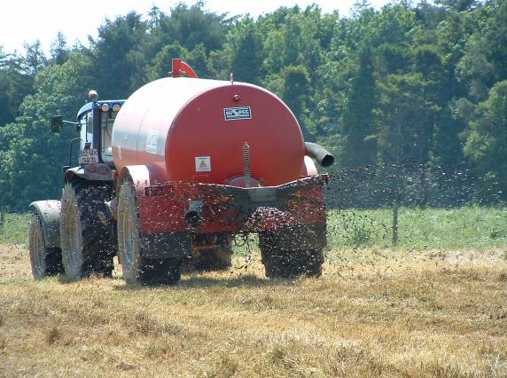
Splashplate
Low maintenance
High Ammonia losses
N Loss during drying
Grassland contamination

Slide 15
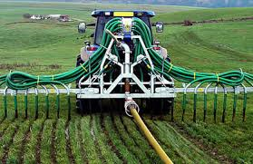
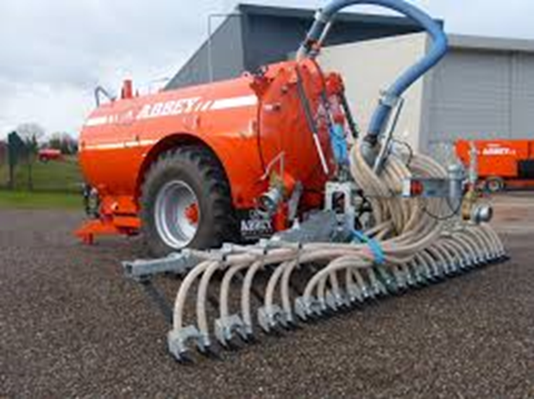
Band Spreader / Trailing Shoe
Reduced Ammonia losses
Less maintenance than TS
Tend to be lighter than TS
Precise application of N/P/K
Less grass contamination

Slide 16
In Summary
Recycle slurry on silage fields
Check slurry DM%
Apply manures to Index 1 & 2 fields first
Aim to maximise slurry application in springtime
Low emission spreading with increase N efficiency & reduce GHG’s

