Slide 1
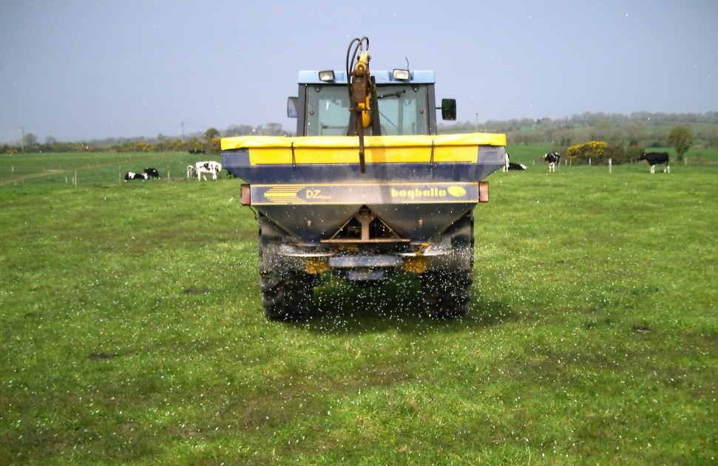
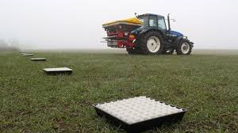
P & K Fertiliser Choice
Fertiliser Products
Timings of Application
Suggested Programmes
Complete a Farm Fertiliser Plan to Determine Actual Farm N & P Allowances

Slide 2
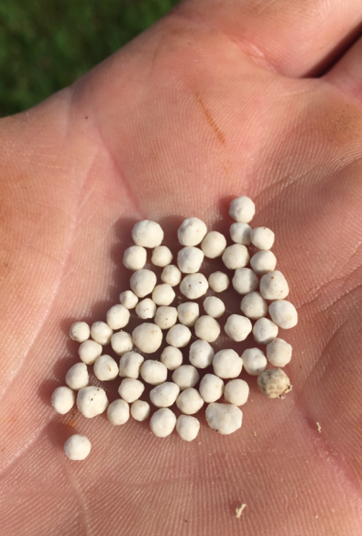
Types of Fertiliser.. Re think Req.!
16% Super P(50kg bag)
Contains:-
- 16 units P
16% Super P
MOP 50% K
18-6-12
0-7-30
0-10-20 / 10-10-20
23-10-0
15-10-10
14-7-14
13-6-20
25-5-0
27-2.5-5
24-2.5-10
18 – 6 – 12 (50kg bag)
Contains:-
- 18 units N
- 6 units P
- 12 units K
23 – 10 – 0 (50kg bag)
Contains:-
- 23 units N
- 10 units P
Now Req.
Complete a Farm Fertiliser Plan to Determine Actual Farm N & P Allowances

Slide 3
Fertiliser Compound Options….
Situation | Fertiliser Type
Grazing | 10-10-20 / 18-6-12 / 18-4-12 / 14-7-14 / 15-10-10 / 27-2.5-5 / 24-2.5-10 / DAP (18N & 20 P) / 25-5-0
Silage / Maize | 0-7-30 / 10-10-20 / 13-6-20 / 15-3-20 / 27-2.5-5 / 24-2.5-10
Build Up | 10-10-20 / MOP 50% K / 16% Super P / 0-7-30 / 0-10-20 / 23-10-0
Fertiliser Blends | Any Fertiliser can be made Max. 40 units in 50kg bag
Complete a Farm Fertiliser Plan to Determine Actual Farm N & P Allowances

Slide 4
Nitrogen Sources
N Type | % N | Cost / kg
Urea | 46% | 0.80c
Urea + NBPT | 46% | 0.85c
CAN | 27% | 0.95c
Protected Urea products
N % | P % | K % | S %
46 | 0 | 0 | 0
38 | 0 | 0 | 7
29 | 0 | 14 | 3.5

Slide 5

Fertiliser programmes (P, K & S)
Standard compounds for Index 3 situation
P:
50% early
50% split in summer
High P/K Compound
(50% of P)
High N - Low P/K
High N - Low P/K
Jan Feb Mar Apr May Jun Jul Aug Sep Oct Nov Dec
Sulphur
Extra P
Extra K
High K
N-P-0 compound
High P
N-0-K compound / Straight K
Low P and K
higher rates / Slurry
Products:
K:P ratio of 2:1 → 3:1 ideal for grazing
Slurry or K:P 4:1 → 6:1 ideal for silage
Adjust based on soil tests, crops, stocking rates
Complete a Farm Fertiliser Plan to Determine Actual Farm N & P Allowances

Slide 6
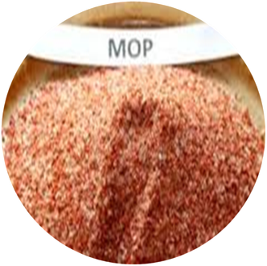
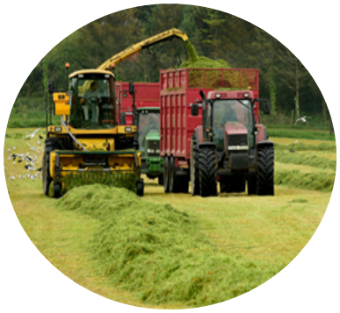
K Advice & Grassland
Grazing Ground
  Low K requirements (animal recycling)
  Apply index 3 rates to avoid Grass Tetany
  Apply build up rates in Sept / Oct
Silage Ground
  High K requirements
  Max. 90 kg K/ha
  Apply build up rates Sept / Oct
  Target cattle slurry to silage fields
Complete a Farm Fertiliser Plan to Determine Actual Farm N & P Allowances

Slide 7
New P Allowances & Tailoring a Fertiliser Programme
Suggested Fertiliser programmes
Many combinations
Availability of products
Complete a Farm Fertiliser Plan to Determine Actual Farm N & P Allowances

Slide 8
New Fertiliser P Allowances
Grassland Stocking Rate (kg/ha) | P Index
 | 1 | 2 | 3 | 4
131 - 170 | 63 | 43 | 13 | 0
171 - 210 | 66 | 46 | 16 | 0
211 - 250 | 66 | 46 | 16 | 0
>250 | 69 | 49 | 19 | 0
50kg P/ha @ Index 1
30kg P/ha @ Index 2
1. Adjust for Conc. Feed (5kg/ton)
2. Slurry Removed from calculations
Complete a Farm Fertiliser Plan to Determine Actual Farm N & P Allowances

Slide 9
New Fertiliser P Allowances
P Rates adjusted for 1t/ha Conc. Feed (5kg/ton)
Grassland Stocking Rate (kg/ha) | P Index
 | 1 | 2 | 3 | 4
131 - 170 | 58 | 38 | 8 | 0
171 - 210 | 61 | 41 | 11 | 0
211 - 250 | 61 | 41 | 11 | 0
>250 | 64 | 44 | 14 | 0
Complete a Farm Fertiliser Plan to Determine Actual Farm N & P Allowances

Slide 10
Example Dairy - N, P & K Rates
P Rates adjusted for 1t/ha Conc. Feed (5kg/ton)
Stocking Rate 131 – 170 kg Org N/ha
P & K Index | N | P | K
 | Kg/ha (units/ac)
1 | 206 (165) | 58 (46) | 90 (72)
2 | 206 (165) | 38 (30) | 60 (48)
3 | 206 (165) | 8 (6) | 30 (24)
4 | 206 (165) | 0 | 0
Complete a Farm Fertiliser Plan to Determine Actual Farm N & P Allowances

Slide 11
Suggested Fertiliser Programmes
The following are a number of suggested fertiliser programmes based on new P allowances.
Prepare a farm fertiliser plan to determine field N, P & K allowances
Formulate fertiliser programmes base on the following
  Soil Types ( heavy / light / peaty)
  Fertilisers should be applied as follows to reduce nutrient losses:-
    Select the Right Product
    At the Right Rate
    At the Right Time
    In the Right Place
Protected Urea referred to as Urea+ in example fertiliser programmes in slides 12 tom 23. Refer to slide 4 for different protected urea formulations

Slide 12
Example Grazing Ground & Fertiliser Programme
SR 131 – 170 kg Org N/ha (P & K Index 1)*
Advice |  | March | April | May | June / July | Sept | Total
Product (units/ac) |  | 1.25 23-10-0 | 2.0bag 18’s | 1.75bag 18’s/ac | 2.0bag 18’s | ~0.5bag Urea +
N Splits |  | 29 | 42 | 34 | 35 | 25
N | 165 | 29 | 36 | 32 | 36 | 27 | 160
P | 46 | 12 | 12 | 10 | 12 |  | 46
K | 72 |  | 24 | 21 | 24 |  | 69
S | 6-12 |  | 6 |  | 6 |  | 12

Slide 13
Example Grazing Ground & Fertiliser Programme
SR 131 – 170 kg Org N/ha (P & K Index 3)* - Peat Soil
Advice |  | March | April | May | June / July | Sept | Total
Product (units/ac) |  | 1 bag/ac 27-2.5-5 | 1.5 bag/ac 27-2.5-5 | 0.9 bag/ac Urea + 38% N & 7% S | 0.9 bag/ac Urea + 38% N & 7% S | 0.9 bag/ac Urea + 29% N & 14% K
N Splits |  | 29 | 42 | 34 | 34 | 25
N | 165 | 27 | 42 | 34 | 34 | 26 | 166
P (3) | 6 | 2.5 | 3.5 |  |  |  | 6
K | 24 | 5 | 7.5 |  |  | 14 | 60
S | 6-12 |  |  | 6 | 6 | 3.5 | 15

Slide 14
Example Grazing Ground & Fertiliser Programme
SR 131 – 170 kg Org N/ha (P & K Index 1)*
Advice |  | Feb | March | April | May | June / July | Sept | Total
Product (units/ac) |  | CS @ 1,500g/ac | 1.25 bag/ac 23-10-0 | 1 bag/ac Urea + | 1.8 bag/ac 18-6-12 | 1.4bag/ac 23-10-0 | 0.5bag /ac Urea +
N Splits |  |  | 27 | 38 | 32 | 32 | 25
N | 165 | 11 | 29 | 38 | 32 | 32 | 23 | 165
P | 46 | 4 | 12 |  | 11 | 14 |  | 41
K | 72 | 43 |  |  | 22 |  |  | 75
S | 6-12 | 2 |  | 7 | 5 |  |  | 14

Slide 15
Example Grazing Ground & Fertiliser Programme
SR 131 – 170 kg Org N/ha (P & K Index 2)*
Advice |  | Feb | March | April | May | June / July | Sept | Total
Product (units/ac) |  | CS @ 1,500g/ac | 1.25 bag 23-10-0 | ~1.0 bag Urea + | 1.25bag 23-10-0 | 0.9 bag Urea + | 0.5 bag Urea +
N Splits |  | 23 | 27 | 42 | 34 | 34 | 27
N | 165 | 14 | 29 | 41 | 29 | 34 | 27 | 174
P | 30 | 4 | 12.5 |  | 12.5 |  |  | 29
K | 48* | 43 |  |  |  |  |  | 58
S | 6-12 | 2 |  | 7 |  | 6 |  | 15

Slide 16
Example Dairy - N, P & K Rates
P Rates adjusted for 1t/ha Conc. Feed (5kg/ton)
Stocking Rate 210 – 250 kg Org N/ha
P & K Index | N | P | K
 | Kg/ha (units/ac)
1 | 250 (200) | 61 (49) | 100 (80)
2 | 250 (200) | 41 (33) | 70 (56)
3 | 250 (200) | 11 (9) | 40 (32)
4 | 250 (200) | 0 | 0
N & K Advice as per the Teagasc Green Book, 2016
Complete a Farm Fertiliser Plan to Determine Actual Farm N & P Allowances

Slide 17
Example Grazing Ground & Fertiliser Programme
SR 210-250 kg Org N/ha (P & K Index 1)*
Advice |  | Feb | March | April | May | June | Aug | Sept | Total
Product (units/ac) |  | ½ bag Urea + | 2.0 bag 18’s/ac | 2.0 bag 18’s/ac | 0.7 bag Urea + | 1.25bag/ac 23-10-0 | 1.0bag/ac 23-10-0 | 0.4 bag/ac Urea +
N Splits |  | 23 | 32 | 40 | 27 | 27 | 27 | 20
N | 200 | 23 | 36 | 36 | 27 | 28 | 23 | 27 | 200
P | 49 |  | 12 | 12 |  | 13 | 10 |  | 47
K | 80 |  | 24 | 24 |  | 21 |  |  | 69
S | 10-15 |  | 5 | 5 | 5 |  |  |  | 15
Protected- Urea (Urea +NBPT) +/- S can be used as an alternative to CAN or Sul-CAN

Slide 18
Example Grazing Ground & Fertiliser Programme
SR 210-250 kg Org N/ha (P & K Index 3) Peat Soil
Advice |  | Feb | March | April | May | June | Aug | Sept | Total
Product (units/ac) |  | ½ bag Urea + | 0.85bag/ac Urea + 38% N & 7% S | 2.2 bag/ac 18-4-12 | 0.7bag/ac Urea + 38% N & 7% S | 0.6bag/ac Urea + 46% N | 0.7bag/ac Urea + 38% N & 7% S | 0.4 bag/ac Urea +
N Splits |  | 23 | 32 | 40 | 27 | 27 | 27 | 20
N | 200 | 23 | 32 | 40 | 27 | 28 | 23 | 27 | 200
P | 9 |  |  | 9 |  |  |  |  | 9
K | 24 |  |  | 26 |  |  |  |  | 26
S | 10-15 |  | 6 |  | 5 |  | 5 |  | 16
Protected- Urea (Urea +NBPT) +/- S can be used as an alternative to CAN or Sul-CAN

Slide 19
Example Grazing Ground & Fertiliser Programme
SR 210-250 kg Org N/ha (P & K Index 1)*
Advice |  | Feb | March | April | May | June | Aug | Sept | Total
Product (units/ac) |  | CS @ 1,500g/ac | 2 bag/ac 23-10-0 | 1.5 bag/ac 27-2.5-5 | 1bag/ac 27-2.5-5 | 1bag/ac 27-2.5-5 | 1.2bag/ac 23-10-0 | 0.75 bag/ac 27-2.5-5
N Splits |  | 23 | 34 | 41 | 27 | 27 | 28 | 20
N | 200 | 14 | 43 | 41 | 27 | 27 | 28 | 20 | 200
P | 49 | 4 | 20 | 4 | 2.5 | 2.5 | 12 | 2.5 | 48
K | 80 | 43 | 0 | 7.5 | 5 | 5 | 0 | 5 | 66
S | 10-15 | 2 |  | 4.5 | 3 | 3 |  | 2 | 15
Protected- Urea (Urea +NBPT) +/- S can be used as an alternative to CAN or Sul-CAN

Slide 20
Example Grazing Ground & Fertiliser Programme
SR 210-250 kg Org N/ha (P & K Index 2)*
Advice |  | Feb | March | April | May | June | Aug | Sept | Total
Product (units/ac) |  | CS @ 1,500g/ac | 1.8bag/ac 23-10-0 | 0.9bag/ac Urea + | 0.8bag/ac Urea + | 0.8bag /ac Urea + | 1bag/ac 23-10-0 | 0.bag/ac Urea +
N Splits |  | 23 | 35 | 40 | 30 | 30 | 22 | 20
N | 200 | 15 | 41 | 40 | 30 | 30 | 23 | 20 | 199
P | 33 | 4 | 18 |  |  |  | 10 |  | 32
K | 56 | 43 | 0 |  |  |  | 0 |  | 43
S | 10-15 | 2 |  |  | 5 | 5 |  | 5 | 17
Protected- Urea (Urea +NBPT) +/- S can be used as an alternative to CAN or Sul-CAN

Slide 21
Example
Drystock - N, P & K Rates
P Rates adjust for 1t/ha Conc. Feed (5kg/ton)
Stocking Rate 131 – 170 kg Org N/ha
P & K Index | N | P | K
 | Kg/ha (units/ac)
1 | 160 (128) | 58 (46) | 75 (60)
2 | 160 (128) | 38 (30) | 45 (36)
3 | 160 (128) | 8 (6) | 15 (12)
4 | 160 (128) | 0 | 0
N & K Advice as per the Teagasc Green Book, 2016
Complete a Farm Fertiliser Plan to Determine Actual Farm N & P Allowances

Slide 22
Example Grazing Ground & Fertiliser Programme
SR 131 – 170 kg Org N/ha (P & K Index 1)*
Advice |  | March | April | May | June / July | Sept | Total
Product (units/ac) |  | 2.0bag/ac 18-6-12 | 1.2 bag/ac 23-10-0 | 1.1 bag/ac 18-6-12 | 0.9bag/ac 23-10-0 | 0.8 bag/ac 18-6-12
N Splits |  | 45 | 28 | 20 | 20 | 15
N | 128 | 36 | 28 | 20 | 20 | 15 | 128
P | 46 | 12 | 12 | 7 | 9 | 5 | 45
K | 60 | 24 |  | 13 |  | 10 | 47
S | 6-12 | 6 |  | 4 |  | 2 | 12
Protected- Urea (Urea +NBPT) +/- S can be used as an alternative to CAN or Sul-CAN

Slide 23
Example Grazing Ground & Fertiliser Programme
SR 131 – 170 kg Org N/ha (P & K Index 2)*
Advice |  | Feb | March | April | May | June / July | Sept | Total
Product (units/ac) |  | CS @ 1,500g/ac | 1.0 bag/ac 23-10-0 | 0.7bag/ac Urea + | 1.0 bag/ac 23-10-0 | 0.5 bag/ac 23-10-0 | 0.5bag/ac CAN
N Splits |  | 23 | 33 | 24 | 16 | 16 | 16
N | 128 | 14 | 23 | 32 | 23 | 12 | 24 | 128
P | 30 | 4 | 10 |  | 10 | 5 |  | 29
K | 45 | 43 |  |  |  |  |  | 43
S | 6-12 |  | 3 | 4 | 3 |  | 3.5 | 12
Protected- Urea (Urea +NBPT) +/- S can be used as an alternative to CAN or Sul-CAN

Slide 24
1st Cut Grass Silage N, P & K Req. (5tDM/ha)
Nutrient Requirements 1 t Grass DM Req. 4kg P & 25kg K |  |  |  | Fertiliser Options
Soil Index | N (kg/ha) | P (kg/ha) | K *(kg/ha) | No Slurry | Cattle Slurry @ 3,000ga/ac
1 | 125 | 40 | 175 | 3.5 bags/ac 13-6-20 1.4 bags/ac Urea 38% N +S | 3.0 bags/ac 27-2.5-5 +S
2 | 125 | 30 | 155 | 3.0 bags/ac 13-6-20 1.6 bags/ac Urea 38% N +S | 3.0 bags/ac 27-2.5-5 +S
3 | 125 | 20 | 125 | 3.0 bags/ac 13-6-20 1.4 bags/ac Urea 38% +S | 3 bags/ac CAN +S Apply 1 bag/ac 0-7-30 every 2 / 3 years
4 | 125 | 0 | 0 | 2.6 bags/ac Urea 38% N +S | 2.6 bags/ac Urea 38% N +S
*Apply P & K balance after 1st cut (June / July / Aug)
Protected- Urea (Urea +NBPT) +/- S can be used as an alternative to CAN or Sul-CAN

Slide 25
In Summary
Apply 50% of P in Spring
Watch K rates
Select suitable fertiliser compounds
Compound fertilisers required each round (18’s / 24’s / 27’s / 23-10-0)
Replace CAN 27% N with Urea + NBPT
Apply 10 to 15units/ac S
Complete a Farm Fertiliser Plan to Determine Actual Farm N & P Allowances

