Slide 1
Friday 20th February 2018
Tim Hyde, Teagasc,
Water Quality and NAP changes

Slide 2
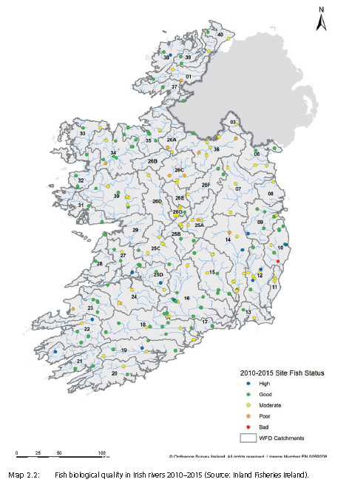
46 Catchments
583 Sub catchments
4829 Waterbodies
3192 river waterbodies

Slide 3
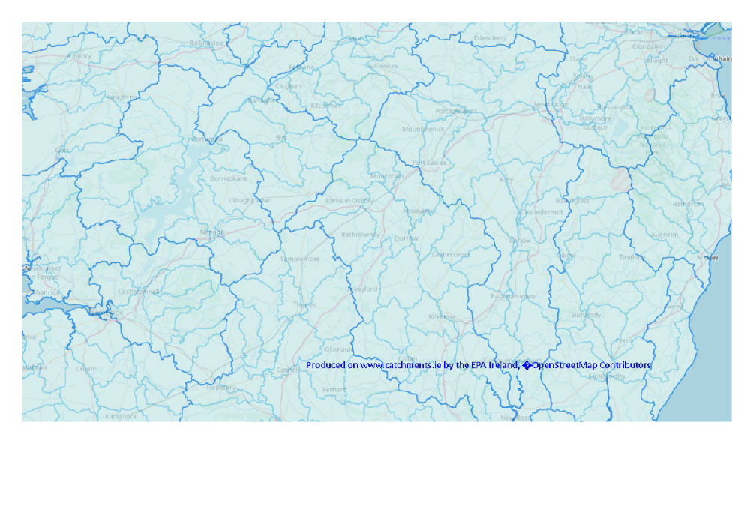
Catchments and Sub Catchments

Slide 4
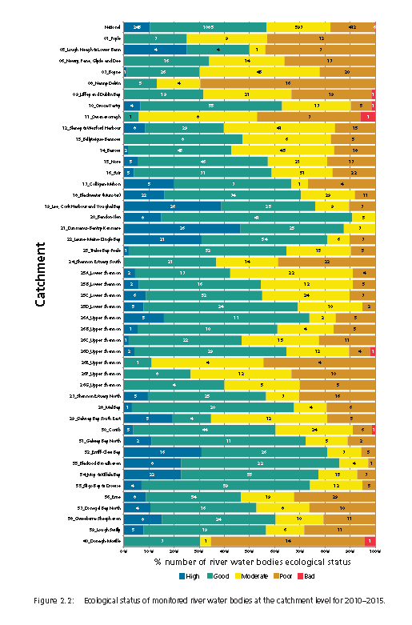
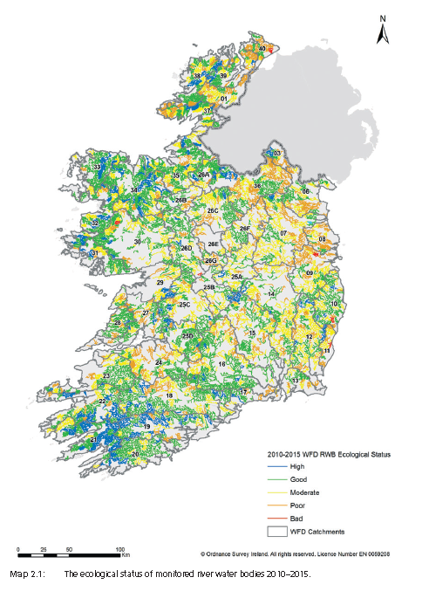

Slide 5
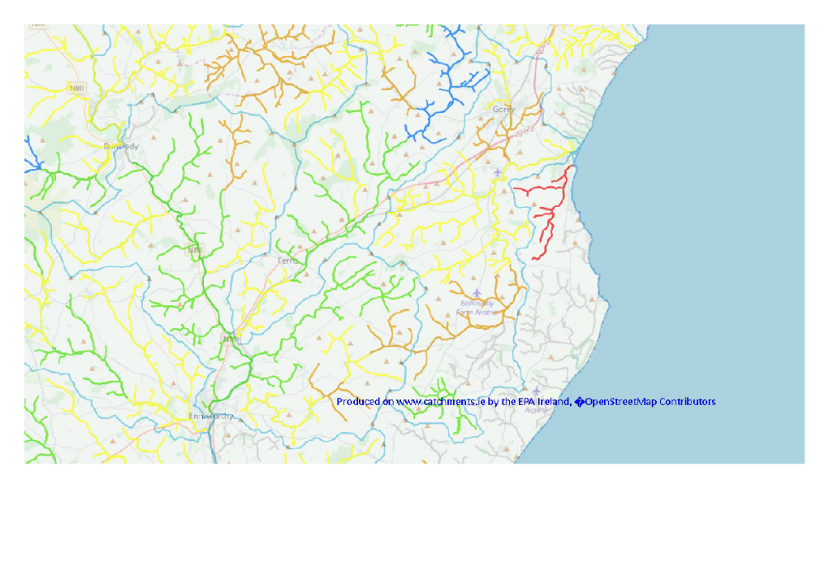
Water Quality High Good Moderate Poor Bad

Slide 6
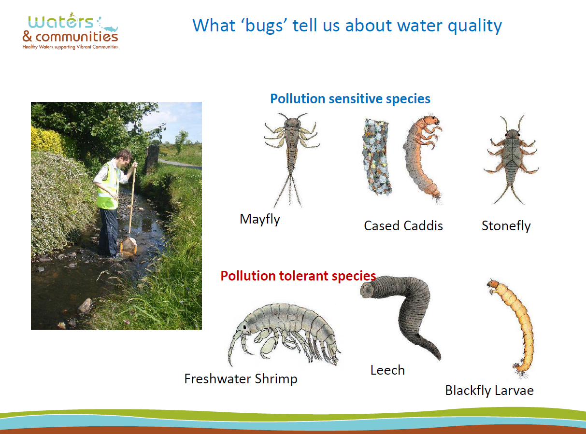

Slide 7
YouTube Kick Sampling demo
https://youtu.be/EfpSzRmQKhs Loughs agency
https://youtu.be/TAFC7Z9o9E0 SEPA
https://youtu.be/yoFK4hCu42c Field Studies Council

Slide 8
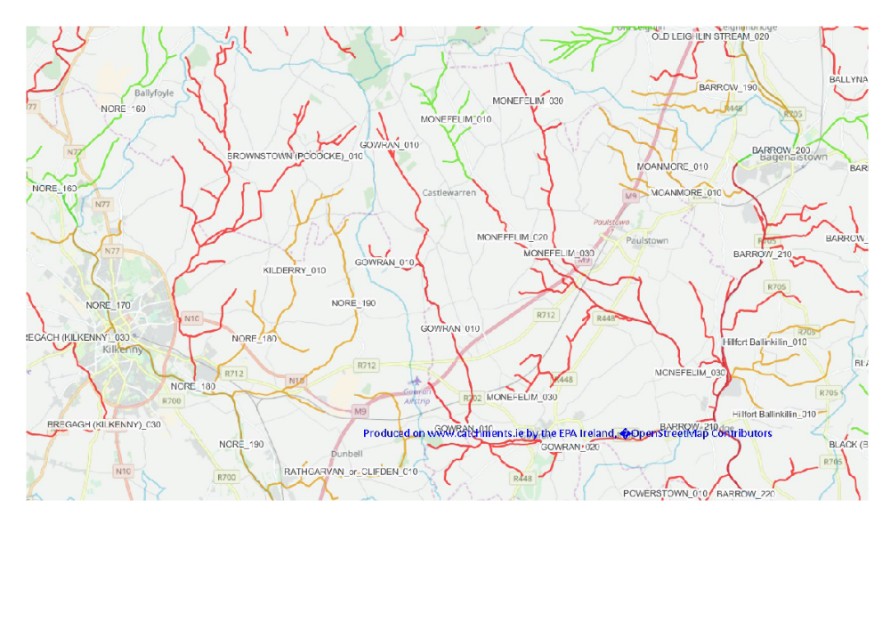
WFD Risk Not at Risk Under Review At Risk

Slide 9
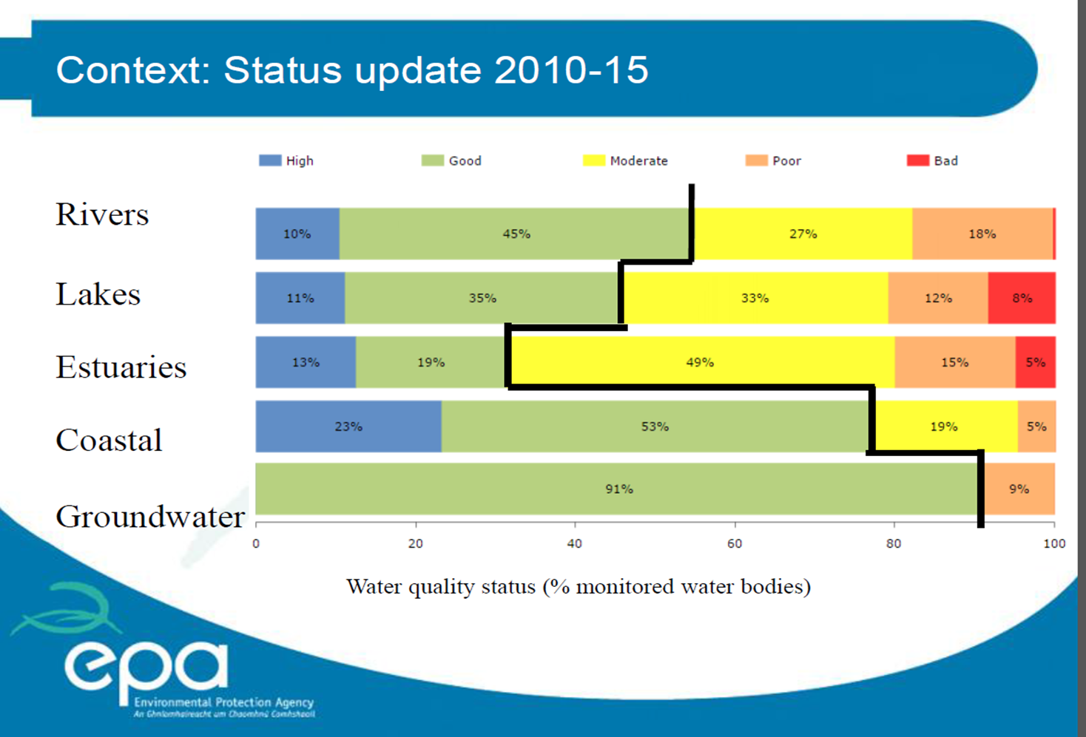

Slide 10
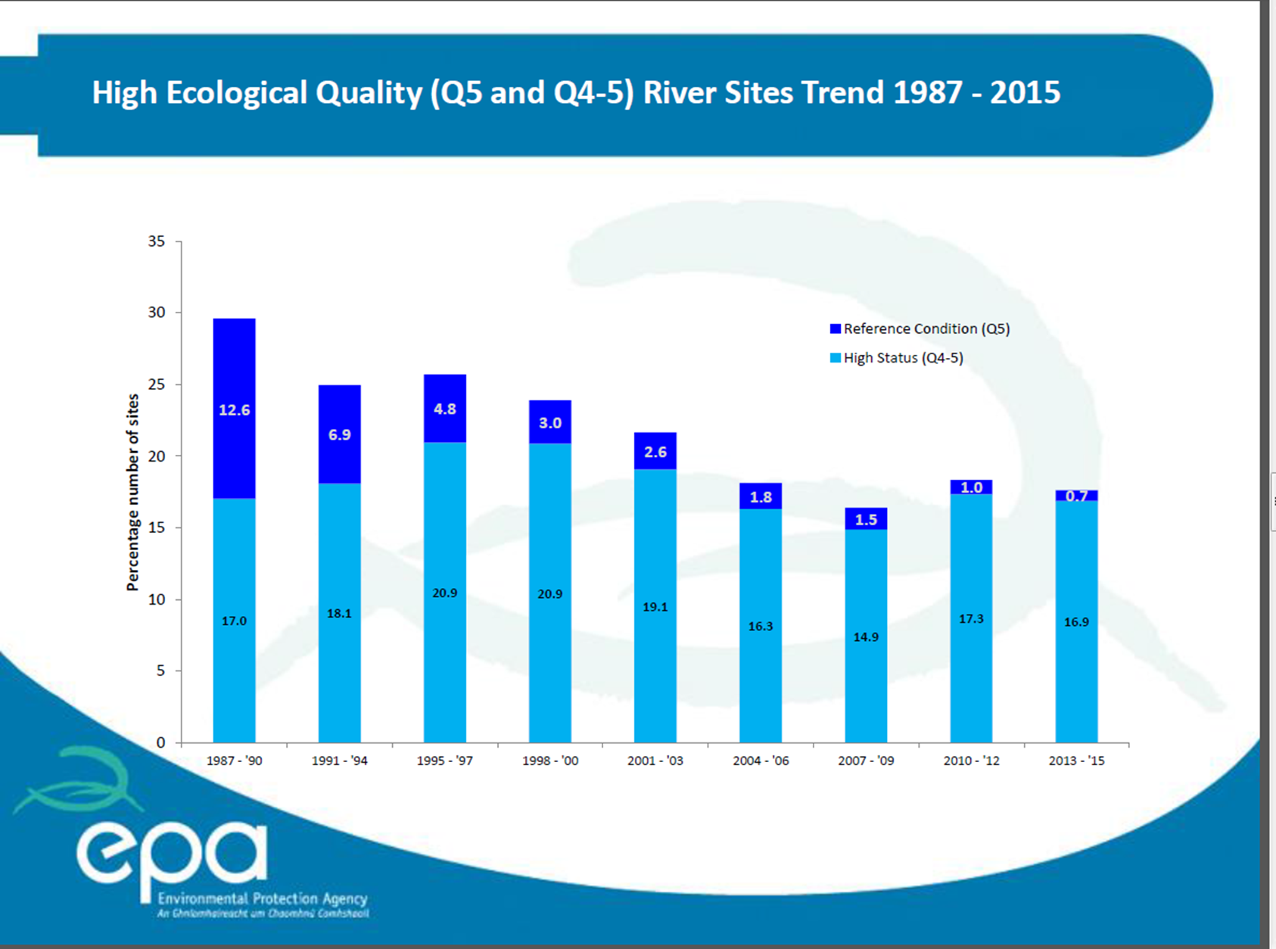

Slide 11
% of monitored lakes in each Status Category
Overall there has been a 3% reduction in the number of monitored lakes at high or good status between 2007-09 and 2013-15

Slide 12
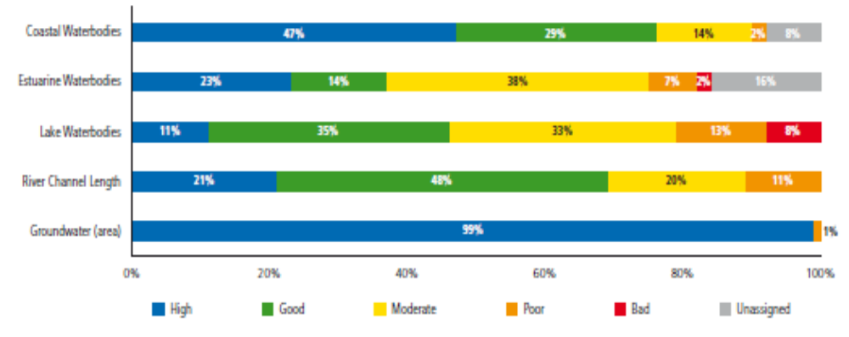
EPA State of the Environment Report (2016)
Eutrophication (nutrient enrichment) main problem in surface waters
EPA source apportionment :
  53% agriculture
  34% municipal
N & P in groundwater and rivers mostly stable and decreasing
since 2007
River inputs to transitional and coastal waters also declining
Nutrient inputs to rivers, particularly from agriculture have fallen:
  N down 18.7%
  P down 37.7%.

Slide 13
National cow numbers
  Actual change 2010 to 2017 and projected change to 2025
Notes:
Peaked at 1.46 million dairy cows – ave 1.4 for the year - +60,000 cows on 2016
Milk production +8% on last year – 45 of the 50% achieved end of 2017?
Milk production increasing faster than cow numbers…
Heifers in place for future growth
Suppliers predicting future growth…
1.55 million dairy cows in 1984

Slide 14
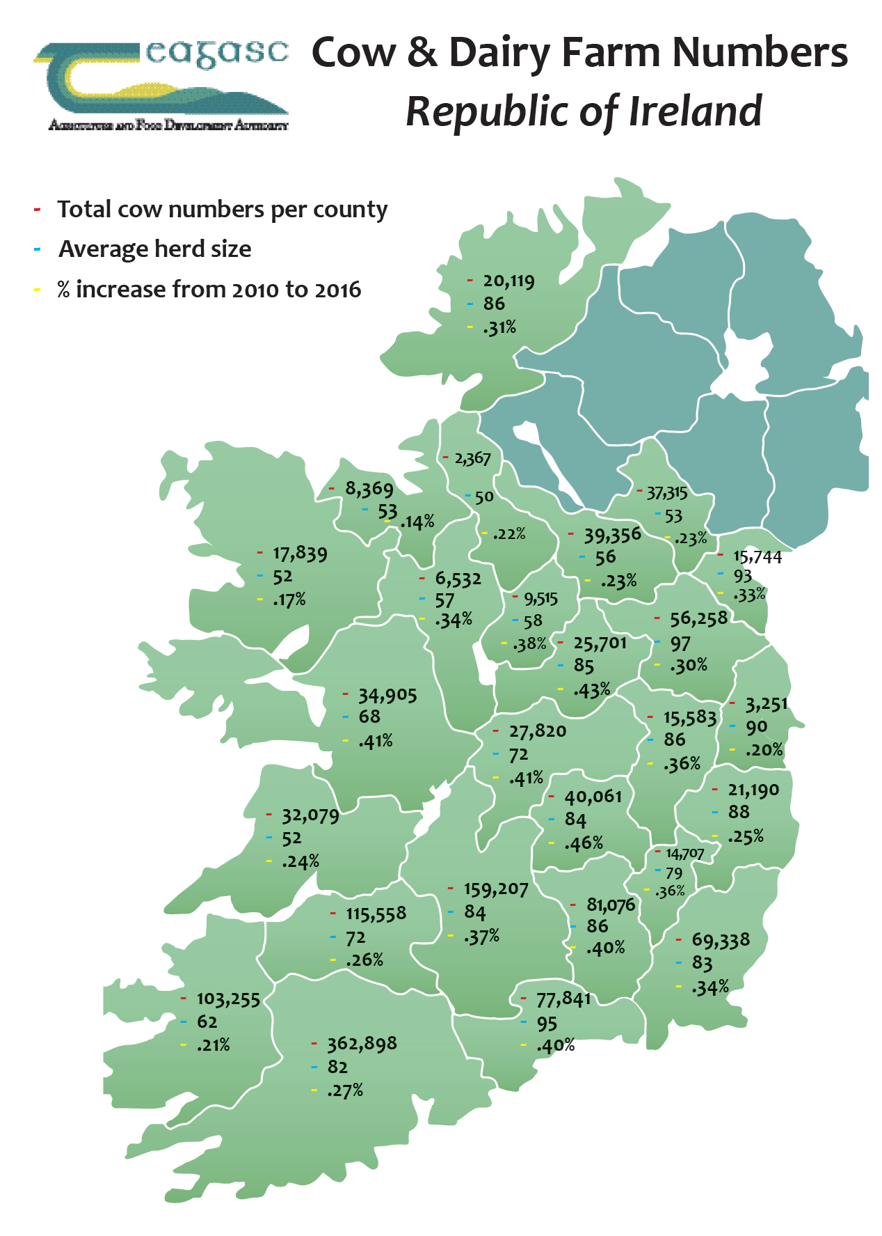
Top 3:
Extra cows
Cork – 77,000
Tipp – 43,000
Lim – 23,000
% increase
Laois – 46%
WestM – 43%
Offaly – 41%
Ave herd size Meath – 97
Waterford – 95
Louth - 93
Ulster 3
+19,000 cows
+25%
Connacht
+16,000 cows
+ 29%
Leinster
+102,000 cows
+36%
Munster
+191,000 cows
+29%
Notes:
Cork increased cow numbers by 77,000 cows – in 2016 only 5 other counties had greater than 77,000 cows in total…
Then Tipp and Limerick…
Traditional areas had the biggest increase in cow numbers but the midlands grew by greatest %
Perspective - cumulative increase in L/ O/ Wm was 29,000
Starting from a small base but still significant
Focus in on Cavan and Kilkenny
Kilkenny
Cavan
To take a quick look at it by province…
Phenomenal increase in scale over a small period of time…
Still a lot of option for future growth around the country…

Slide 15
2015
WFD 6 year cycle
2016
ACP 4 year cycle
2017
EPA Water Quality in Ireland report
NAP review
2018
2019
2020
2021
GAP and Derogation 4 year cycle
ACP End of 4 year cycle
EPA water report
NAP review -- GAP and derogation approval in 2022 ?

Slide 16
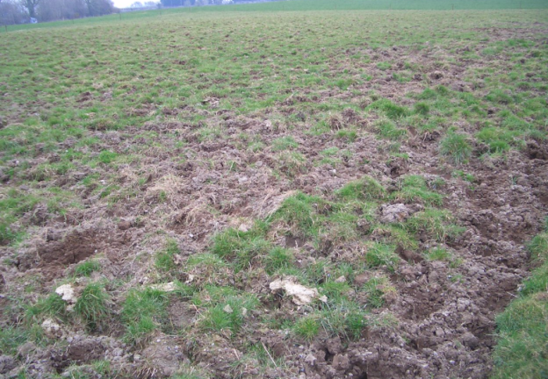
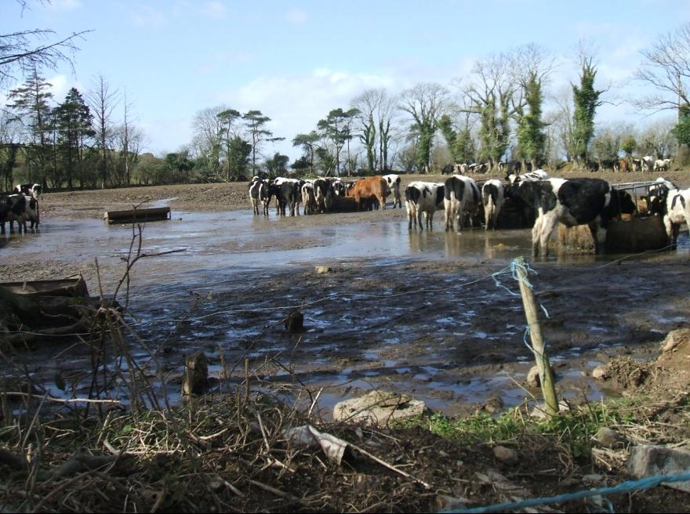
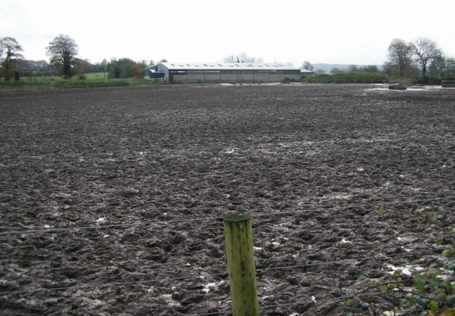
New water protection measures – all farmers
Prevention of run off resulting from poaching
  Livestock management
  Preventing nutrient and sediment loss
Brings NAP/GAP regs in line with GAEC

Slide 17
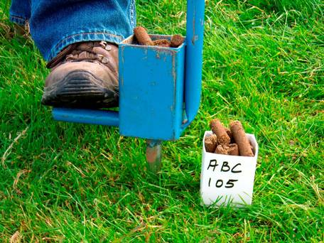
Change to soil analysis
All farmers
Soil analysis
  Reduced area and increased frequency
  Previously soil sample per 8 hectares (Max) every 5 years
  Now max soil sample area of 5 hectares every 4 years – For all soil samples received in soil laboratories after 1st January 2018.
  32 ha farm now needs a minimum of 7 soil samples
  All farmers must have a fertiliser plan to know the fertiliser limits for their farm to comply with DAFM Nitrates inspections.

Slide 18
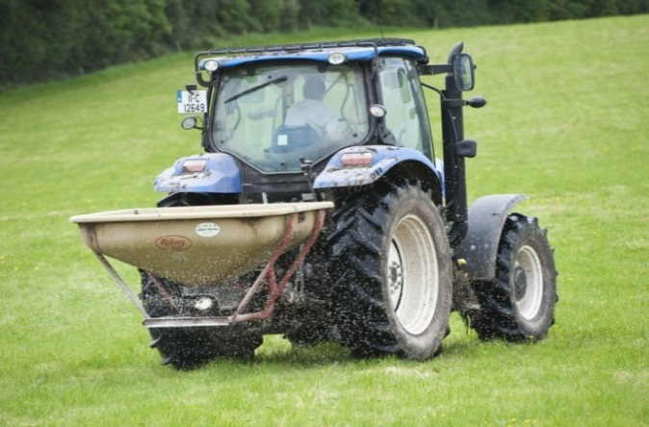
Phosphorus build-up
Currently 62 % of Irish soils in P index 1 and 2
Old build-up rates not sufficient to increase P in reasonable timeframe (pre January 2018)
  Index 1 – 20 kg P/ha/year
  Index 2 – 10 kg P/ha/year
New build up rates for farms > 130 kg N/ha stocking rate
  Index 1 – 50 kg P/ha/year
  Index 2 – 30 kg P/ha/year
Built in safeguards to prevent P transfer to water
  NMP – KT - Four year programme
  Allows farmers to spread more bag P

Slide 19
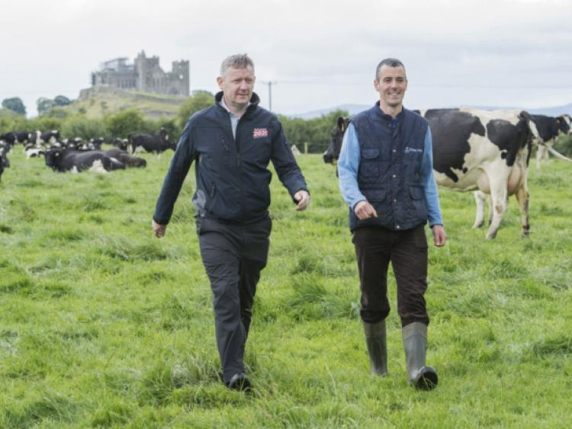
Phosphorus build-up
  Grassland Stocking rate >130kgs NpH
  Soil samples for all lands farmed including all conacre
  If peaty soils with >20% Organic matter – may need OM test
  SOM test will be based on EPA maps
  Must engage services of a Agricultural Advisor
  Fertiliser plan – must be submitted to DAFM at start of Soil P build-up and must include Slurry Storage on farm
  Maximum soil sample area of 5ha’s from year 1 - Take enough soil samples
  Can only avail of this 2018-2021 and currently only in place until end 2021.

Slide 20
Affect of P build-up rates
Derogation farmer, 40ha farm all grassland, 18 week storage zone
82 dairy cows and 20 replacements to 2 years (215 GSR)
Total N from grazing livestock in previous year 7570kgs
90 Tonnes meal used in previous year
Assumption that the 50% P availability on P index 1 and 2 soils
Ha’s | P Index | Available P allowed Current regulations/ha | Totals 2017 | P allowed/ha 2018 SR 215 | Totals 2018 - 2021
10 | 1 | 51 | 510 | 69 | 690
10 | 2 | 41 | 410 | 49 | 490
10 | 3 | 31 | 310 | 19 | 190
10 | 4 | 0 | 0 | 0 | 0
Winter P Deduction |  |  | (-400) | N/A | N/A
All slurry/FYM produced applied to P index 1 & 2 soils |  |  | + 200 |  | + 200
Concentrate P Deduction |  |  | (-317) |  | (-317)
Maximum Chemical P permitted |  |  | 713kg’s 18 kgs / ha 14.25 units/acre |  | 1253kg’s 31 Kgs / ha 25 units/acre

Slide 21
Affect of P build-up rates
Non- Derogation farmer, 40ha farm all grassland, 18 week storage zone
50 suckler cows and all stock killed at 18 months (140 GSR)
Total N from grazing livestock in previous year 5590kgs
60 Tonnes meal used in previous year
Assumption that the 50% P availability on P index 1 and 2 soils
Ha’s | P Index | Available P allowed Current regulations/ha | Totals 2017 | P allowed/ha 2018 SR 215 | Totals 2018 - 2021
10 | 1 | 41 | 410 | 63 | 630
10 | 2 | 31 | 310 | 43 | 430
10 | 3 | 21 | 210 | 13 | 130
10 | 4 | 0 | 0 | 0 | 0
Winter P Deduction |  |  | (-295) | N/A | N/A
All slurry/FYM produced applied to P index 1 & 2 soils |  |  | + 147 |  | + 147
Concentrate P Deduction |  |  | (-200) |  | (-200)
Maximum Chemical P permitted |  |  | 582kg’s 14.50 kgs / ha 12 units/acre |  | 1137kg’s 28 Kgs / ha 23 units/acre

Slide 22
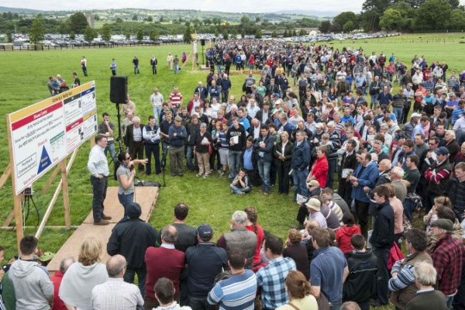
P Build up – short course on Soil Fertility
Farmers availing of P build-up allowances required to participate in appropriate training programme (Details to follow)
  Must include Farm safety
  5-6 hour course not part of KT
  Review farmers NMP
  Soil analysis results and soil fertility status of farm.
  Soil pH and Lime
  Understanding the soil P & K Index system
  Organic Manures & Nitrogen Management
  Balancing P & K
  Mitigating measures for N & P loss to water !!!!!!

Slide 23
Nitrates Simplification
  Facilitate better understanding of requirements, improved implementation
  Simplification of calculations for max N and P allowances
  Removal of requirement to deduct N & P in grazing livestock manure in storage period
  Reduction in the number of calculations required
  New tables 12 and 13A, 13B
Basing nutrient management plans on previous years stocking rate data
  Earlier planning for advisers
  Facilitates forward planning for fertiliser purchases
  Increases safety of N & P recommendations

Slide 24
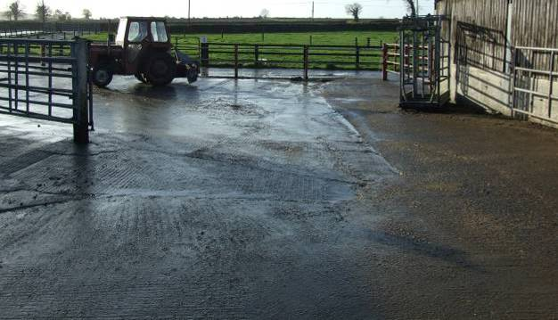
  How clean do concrete yards have to be kept?

Slide 25
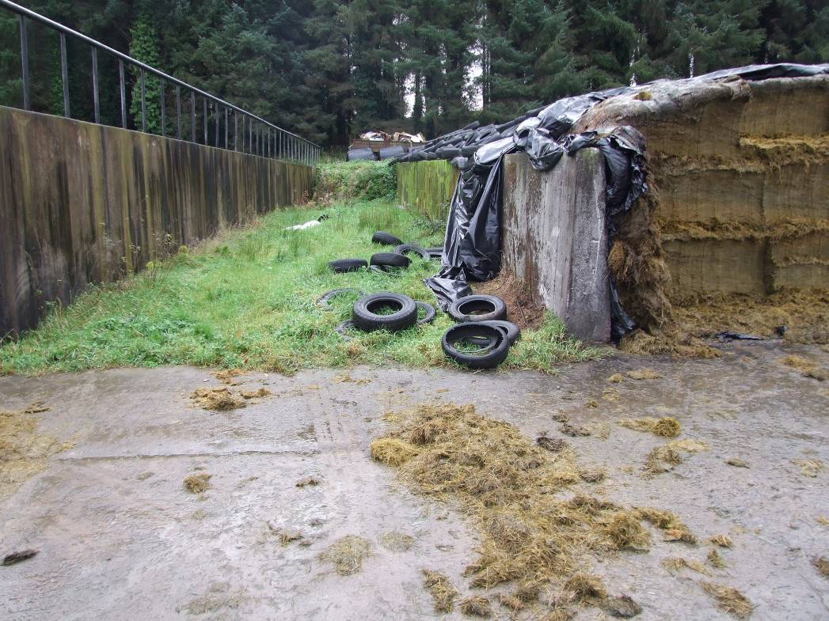
  How clean do concrete yards have to be kept?
Notes:
Is this allowable under Nitrates? No, all silage pit areas must be kept clean of fallen/waste silage. This would only be allowable if the area concerned was channeled and the rainfall on this area was stored for 16/18/20/22 weeks. But if this silage was cleaned on a regular basis then the rainfall falling on this area would be classed as clean water and could be diverted to a to a clean water system. (Best practice would be to ensure that this clean water would be filtered by fields/soil prior to entering watercourses). This material should not discharge directly into watercourses or indirectly into ground water.
If I keep the silage apron clean on a regular basis – how should I manage the rainfall from the apron etc? See answer above.
Can this rainfall be directed to a soak pit? Best practice would suggest that this should be filtered prior to entry into watercourses/groundwater. What is the recommended method filtration?
If the outfall from my 2 way effluent collection system is directly into a watercourse – is this allowable? See answer above.
How should this area be managed by the farmer to avoid any penalties under Cross Compliance? See answer above.
The DAMF will accept earthen walls on silage pits which are lined with plastic provided there is no evidence of effluent escaping and all effluents are collected as highlighted below. I do not know what other material could be used?? If the plastic on the earthen walls is torn or evidence of effluent escaping between the floor and the earthen wall a sanction will apply depending on the scale of the problem but will most likely start at 3% and go upwards from there. Silage made on clay or hard core will incur a 20% sanction at least.

Slide 26
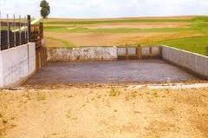
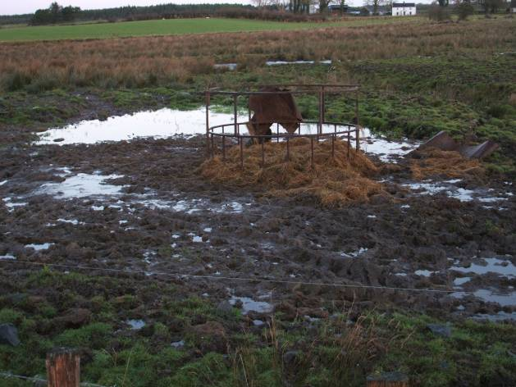
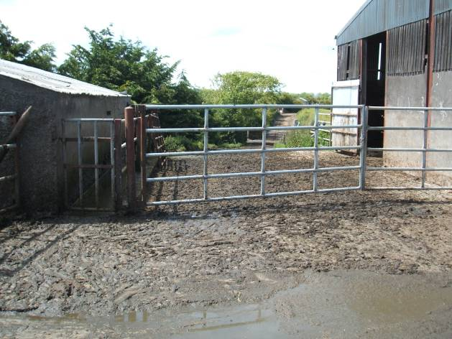
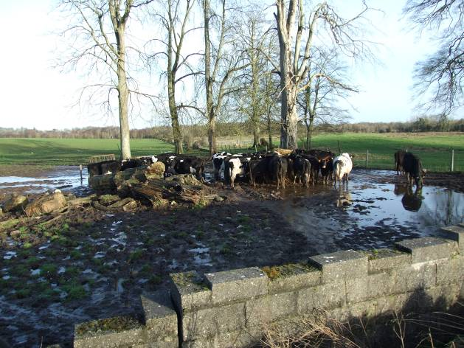
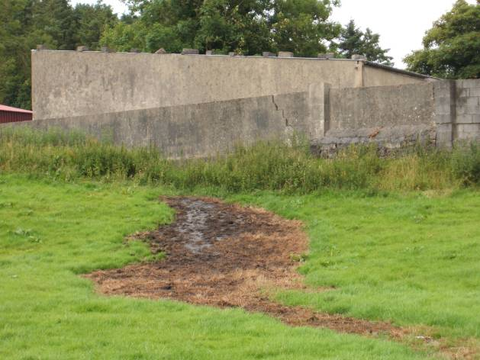
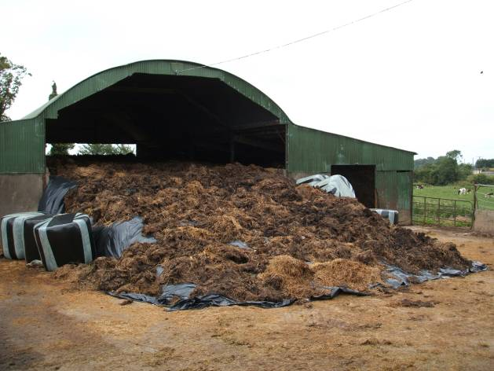
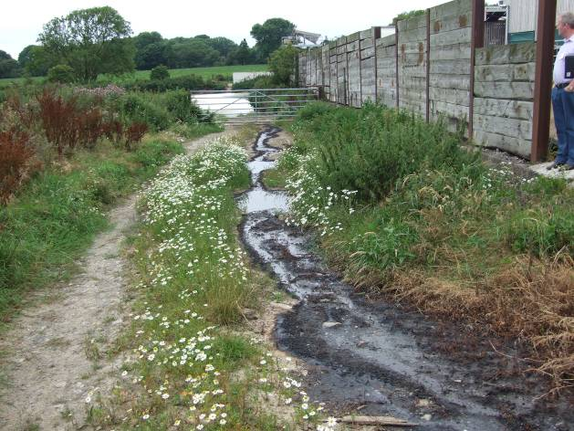
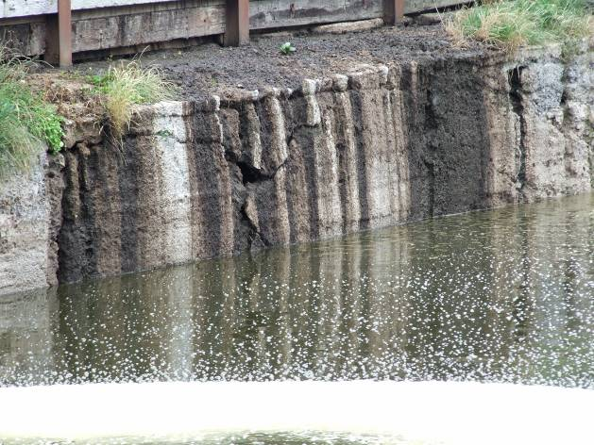
Problem Areas that still exist?
Increased focus on sorting out before end of 2018

Slide 27
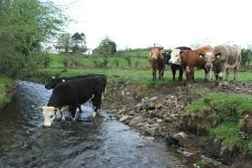
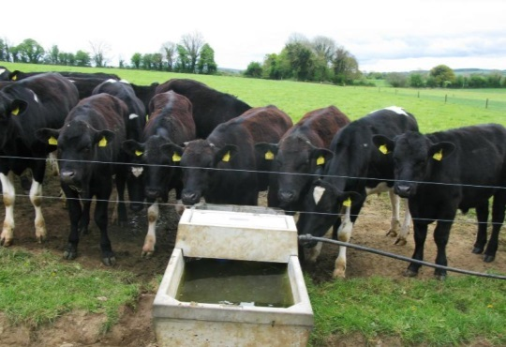
New water protection measures GSR>170NpH
Exclusion of bovines from watercourses
  Effective from 1st January 2021
  Fence 1.5m from top of watercourse bank
  For grassland stocking rate >170kgs/ha
  Water troughs set back 20m + from watercourses
  Effective from 1st January 2021
  For grassland stocking rate >170kgs/ha
  Accounts for 12,350 farms and 1/3 of national bovine numbers
  If watercourse with road beside it and trough on field side it may be ok
  Both apply to derogation farmers & farmers who export slurry to remain under 170NpH

Slide 28
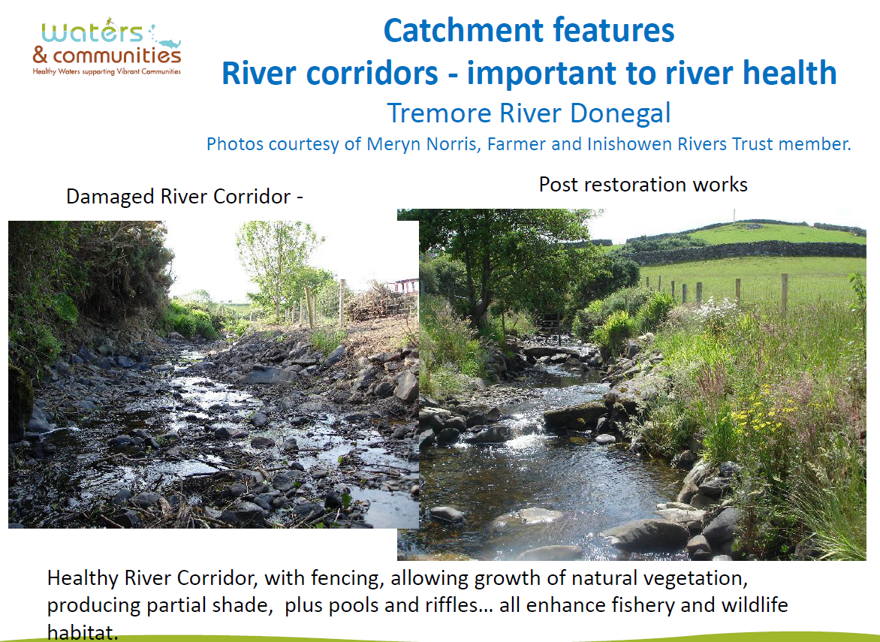

Slide 29
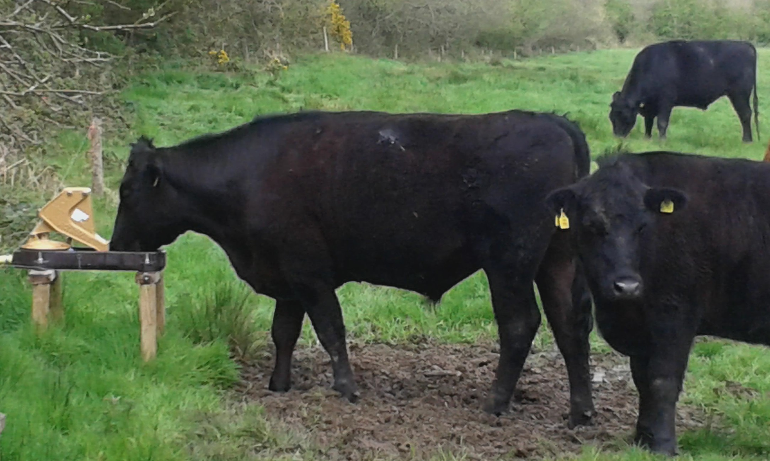

Slide 30
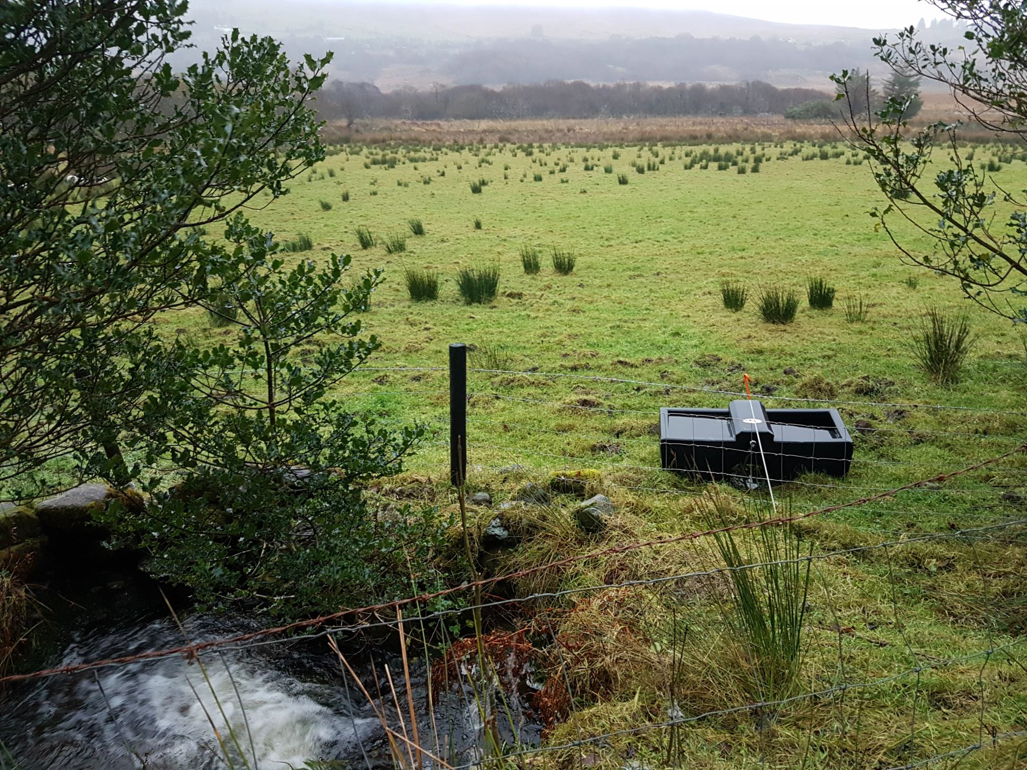

Slide 31
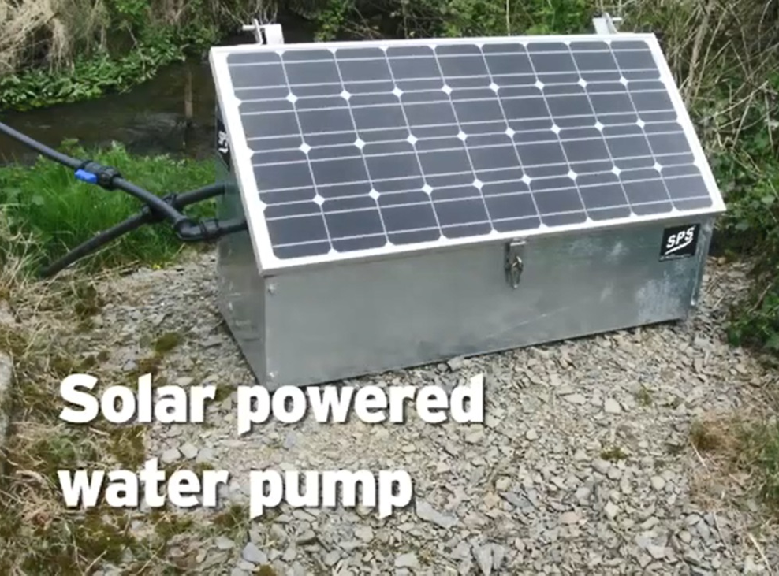
Solar Powered water Pumps
Simple Installation:
Place SPS pump beside water source and insert the suction pipe into the water.
Connect your outlet pipe delivering water to your tanks/troughs.
It can be placed on a concrete surface/slab and bolted down if desired.
The end of the suction pipe, featuring a heavy-duty stainless steel filter and a foot-valve, is placed into the water source.
Pumps water from any remote location without needing access to electricity.
Pumps water up to 60m (200ft) vertically and 1.5km horizontally.
Automatic Operation - Pressure regulated up to 80 psi.
Switch it on by connecting the battery supplied .
Can also power 12v electric fence.
No running costs - 100% solar powered.
Supply up to 3500 litres/day.

Slide 32
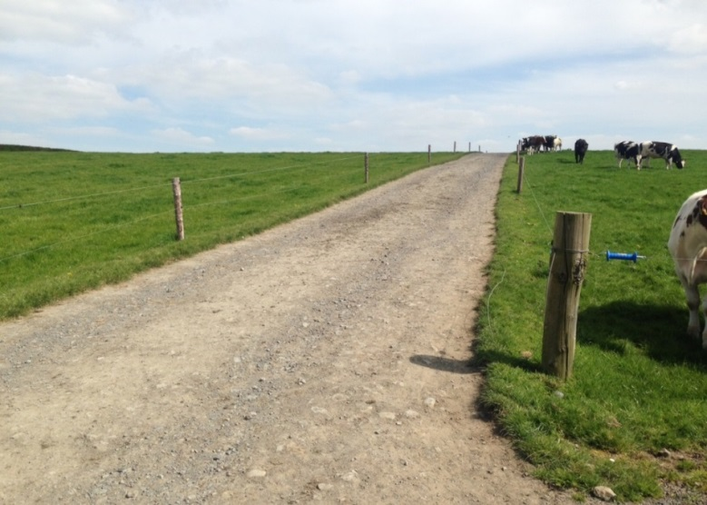
New water protection measures – All farmers
Prevention of direct runoff from farm roadways to waters
  Effective from 1st January 2021
  Waters defined as anything that could convey water (dry drain up to a river)
  As farmers upgrade roadways they should camber the roads away from waters
  DAFM specifications to follow

Slide 33
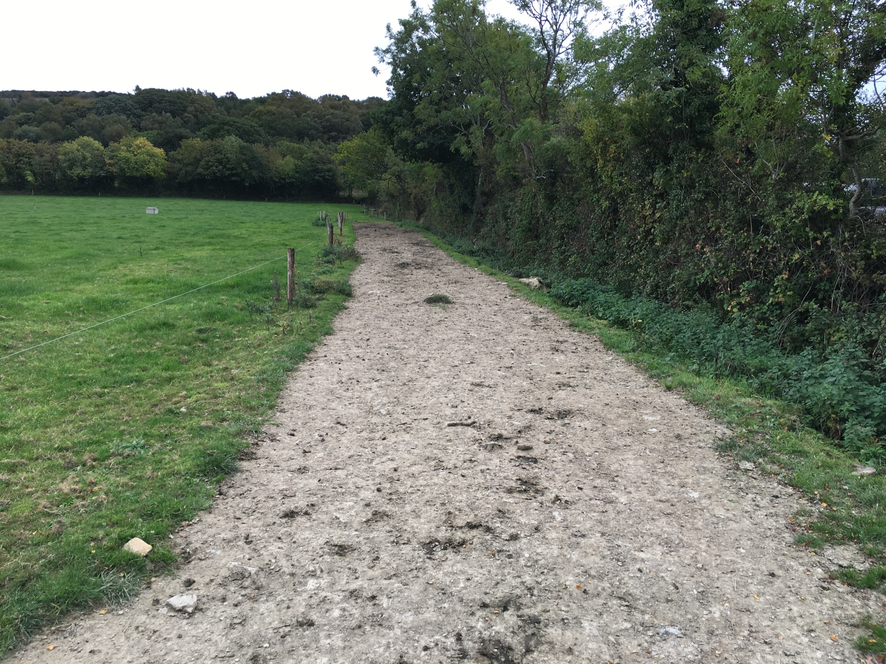
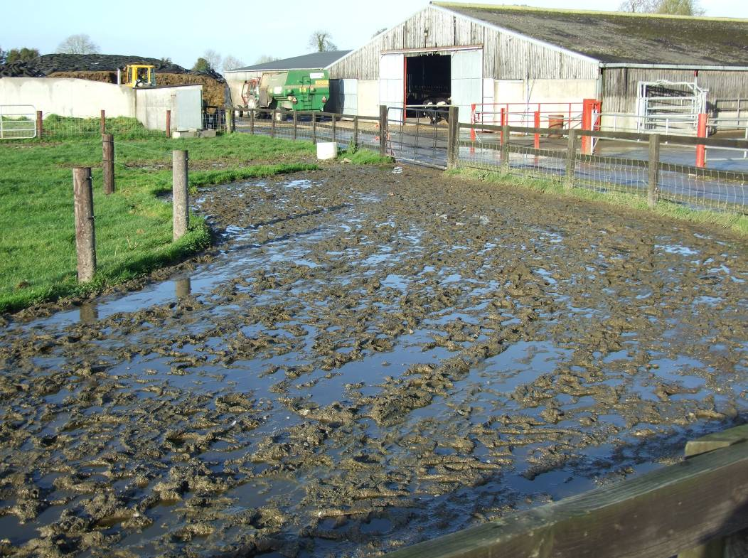
  Farm Roadways
Notes:
Farm roads where cattle walk daily – concreted and gravel based. What is the DAFF viewpoint on these areas? Yards used intermittently can be cleaned after use and the water can directed to fields.
Can the solid organic material from these areas be left to one side of the roadway during the closed period? Best practice would suggest that the farm roadways are beveled to 1 side, away from watercourses/rivers and are not sloped back into farmyards (if it is then the water from these areas would be prevented from entering manure storage facilities and would be diverted away to fields).
It is understood by the farming public that the farm roadway stops at the collecting yard and as the cows are not standing in the roadways for lengthy periods (only passing through); then these roadways are ignored during an inspection? In the photograph above the farmyard is not part of the farmyard complex and provided no direct/indirect runoff to groundwater/surface water should not be an issue.
What if a farm roadway is concreted? If the farm roadway is not part of the farmyard complex, than all rainfall falling on this area must be prevented from flowing into the yard and into slurry storage facilities or soiled yards. This is where the farm roadway is used to walk cows on and is not used as a collecting yard or where cows are standing before or after milking.

Slide 34
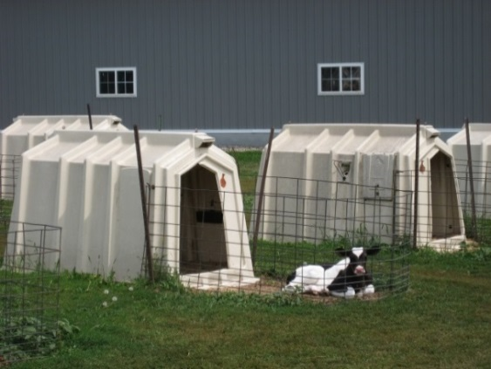
Other issues to be aware of
  Slurry 5m from any watercourse/dry drain. Increased to 10m two weeks before end and after start of slurry spreading season
  FYM & silage bales must be stored >20m away from any watercourse/dry drain
  Silage bales can be stored in fields, gravel base or hardcore. Any seepage must be contained, collected and stored
  Calf hutches on land and hardcore are no longer acceptable at any time of year. If on concrete the seepage must be collected & clean water needs to be diverted.
  No round feeders within 20m of any watercourse/dry drain

Slide 35


Slide 36
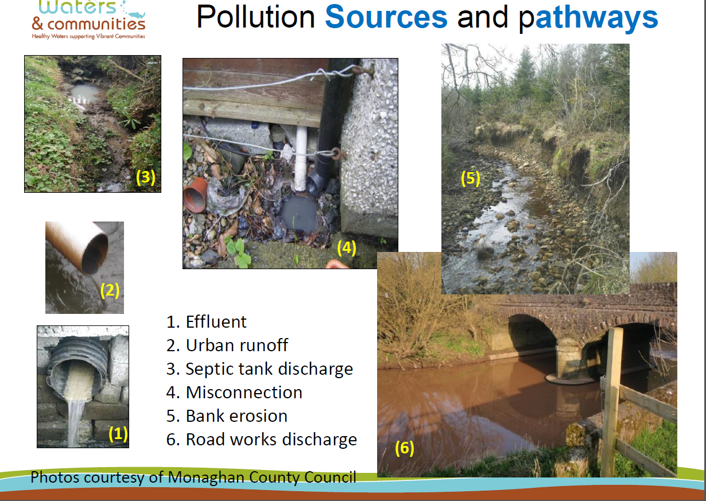

Slide 37
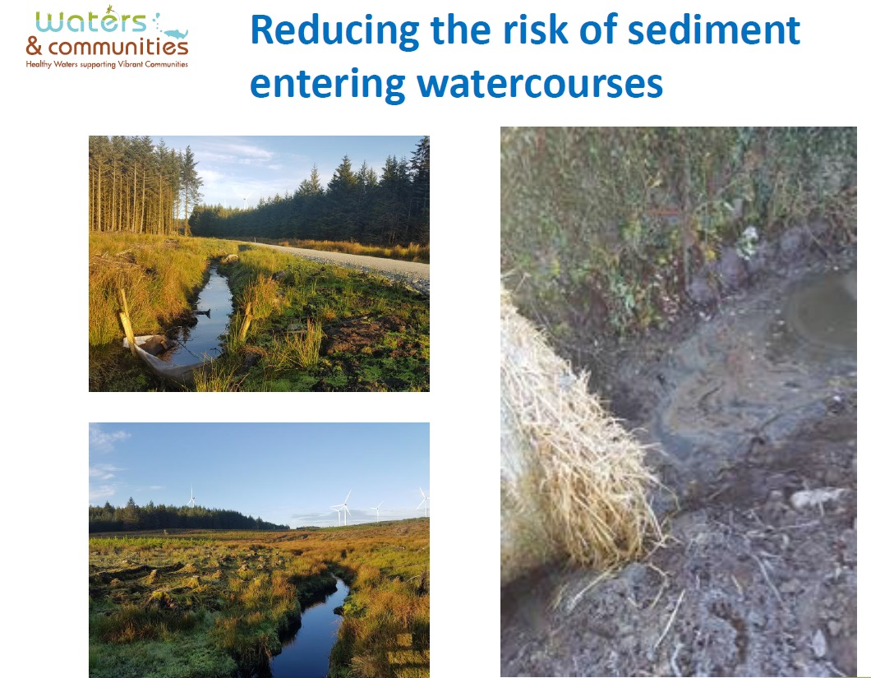

Slide 38
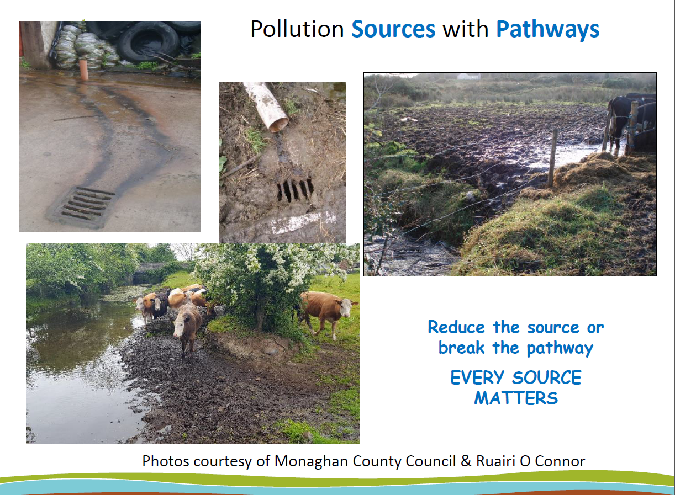

Slide 39
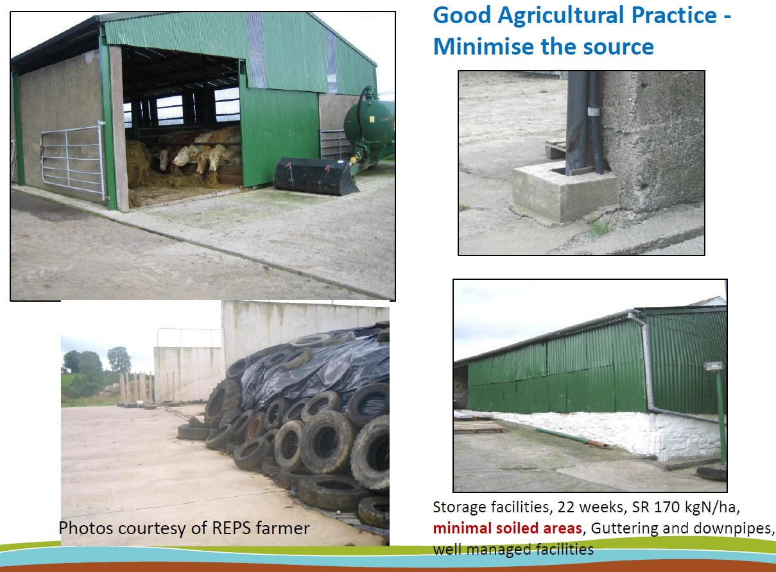
18

Slide 40
Possible challenges for farming in the future
  Protected Urea for farmers using high fertiliser N rates from 1st January 2021 (Ministerial decision)?
  Could normal urea be banned in the future? (Germany & France)
  Could CAN be banned due to GHG’s?
  Will TAMS II grants/build be available for uncovered tanks due to emissions?
  Derogation limit down to 210Kg’s N/Ha? (Or no Derogation Agreed)
  Limit on Number of dairy Cows/Herd number or emissions quota?
  Dairy cow = 85kgs N/head Ireland (110kgs N/Head Denmark)?
  Denmark 2 year derogation? Dutch culled 50,000 cows
  Restricted expansion in areas of bad water quality/perfect water quality?
  Grey water issues being raised by Local Authorities which applies to run-off from clean concrete in front of silage pits
  Industry and farming must be future proofed - Start now & not 4 years time
Teagasc launching new Water Quality Advisors in key areas (ASSAP)

Slide 41
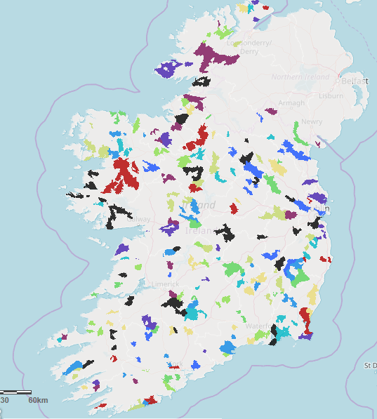

Slide 42
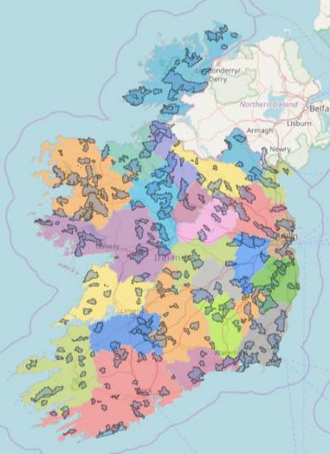





Overview of New ASSAP Advisory Programme
What?
30 advisors from Teagasc & Co-ops
Voluntary
Free advisory service
Support farmers
Practical Advice
Where?
192 Areas for Action
Located all over Ireland
Find your local Area for Action at www.catchments.ie
How?
Reduce nutrient loss by ‘breaking the pathway’
On Farm tailored advice
Farmyard Improvement
Nutrient Management
Land Management
Why?
Need to Improve Water Quality for everyone's benefit
Important for Nitrates derogation and future development of Irish agriculture
When?
2018 - 2021
ASSASP service
provided by:
Supported
By:

