Slide 1
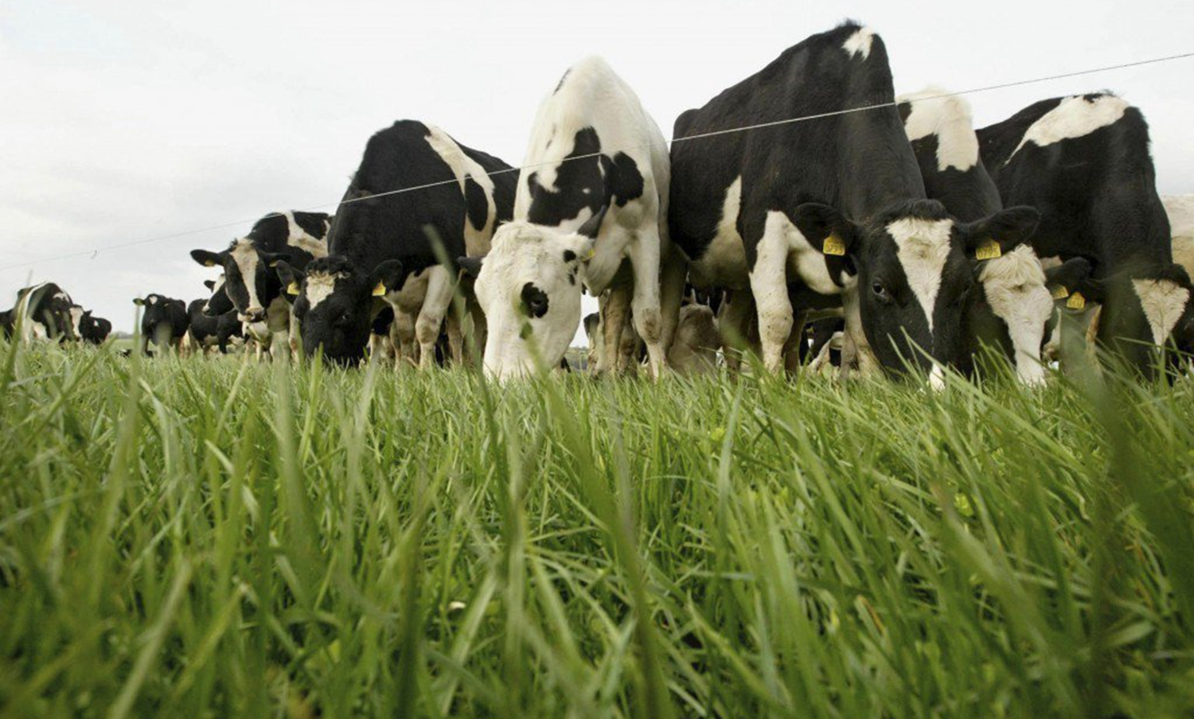
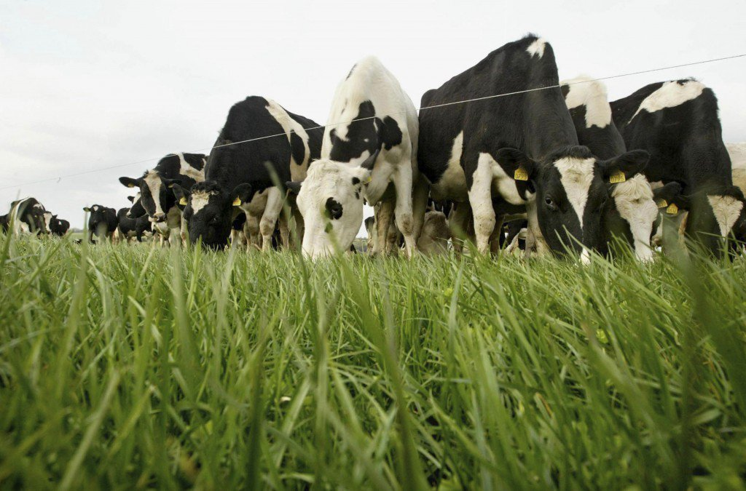



Greenhouse Gases and Ammonia In Irish Agriculture
Gary Lanigan, Patrick Forrestal, William Burchill, Owen Fenton, Rogier Schulte and Karl Richards
C sequestration update
Gary Lanigan¹, Rachael Murphy, James Rambaud¹, Matt Saunders³, Karl Richards¹
¹Teagasc, Johnstown Castle, Wexford
³Trinity College Dublin

Slide 2
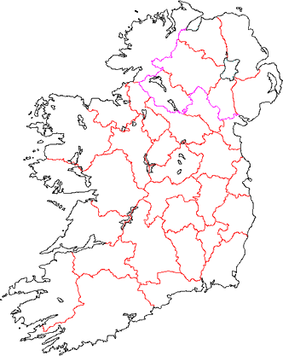
NASCO Sites
Currently 16 towers have been deployed
Four more in the next two weeks
Mineral grassland
Multi-species pasture
-
Histic grassland
Cropland
Forest

Slide 3
Mineral grassland
Multi-species pasture
-
Histic grassland
Cropland
Forest

Slide 4
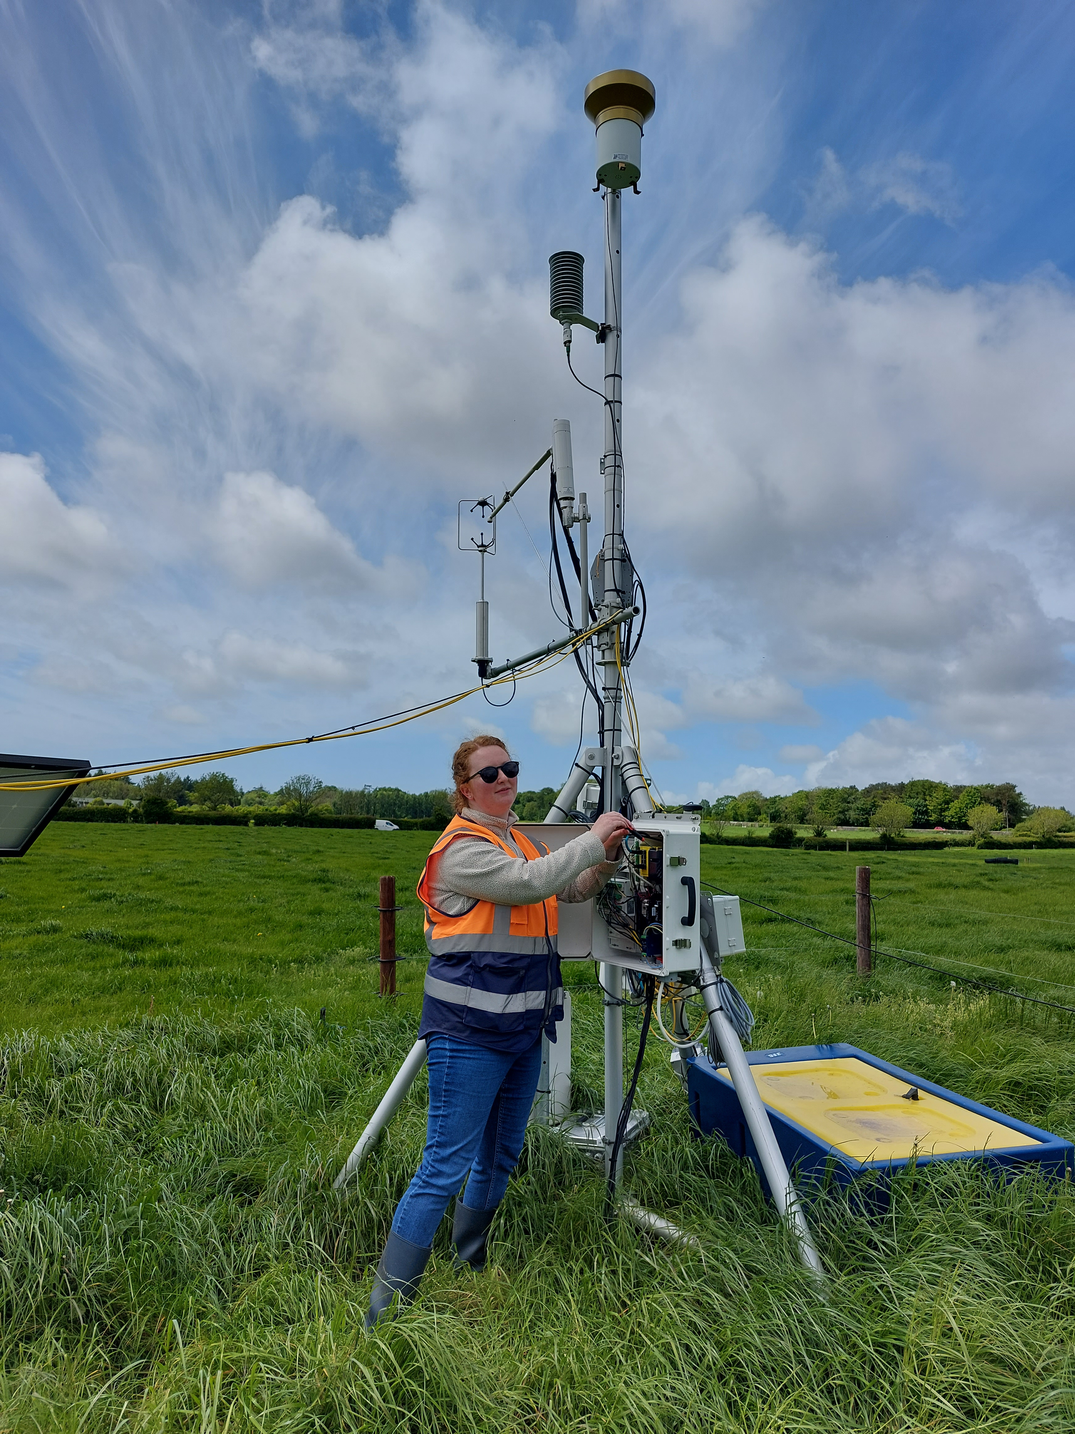

Slide 5
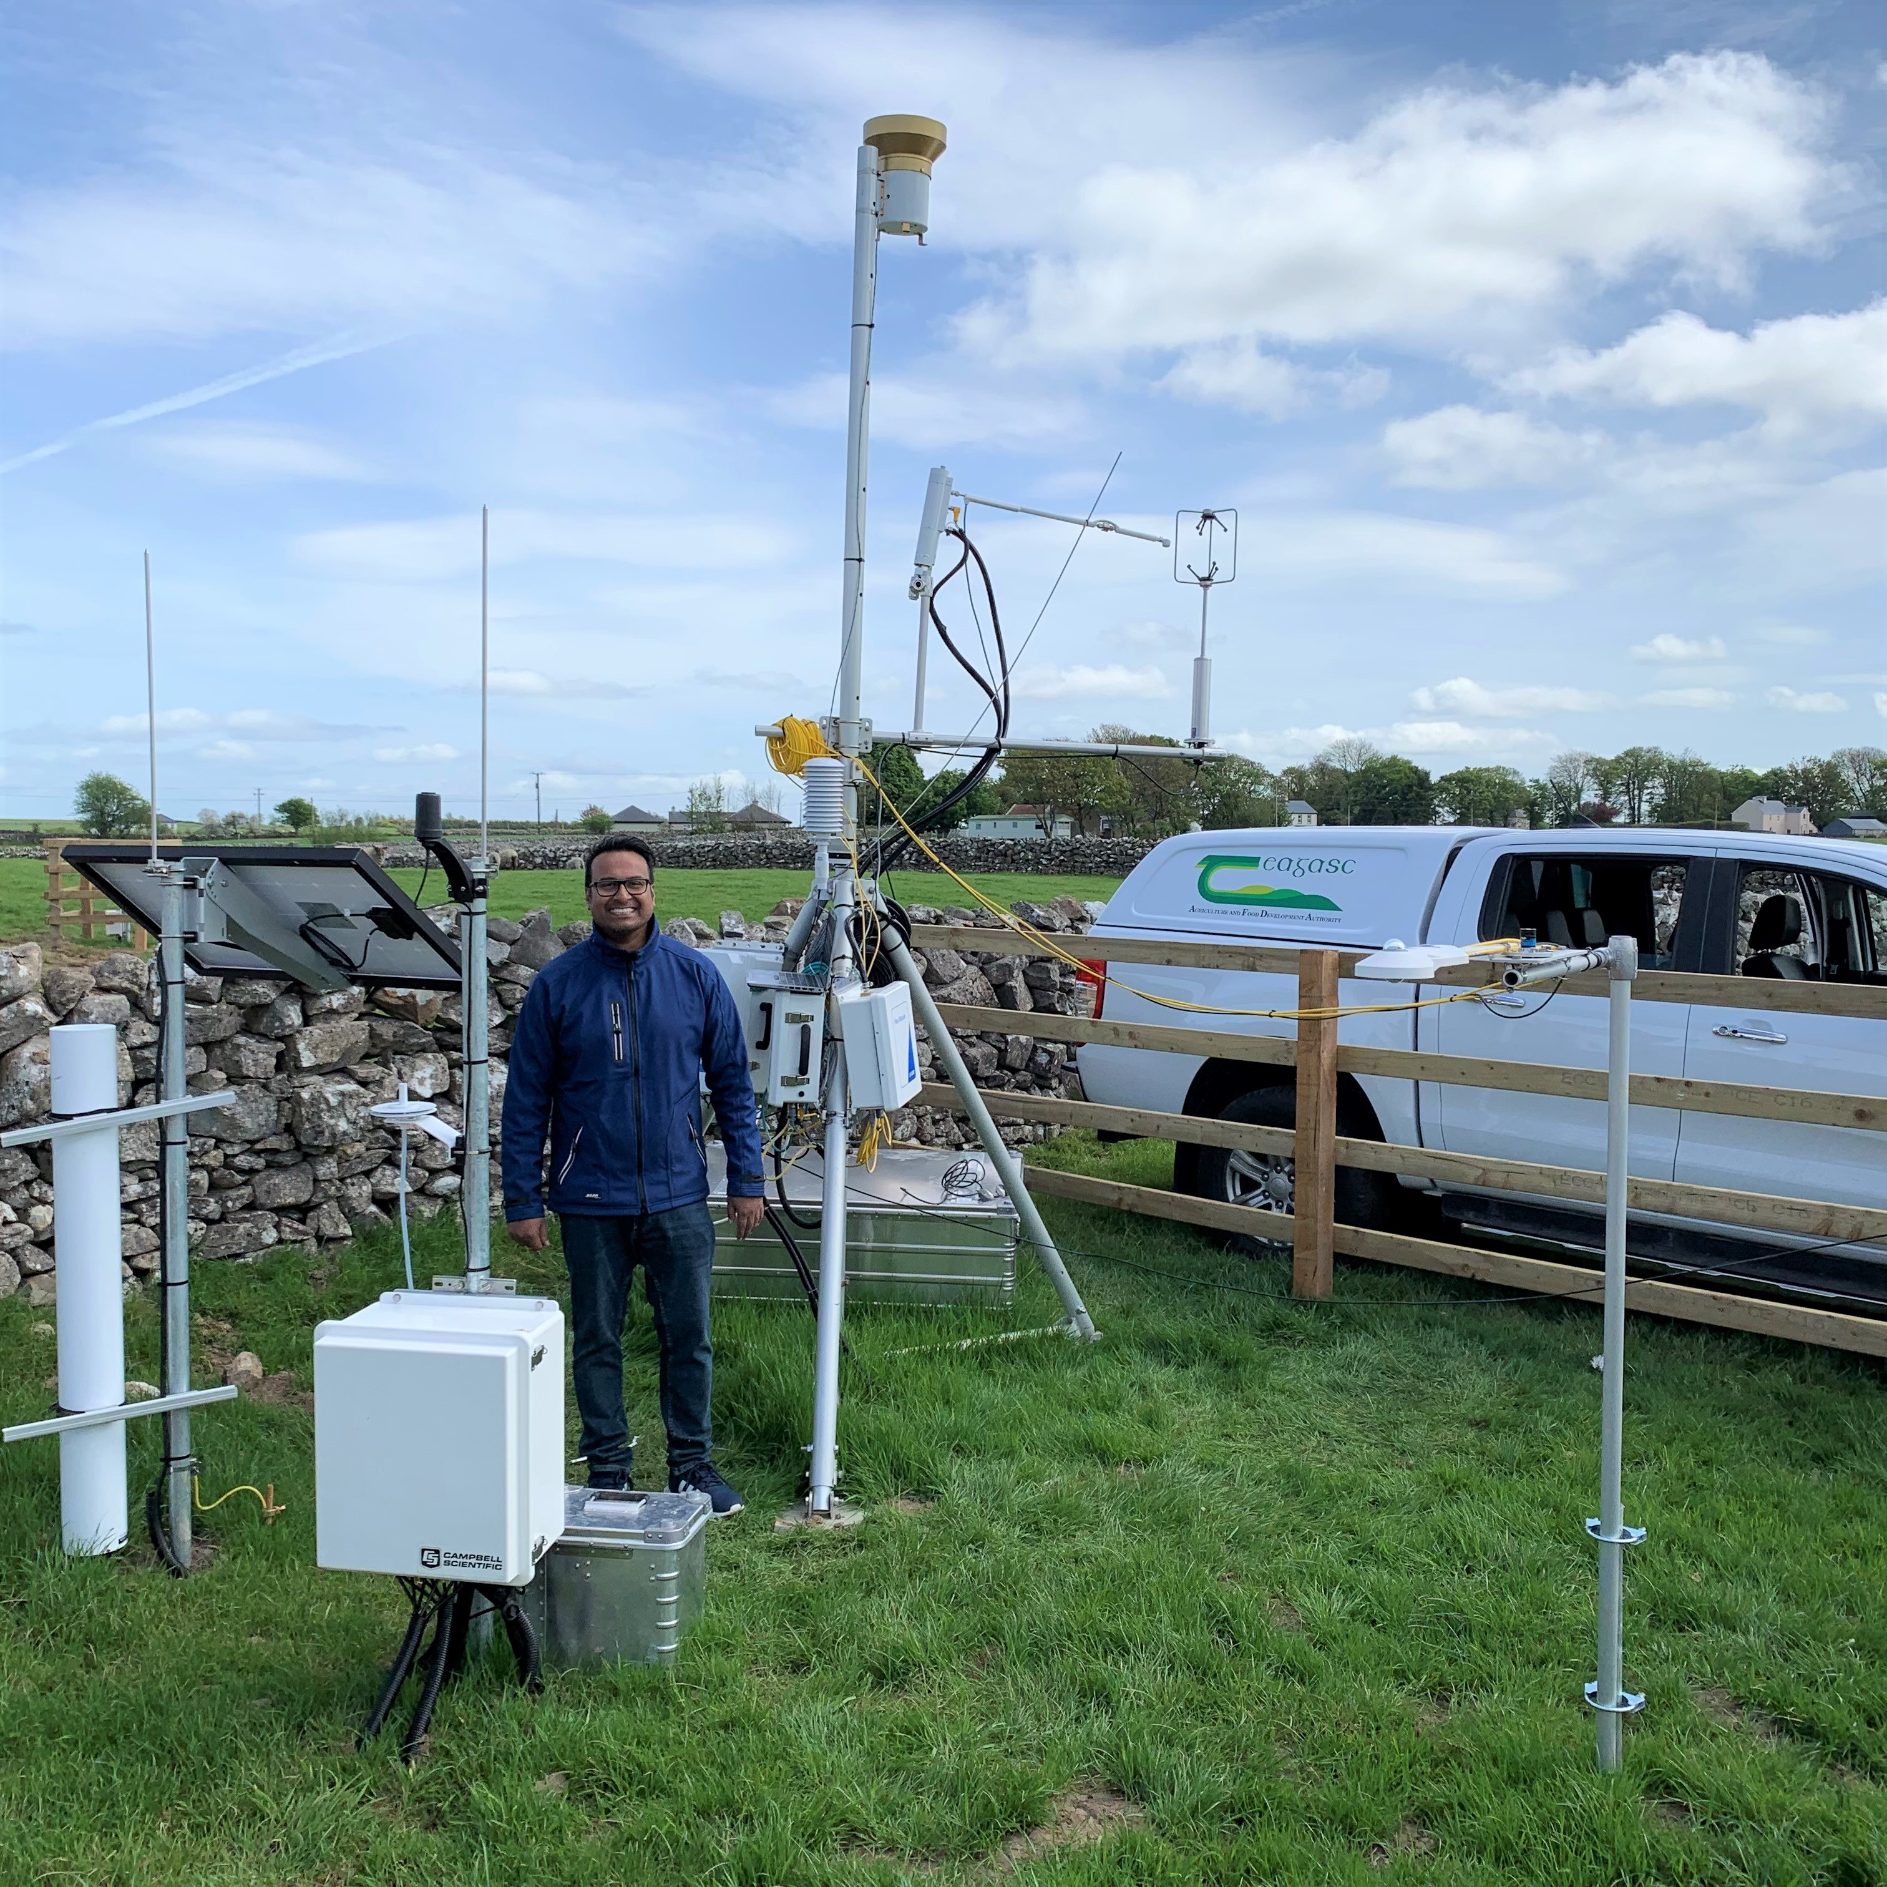

Slide 6
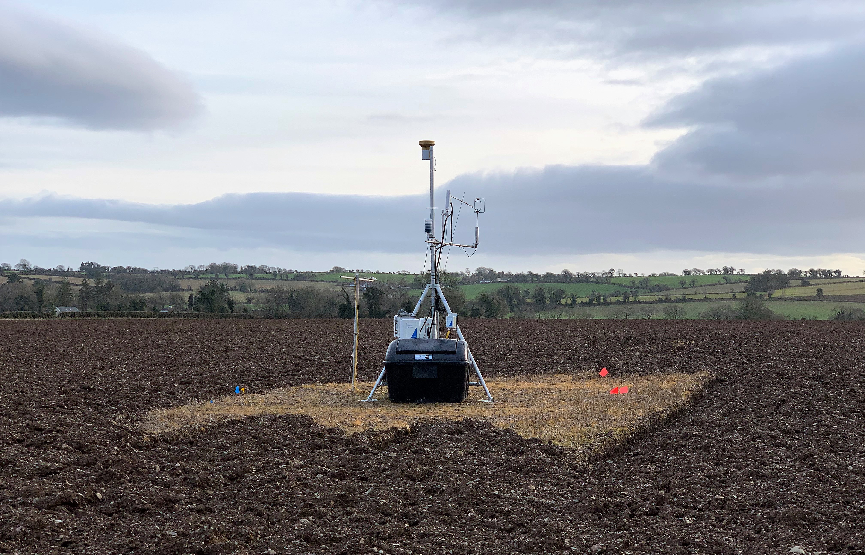

Slide 7
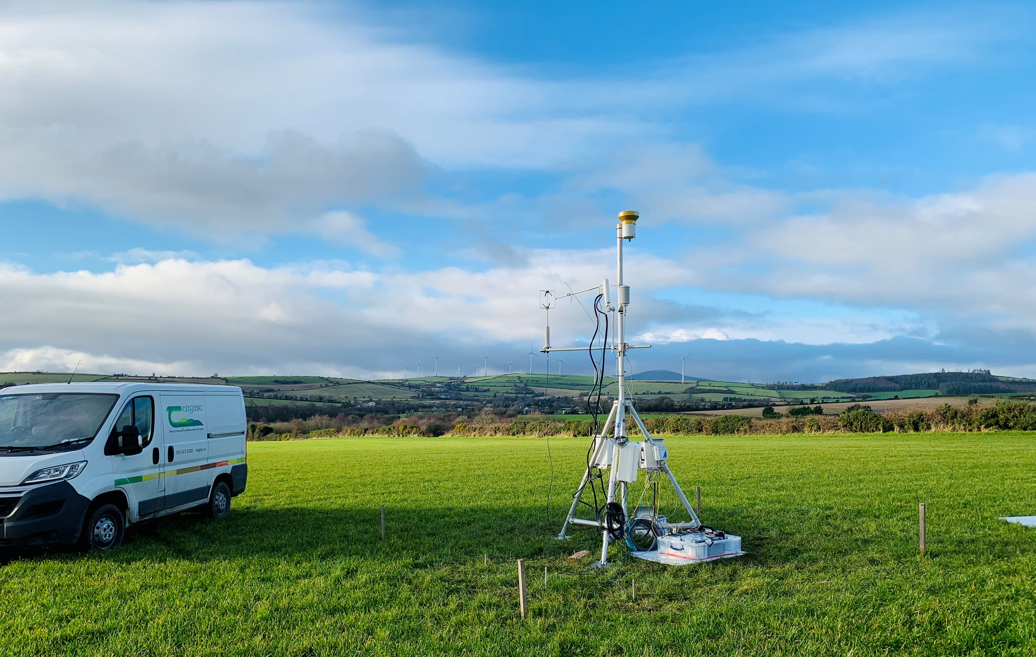

Slide 8
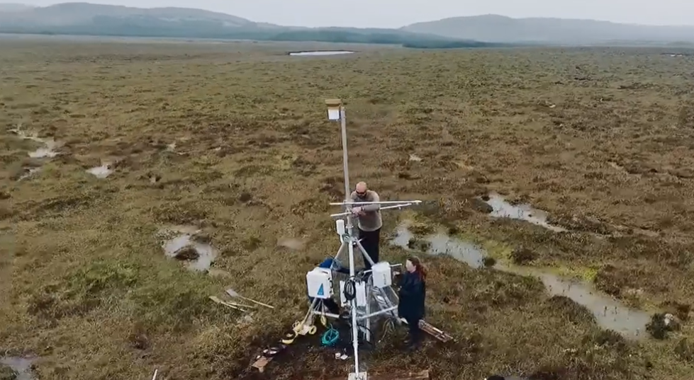
Rough grazed blanket peatland

Slide 9
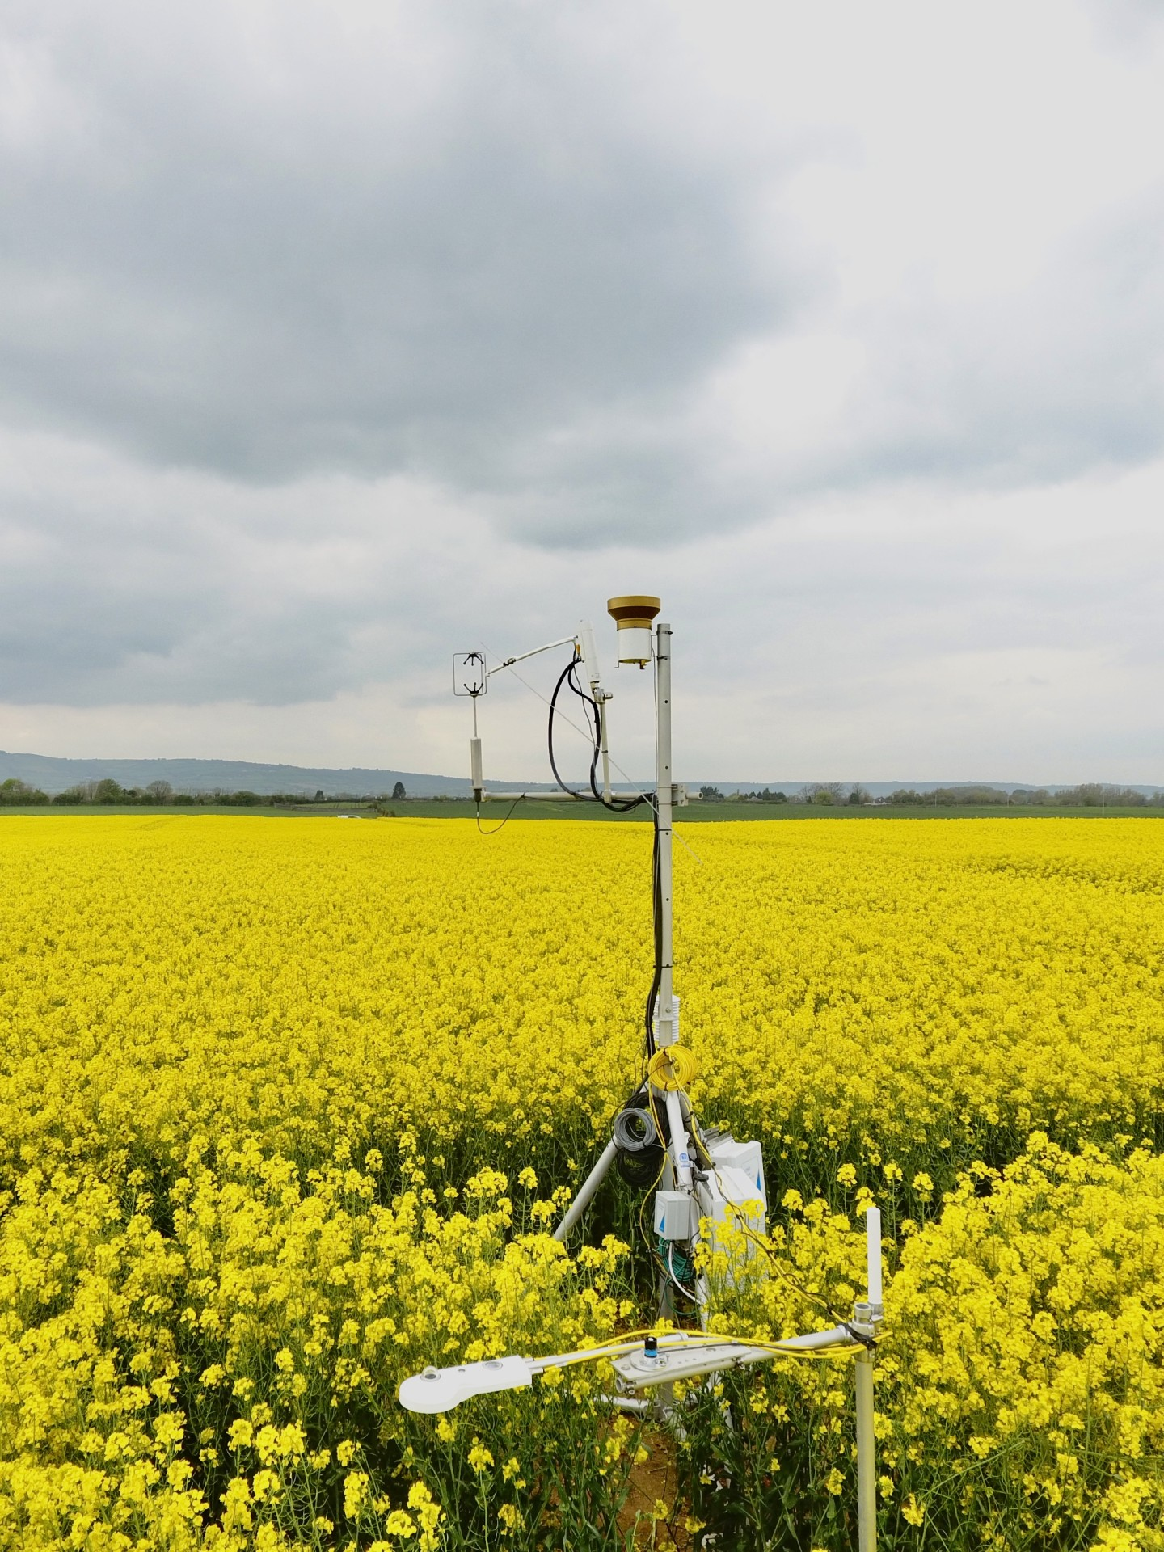

Slide 10

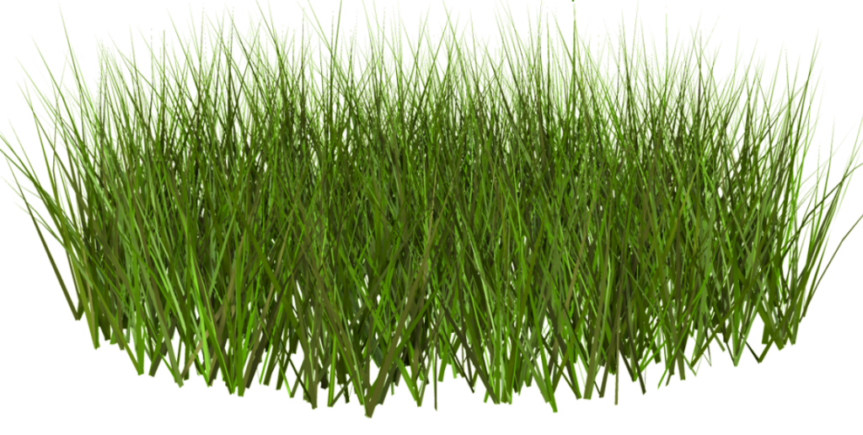
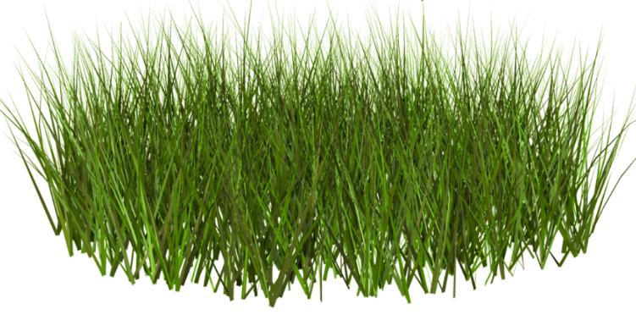



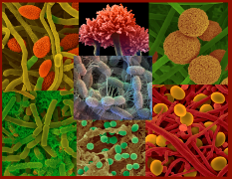
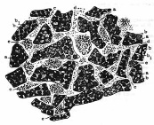
The main processes in the Carbon cycle
GPP
Photosynthesis
CO₂
Autotrophic respiration
CH₄
Harvest
Breathing animals
NEE = GPP - TER
manure
Animal deposited C
manure C
Heterotrophic
Respiration
Soil Organic Matter
TER
Humification
& physical protection
Exudates
Fungal/
Microbial Biomass
Mortality/Litter
Dissolved Carbon
NBP

Slide 11
Castledockrell (20/01 – 26/08/2022)

Slide 12
Timoleague (28/01-06/04/2022)

Slide 13
Cregduff (04/05-25/08/2022)

Slide 14
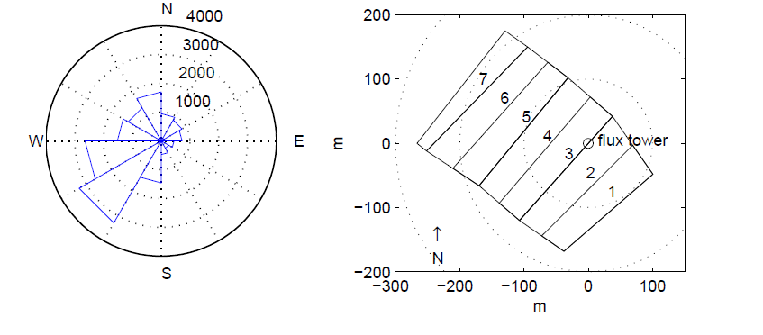
What you measure over depends on wind direction and windspeed

Slide 15
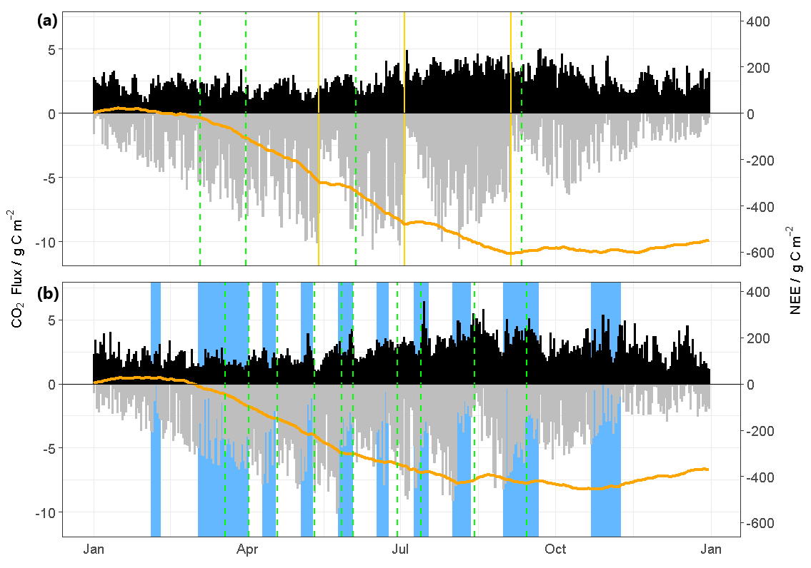
Half-hourly data gives good temporal indication of management impacts
2019
2020

Slide 16
Long term Carbon budget of grassland at Johnstown Castle
NEE (g C m⁻² mth⁻¹)

Slide 17
Higher Net productivity – mean higher offtake
Will not necessarily lead to higher NBP
Net Harvest/grazing offtake
CO2 (gC m⁻² month⁻¹)

Slide 18
Getting the final balance- Net Biome Productivity
C Balance (gC m⁻² yr⁻¹)

Slide 19
Net grassland balance
In JC grassland – net C balance ranged from a source of 1.87 tC ha⁻¹ yr⁻¹ to a sink of 2.65 tC ha⁻¹ - driven mainly by land management decisions
Net balance while in winter kale was +1.21 ±0.63 tC ha⁻¹ yr⁻¹ and -1.06 ±0.83 tC ha⁻¹ yr⁻¹ when in grass
However in bad drought year – grassland was a source of 1.38 tC ha⁻¹ yr⁻¹

Slide 20





Acknowledgements

