Slide 1
Climate challenges ahead – a farmers perspective
Thomas Duffy
Chair Signpost Steering Group

Slide 2
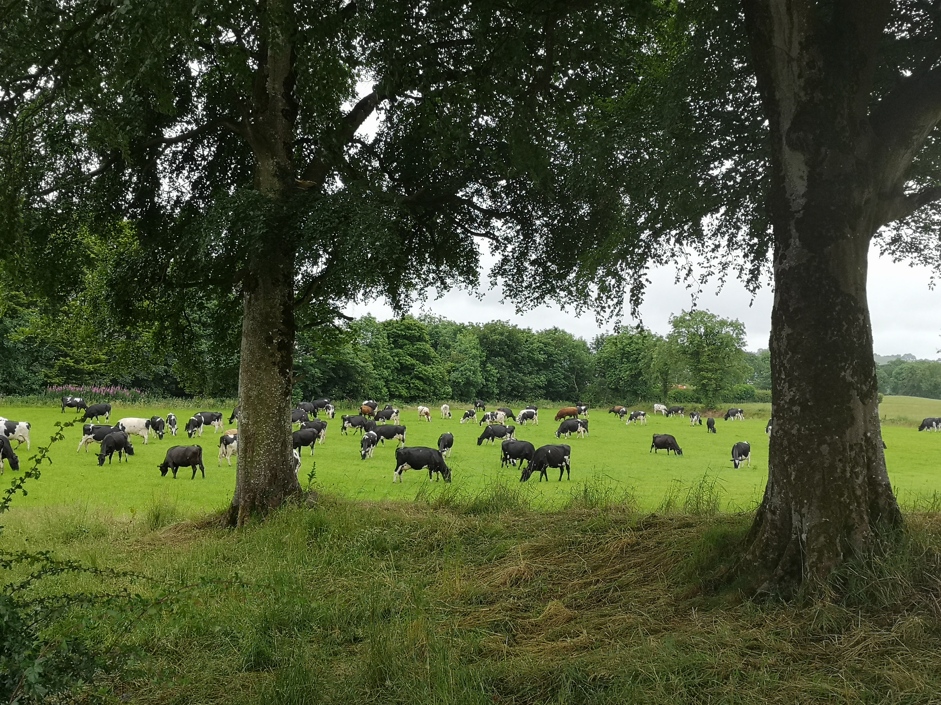
Introduction
95 dairy cows
East Cavan – lot of full time beef, no rapid expansion of dairy since 2015 (some prior expansion)
Land type: GP free draining, outfarms heavy clay
SR: 1.98, 169.22kg N/ha
Milk Platform SR3.14 279kg N/ha

Slide 3
Measures to address climate (both mitigation and adaptation)
Already in place
Aims to achieve
100% Protected Urea (all P & K as straights)
100% Sexed Semen + high terminal beef
All slurry LESS (contractor)
Focus on EBI
High clover (ongoing reduction in N)
Some Multi Species Swards and Red Clover silage
More accurate kgs MS/kg BW breeding
More Multi Species Swards (located on drought prone areas)
More Red Clover Silage
Potential for IVF to improve beef progeny (cost dependent)

Slide 4
Concerns for farmers
Prior recognition of emissions reductions; cut on baseline average vs cut on existing
Access to product
Return from markets/private incentives
National/EU incentives
Misinformation/exaggerated claims/missed

Slide 5
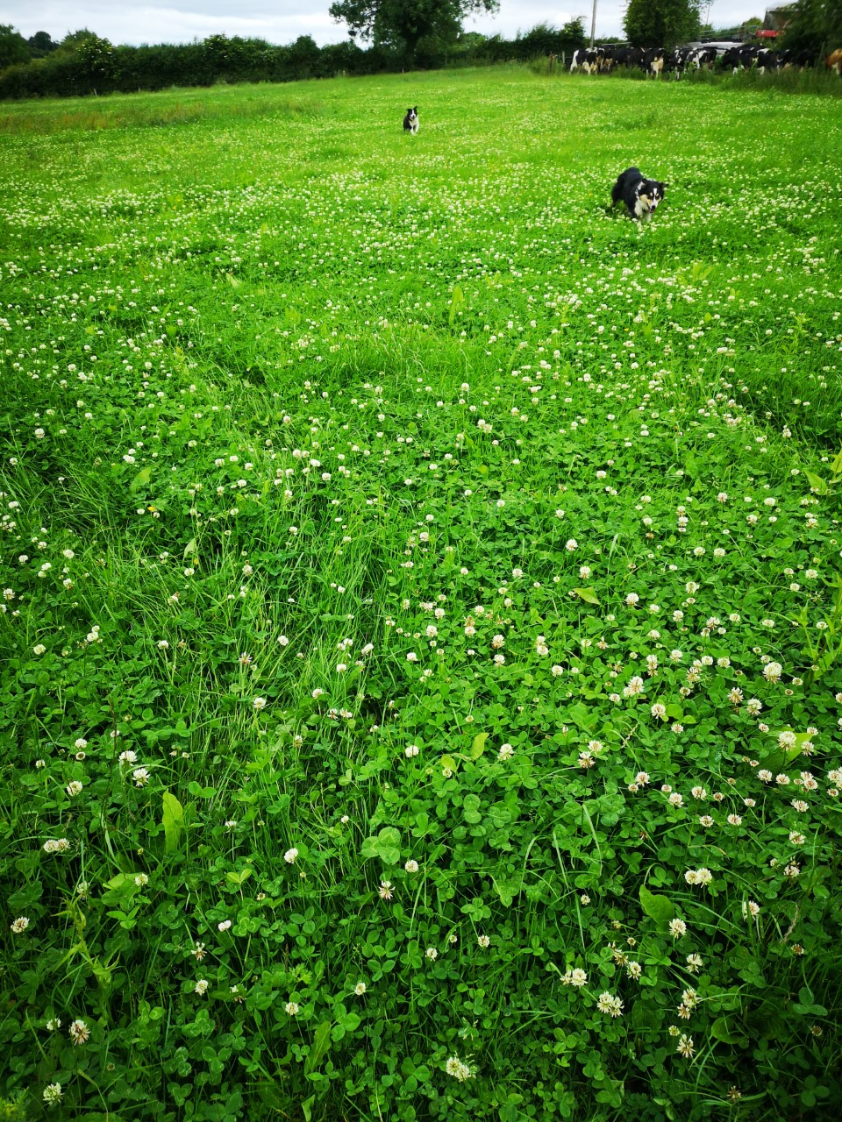
Thank you for listening

