Slide 1
The Signpost Programme Progress Report
Tom O’Dwyer
Teagasc
29th August 2022

Slide 2
Presentation Overview
Recap – programme objectives, partners and Signpost Farms
NFS results
  Farm characteristics
  Sustainability KPI’s (preliminary)
National Agricultural Soil Carbon Observatory (NASCO) results
  Soil analysis campaign 2021/22
Resources, events and other activities

Slide 3

But firstly…
Notes:
But firstly. the results that I will present in my presentation were generated through the commitment and hard work of all of the farmers, partners and participants in the Signpost Programme, many of whom are in the room today. The Signpost Farmers, the programme partners, my colleagues in Teagasc. I want you all to stand up and give one another a round of applause for a busy and successful 18 months since the launch of the Signpost Programme in May 2021.

Slide 4
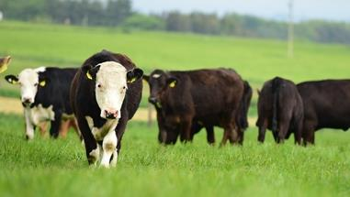
Objectives
Lead and support the transition of Irish farming towards more sustainable farming systems;
Contribute to the agricultural sector efforts to reduce agricultural emissions in line with national policy objectives;
Ensure that there are no unintended consequences of attempts to reduce agricultural emissions and that progress is made in both improving water quality and enhancing biodiversity;
Promote farming practices and systems which can improve margins and the overall sustainability of farming systems;
Build national capability and capacity (both of Irish farmers and those supporting them) to undertake the changes required;
Be a trusted knowledge source and broker, facilitating the alignment of programme partners and the strengthening of existing and new programme collaborations.

Slide 5

Signpost Programme
Signpost Farms
Signpost Advisory
NASCO
(and other on-farm research)

Slide 6

Signpost Partners
62 partners
+ Drinks Ireland, Diageo, Heineken, Irish Distillers and William Grant & Sons

Slide 7
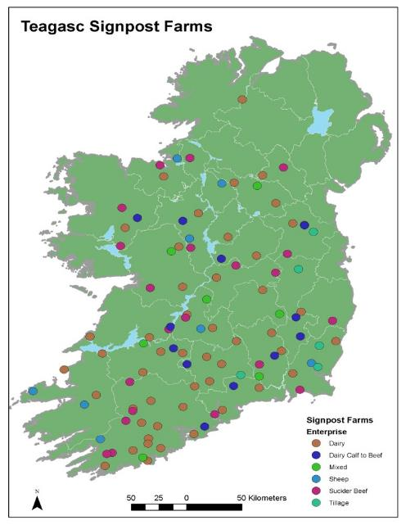
Signpost Farms
Total 119
Dairy 50 (2 organic)
Future Beef (suckler) 24 (2 organic)
DairyBeef500 16
Sheep 8
Tillage 8 (1 organic)
Pig 2
Poultry 1
Agricultural Colleges 6
Other 4
(Organic 5)
Notes:
Future Beef includes Newford and Kepak farms

Slide 8
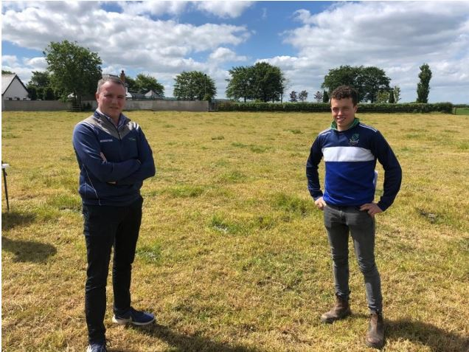

Signpost Programme and NFS
Signpost Farmers’ data recorded by NFS technicians
2021 is a baseline year
New Signpost Sustainability Report created
  66 reports issued to individual farmers
  remaining reports to be generated and issued shortly
Further analysis of data required
Notes:
NFS technician, Kevin McNamara and Signpost dairy farmer, David Fennelly.

Slide 9
NFS Results – farm characteristics
n = 104 | ha
Land owned (ha) | 62.7
Land rented (ha) | 25.0
Land farmed (ha) | 87.2
Utilisable agricultural area (UAA, ha) | 83.8
Total pasture (ha) | 67.5
Total tillage crops (ha) | 12.4
Farm forestry (ha) (16 farms) | 2.1
Old woodland (ha) (18 farms) | 1.1
n = 104* | %
Married (%) | 85
Female (%) | 2
Family operated – single operator (%) | 46
Family operated – more than one operator (%) | 27
Company (%) | 22
Dairy cows (avg., n = 48) | 156
Milk produced (litres, n = 48) | 929,000
Suckler cows (avg., n = 23) | 43

Slide 10
Preliminary Results – Dairy (n = 37; year = 2021)
 |  | Avg. | Min | Max | NFS*
Total GHG emissions (tCO_{2eq.}) |  |  | 413 | 2160
GHG emissions per ha (tCO_{2eq.}) |  | 9.7 | 5.5 | 14.2 | 8.7
GHG emissions per kg FPCM (kgCO_{2eq.} per kg FPCM) | IPCC LCA | 0.70 0.93 | 0.58 0.70 | 0.93 1.18 | 0.81 1.06
NH₃ per hectare (kg/ha) |  | 47.4 | 22.6 | 69.8 | 49.4
Farm-gate N balance per ha (kg/ha) |  | 181 | 85 | 281 | 184
N use efficiency (%) |  | 27.5 | 20.3 | 39.2 | 23.8
% fertiliser N as protected urea (%) |  | 36 | 0 | 100 | 3
% LESS |  | 91 | 10 | 100 | 29
% slurry applied Jan to Apr |  | 57 | 20 | 80 | 46
* Three year average 2018, 2019, 2020
Notes:
This slide contains the results for 37 of our Signpost dairy farmers, with the three year average for the overall NFS sample include for comparison purposes.
Each Signpost Farmer has a total farm emissions figure – this slide shows the range in those figures. This is the figure that farmers have to work on reducing if we are to meet the agricultural emissions reduction target of 25% by 2030.
Dividing this figure by the number of hectares farmed gives the figure on the second row of this slide. The Signpost dairy farmers have a higher emissions per hectare figure, but there is quite a range. This group of farmers are, on average, stocked more highly than the NFS average, and have greater milk solids output per hectare also.
The emissions per kilogram of fat and protein corrected milk is reported using two methodologies: firstly the IPCC methodology, and secondly using the LCA approach. Looking at the LCA figures, we can see that on average these 37 farmers have a lower carbon footprint than the NFS average, and that there is quite a range in performance.
The NFS analysis has also calculated a N balance and N use efficiency figure for each farm. To me what is of interest on this slide is the range – that one farmer can achieve a N use efficiency figure of 39% and that a second different farmer can achieve a N balance of less than 100 kg/ha. We need to look more closely at the figures to begin to understand how they are achieving these types of figures.
Finally, I have included results for three KPI’s on the final three rows. This group are on average applying over one third of their fertiliser N as protected urea, over 90% of their slurry using LESS, and almost 60% of their slurr in the spring. All well above national average performance. And again, I want to highlight the range in performance.

Slide 11
Preliminary Results – Beef (n = 26; year = 2021)
 |  | Avg. | Min | Max | NFS*
Total GHG emissions (tCO_{2eq.}) |  |  | 109 | 1000
GHG emissions per ha (tCO_{2eq.}) |  | 6.2 | 3.2 | 9.2 | 4.2
GHG emissions per kg beef LWT (kgCO_{2eq.} per kg LWT) | IPCC | 8.7 | 5.3 | 13.0 | 11.0
NH₃ per hectare (kg/ha) |  | 32.5 | 14.8 | 58.3 | 24.2
Farm-gate N balance per ha (kg/ha) |  | 118 | 52 | 194 | 61.9
N use efficiency (%) |  | 14.6 | 4.7 | 29.0 | 22.0
% fertiliser N as protected urea (%) |  | 21 | 0 | 85 | 1
% LESS |  | 41 | 00 | 100 | 11
% slurry applied Jan to Apr |  | 59 | 20 | 100 | 37
* Three year average 2018, 2019, 2020
Notes:
This slide contains the results for 26 of our Signpost beef farmers, a mixture of both suckler farmers and our dairy calf to beef farmers. Again, the three year average for the overall NFS sample is included for comparison purposes.
Again each Signpost Farmer has a total farm emissions figure. Of interest here is that while the lowest figure is well below the dairy minimum, the maximum figure is sizeable and exceeds all bar nine of the 37 dairy farms.
Dividing this figure by the number of hectares farmed gives the figure on the second row of this slide. And once again, while on average the group has a lower figure here, there are some beef farmers with per hectare GHG emissions comparable to the average of our Signpost dairy farmers.
The GHG emissions are next reported on a per kilogram of beef LWT, and this group of beef farmers have a lower carbon footprint than the NFS average, and that there is quite a range in performance.
Both the N balance and N use efficiency figures are lower than for the dairy farmer group, and it would appear that there is significant scope for this group of farmers to improve their N use efficiency performance, while holding the N balance at its current low level. Again the range in both of these figures is noteworthy.
Finally, it is good to see that this group of beef farmers are using protected urea, LESS and applying most of their slurry in the spring – well ahead of the NFS average, but also with scope for future improvements.

Slide 12
Next steps
Remaining individual farmer reports to be generated
Data is being recorded on all farms again in 2022
  Observe impact of management changes on Sustainability KPI’s
Further analysis of 2021 baseline data
  Provide data by enterprise, partner, programme etc.

Slide 13
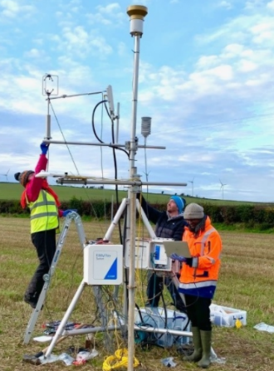
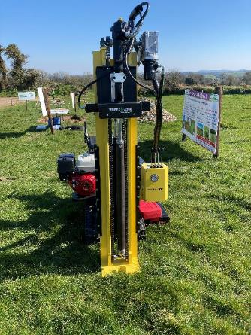
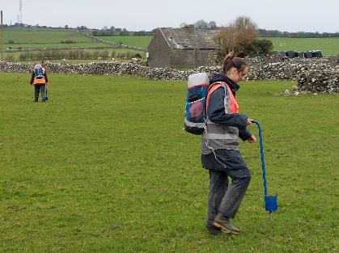
National Agricultural Soil Carbon Observatory (NASCO)
Notes:
New Teagasc research project with the aim of providing an accurate assessment of carbon sequestration
All Signpost farms will be part of the NASCO
Autumn 2021: all farms soil sampled
Summer 2022: Deep soil sampling (1m) to measure soil C
Plus up to 30 C flux towers

Slide 14
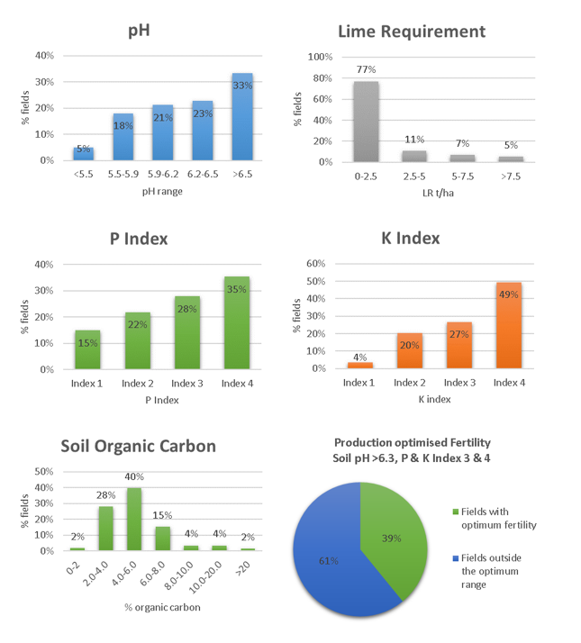
Initial Results
101 farms, 2,993 samples
 | No. farms | % pH>6.2 | % optimum | %SOC 0-2% | %SOC 2-4%
Dairy | 49 | 61% | 42% | 0 | 25
Beef | 33 | 43% | 43% | 0 | 19
Sheep | 8 | 34% | 34% | 4 | 11
Tillage | 6 | 79% (61% pH>6.5) | 42% | 19 | 73
Notes:
101 farms, including 33 beef farms, 8 sheep farms, 49 dairy farms and 6 tillage farms.

Slide 15
Slurry analysis
Sample type | N | Available N* (units/ 1,000 gals) | Available P (units/ 1,000 gals) | Available K (units/ 1,000 gals)
Dairy (indoors) | 52 | 10.3 | 6.3 | 24.8
Dairy (outdoors/ washings) | 16 | 4.0 | 2.5 | 11.9
Beef (suckler/ dairy calf to beef) | 55 | 10.8 | 7.4 | 28.8
*40% availability assumed (LESS)
Notes:
136 samples taken in early 2022
First time slurry was analysed in many of these farms…confirmed that it contained valuable nutrients…results used to tailor fertiliser applications

Slide 16
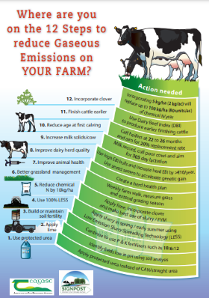

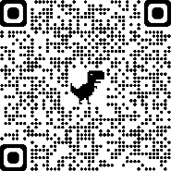


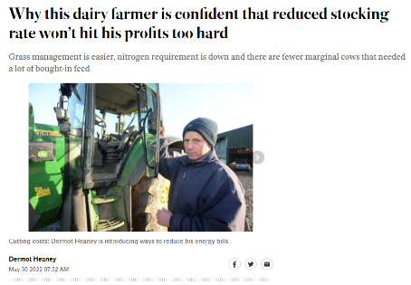
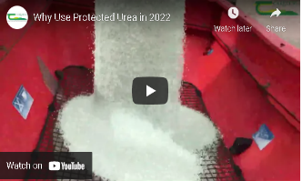
Resources Produced
Infographics and checklists
Signpost monthly e-newsletter
Booklets and factsheets
www.teagasc.ie/signpost
@TeagascSignpost
Videos
Farmer updates

Slide 17
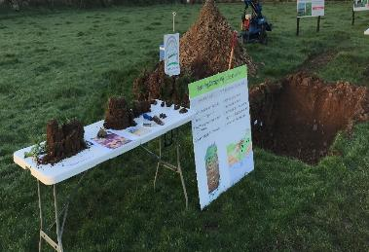
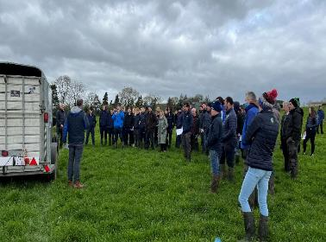
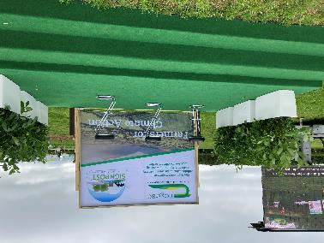
Demo events/ farm walks held
30 farm walks
2,433 attendees
81 attendees/ event
Signpost has also been present at all Teagasc major Open Days in 2022

Slide 18

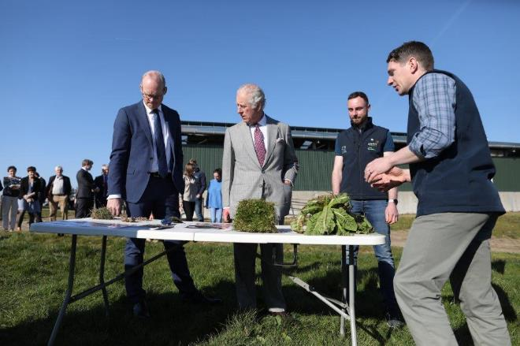
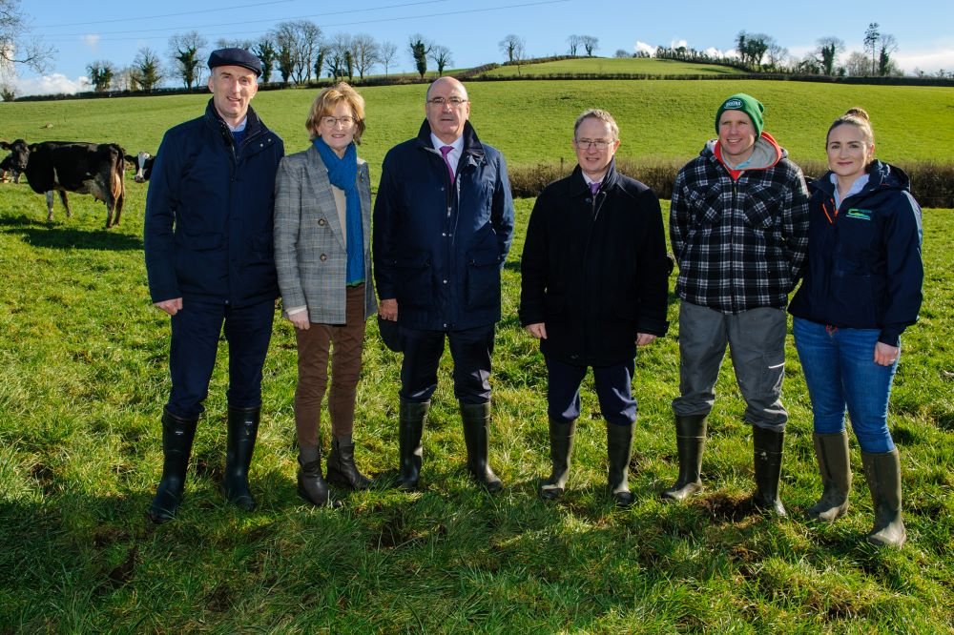
VIP visitors and awards

Slide 19

Thank You
Tom O’Dwyer
tom.odwyer@teagasc.ie
Siobhan Kavanagh
siobhan.kavanagh@teagasc.ie
Seamus Kearney
seamus.kearney@teagasc.ie

